Slide 1
Wallpaper Help

Slide 2
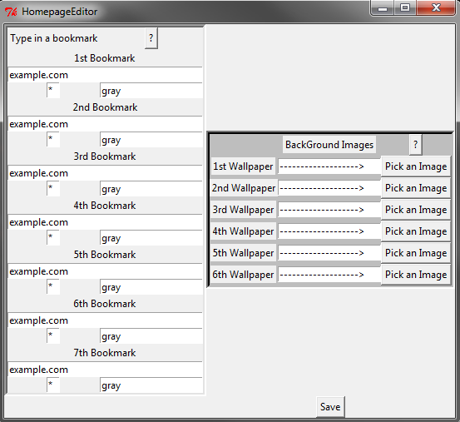

Slide 3
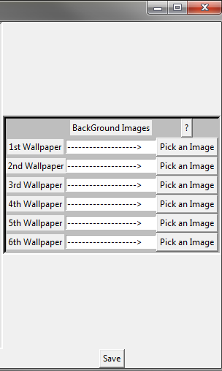
Pick any image file using the Pick an Image button.
For best results, pick 1920x1080 pictures.
Pick up to six unique pictures.
Click save when done with both bookmark and wallpaper selection.

Slide 4
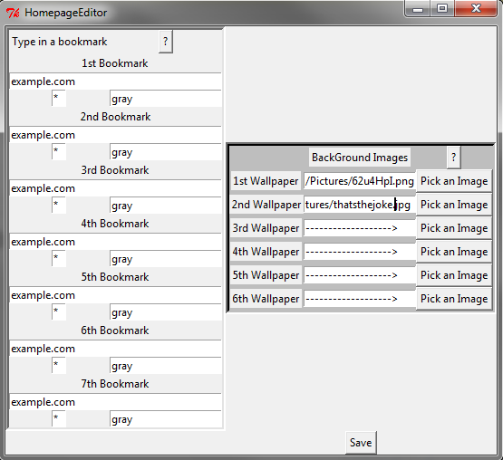
Example

