Slide 1
Thesis data set, and why the absorber is not learned above its pole
Model augmentation for a dual-gantry motion system | meeting 1 October 2026

Slide 2
Goal of this meeting
1
Show the thesis data set
records, friction, measurement noise, excitation band
2
Discuss the main issue
the added states do not learn the absorber resonance; above the 212 Hz pole the augmented model is worse than it should be
3
Leave with decisions
on the questions of the last slide
Notes:
Four slides on the data set (records, friction, noise, band), then the first results and the main issue. The last slide lists the decisions I need.

Slide 3
Data sets: training and validation
Training covers Y from -3.0×10⁻¹ to 3.0×10⁻¹ m; validation stays inside that range
Every record: same truth (FP baseline + payload absorber + tanh rail friction), controller K1 (designed at Y = 0), 12 s at 20 kHz, trained at 4 kHz, plus a noise-free twin.
Stroke: X ±3.75×10⁻¹ m, Y ±4.0×10⁻¹ m.
Set | Records | Y covered [m] | X covered [m] | Motion | Multisine
Training | 5 standstill | -3.0×10⁻¹, -1.5×10⁻¹, 0, 1.5×10⁻¹, 3.0×10⁻¹ | 0 | none | yes
Training | 3 Y sweeps | -3.0×10⁻¹ to 3.0×10⁻¹ | 0 | sine 0.2 / 0.5 / 0.75 Hz | yes
Training | 4 S-curve moves | -3.0×10⁻¹ to 3.0×10⁻¹ | -2.8×10⁻¹ to 2.8×10⁻¹ | point-to-point, 25 to 75 % of max acc. | yes
Training | 2 Lissajous | -3.0×10⁻¹ to 3.0×10⁻¹ | -2.8×10⁻¹ to 2.8×10⁻¹ | combined X and Y sines | yes
Training | 4 ILC-shape routes | -3.0×10⁻¹ to 3.0×10⁻¹ | -8.0×10⁻² to 8.0×10⁻² | measured ASMPT move shape, 45 and 75 % of max | no
Validation | 1 standstill | 1.0×10⁻¹ | 0 | none | yes
Validation | sweep, S-curve, Lissajous | -2.5×10⁻¹ to 3.0×10⁻¹ | -2.8×10⁻¹ to 2.8×10⁻¹ | new centres and setpoints | yes
Validation | 2 ILC-shape routes | -2.8×10⁻¹ to 2.8×10⁻¹ | -8.0×10⁻² to 8.0×10⁻² | stops at Y no training route uses | no
Validation is only used to select the checkpoint.
Notes:
Every record shares one truth, one controller and one timing. Validation only selects the checkpoint; test records are never used for any choice. Stroke of the machine: X +-3.75×10⁻¹ m, Y +-4.0×10⁻¹ m, so there is room outside the training range for extrapolation tests.

Slide 4
Data sets: test records
Each extrapolation record (E) differs from its interpolation partner (I) in exactly one quantity
Record | Partner | What is new | Y covered [m] | Multisine
I1 |  | S-curve moves as in training, new phases and setpoints | -3.0×10⁻¹ to 2.9×10⁻¹ | yes
I2 |  | standstill between two training points | -2.25×10⁻¹ | yes
I3, I4, I5 |  | ASMPT routes: X and Y together, X-only / Y-only, S-curve | -1.7×10⁻¹ to 1.5×10⁻¹ | no
I6 |  | long strokes at 1.5 m/s | -2.8×10⁻¹ to 2.8×10⁻¹ | no
E1 | I2 | position beyond training (standstill) | -3.9×10⁻¹ | yes
E2 | I3 | position beyond training while moving | -3.3×10⁻¹ to 3.9×10⁻¹ | no
E3 | I5 | acceleration 30 / 50 m/s² (training max 22.5 / 37.5) | as I5 | no
E4 | I6 | velocity 1.95 m/s (training max 1.5) | as I6 | no
E5 | I3 | controller gains +20 % | as I3 | no
E6 | I3 | measured ILC move, X acceleration 1.31 × max (stress case) | as I3 | no
TF-1 to TF-3 |  | FRF check: standstill, 4 phase realisations each | 1.5×10⁻¹, 2.25×10⁻¹, 3.5×10⁻¹ | yes
Truly unseen positions are only |Y| > 3.0×10⁻¹ m (E1, E2): training moves pass through the Y of I2.
Test records are never used for any choice.
Notes:
Because E and its I partner differ in one quantity, the change in error is attributable to that quantity. Honest caveat: I2 is held out as a standstill point, but training moves pass through its Y; the truly unseen positions are only |Y| > 3.0×10⁻¹ m (E1, E2). TF records are only for the FRF check (result R3).

Slide 5
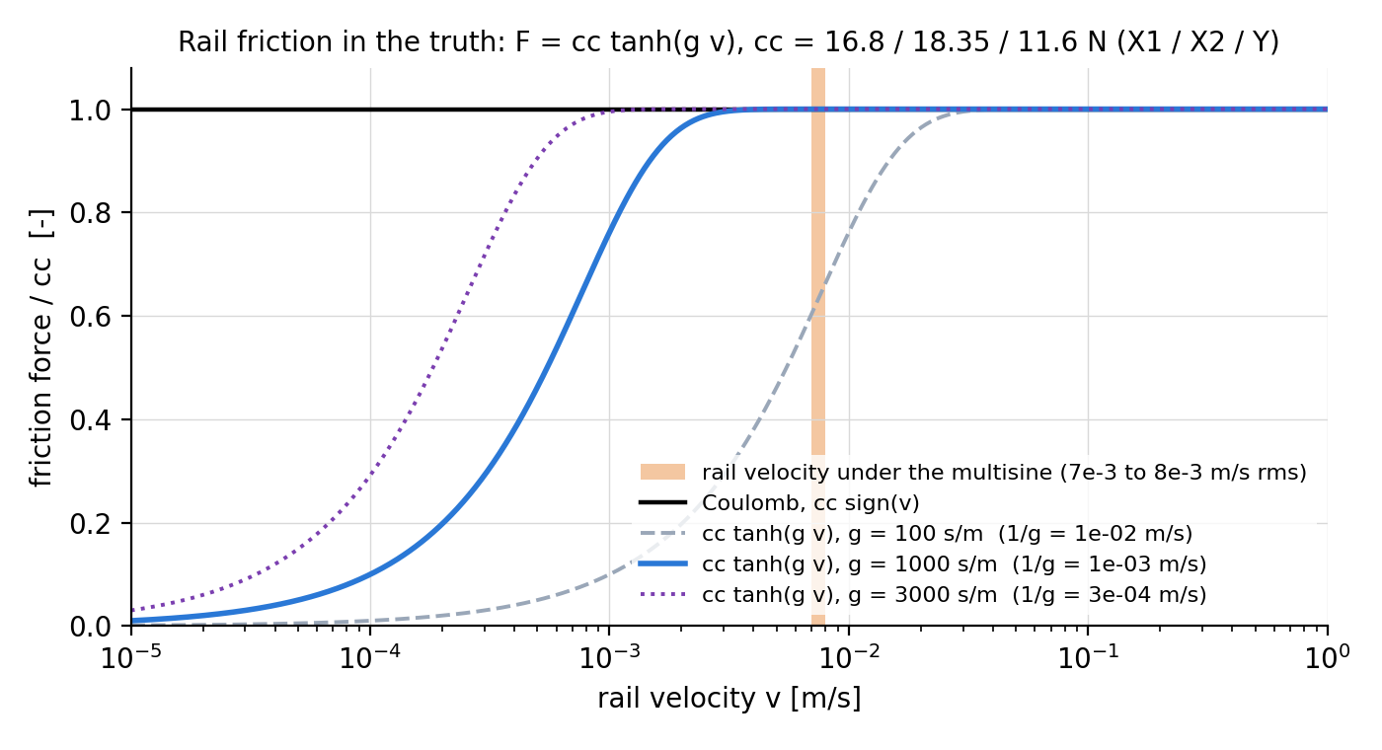
Friction in the truth
Rail friction is Coulomb, smoothed with tanh, and only in the truth (the baseline has none)
Fᵢ = ccᵢ · tanh(g · vᵢ) per rail X1, X2, Y
cc = 16.8 / 18.35 / 11.6 N (Garcia)
Why smooth
a hard stick law made the simulation stick-slip at standstill; the machine does not
Why g = 1000 s/m
multisine moves the rails at 7×10⁻³ to 8×10⁻³ m/s rms
g = 100: still rising there, acts as a damper
g = 1000: flat (Coulomb) there, stage still settles
g = 3000: stage creeps at standstill
Limit
below 10⁻³ m/s it is a steep damper (≈ 1.7×10⁴ N s/m), not a stick
Notes:
Why smooth: a set-valued stick law made the simulated stage stick-slip at standstill, which the machine does not do. How to read the figure: at g = 1000 the curve is flat (Coulomb) where the rails move under the multisine, at g = 100 it is still rising, so it acts as a viscous damper. At g = 1000 the stage still settles at standstill (6×10⁻¹¹ / 10⁻¹⁰ / 1.7×10⁻⁹ m); g = 3000 already creeps. ASMPT: higher is more accurate. Limit: below 10⁻³ m/s it is a steep damper, slope cc g about 1.7×10⁴ N s/m, not a stick.

Slide 6
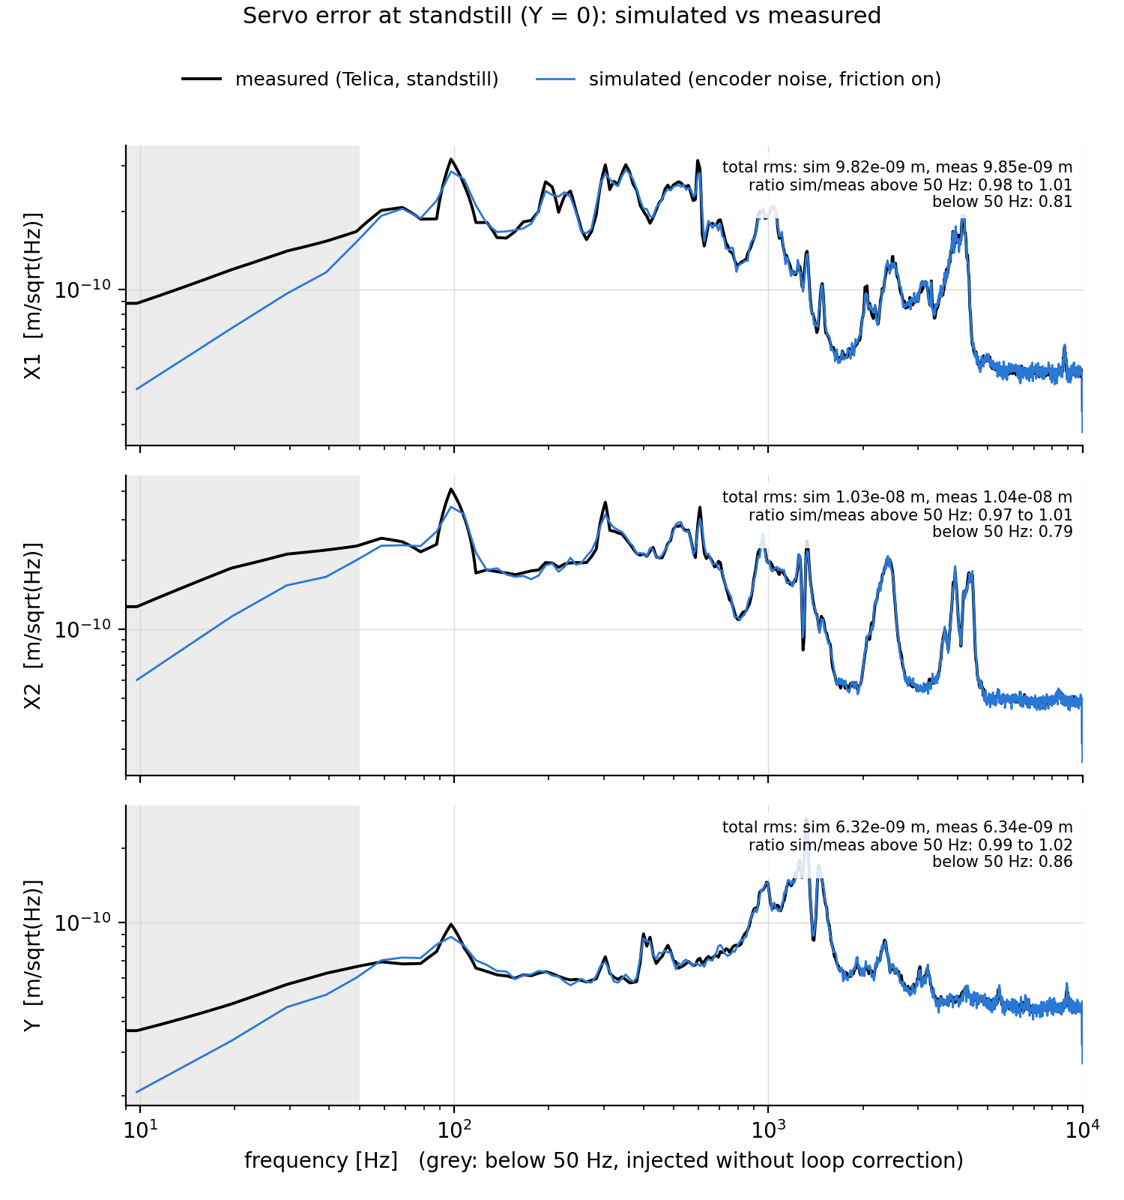
Measurement noise
Measured standstill noise is injected on the encoder, so the simulated servo error matches the machine
Where
controller sees y = q + v: it reacts to the noise and moves the stage, as on the machine
Source
standstill parts of 145 Telica logs, rms X1 9.8×10⁻⁹, X2 1.04×10⁻⁸, Y 6.3×10⁻⁹ m
Shape
the loop filters the noise (e = −S v), so inject Φₘₑₐₛ / |S|²
below 50 Hz: no correction, else the stage would follow a large slow encoder error
cost below 50 Hz: 0.7 to 0.9 of measured, < 1 % of the variance
Check
above 50 Hz, simulated / measured = 0.97 to 1.03 per band
total rms within 1 % on all three axes
Notes:
The controller sees y = q + v, reacts to the noise and moves the plant, as on the machine; training reads the measured y. Inside the loop the recorded error is e = -S v, so the loop reshapes the noise; we inject v with spectrum Phi_meas / |S|^2. Below the loop bandwidth |S| is very small, so that correction would give a large slow encoder error that the controller would follow and physically move the stage; so below 50 Hz the measured spectrum is injected without correction. Cost: the simulated error there is 0.7 to 0.9 of the measured, under 1 % of the total variance. 50 Hz is a heuristic (noise design note CN-012), to confirm with Jasper. Check (what Jasper asked, shape): per band above 50 Hz the ratio simulated / measured is 0.97 to 1.03.

Slide 7
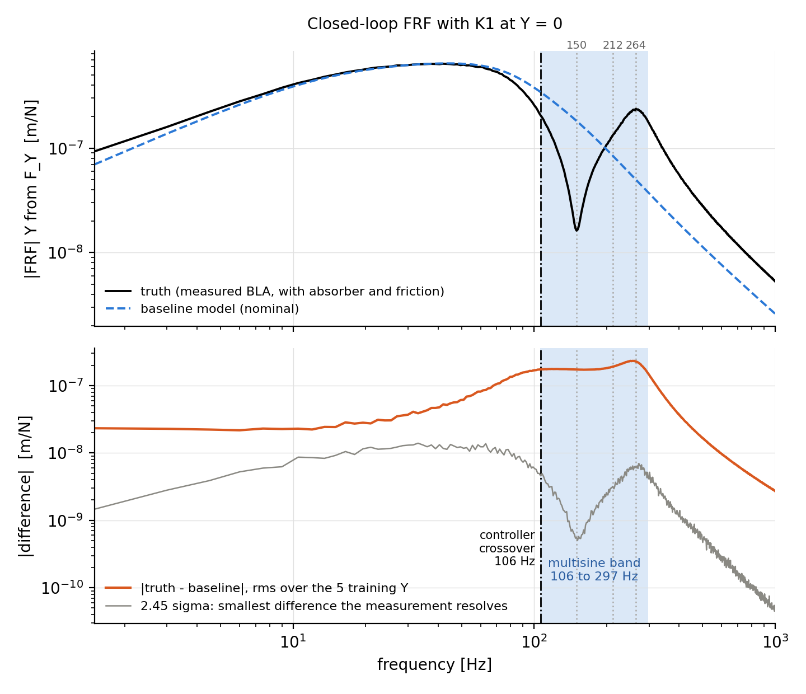
Choosing the multisine band from the FRF
The multisine (106 to 297 Hz) excites where truth and baseline differ, above the controller bandwidth
1. Measure
closed-loop FRF of the truth, K1, 5 training Y; subtract the baseline
2. Keep only real differences
larger than the measurement spread (2.45σ, 95 %)
3. Lower edge 106 Hz = controller crossover
below it the motion references already excite the differences
4. Upper edge 297 Hz
narrowest band holding 90 % of the remaining difference
Result
band holds the anti-resonance (150 Hz), the absorber pole (212 Hz) and the closed-loop peak (264 Hz)
largest difference: 230 to 297 Hz, above the pole
Notes:
Step 1: closed-loop FRF of the truth (with friction, so its BLA) with K1 at the five training Y, broadband 1 Hz to 1 kHz, 10 phase realisations; subtract the baseline FRF. Step 2: a difference counts where it exceeds the measurement spread (2.45 sigma, 95 %). Step 3: below the 106 Hz crossover the motion references already excite the differences (70 to 85 % resolved) and all ten parameter combinations are separable with the references alone. Step 4: 90 % is a choice; 80 % gives 111 to 276 Hz, 95 % gives 106 to 323 Hz. Above 297 Hz the difference falls off steeply (2.3×10⁻⁷ m/N at 250 Hz to about 3×10⁻⁹ m/N at 1 kHz). The same band serves the nominal and the 10 % detuned baseline. Multisine: 383 lines on a 0.5 Hz grid (repeats every 2 s), random phases, lowest crest factor of 30 draws, 240 N / 87 N m / 180 N, inside all force and position limits. Bridge: the largest difference sits at 230 to 297 Hz on Y, above the 212 Hz pole; that is where the model fails.

Slide 8
First results: runs 41 to 49
The augmentation lowers the validation error by 30 to 40 %, but the added states contribute little
Run | Arm | Added states | Seed | Start [m] | Best [m] | Progress
42 | U | 2 | 1 | 1.68×10⁻⁵ | 1.027×10⁻⁵ | done
44 | U | 2 | 2 | 1.48×10⁻⁵ | 1.029×10⁻⁵ | done
46 | U | 2 | 3 | 1.48×10⁻⁵ | 1.020×10⁻⁵ | done
41 | OBC | 2 | 1 | 1.68×10⁻⁵ | 1.156×10⁻⁵ | 39 %
43 | OBC | 2 | 2 | 1.48×10⁻⁵ | 1.149×10⁻⁵ | 36 %
45 | OBC | 2 | 3 | 1.48×10⁻⁵ | 1.051×10⁻⁵ | 82 %
47 | OBC | 0 | 1 | 1.68×10⁻⁵ | 1.150×10⁻⁵ | 97 %
48 | OBC | 4 | 1 | 1.68×10⁻⁵ | 1.108×10⁻⁵ | 49 %
49 | OBC | 8 | 1 | 1.68×10⁻⁵ | none yet | 3 %
Best validation free-run rms error
U = unconstrained, OBC = orthogonal projection
Run 47 has no added states, yet matches run 41 (2 states)
so the added states add almost nothing yet
Notes:
U = unconstrained augmentation, OBC = orthogonal projection. Numbers: best validation free-run rms error from the server logs of 30 September; the OBC runs were not finished. Key point: OBC with 0 added states (run 47) reaches the same level as OBC with 2 (run 41). Update from the server before the meeting if possible.

Slide 9
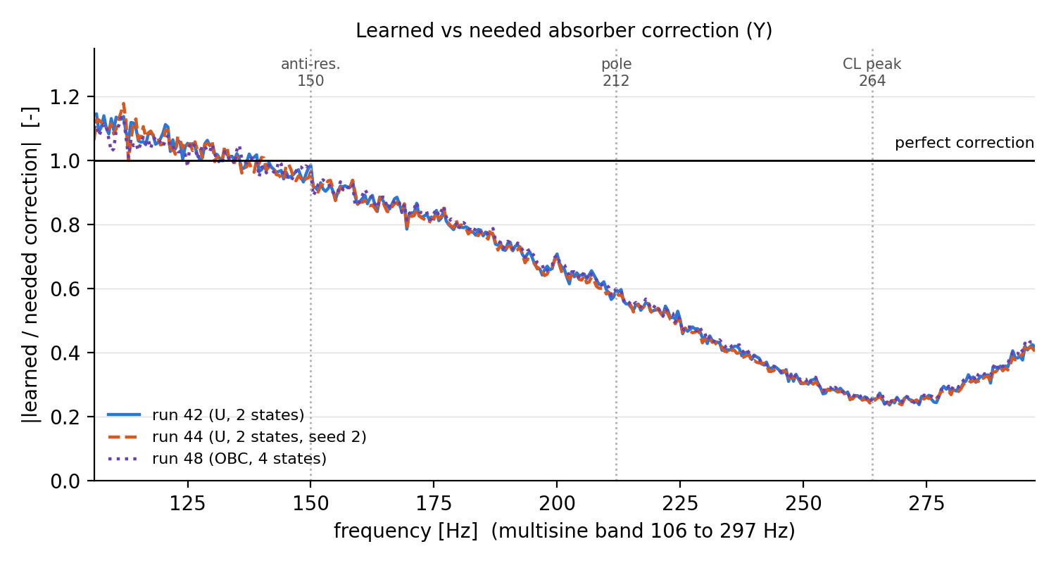
Main issue: the absorber is not learned above its pole
Below the 212 Hz pole the model removes about 90 % of the absorber error, above it only 22 %
Y error energy removed, run 42
90 %
106 to 140 Hz
89 %
140 to 230 Hz
22 %
230 to 297 Hz
Same shape in runs 42, 44, 48 (U and OBC, 2 and 4 states, two seeds): systematic.
Notes:
The figure shows learned correction divided by the correction the truth needs, Y channel, on the multisine validation records; 1 is perfect. It is 1.0 at 150 Hz, 0.60 at 212, 0.26 at 264 and 0.42 at 296 Hz: a broad over-damped bump, not the sharp pole. Coherence is 0.98 to 1.00, so it is systematic, not noise. Same shape in runs 42, 44 and 48 (U and OBC, 2 and 4 states, two seeds), within 0.02 in gain. The band numbers are Y error energy removed, run 42.

Slide 10
What causes it (diagnosis, 30 September)
An optimisation problem: the model class and the objective both allow the resonance
Finding | Evidence
The added states realise no resonance | only fast real poles (|z| ≤ 0.6), no pair near 212 Hz, in any checkpoint
The model class can | an exact member with the 212 Hz pole has 7× lower training loss
The objective rewards it | the truth scores 3.8× better on the windowed loss, even with its absorber state unknown at each window start
What blocks it | the learned static correction takes the absorber’s place first; a correct absorber on top gains 15 %, without the static part 94 %
Static path switched off | the added states learn the same static map, one sample delayed; the resonance is still uphill
Whatever path learns first takes the memoryless part of the absorber; from there the resonance is uphill.
Ruled out: data, noise, friction, controller, weighting, epochs, capacity, seed, OBC, pipeline (backup).
Notes:
Ruled out, one line each in the backup: data, noise, friction, controller, weighting, too few epochs, capacity, seed, OBC, pipeline. With the static path switched off (local test) the added states learn the same static map with one sample delay; growing a resonance from there is still uphill. So whatever path learns first learns the memoryless part of the absorber, and from there the resonance is uphill. Side finding: the OBC reference set uses x_a = 0, so the projection constrains only the static part; to check.

Slide 11
Options (for discussion, nothing launched)
Four ways forward; the first alone is not enough according to the local test
1
Two-phase training
static path off first; local test: not sufficient on its own
2
Hoekstra parameterisation (arXiv:2602.17297, Eq. 29)
ResNet form with a linear part, added states co-estimated in the encoder
3
Faster start-up
learning rate 10⁻⁵ now, against 10⁻³ in Hoekstra
4
Accept and report
the augmentation fits the absorber below the pole; the added states stay static
Notes:
Option 2 refers to Hoekstra arXiv:2602.17297, Eq. 29: a ResNet form with a linear part, with the added states co-estimated in the encoder. Option 3: our learning rate is 10⁻⁵ against Hoekstra's 10⁻³. Option 4: report that the augmentation fits the absorber below the pole and that the added states stay static, with the error stated.

Slide 12
Questions for the supervisors
Which option of the previous slide, or another idea from experience with added states?
Is a learned model without a resonance in its added states acceptable for the thesis, if the error is stated?
Noise: is the 50 Hz corner acceptable, and the 10 % tolerance? (Jasper)
Settling: show a fixed 2×10⁻¹ to 4×10⁻¹ s interval after each move, or leave it out?
Are the ASMPT routes I3 to I6 acceptable as ASMPT motion? (Jasper, Dragan)
Is the Y-loop phase margin of 28.5° with K1 (25° with K2) acceptable?
Notes:
Settling: show a fixed 2×10⁻¹ to 4×10⁻¹ s post-move interval, or leave it out. Jasper and Dragan for the ASMPT routes and the noise. Phase margin: 28.5 deg with K1, 25 deg with K2.

Slide 13
Backup

Slide 14
Backup: thesis results and the records they use
Result | Question | Records
R1 | does Y scheduling (LPV) beat a frozen LTI baseline | I2 with E1, I3 with E2
R2 | how many added states the absorber needs (0, 2, 8) | chosen on validation, reported on I1 to I6
R3 | does the trained model reproduce the plant FRF (BLA) | TF-1 to TF-3
R4 | does OBC keep the physical parameters interpretable | training (parameters), I1 to I6 (accuracy)
R5 | true parameter recovery with an orthogonal addition | needs a separate truth, not generated
R6 | generalisation against the black box and LTI | I / E pairs, cross-coupling on I4
R7 | controller transfer | E5 against I3
R8 | training effort and robustness against the black box | all runs
Notes:
Confirm this list matches the 28 September agreement. R5 needs a separate truth that is not generated yet.

Slide 15
Backup: from 20 kHz data to 4 kHz training
Filter before downsampling, so the noise does not fold into the band
Taking every 5th sample would fold the noise between 2 and 10 kHz into the band (+28 to 40 % rms)
So y is low-pass filtered first: 8th-order Butterworth at 1.6 kHz, forward and backward (no phase shift)
applied to y − r (the servo error), then r is added back
Forces are averaged over each 4 kHz sample interval; 5×10⁻³ s is cut at both record ends
The same filtered positions feed everything: rollouts, normalisation, OBC basis velocities
1.6 kHz > 5 × the 212 Hz pole (Janot et al. 2019); basis angle to the noise-free basis: sin 1.9×10⁻³
Notes:
Filtering the full position instead of the servo error would distort it by 5.5×10⁻⁸ to 1.7×10⁻⁷ m. The 1.6 kHz cut-off is above 5 x the 212 Hz absorber pole (rule of Janot et al. 2019).

Slide 16
Backup: causes ruled out
Candidate cause | Verdict | Deciding number
Too few epochs | refuted | curves flat in last quarter (run 42: 1.031×10⁻⁵ to 1.027×10⁻⁵ m)
Nothing to learn | refuted | ceiling 1.42×10⁻⁵ m = 124 % of the no-added-state plateau
Band above the pole | supported | 230 to 297 Hz: 2.52×10⁻⁵ to 2.23×10⁻⁵ m (22 %)
Friction masks absorber | refuted | friction / absorber signal 0.01 to 0.03 in 140 to 230 Hz
Noise | refuted | noise floor 5×10⁻⁸ to 1.2×10⁻⁷ m in band
Controller | refuted | absorber visibility 1.02×
Parameter substitution | refuted | tangent span 34 % (thesis) vs 65 % (old data)
OBC projection | refuted | OBC and U give the same response
Capacity (2 to 4 states) | refuted | |H| within 0.02 at 250 to 280 Hz
Seed | refuted | run 44 within 0.02 of run 42
Closed-loop peak 264 Hz | refuted | |S_YY| smooth 1.28 to 1.56
Pipeline change | refuted | old checkpoint reproduced: 5.8588×10⁻⁶ m
Objective prefers damped shape | refuted | training loss: truth 1.35×10⁻⁹ vs model 5.09×10⁻⁹
Notes:
Source: scripts/gantry/absorber-learning-diagnosis/DIAGNOSIS.md.

Slide 17
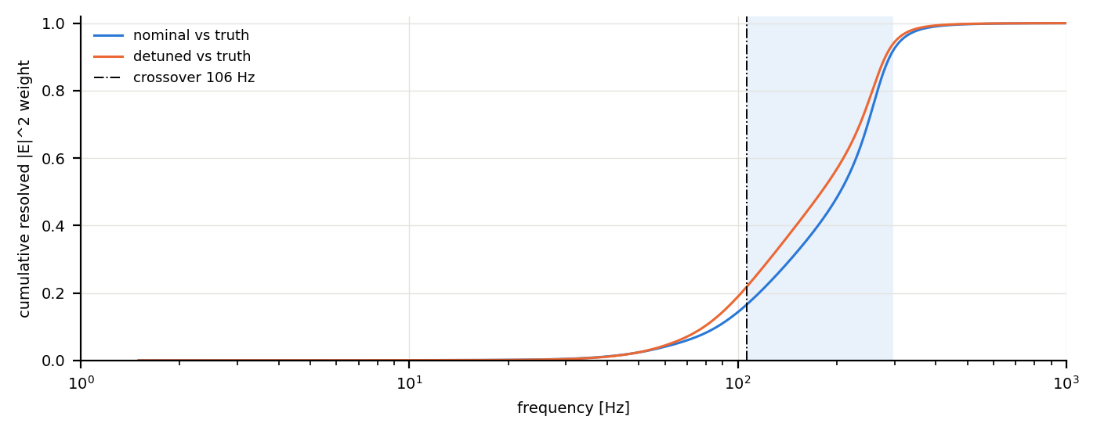
Backup: excitation adequacy and band weight
Multisine at least 67 dB above the noise-induced force in band
Motion references 36 to 51 dB below the crossover
All ten parameter combinations separable (Brun γ = 1.27)
Notes:
Figure: cumulative resolved difference weight over frequency; band shaded. 95 % is reached at 323 Hz.

Slide 18
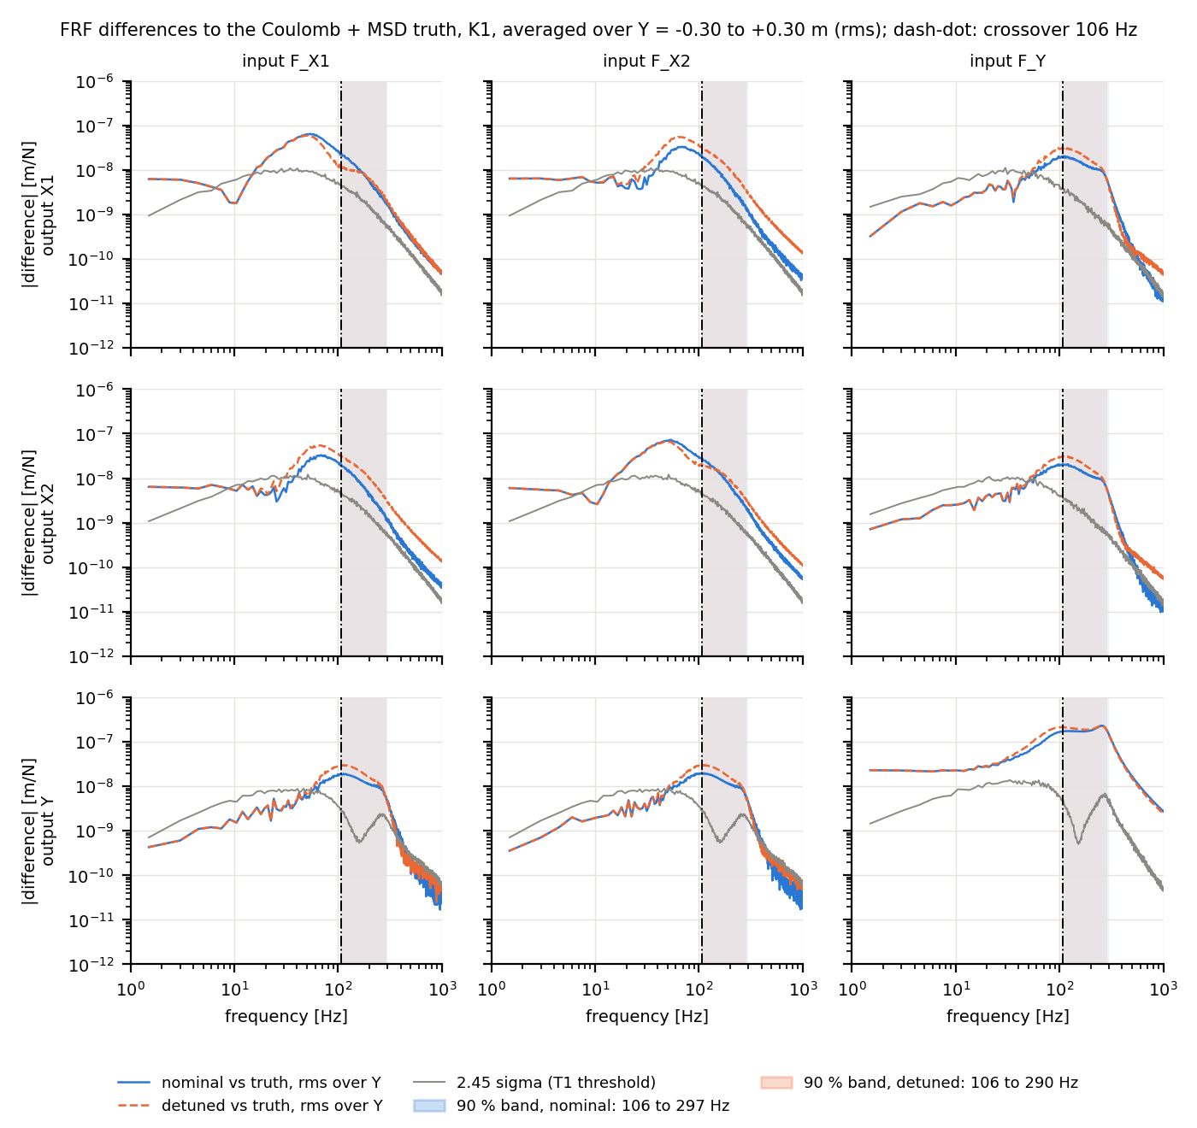
Backup: all FRF differences (3 × 3)

