Slide 1


Data-driven initialisation
of the added states
with a zero and with a live start of g_aug
Notes:
• new: a data-driven start for the added states x_a • question to Jan: a proper extension of the framework, or a workaround? • Jan asked for the motivation beyond RMS • route: what goes wrong → why → what a fix must do → the method → evidence → results → question
• part 1: the zero start and its results; part 2: Jan's question, a live start of g_aug

Slide 2
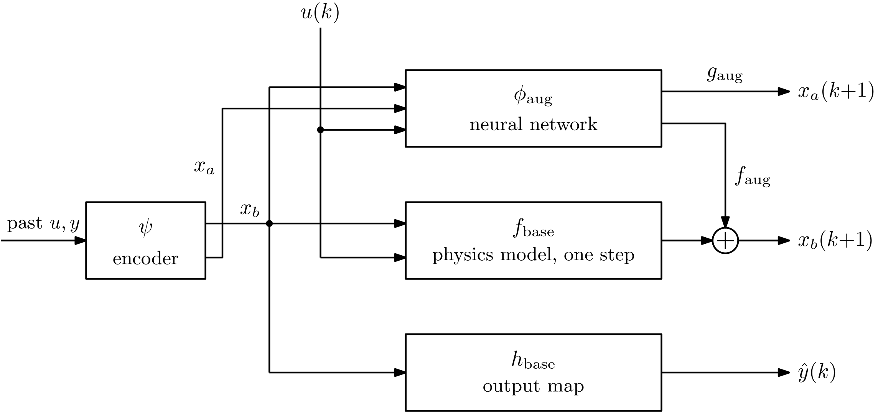

The augmented model, one step
x_b: physical states (6)
x_a: added states (2)
one network gives both f_aug (to x_b) and g_aug (to x_a)
the encoder ψ gives the start state from past u and y
2
Data-driven initialisation of the added states
Notes:
• recap of the model (dynamic parallel, Jan's paper) • x_b: X, Θ, Y and their rates, x_a: two added states for what the physics misses • one network φ_aug: physical rows f_aug, added-state rows g_aug • output only from x_b: x_a can only reach the output through f_aug • encoder ψ on 30 past samples gives x̂(k) = [x_b, x_a] at the start of every training window

Slide 3
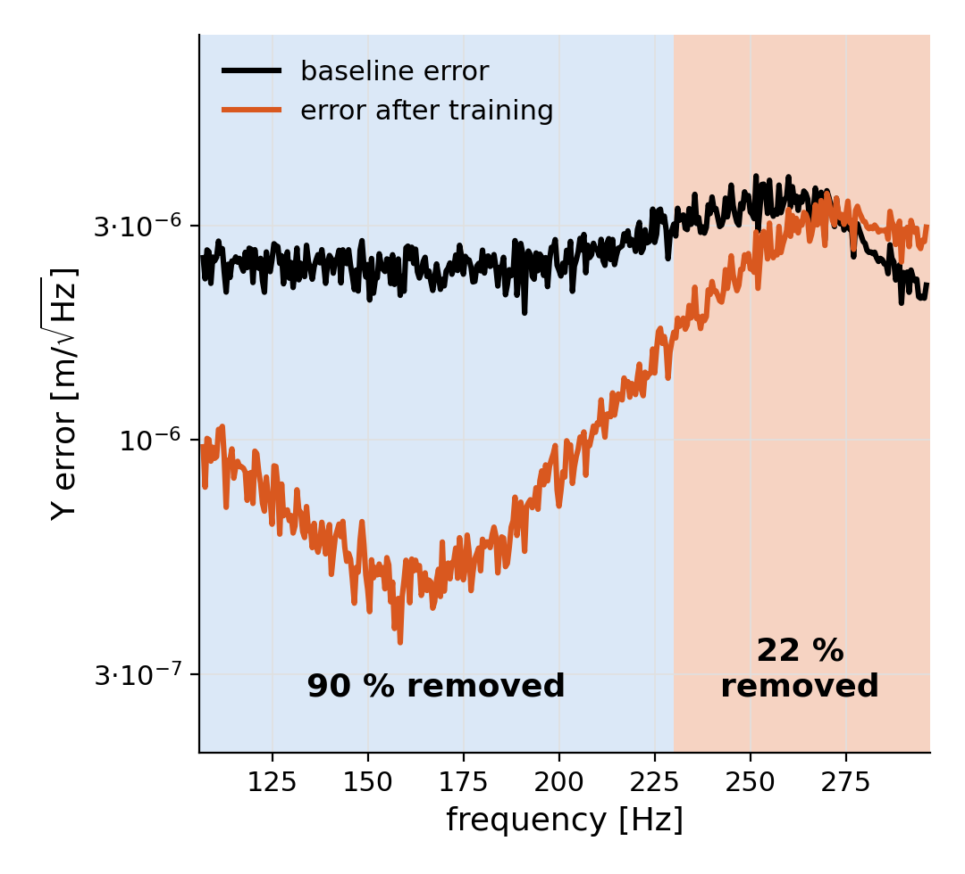
The problem: the absorber band is not learned
Plain training: 90 % of the error removed below 230 Hz, only 22 % above
3
Data-driven initialisation of the added states
Notes:
• shown last week: black baseline error, orange after training, Y axis • below 230 Hz: 90 % removed • 230 to 297 Hz (the absorber resonance region): only 22 % • same with another seed, with OBC and with 4 added states

Slide 4
The problem: the absorber band is not learned
Plain training: 90 % of the error removed below 230 Hz, only 22 % above
Setting x_a to zero changes the trained model by only 17 %: the added states are barely used
3
Data-driven initialisation of the added states
Notes:
• clamp test on run 42: the added-state rows set to zero, the model changes by only 17 % • so the trained model hardly relies on x_a • across runs 42, 44, 48: 0 of 672 checked encoder states show an oscillating pair between 95 and 380 Hz • these are the symptoms beyond RMS: wrong band, unused states, no oscillation

Slide 5
The model can learn the absorber, training never starts near it
• Network too small? No: the true absorber fits in it, with 7× lower loss
4
Data-driven initialisation of the added states
Notes:
• test K1: the true absorber written by hand into the same network • training loss 7.0e-10, against 5.1e-9 for the trained model • so capacity is not the limit

Slide 6
The model can learn the absorber, training never starts near it
• Network too small? No: the true absorber fits in it, with 7× lower loss
• Loss does not reward it? No: the true system scores 3.8× better than the trained model
4
Data-driven initialisation of the added states
Notes:
• test G1: the true system evaluated with the same loss: 1.35e-9 • trained model 5.1e-9, so the loss prefers the absorber

Slide 7
The model can learn the absorber, training never starts near it
• Network too small? No: the true absorber fits in it, with 7× lower loss
• Loss does not reward it? No: the true system scores 3.8× better than the trained model
4
Data-driven initialisation of the added states
Notes:
• test L1: scan of the added pole's frequency and damping, loss at each point • the loss falls steadily toward the true pole, a well about ±40 Hz wide around 212 Hz • so from nearby, gradient descent would find it

Slide 8
The model can learn the absorber, training never starts near it
• Network too small? No: the true absorber fits in it, with 7× lower loss
• Loss does not reward it? No: the true system scores 3.8× better than the trained model
• The problem is the starting point
4
Data-driven initialisation of the added states
Notes:
• the answer exists, the loss prefers it, and from nearby it is easy to reach • training never gets near it • picture: the valley exists and is the deepest point, but we start on a flat plateau far away • next: why training never gets near

Slide 9
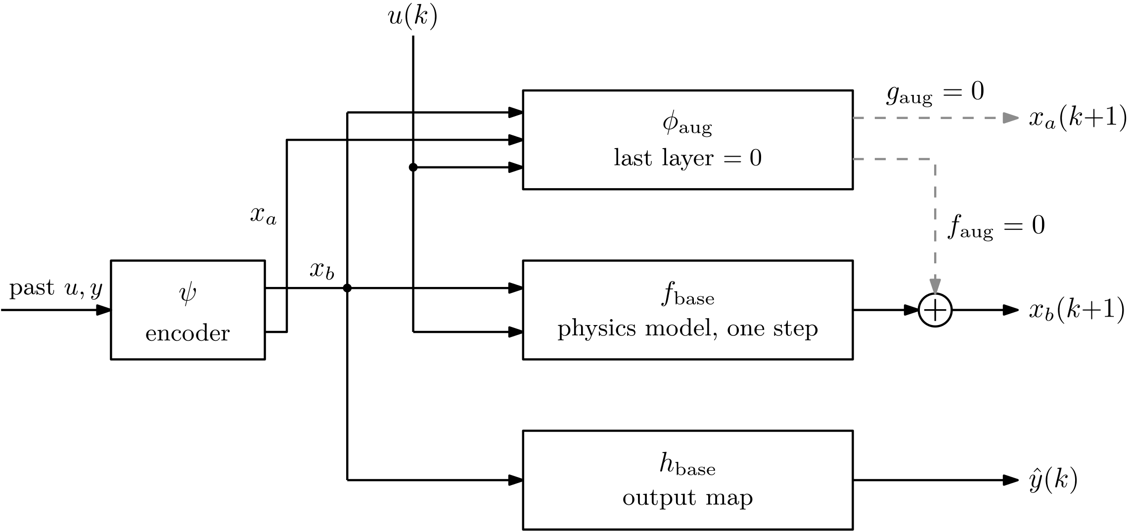
Why: the added states start switched off
Last layer of the network starts at zero: f_aug = 0 and g_aug = 0
5
Data-driven initialisation of the added states
Notes:
• by design: the model starts equal to the baseline (paper Sec. 5.4, Jan's code does the same) • so f_aug = 0 and g_aug = 0 at the start • x_a stays 0 after the first step, only the encoder's start value x_a(0) is nonzero

Slide 10
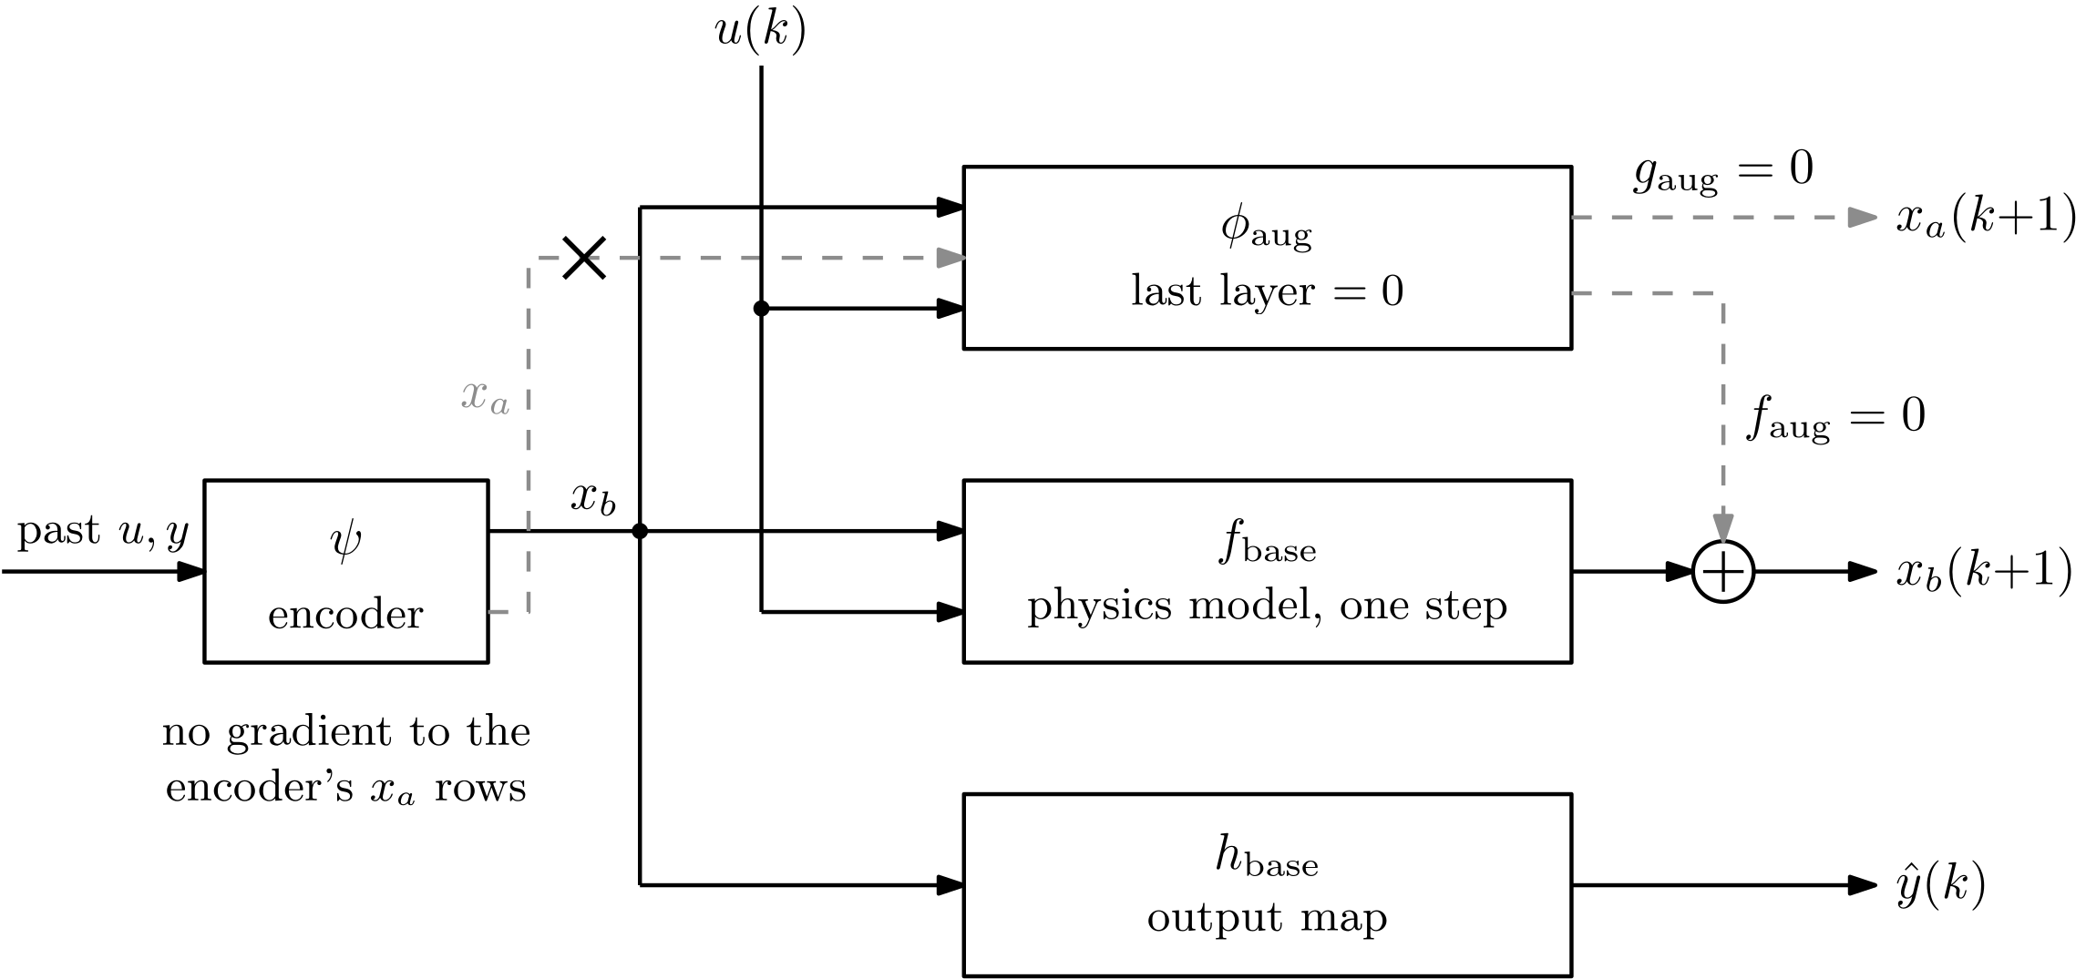
Why: the added states start switched off
Last layer of the network starts at zero: f_aug = 0 and g_aug = 0
So at initialization x_a does not reach the output: no gradient for the encoder's x_a rows
5
Data-driven initialisation of the added states
Notes:
• output depends on x_a only through f_aug, which is zero → ∂y/∂x_a = 0 • the loss gives the encoder's x_a rows exactly zero gradient at the start • the g_aug output rows also get zero gradient at the exact zero start

Slide 11
Why: the added states start switched off
Last layer of the network starts at zero: f_aug = 0 and g_aug = 0
So at initialization x_a does not reach the output: no gradient for the encoder's x_a rows
At the start only f_aug gets a gradient: it learns first, from x_b and u only
x_a can only switch on later, indirectly, and in practice never forms the resonance
5
Data-driven initialisation of the added states
Notes:
• exact at the zero start: f_aug's output rows get a gradient, the x_a path does not • f_aug only sees x_b and u: a correction without memory of its own, it cannot hold an oscillation that is not already in x_b • x_a can open up later, once the readout weights move, not a proof it never learns • measured (slide 3): plain training ends with one real eigenvalue in x_a (|z| = 0.67, a fast lag of about 0.6 ms), no resonance • not capacity: the model can hold the resonance (7× lower loss), the loss prefers it (truth 3.8× better), higher learning rates and early LM do not create the pole • my interpretation: the early correction fills part of the gap, so little pull is left toward forming the resonance • → the gap: x_b gets a start from the baseline, x_a only a random one

Slide 12
The cause: x_b starts with a model, a meaning and a gradient, x_a with none
 | physical states x_b | added states x_a
Dynamics at the start | baseline model f_base | none, g_aug = 0
Encoder map | from the baseline model | random
Path to the output | direct, through h_base | only through f_aug, which is 0
Gradient at the start | yes | exactly 0
Learning rate | 1·10⁻⁵ | the same
Measured at the start: f_aug rows 1.9·10⁻⁵, encoder x_b rows 1.4·10⁻⁷, x_a rows and g_aug exactly 0
6
Data-driven initialisation of the added states
Notes:
• the output layer is zero for all rows, the difference is in everything around it • x_b: the baseline gives the dynamics, the encoder map (reconstructability, W^b) and a direct path to the output • x_a: no dynamics, a random encoder map (W^a), no path while f_aug = 0 • gradients: RMS over 4 batches of 64 windows of 400 samples, at initialisation • physical parameters 7.1e-9 • so at the start only the physical side learns, in the same network at the same learning rate

Slide 13
The static part learns first, and then blocks the resonance
• f_aug learns first: it takes the part of the error that needs no memory
7
Data-driven initialisation of the added states
Notes:
• follows from the gradients on the previous slide: only f_aug and the physical side move at first • f_aug sees x_b and u at the same sample, no memory of its own

Slide 14
The static part learns first, and then blocks the resonance
• f_aug learns first: it takes the part of the error that needs no memory
• Exact absorber added afterwards: loss 94 % lower on the baseline, only 15 % on the trained model
7
Data-driven initialisation of the added states
Notes:
• test M1c: the true absorber grafted into the added states • trained model: loss to 0.85× • model without the learned correction: loss to 0.06× • the learned static correction already covers part of the error, so the resonance adds little

Slide 15
The static part learns first, and then blocks the resonance
• f_aug learns first: it takes the part of the error that needs no memory
• Exact absorber added afterwards: loss 94 % lower on the baseline, only 15 % on the trained model
• The trained f_aug already imitates part of the absorber, so the real absorber barely pays off
7
Data-driven initialisation of the added states
Notes:
• tests N1, O1: static path switched off • x_a then learns a delayed static map first (negative real eigenvalue) • so it is not only two paths competing

Slide 16
The static part learns first, and then blocks the resonance
• f_aug learns first: it takes the part of the error that needs no memory
• Exact absorber added afterwards: loss 94 % lower on the baseline, only 15 % on the trained model
• The trained f_aug already imitates part of the absorber, so the real absorber barely pays off
• Whatever learns first from zero takes the part without memory, so the start must already carry memory
7
Data-driven initialisation of the added states
Notes:
• longer training does not help, a random start carries no information about the missing dynamics • without system knowledge, a start with memory can only come from data

Slide 17
What a fix must do
• R1: a training signal for x_a that rewards memory, before the normal loss shapes it
8
Data-driven initialisation of the added states
Notes:
• from the previous slides: the memory part never gets its own signal

Slide 18
What a fix must do
• R1: a training signal for x_a that rewards memory, before the normal loss shapes it
• R2: only data, no knowledge of the absorber
8
Data-driven initialisation of the added states
Notes:
• no poles, frequencies or absorber information • otherwise it would be a gantry workaround

Slide 19
What a fix must do
• R1: a training signal for x_a that rewards memory, before the normal loss shapes it
• R2: only data, no knowledge of the absorber
• R3: a direct training signal for the transition g_aug
8
Data-driven initialisation of the added states
Notes:
• g_aug only gets a weak, indirect gradient through the 400-step rollout

Slide 20
What a fix must do
• R1: a training signal for x_a that rewards memory, before the normal loss shapes it
• R2: only data, no knowledge of the absorber
• R3: a direct training signal for the transition g_aug
• R4: the final model and its loss unchanged, standard S-DP
8
Data-driven initialisation of the added states
Notes:
• so it stays Jan's framework: same model, same objective, no extra parameters

Slide 21
The idea: give the added states a data-driven start
Physical states
the encoder starts from the baseline model
9
Data-driven initialisation of the added states
Notes:
• for x_b the encoder already has a good start: built from the baseline model (observability, Jan's encoder paper) • for x_a there is nothing like that: random start

Slide 22
The idea: give the added states a data-driven start
Physical states
the encoder starts from the baseline model
Added states
random start → now: learned from the model's own residual
Two phases in the first part of training, then normal training continues
9
Data-driven initialisation of the added states
Notes:
• the method gives x_a an equivalent start, but from data • phase 1: make the encoder's x_a carry information that predicts the current model's error • phase 2: make the network propagate those x_a from one step to the next • "initialisation" in a broad sense: not before training, but during the first updates • only data: the residual and a one-step regression, no truth, no poles, no frequencies used

Slide 23
Each phase meets a requirement
Requirement | How the method meets it
R1: signal that rewards memory | Phase 1: predict the future residual from the past window, only through x_a (I used 2 states here)
R2: only data | The target is the model's own residual on measured data
R3: direct signal for g_aug | Phase 2: with x_a as data, the transition becomes regression
R4: model unchanged | The temporary network is deleted, normal training continues
A static correction acts on the current sample only: it cannot make the past predict the future error. Only memory can.
10
Data-driven initialisation of the added states
Notes:
• key argument for R1: predicting the future error from the past is only possible with dynamics that have memory • the temporary network sees only x_a: a bottleneck of 2 numbers, so x_a must summarise that memory • R3: once x_a(k) and x_a(k+1) exist as data, fitting g_aug needs no rollout and no pole search • R4: after phase 2 the run is the ordinary S-DP run

Slide 24
Why this method: the steps of subspace identification
Subspace identification | This method
1. Regress the future outputs on the past | Phase 1: predict the future residual from the past window
2. Keep a low-rank part | x_a has only 2 dimensions
3. State = map of the past | x_a = the encoder applied to the past window
4. Least squares of x(k+1) on x(k) and u(k) | Phase 2: one-step regression of g_aug
The baseline gives the state map for x_b, the data now give it for x_a
Differences: residual instead of output, nonlinear, no future inputs, closed-loop data
11
Data-driven initialisation of the added states
Notes:
• Bauer, Order estimation for subspace methods, Automatica 2001, Sec. 2: all subspace algorithms follow these steps • Hefny, Downey, Gordon, NeurIPS 2015: the first-stage regression may be nonlinear • Downey et al., PSRNN, NeurIPS 2017: two-stage regression as initialisation, then backpropagation, random initialisation followed by backpropagation failed in their experiments • differences: the subspace consistency results do not transfer (nonlinear, Adam-trained) • closed loop: subspace methods are known to be biased there (standard knowledge, not checked in a source)

Slide 25
When it happens: during the first updates
Normal training starts as usual: closed-loop simulation loss, model equal to the baseline
12
Data-driven initialisation of the added states
Notes:
• start exactly as without the method • network random, last layer zero → model = baseline • normal training runs from update 1

Slide 26
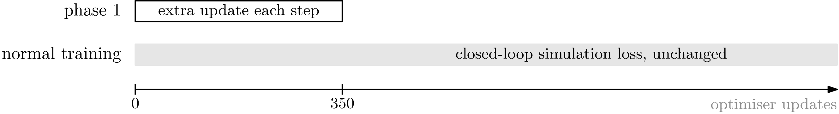
When it happens: during the first updates
Normal training starts as usual: closed-loop simulation loss, model equal to the baseline
Phase 1, first 350 updates: one extra update after each normal one
12
Data-driven initialisation of the added states
Notes:
• phase 1 runs next to normal training • each normal update is followed by one extra update with its own optimiser • ends at a plateau or at 350 updates (the cap ended it in every run so far)

Slide 27
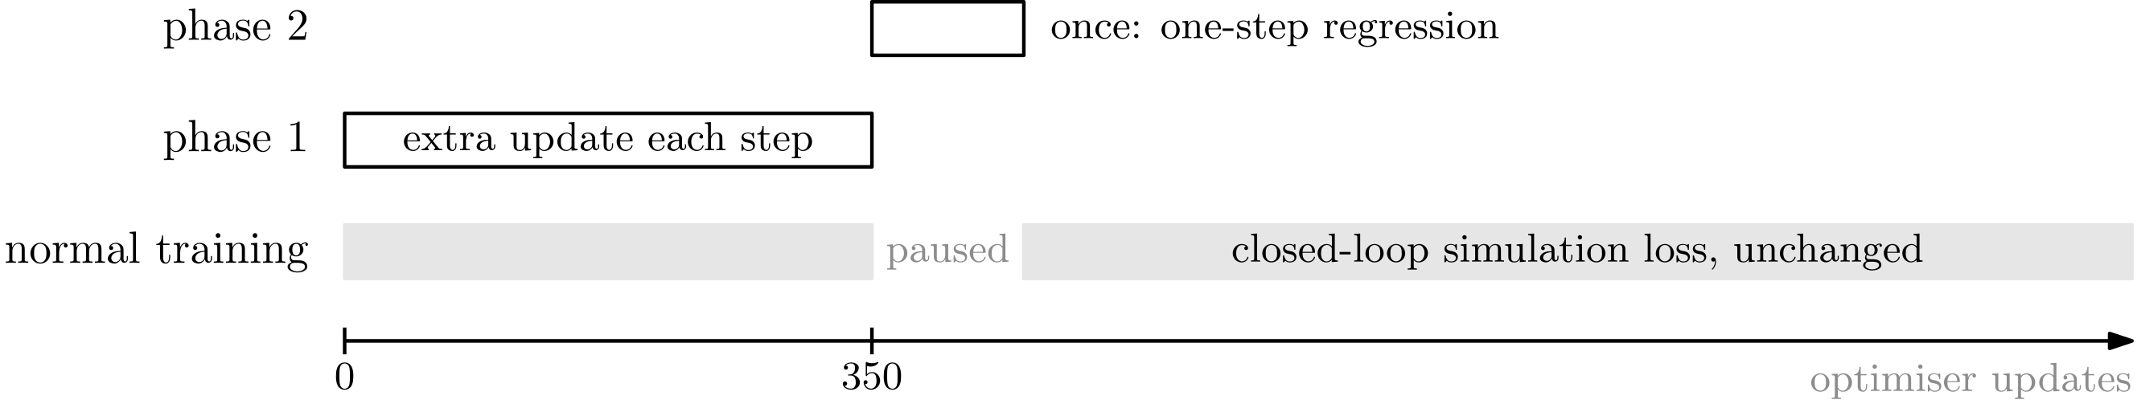
When it happens: during the first updates
Normal training starts as usual: closed-loop simulation loss, model equal to the baseline
Phase 1, first 350 updates: one extra update after each normal one
Phase 2, once: a one-step regression, normal training paused
12
Data-driven initialisation of the added states
Notes:
• phase 2 runs once, right after phase 1 • a few thousand regression steps on a fixed set of state pairs (3100 to 3300 in the server runs) • normal training waits during it

Slide 28
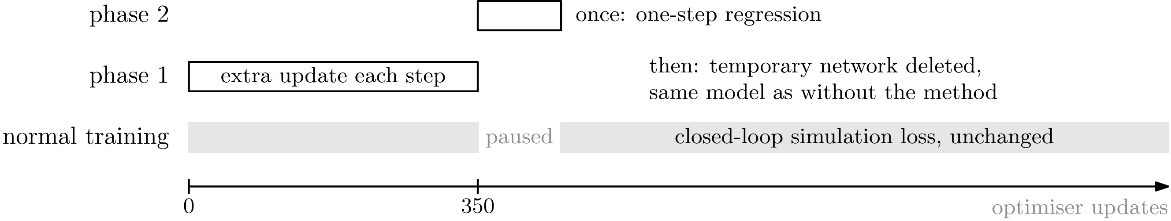
When it happens: during the first updates
Normal training starts as usual: closed-loop simulation loss, model equal to the baseline
Phase 1, first 350 updates: one extra update after each normal one
Phase 2, once: a one-step regression, normal training paused
Then normal training continues, the final model has no extra parameters
12
Data-driven initialisation of the added states
Notes:
• after phase 2: back to the ordinary run (Adam, L-BFGS polish, free-run checkpoint selection, all unchanged) • the temporary network is thrown away • the deployed model has the same structure as plain S-DP • next: phase 1 in three steps

Slide 29
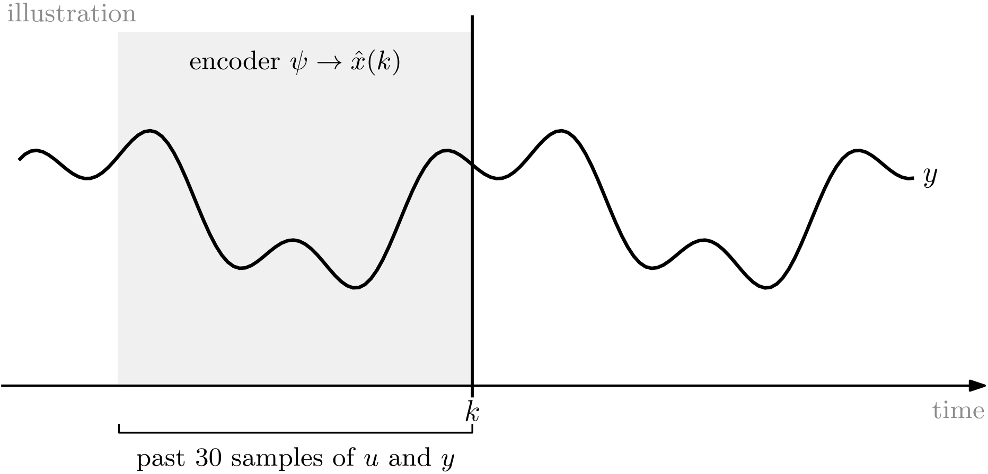
Phase 1, step 1: what is the current model's error?
Pick a window in the training data, the encoder gives x̂(k) = [x_b, x_a]
13
Data-driven initialisation of the added states
Notes:
• sample a window start k in the training records (batch of 64 windows) • encoder on the past 30 samples of u and y (up to and including k) gives the full start state • encoder = linear map + NN correction, linear part for x_b from the baseline, for x_a random

Slide 30
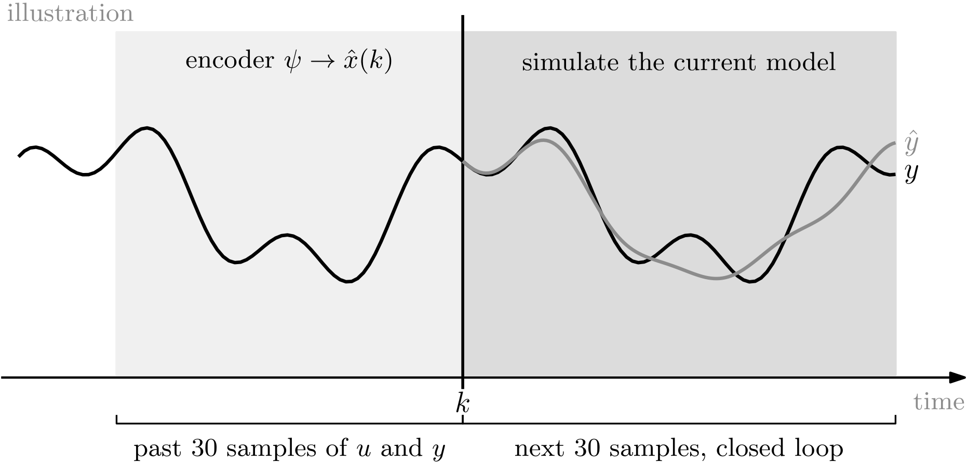
Phase 1, step 1: what is the current model's error?
Pick a window in the training data, the encoder gives x̂(k) = [x_b, x_a]
Simulate the current model 30 samples ahead, in closed loop with the known controller
13
Data-driven initialisation of the added states
Notes:
• same closed-loop prediction path as validation: recorded u, plus the controller's response to the model's own error • the current model: baseline + whatever normal training has learned so far • 30 samples ahead = the same length as the encoder window (7.5 ms)

Slide 31
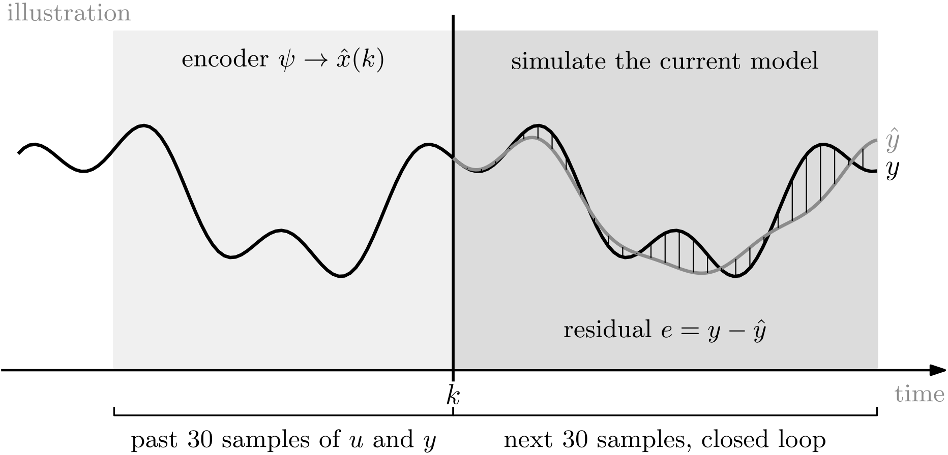
Phase 1, step 1: what is the current model's error?
Pick a window in the training data, the encoder gives x̂(k) = [x_b, x_a]
Simulate the current model 30 samples ahead, in closed loop with the known controller
Residual e = y − ŷ for X1, X2 and Y: what the model still misses
13
Data-driven initialisation of the added states
Notes:
• residual = measured minus simulated, 30 samples × 3 outputs • recomputed every update with the latest weights and encoder states • treated as a fixed target in the extra update (no gradient through it) • scaled per batch to a common size

Slide 32
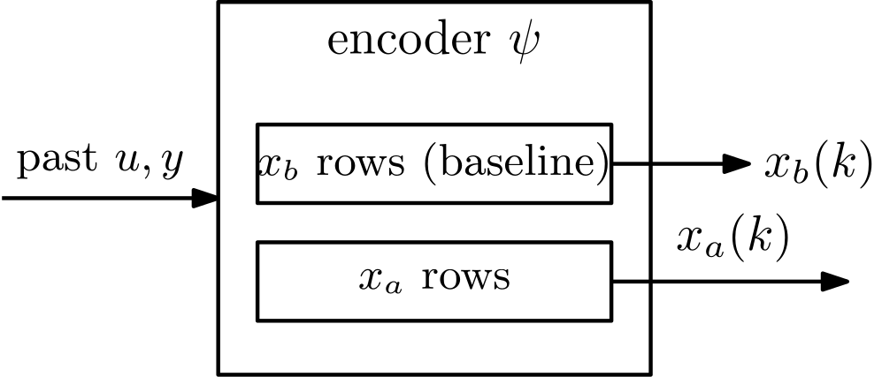
Phase 1, step 2: predict that error from x_a alone
Take only x_a from the encoder
14
Data-driven initialisation of the added states
Notes:
• the encoder has two parts: rows that give x_b (from the baseline) and rows that give x_a • we only use x_a here: the question is whether x_a can carry what the model misses

Slide 33
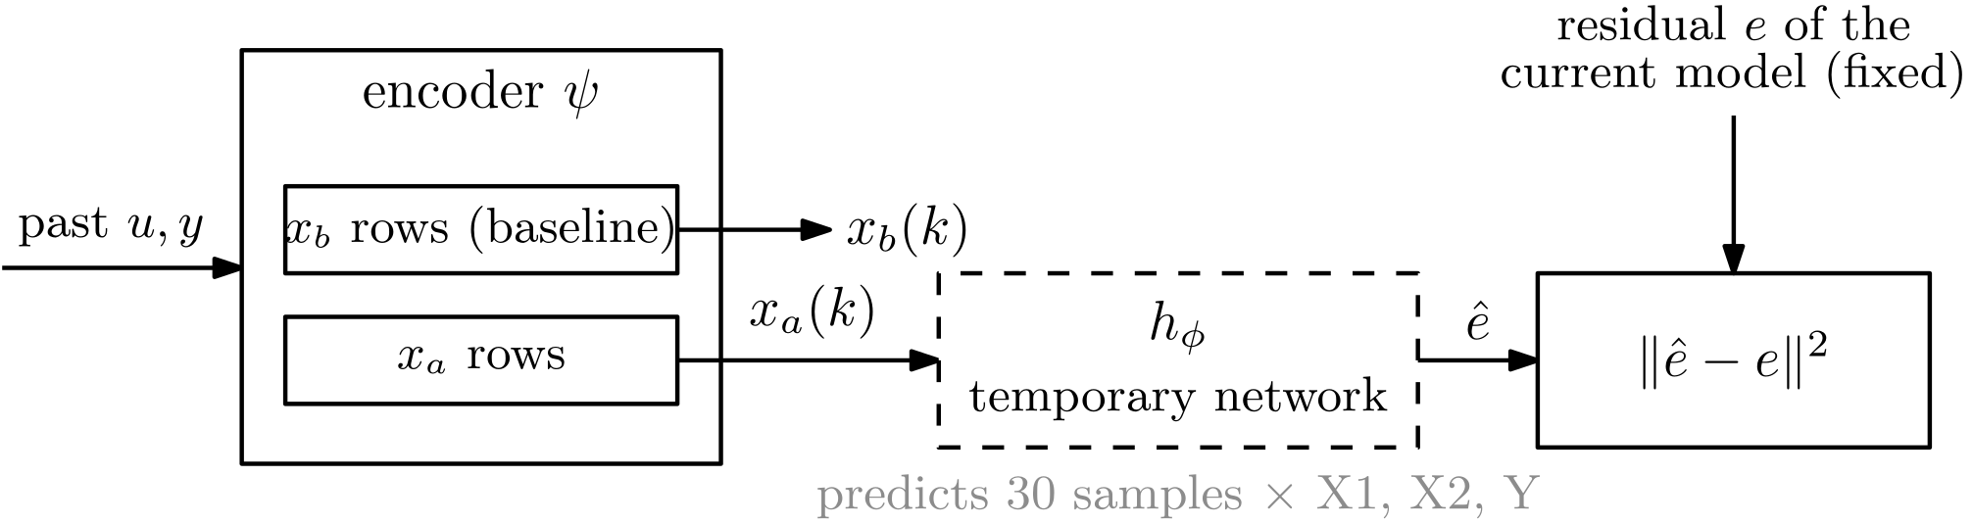
Phase 1, step 2: predict that error from x_a alone
Take only x_a from the encoder
A temporary network predicts the 30-sample residual from x_a:
loss ‖ê − e‖²
14
Data-driven initialisation of the added states
Notes:
• temporary network h_φ: input x_a (2 numbers), output 30 samples × X1, X2, Y • one tanh layer of width 16, output layer starts at zero (predicts "no error") • loss: squared difference with the residual from step 1 • to predict the coming error, x_a must hold information about the dynamics the model misses

Slide 34
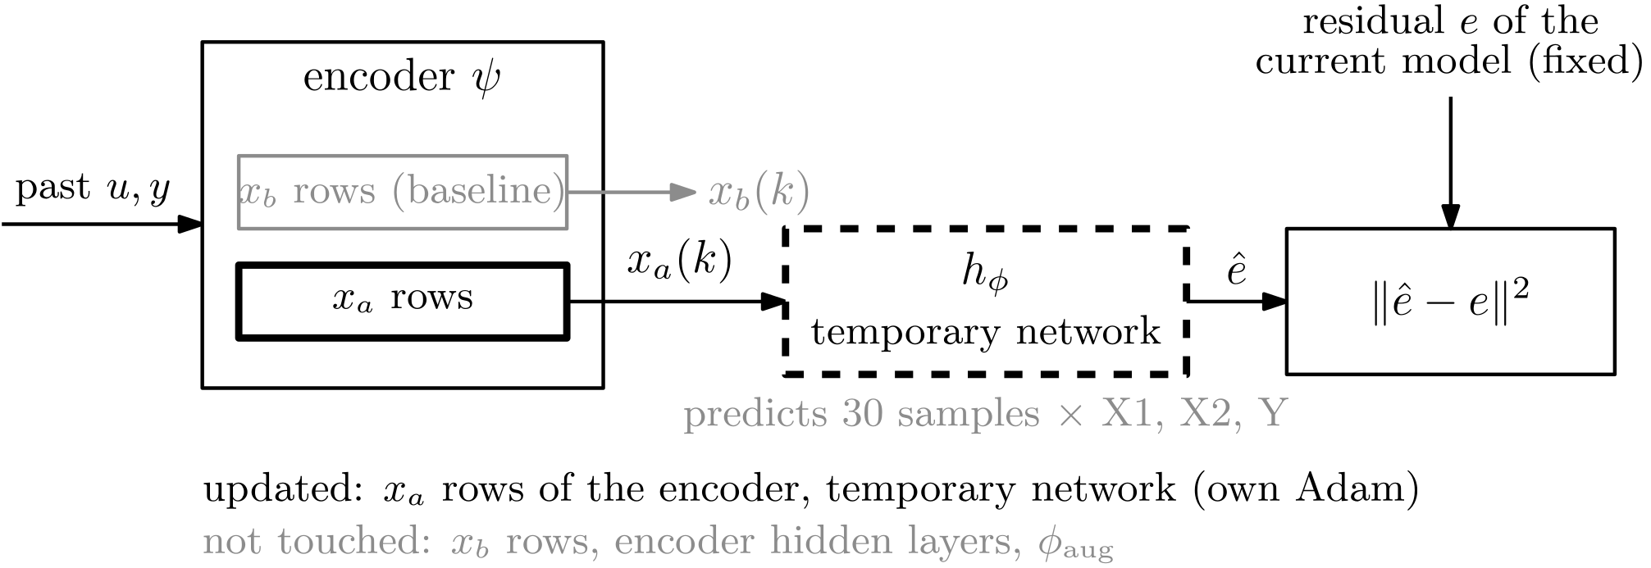
Phase 1, step 2: predict that error from x_a alone
Take only x_a from the encoder
A temporary network predicts the 30-sample residual from x_a:
loss ‖ê − e‖²
Only the encoder's x_a rows and the temporary network are updated, with their own Adam
14
Data-driven initialisation of the added states
Notes:
• updated in this extra step: • the temporary network • the rows of the encoder's linear map that give x_a • the rows of the encoder NN's last layer that give x_a • not touched by this step: x_b rows, encoder hidden layers, the augmentation network (normal training can still update them) • own Adam, learning rate 1e-3, batch 64, gradients kept separate from the normal update • checked in a test: protected weights stay bit-identical

Slide 35
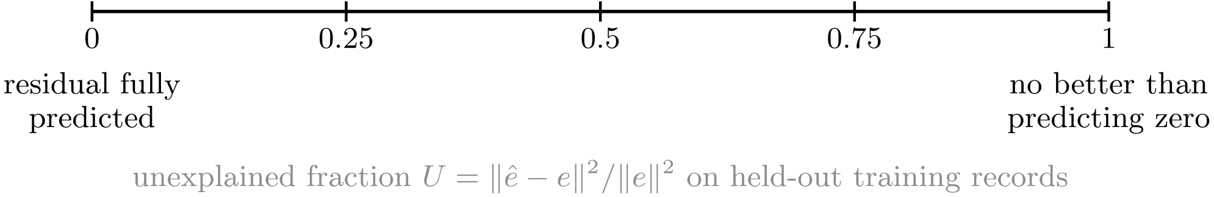
Phase 1, step 3: is x_a good enough to continue?
Checked every 25 updates on 4 training records held out from this fit (one per record type)
15
Data-driven initialisation of the added states
Notes:
• U: prediction error relative to predicting zero residual • held-out records: TR-S5, TR-Y3, TR-P4, TR-T4, not used to fit phase 1 or 2, but still in normal training • one per record type, because what predicts the error in one type need not transfer to another

Slide 36
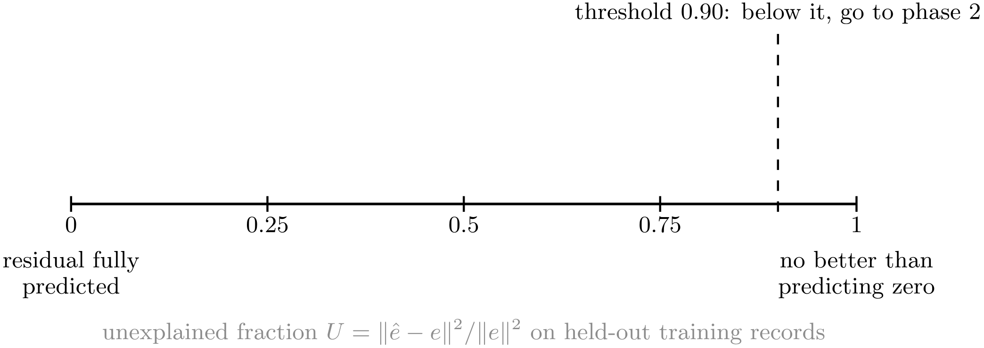
Phase 1, step 3: is x_a good enough to continue?
Checked every 25 updates on 4 training records held out from this fit (one per record type)
Stop at a plateau or at 350 updates, U must be below 0.90, else skip phase 2 and train as normal
15
Data-driven initialisation of the added states
Notes:
• 0.90 = at least 10 % of the squared error explained, compared with predicting zero • also checked at update 150 • fail → temporary network deleted, no phase 2, training continues as normal • note: the encoder changes from phase 1 stay in that case (not a full reset) • thresholds and caps are hand-set, not from literature

Slide 37
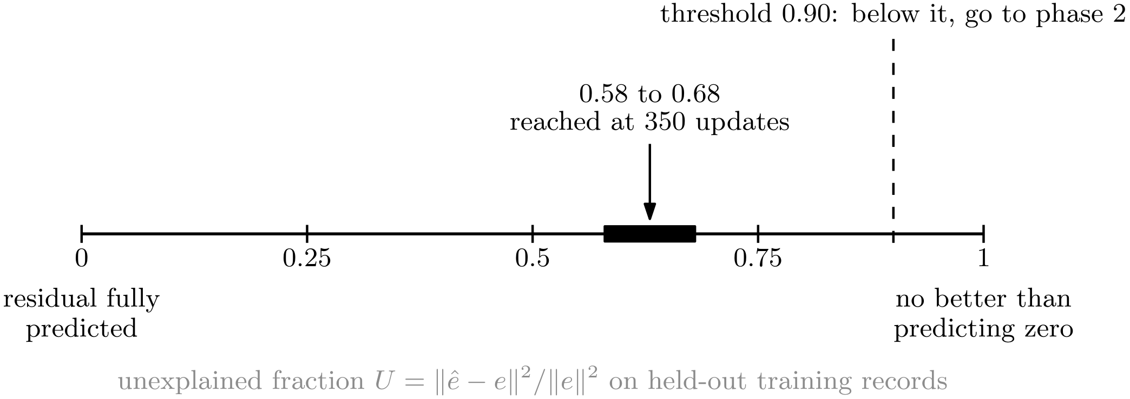
Phase 1, step 3: is x_a good enough to continue?
Checked every 25 updates on 4 training records held out from this fit (one per record type)
Stop at a plateau or at 350 updates, U must be below 0.90, else skip phase 2 and train as normal
Server runs: 0.58 to 0.68 at 350 updates, so all went on to phase 2
15
Data-driven initialisation of the added states
Notes:
• four logged server runs: U between 0.58 and 0.68 • the cap of 350 ended phase 1 every time, it was still improving about 1 % per 25 updates • so a better stopping rule is still open • the fall-back never triggered in the gantry runs

Slide 38
Phase 2: make the model step x_a forward itself
In simulation the model must compute the next x_a itself, without the encoder
16
Data-driven initialisation of the added states
Notes:
• after phase 1 the encoder gives a useful x_a at any sample k • but in a simulation the encoder is only used once, at the start of the window • after that the model must move x_a forward itself, step by step: that is g_aug, still zero • input for that step: the encoder's state at k and the input u(k)

Slide 39
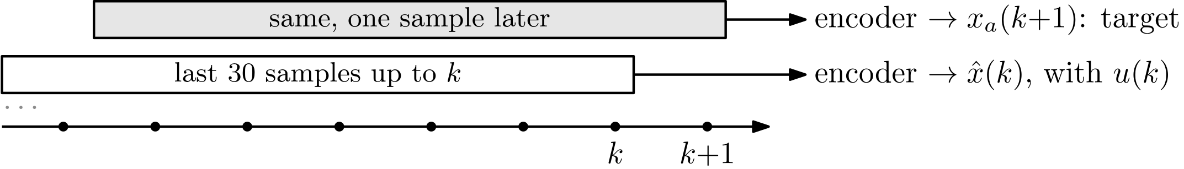
Phase 2: make the model step x_a forward itself
In simulation the model must compute the next x_a itself, without the encoder
Target x_a(k+1): the encoder on the 30 samples up to k+1, instead of up to k
16
Data-driven initialisation of the added states
Notes:
• move the window one sample: the encoder now gives x_a(k+1) • both windows 30 samples: the current sample plus 29 past (lag 29), only the end moves • the target is only a label, the encoder is not trained here • that is what g_aug should produce from the state at k • 8192 such pairs from the fitting records, 2048 from the held-out records • the pairs are made once and stay fixed: the encoder does not change in phase 2

Slide 40
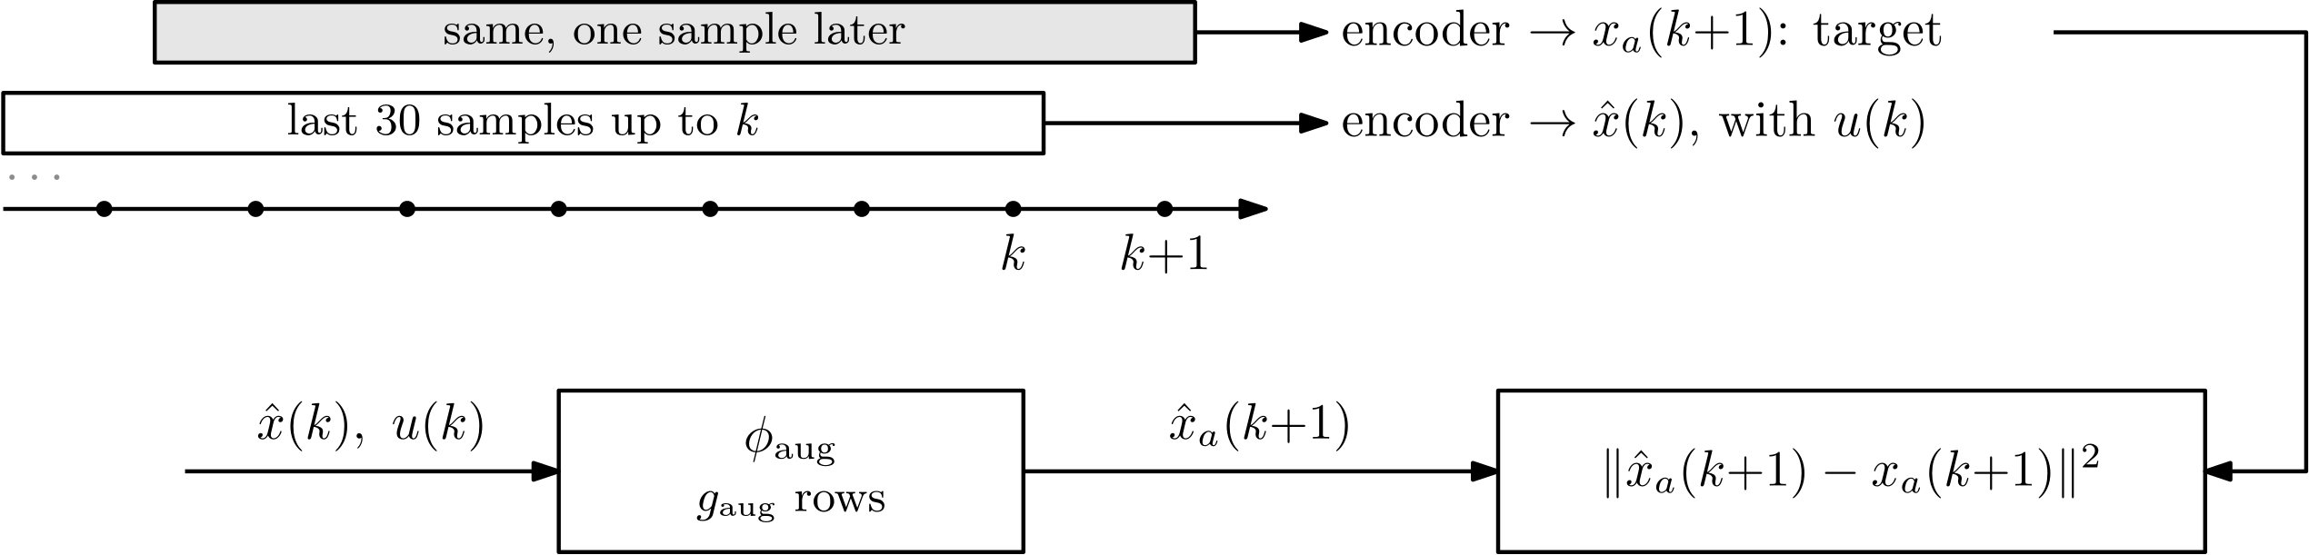
Phase 2: make the model step x_a forward itself
In simulation the model must compute the next x_a itself, without the encoder
Target x_a(k+1): the encoder on the 30 samples up to k+1, instead of up to k
Fit the model's own network: its next-x_a output should match the target x_a(k+1)
16
Data-driven initialisation of the added states
Notes:
• plain supervised regression, no long rollout needed • the existing augmentation network, not a new one • own Adam (1e-3), batches of 512 pairs • loss normalised by the variance of the targets

Slide 41
Phase 2: make the model step x_a forward itself
In simulation the model must compute the next x_a itself, without the encoder
Target x_a(k+1): the encoder on the 30 samples up to k+1, instead of up to k
Fit the model's own network: its next-x_a output should match the target x_a(k+1)
Updated: the x_a outputs and the hidden layers, which f_aug shares. Frozen: the f_aug outputs and the encoder
16
Data-driven initialisation of the added states
Notes:
• the f_aug output weights get zero gradient → unchanged • but the hidden layers are shared, so the physical correction can still change a bit • encoder frozen: the targets stay fixed, so encoder and transition cannot shrink together • normal training paused during this phase

Slide 42
Phase 2: make the model step x_a forward itself
In simulation the model must compute the next x_a itself, without the encoder
Target x_a(k+1): the encoder on the 30 samples up to k+1, instead of up to k
Fit the model's own network: its next-x_a output should match the target x_a(k+1)
Updated: the x_a outputs and the hidden layers, which f_aug shares. Frozen: the f_aug outputs and the encoder
Stop when the error on held-out pairs no longer improves
16
Data-driven initialisation of the added states
Notes:
• same network the model uses in simulation, the temporary network is already deleted, no weights copied • hidden layers are shared, so f_aug's output can shift a little, normal training afterwards corrects that • checked every 100 steps on 2048 held-out pairs • stop after at least 500 steps when the last 5 checks improve less than 1 %, at most 8000 steps, best weights kept • server runs: normalised error from 1.00 (g_aug = 0, predicts nothing) to 0.004 to 0.011, in 3100 to 3300 steps • if asked: square root gives 6 to 10 %, the predicted x_a(k+1) is off by that fraction of its typical spread (rms) • caveat: at 4 kHz x_a changes little per sample, so "x_a stays the same" would already score well, that reference is not computed yet • one-step fit, not a guarantee that x_a stays consistent over many steps

Slide 43
After the two phases: the same model, a live start
Encoder gives a useful x_a, g_aug moves it forward
Normal closed-loop training continues, unchanged
Temporary network deleted: no extra parameters
17
Data-driven initialisation of the added states
Notes:
• before: x_a switched off, no gradient path • after: x_a carries information about the model's error, and the network can step it forward • the closed-loop simulation loss then decides what x_a finally does • Adam, L-BFGS polish and free-run checkpoint selection unchanged • the deployed model is plain S-DP: same structure, same size

Slide 44
Evidence besides RMS
• R1: after phase 1, x_a predicts 32 to 42 % of the residual on held-out records
18
Zero start of g_aug (MLP). Interim: production server runs, best checkpoints so far
Notes:
• unexplained fraction 0.58 to 0.68 on the four held-out training records

Slide 45
Evidence besides RMS
• R1: after phase 1, x_a predicts 32 to 42 % of the residual on held-out records
• R3: one-step error of g_aug from 1.00 to 0.011
18
Zero start of g_aug (MLP). Interim: production server runs, best checkpoints so far
Notes:
• normalised by the variance of the targets, 3100 to 3300 steps

Slide 46
Evidence besides RMS
• R1: after phase 1, x_a predicts 32 to 42 % of the residual on held-out records
• R3: one-step error of g_aug from 1.00 to 0.011
• x_a is used: setting it to zero makes the model 8 to 9× worse (plain S-DP: 17 %)
18
Zero start of g_aug (MLP). Interim: production server runs, best checkpoints so far
Notes:
• same clamp test as on slide 3: added-state rows set to zero

Slide 47
Evidence besides RMS
• R1: after phase 1, x_a predicts 32 to 42 % of the residual on held-out records
• R3: one-step error of g_aug from 1.00 to 0.011
• x_a is used: setting it to zero makes the model 8 to 9× worse (plain S-DP: 17 %)
• Absorber band: about 90 % of the error removed (plain S-DP: 9 to 20 %), X below 106 Hz unchanged
18
Zero start of g_aug (MLP). Interim: production server runs, best checkpoints so far
Notes:
• Y error in 230 to 297 Hz, this method divided by plain S-DP: 0.08 to 0.11 • X below 106 Hz: ratio 0.94 to 1.04, so the friction correction is not traded away

Slide 48
Evidence besides RMS
• R1: after phase 1, x_a predicts 32 to 42 % of the residual on held-out records
• R3: one-step error of g_aug from 1.00 to 0.011
• x_a is used: setting it to zero makes the model 8 to 9× worse (plain S-DP: 17 %)
• Absorber band: about 90 % of the error removed (plain S-DP: 9 to 20 %), X below 106 Hz unchanged
18
Zero start of g_aug (MLP). Interim: production server runs, best checkpoints so far
Notes:
• quiet records: no multisine • diagnosis only: the added-state pair sits at 213 Hz, damping 0.045 (U) and 0.034 (OBC), truth 211.9 Hz, 0.043 • describes this realisation, not a coordinate-invariant pole

Slide 49
Results so far: about six times lower error
Total validation free-run error [m], seed 1
 | plain S-DP | with this method
without OBC | 1.03·10⁻⁵ | 1.60·10⁻⁶
with OBC | 1.15·10⁻⁵ | 1.99·10⁻⁶
19
Zero start of g_aug (MLP). Interim: best checkpoints of runs in progress, measurement noise and Coulomb friction
Notes:
• validation free run over the full records, closed loop • without OBC: 1.027e-5 → 1.597e-6 m (ratio 0.16) • with OBC: 1.153e-5 → 1.992e-6 m (ratio 0.17), OBC seeds 2 and 3 similar (0.14, 0.17) • interim: runs still in progress, two references are copies from before their best checkpoint, so the ratio may be a bit too favourable • references are the older thesis runs with the same settings, not re-runs with the same code

Slide 50
Results so far: about six times lower error
Total validation free-run error [m], seed 1
 | plain S-DP | with this method
without OBC | 1.03·10⁻⁵ | 1.60·10⁻⁶
with OBC | 1.15·10⁻⁵ | 1.99·10⁻⁶
Absorber band, 230 to 297 Hz, RMS on Y [m]
 | plain S-DP | with this method
without OBC | 2.23·10⁻⁵ | 1.70·10⁻⁶
with OBC | 2.12·10⁻⁵ | 2.37·10⁻⁶
20
Zero start of g_aug (MLP). Interim: best checkpoints of runs in progress, measurement noise and Coulomb friction
Notes:
• 230 to 297 Hz, mean over the four multisine validation records • Y: about 10 times lower, plain training removes 9 to 20 % of that band, this method about 90 % • X1, X2 in that band: 8.54e-7 / 7.43e-7 → 2.40e-7 / 2.72e-7 (without OBC), 1.06e-6 / 8.79e-7 → 2.86e-7 / 3.12e-7 (with OBC) • diagnosis only, never used for selection: added-state pair at 213 Hz, damping 0.045, true absorber 211.9 Hz, 0.043, plain run: real eigenvalue only • side test, local: cubic absorber spring, 600 updates, 3 seeds: 45 to 50 % lower validation error than plain S-DP

Slide 51
Jan's question: does PS2 still help when g_aug starts live?
• Until now: the whole last layer started at zero, so g_aug = 0 and x_a started switched off
21
Live start of g_aug: seed 1, low-pass noise data set, best checkpoints
Notes:
• Jan: g_aug should not start at zero. He did not prescribe a scale or an architecture
• his 2026 paper: NN(z) + W_a z, zero initial NN output, W_a entries U(-1, 1); its parallel simulation examples used feedforward networks; the public parallel examples I inspected zero the augmentation
• the MLP keeps the previous architecture; the ResNet adds a direct path that can represent linear dynamics
• exactly at the start the live g still gets no output-loss gradient (f_aug is zero); it becomes trainable once the coupling learns, checked in the local preflight (nonzero gradients after the first update)
• z = [x_b, x_a, u] has 11 entries: 6 physical states, 2 added states, 3 inputs

Slide 52
Jan's question: does PS2 still help when g_aug starts live?
• Until now: the whole last layer started at zero, so g_aug = 0 and x_a started switched off
• Now g_aug starts nonzero; f_aug still starts at zero, so the start is still the baseline
21
Live start of g_aug: seed 1, low-pass noise data set, best checkpoints
Notes:
• Jan: g_aug should not start at zero. He did not prescribe a scale or an architecture
• his 2026 paper: NN(z) + W_a z, zero initial NN output, W_a entries U(-1, 1); its parallel simulation examples used feedforward networks; the public parallel examples I inspected zero the augmentation
• the MLP keeps the previous architecture; the ResNet adds a direct path that can represent linear dynamics
• exactly at the start the live g still gets no output-loss gradient (f_aug is zero); it becomes trainable once the coupling learns, checked in the local preflight (nonzero gradients after the first update)
• z = [x_b, x_a, u] has 11 entries: 6 physical states, 2 added states, 3 inputs

Slide 53
Jan's question: does PS2 still help when g_aug starts live?
• Until now: the whole last layer started at zero, so g_aug = 0 and x_a started switched off
• Now g_aug starts nonzero; f_aug still starts at zero, so the start is still the baseline
• Live MLP: the same tanh network as before, only its x_a output weights random
21
Live start of g_aug: seed 1, low-pass noise data set, best checkpoints
Notes:
• Jan: g_aug should not start at zero. He did not prescribe a scale or an architecture
• his 2026 paper: NN(z) + W_a z, zero initial NN output, W_a entries U(-1, 1); its parallel simulation examples used feedforward networks; the public parallel examples I inspected zero the augmentation
• the MLP keeps the previous architecture; the ResNet adds a direct path that can represent linear dynamics
• exactly at the start the live g still gets no output-loss gradient (f_aug is zero); it becomes trainable once the coupling learns, checked in the local preflight (nonzero gradients after the first update)
• z = [x_b, x_a, u] has 11 entries: 6 physical states, 2 added states, 3 inputs

Slide 54
Jan's question: does PS2 still help when g_aug starts live?
• Until now: the whole last layer started at zero, so g_aug = 0 and x_a started switched off
• Now g_aug starts nonzero; f_aug still starts at zero, so the start is still the baseline
• Live MLP: the same tanh network as before, only its x_a output weights random
• Live ResNet: network output zero, plus a linear path W z with random x_a rows
21
Live start of g_aug: seed 1, low-pass noise data set, best checkpoints
Notes:
• Jan: g_aug should not start at zero. He did not prescribe a scale or an architecture
• his 2026 paper: NN(z) + W_a z, zero initial NN output, W_a entries U(-1, 1); its parallel simulation examples used feedforward networks; the public parallel examples I inspected zero the augmentation
• the MLP keeps the previous architecture; the ResNet adds a direct path that can represent linear dynamics
• exactly at the start the live g still gets no output-loss gradient (f_aug is zero); it becomes trainable once the coupling learns, checked in the local preflight (nonzero gradients after the first update)
• z = [x_b, x_a, u] has 11 entries: 6 physical states, 2 added states, 3 inputs

Slide 55
The two live starts, next to the original
Initial values of the learning function, all output biases zero
 | original MLP | live MLP | live ResNet
hidden layers (2 × 16, tanh) | random | random | random
output to x_b (f_aug) | zero | zero | zero
output to x_a (g_aug) | zero | random, ±0.25 | zero
linear path W z to x_a | none | none | random, ±0.30
linear path W z to x_b | none | none | zero
Random weights: PyTorch default, uniform ±1/√(number of inputs): 16 → 0.25, 11 → 0.30
Encoder, x_a part: Xavier uniform, ±√(6 / (inputs + outputs)); x_b part: the analytical map
22
Live start of g_aug: seed 1, low-pass noise data set, best checkpoints
Notes:
• one rule (nn.Linear default, kaiming_uniform_ with a = sqrt(5)) at different fan-in, not two tuned bounds
• it replaces the paper's U(-1, 1) after an overflow (next slide); conditioning only, no stability guarantee
• within each architecture plain and PS2 get identical initial parameters for the same seed
• the architecture comparison also includes the different live paths, it does not isolate architecture

Slide 56
Numerical problems so far
• Paper scale U(−1, 1) for W: overflow after one update (local test, ResNet, seed 1)
23
Live start of g_aug: seed 1, low-pass noise data set, best checkpoints
Notes:
• overflow: 400-sample local trial, after one optimizer update
• the later NaN is not shown to have the same cause; not traced
• the final L-BFGS polish of the PS2 run ran out of GPU memory (16,384 windows in one chunk, 11 GB card): weights unchanged
• 'Training done | 200 ep' in the log is the configured budget; the run stopped at about 17 epochs
• MLP: launch/cancellation issues, one cancelled during data loading without a Python traceback; cause not established

Slide 57
Numerical problems so far
• Paper scale U(−1, 1) for W: overflow after one update (local test, ResNet, seed 1)
• With the PyTorch scale ±0.30: no immediate overflow, but no stability guarantee
23
Live start of g_aug: seed 1, low-pass noise data set, best checkpoints
Notes:
• overflow: 400-sample local trial, after one optimizer update
• the later NaN is not shown to have the same cause; not traced
• the final L-BFGS polish of the PS2 run ran out of GPU memory (16,384 windows in one chunk, 11 GB card): weights unchanged
• 'Training done | 200 ep' in the log is the configured budget; the run stopped at about 17 epochs
• MLP: launch/cancellation issues, one cancelled during data loading without a Python traceback; cause not established

Slide 58
Numerical problems so far
• Paper scale U(−1, 1) for W: overflow after one update (local test, ResNet, seed 1)
• With the PyTorch scale ±0.30: no immediate overflow, but no stability guarantee
• ResNet with PS2: NaN at update 2,889, best weights kept; cause not traced yet
23
Live start of g_aug: seed 1, low-pass noise data set, best checkpoints
Notes:
• overflow: 400-sample local trial, after one optimizer update
• the later NaN is not shown to have the same cause; not traced
• the final L-BFGS polish of the PS2 run ran out of GPU memory (16,384 windows in one chunk, 11 GB card): weights unchanged
• 'Training done | 200 ep' in the log is the configured budget; the run stopped at about 17 epochs
• MLP: launch/cancellation issues, one cancelled during data loading without a Python traceback; cause not established

Slide 59
Numerical problems so far
• Paper scale U(−1, 1) for W: overflow after one update (local test, ResNet, seed 1)
• With the PyTorch scale ±0.30: no immediate overflow, but no stability guarantee
• ResNet with PS2: NaN at update 2,889, best weights kept; cause not traced yet
• Live MLP: cluster jobs cancelled at launch, no results yet
23
Live start of g_aug: seed 1, low-pass noise data set, best checkpoints
Notes:
• overflow: 400-sample local trial, after one optimizer update
• the later NaN is not shown to have the same cause; not traced
• the final L-BFGS polish of the PS2 run ran out of GPU memory (16,384 windows in one chunk, 11 GB card): weights unchanged
• 'Training done | 200 ep' in the log is the configured budget; the run stopped at about 17 epochs
• MLP: launch/cancellation issues, one cancelled during data loading without a Python traceback; cause not established

Slide 60
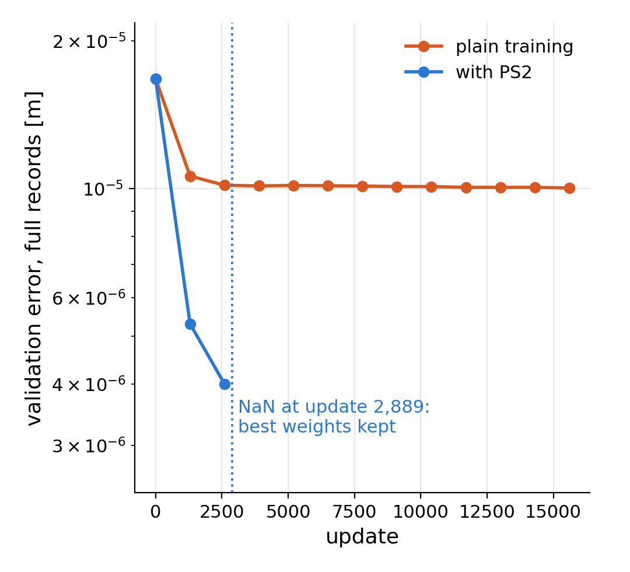
Live ResNet: PS2 still lowers the error
Same data, seed and initial values; only PS2 differs
Update 2,600: plain 1.02·10⁻⁵ m, PS2 4.00·10⁻⁶ m
24
Live start of g_aug: seed 1, low-pass noise data set, best checkpoints
Notes:
• validation = closed-loop free run over the six full validation records, mean of per-record RMS (the checkpoint-selection metric), every 1,300 updates
• plain: run 161, job 88532, 1.00·10⁻⁵ m at 15,600 updates, still running when copied, no NaN in the copied log
• PS2: run 162, job 88531; phase 1 ended at the 350 cap, unexplained 0.51; phase 2 0.79 to 0.012 in 2,200 steps
• PS2 best checkpoint on test: 2.38·10⁻⁶ m (record E5, 1.2x controller gain, skipped)
• one seed, PS2 stopped by the NaN: preliminary

Slide 61
Live ResNet: PS2 still lowers the error
Same data, seed and initial values; only PS2 differs
Update 2,600: plain 1.02·10⁻⁵ m, PS2 4.00·10⁻⁶ m
Plain at 15,600: still 1.00·10⁻⁵ m
24
Live start of g_aug: seed 1, low-pass noise data set, best checkpoints
Notes:
• validation = closed-loop free run over the six full validation records, mean of per-record RMS (the checkpoint-selection metric), every 1,300 updates
• plain: run 161, job 88532, 1.00·10⁻⁵ m at 15,600 updates, still running when copied, no NaN in the copied log
• PS2: run 162, job 88531; phase 1 ended at the 350 cap, unexplained 0.51; phase 2 0.79 to 0.012 in 2,200 steps
• PS2 best checkpoint on test: 2.38·10⁻⁶ m (record E5, 1.2x controller gain, skipped)
• one seed, PS2 stopped by the NaN: preliminary

Slide 62
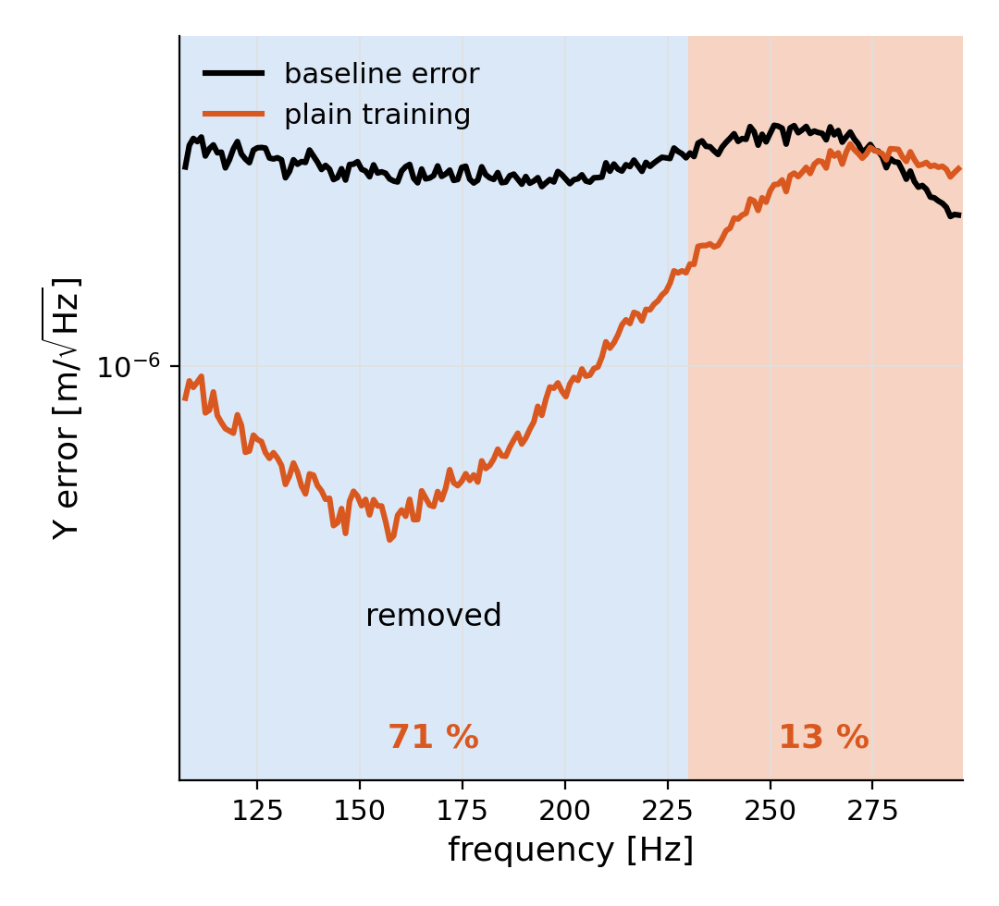
Prediction error vs frequency, live ResNet
Baseline: Y RMS 4.08·10⁻⁵ m overall, 2.54·10⁻⁵ m in 230–297 Hz
Plain: Y RMS 2.40·10⁻⁵ m overall, 2.20·10⁻⁵ m in 230–297 Hz
25
Live start of g_aug: seed 1, low-pass noise data set, best checkpoints
Notes:
• e = y - y_hat, closed-loop free run over the full validation records, Y axis
• Welch ASD: Hann window, 4096 samples (about 1 Hz), 50 % overlap, fs 4 kHz; PSD averaged over the four multisine records VA-S1, Y1, P1, L1; records never joined
• band RMS: rfft Parseval per record, mean over the same four records; RMS, not power
• baseline = the model at the start, before training (detuned physical parameters); on slide 3 the black line was the baseline at true parameters, other run and data set, so do not compare the two figures line by line
• % removed = 1 - band RMS / baseline band RMS (RMS, not power)
• blue band 106 to 230 Hz, red band 230 to 297 Hz (the earlier absorber-region band)
• side numbers: Y, mean over the four multisine records; 106-230 Hz: baseline 3.17·10⁻⁵, plain 9.25·10⁻⁶, PS2 5.53·10⁻⁶ m
• full-record validation (all 6 records, all axes, mean per-record RMS): baseline 1.68·10⁻⁵, plain 1.00·10⁻⁵, PS2 4.00·10⁻⁶ m; the PS2 value reproduces the logged 3.998e-06
• quiet records VA-T1, T2, Y whole RMS: baseline 3.34·10⁻⁶, plain 3.63·10⁻⁶, PS2 1.27·10⁻⁶ m
• ratios PS2 / plain on Y: whole 0.38, 106-230 Hz 0.60, 230-297 Hz 0.31

Slide 63
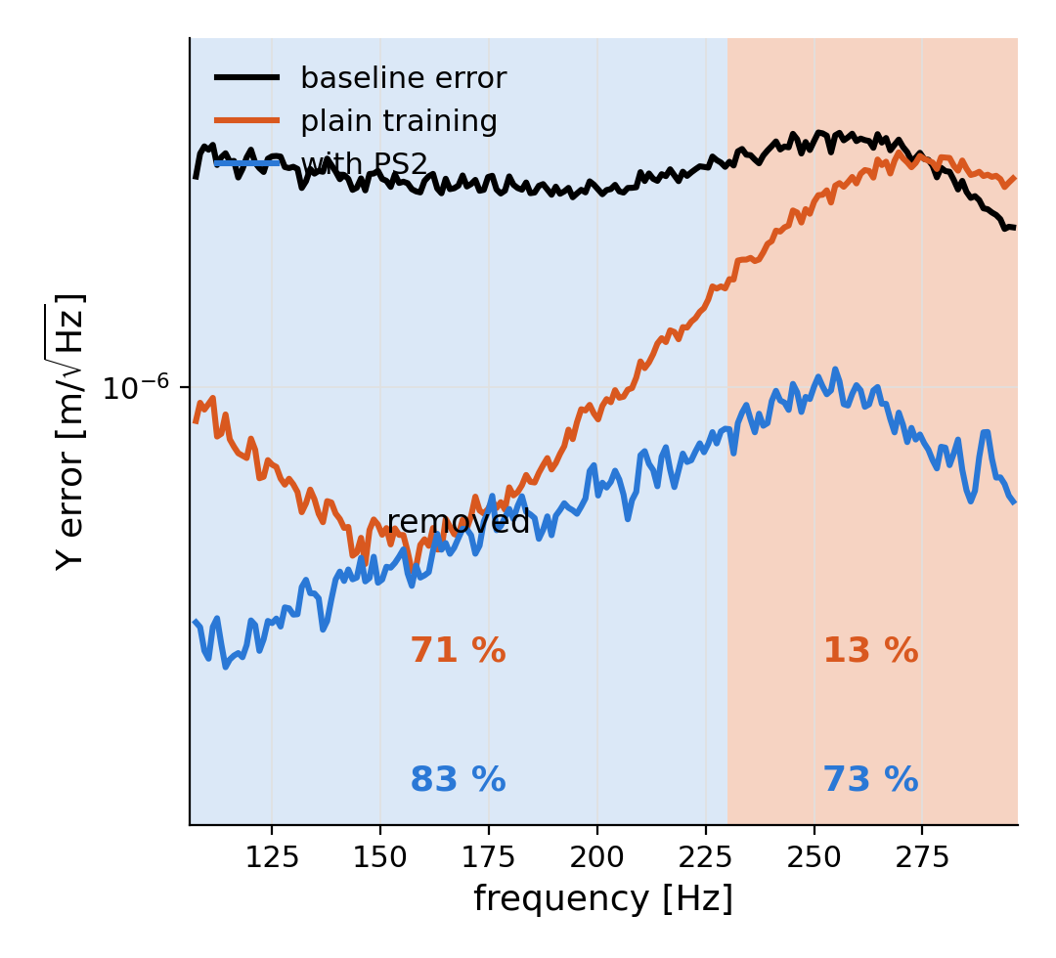
Prediction error vs frequency, live ResNet
Baseline: Y RMS 4.08·10⁻⁵ m overall, 2.54·10⁻⁵ m in 230–297 Hz
Plain: Y RMS 2.40·10⁻⁵ m overall, 2.20·10⁻⁵ m in 230–297 Hz
PS2: Y RMS 9.11·10⁻⁶ m overall, 6.77·10⁻⁶ m in 230–297 Hz
25
Live start of g_aug: seed 1, low-pass noise data set, best checkpoints
Notes:
• e = y - y_hat, closed-loop free run over the full validation records, Y axis
• Welch ASD: Hann window, 4096 samples (about 1 Hz), 50 % overlap, fs 4 kHz; PSD averaged over the four multisine records VA-S1, Y1, P1, L1; records never joined
• band RMS: rfft Parseval per record, mean over the same four records; RMS, not power
• baseline = the model at the start, before training (detuned physical parameters); on slide 3 the black line was the baseline at true parameters, other run and data set, so do not compare the two figures line by line
• % removed = 1 - band RMS / baseline band RMS (RMS, not power)
• blue band 106 to 230 Hz, red band 230 to 297 Hz (the earlier absorber-region band)
• side numbers: Y, mean over the four multisine records; 106-230 Hz: baseline 3.17·10⁻⁵, plain 9.25·10⁻⁶, PS2 5.53·10⁻⁶ m
• full-record validation (all 6 records, all axes, mean per-record RMS): baseline 1.68·10⁻⁵, plain 1.00·10⁻⁵, PS2 4.00·10⁻⁶ m; the PS2 value reproduces the logged 3.998e-06
• quiet records VA-T1, T2, Y whole RMS: baseline 3.34·10⁻⁶, plain 3.63·10⁻⁶, PS2 1.27·10⁻⁶ m
• ratios PS2 / plain on Y: whole 0.38, 106-230 Hz 0.60, 230-297 Hz 0.31

Slide 64
Limits
• Interim: best checkpoints of runs still in progress, no test-set result yet
• Settings are heuristics: 350-update cap, 10 % threshold, phase 2 stop rule, no sensitivity study
• One plant and one controller, plus a small cubic-spring test (45 to 50 % lower validation error)
• No gain where plain S-DP already learns the hidden state (open-loop mass-spring test)
• Live start: one seed, ResNet only, the PS2 run ended in a NaN; live MLP pending
26
Data-driven initialisation of the added states
Notes:
• validation records are also used for checkpoint selection, on both sides • the 350 cap ended phase 1 in every run • open-loop hidden-Duffing mass-spring: plain S-DP already learns the hidden mass, this method gives no gain • so it targets the case where plain training does not form the state, it is not a general improvement • if phase 1 fails, phase 2 is skipped but the phase 1 encoder changes stay

Slide 65
Question
A proper extension of the framework, or a workaround?
For: no system knowledge, model and loss unchanged
For: fills a gap, x_b has a start from the baseline, x_a had none
For: the same steps as subspace identification
Against: heuristic settings, one plant and one controller
Against: no gain where plain S-DP already works
27
Data-driven initialisation of the added states
Notes:
• same question as in my mail, now with the reasoning behind it • for: the counterpart of the baseline-based encoder start for x_b, but from data • for: no truth, poles or frequencies used to decide anything • against: thresholds and caps are hand-set, the 350 cap decided phase 1 every time • against: simulation only so far • open question: which initialisation produced the S-DP results in Jan's paper? Not visible in the public code

Slide 66
Black box: SUBNET, trained on the closed loop
• Plain SUBNET in deepSI: encoder, state network and output network
28
Black-box comparison
Notes:
• purpose: a reference without any physics, for the thesis comparison • same model class and training routine as in Jan's work, only the signals and settings chosen by me

Slide 67
Black box: SUBNET, trained on the closed loop
• SUBNET in deepSI: encoder, state network and output network
• Random start: no physics, no controller in the model, no linear (BLA) start
28
Black-box comparison
Notes:
• random initialisation, as in Jan's code • no controller anywhere in the model or the rollout • no BLA, subspace or other linear start, and no truth information

Slide 68
Black box: SUBNET, trained on the closed loop
• SUBNET in deepSI: encoder, state network and output network
• Random start: no physics, no controller in the model, no linear (BLA) start
• It learns the whole closed loop: from the reference r and the multisine force f to the servo error e = y − r
• Predicted positions: ŷ = r + ê, scored the same way as the grey box
28
Black-box comparison
Notes:
• why the closed loop and not the plant: a random black-box plant simulated inside the controller blows up from the first steps (the controller's normalised gain is about 3.7·10³ × a random model's step gain), five designs failed this way • r and f do not depend on y, so this is a proper input-output map • why e and not y: normalised by the move range (0.05 to 0.15 m), the 10⁻⁵ m loop behaviour is invisible to the loss, on raw y the model was 30 to 100× worse than ŷ = r • ŷ − y = ê − e, so the score is the same as predicting y directly

Slide 69
Black box: setup and training
Item | Setting
Model | 16 states, Jan's network sizes, 12 838 weights
Encoder | start state from 30 samples (29 past plus the current one)
Training | simulation error over windows of 400 steps (0.1 s), Adam
Data | same 18 training records and 4 kHz samples as the grey box
Selection | free run over the full 12 s of the 6 validation records
29
Black-box comparison
Notes:
• network sizes from Jan's code: state and output nets 2 × 8, encoder 2 × 16 (tanh, with a linear part) • 16 states is a free choice, not the true order: enough memory for stage, absorber and controller • encoder window 30 samples (lag 29 plus the current one), the same as the grey box • window 400 steps, same as the grey box, no teacher forcing, encoder trained jointly • Adam: learning rate 1e-2 for the proof runs (1596 updates), 3e-3 for the longest run (9576 updates) • both the noisy and the noise-free version of the data, 3 seeds each • best validated model kept, test records never loaded

Slide 70
Black box: in the same range as the grey box
Mean over 6 validation records [m] | X1 | X2 | Y
Black box, longest run (1 seed) | 7.9·10⁻⁶ | 8.1·10⁻⁶ | 1.4·10⁻⁵
Black box, 3 seeds × 2 versions | 1.0·10⁻⁵ | 1.1·10⁻⁵ | 1.6·10⁻⁵
Grey box at epoch 0 (untrained) | 4.0·10⁻⁶ | 3.6·10⁻⁶ | 2.8·10⁻⁵
No model, ŷ = r | 1.9·10⁻⁵ | 1.9·10⁻⁵ | 3.1·10⁻⁵
30
Black-box comparison. The grey box here is the untrained start (epoch 0)
Notes:
• free run over the full 12 s, per axis, mean over the 6 validation records • noisy and noise-free versions agree within a few percent (noise 10⁻⁸ m, 1000× below these errors) • noise floor: 7.6e-9 / 8.2e-9 / 4.6e-9 m

Slide 71
Black box: in the same range as the grey box
Mean over 6 validation records [m] | X1 | X2 | Y
Black box, longest run (1 seed) | 7.9·10⁻⁶ | 8.1·10⁻⁶ | 1.4·10⁻⁵
Black box, 3 seeds × 2 versions | 1.0·10⁻⁵ | 1.1·10⁻⁵ | 1.6·10⁻⁵
Grey box at epoch 0 (untrained) | 4.0·10⁻⁶ | 3.6·10⁻⁶ | 2.8·10⁻⁵
No model, ŷ = r | 1.9·10⁻⁵ | 1.9·10⁻⁵ | 3.1·10⁻⁵
• Better on Y, about 2× worse on X, the X gap sits in the records with large moves
• Limit: it models the loop, not the plant, so it cannot be used with another controller
30
Black-box comparison. The grey box here is the untrained start (epoch 0)
Notes:
• Y: the untrained grey box has no absorber and no friction, so its Y error is large • X: on the move records the grey box's physics predicts the tracking error by construction, the black box must learn it from 18 records • compared against the untrained grey box: no trained grey box on these full records yet • open: 3 seeds at the longest budget, compare with the trained grey box once available

Slide 72
Backup: each ingredient is needed
Variant | What is missing | Oscillating pair near the absorber | Free-run error [m]
plain S-DP | everything | 0 % of points | 1.15·10⁻⁵
map fit on random x_a | the phase 1 target | real lags only
target, too little map fit | enough phase 2 | 46 %, damping 0.99
map fit before the target formed | the order | 46 %, damping 0.72
both, in order | nothing | 96 to 100 %, 208 to 209 Hz | 3.8·10⁻⁶
Local runs, 900 updates, mostly one seed, an earlier implementation of the same two steps
35
Backup
Notes:
• runs U1, E1, E2, E3, E4, E5, E9 • remove one ingredient at a time • the target alone or the map fit alone gives no proper oscillation • not shown as separate methods, only as an ablation

Slide 73
Measurement noise: why the method changed
Before
measured spectrum copied bin by bin, corrected per frequency for the loop
Problem
that also copies the real machine's resonances and disturbances into the simulation
14
Measurement noise in the simulated data
Notes:
• before: measured standstill servo error copied per frequency, divided by what the loop lets through (|S|²) • Jasper: the measured error was shaped by the real loop, so it holds real resonances and disturbances that the simulated system does not have • "nu neem ik dynamica van het echte systeem op"

Slide 74
Measurement noise:
Method
Low-order noise model that only matches the shape of the measured noise
14
Measurement noise in the simulated data
Notes:
• Jasper's advice: very low order (2 or 3), a slope at low frequency plus the constant floor, or fully white • match the shape, not the exact frequency content • keep the low-frequency weighting so the 10 to 100 Hz slope is captured, leave out the region around 1 kHz on Y • what stays the same: noise on the encoder, one independent generator per axis

Slide 75
Measurement noise:
Method
Low-order noise model that only matches the shape of the measured noise
We dont capture actual dynamcis of the system in the noise, only the general noise shape
14
Measurement noise in the simulated data
Notes:
• Jasper's advice: very low order (2 or 3), a slope at low frequency plus the constant floor, or fully white • match the shape, not the exact frequency content • keep the low-frequency weighting so the 10 to 100 Hz slope is captured, leave out the region around 1 kHz on Y • what stays the same: noise on the encoder, one independent generator per axis

Slide 76
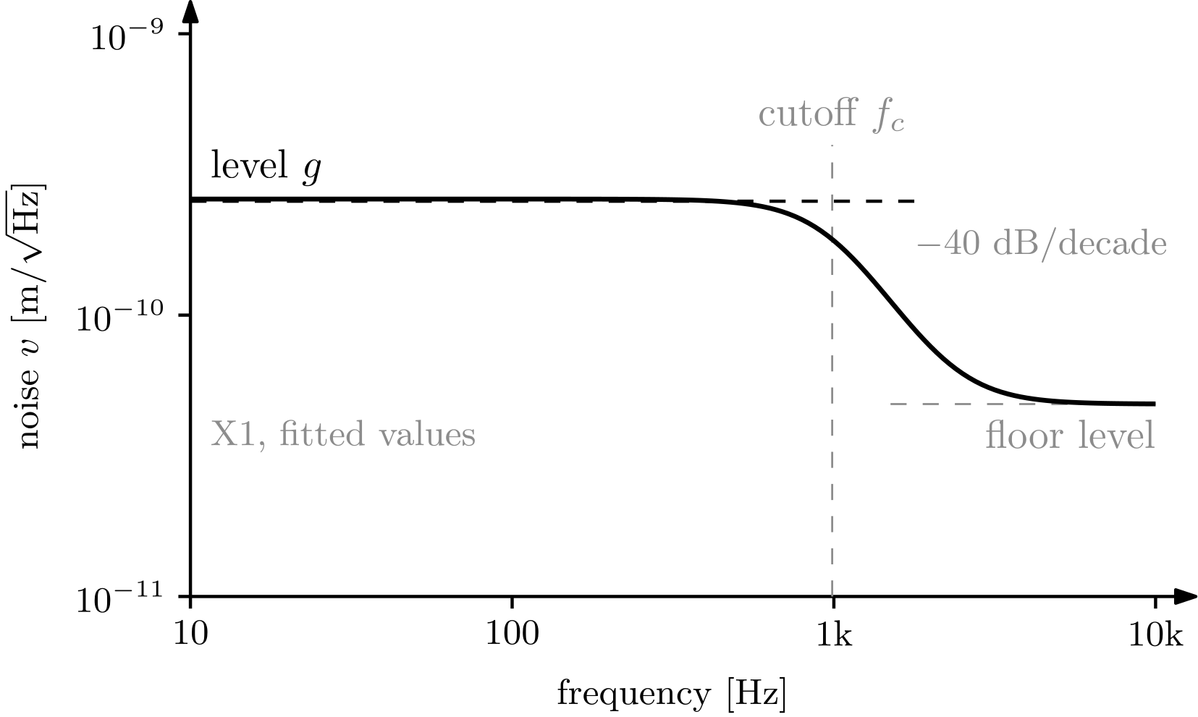
The noise model: the shape we want
Low frequencies: flat, the height is the level g
15
Measurement noise in the simulated data
Notes:
• this is the noise v itself, for X1 with the fitted values • the shape the measured noise has, without the real machine's peaks • low frequencies: the encoder noise is strongest there • g is the height of this flat part, in m/√Hz

Slide 77
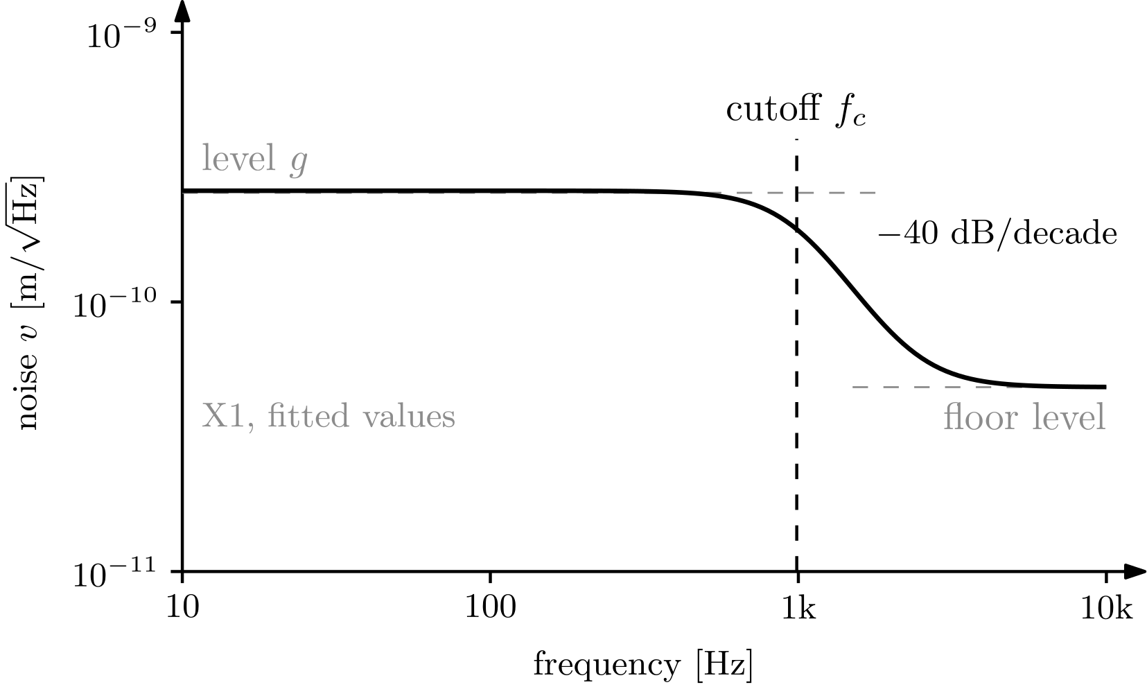
The noise model: the shape we want
Low frequencies: flat, the height is the level g
Above the cutoff frequency: falls off, 40 dB per decade
15
Measurement noise in the simulated data
Notes:
• cutoff frequency: where the flat part ends • X1, X2 about 1 kHz, Y about 2.6 kHz • 40 dB per decade: 10 times higher frequency gives 100 times lower amplitude

Slide 78
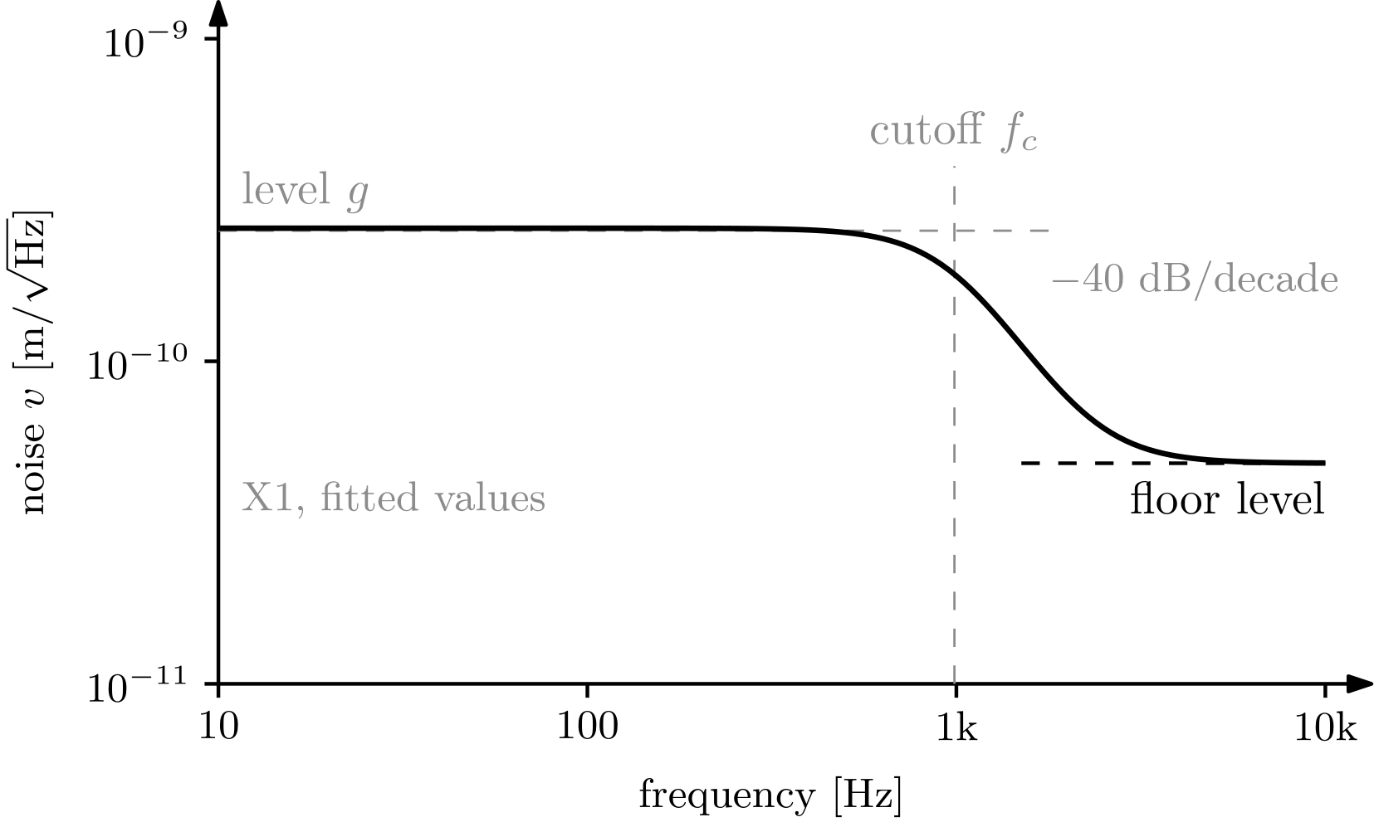
The noise model: the shape we want
Low frequencies: flat, the height is the level g
Above the cutoff frequency: falls off, 40 dB per decade
High frequencies: flat again, the height is the floor level
15
Measurement noise in the simulated data
Notes:
• floor: what is left at high frequency, flat up to 10 kHz (half the 20 kHz sample rate) • so three numbers per axis describe the whole noise: level g, cutoff, floor • next: how this shape is made, then how the three numbers are fitted

Slide 79
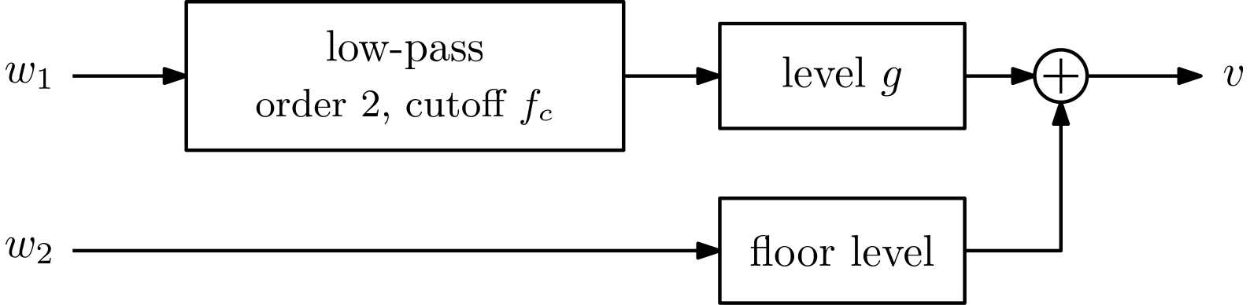
How the noise is made: two white noise sources
White noise: random numbers, equally strong at every frequency
16
Measurement noise in the simulated data
Notes:
• w1 and w2: two independent white noise signals, one new random value per sample • white = flat spectrum, every frequency equally strong

Slide 80
How the noise is made: two white noise sources
White noise: random numbers, equally strong at every frequency
Source 1 goes through a low-pass filter and is scaled by g: the flat part and the fall-off
16
Measurement noise in the simulated data
Notes:
• low-pass: 2nd-order Butterworth, in code butter(2, cutoff/(f_s/2), 'low'), f_s = 20 kHz • passes everything below the cutoff, then 40 dB per decade down • order 2, as Jasper suggested (2 or 3), Butterworth has no peak at the cutoff, so it adds no resonance

Slide 81
How the noise is made: two white noise sources
White noise: random numbers, equally strong at every frequency
Source 1 goes through a low-pass filter and is scaled by g: the flat part and the fall-off
Source 2 is only scaled by the floor level: the flat part at high frequencies
16
Measurement noise in the simulated data
Notes:
• no filter: stays flat up to 10 kHz • only visible where the filtered part has died out

Slide 82
How the noise is made: two white noise sources
White noise: random numbers, equally strong at every frequency
Source 1 goes through a low-pass filter and is scaled by g: the flat part and the fall-off
Source 2 is only scaled by the floor level: the flat part at high frequencies
Both added together give the noise v, with the shape of the previous slide
16
Measurement noise in the simulated data
Notes:
• v = g · LP(w1) + floor · w2 • g and floor are spectrum heights in m/√Hz • rms check: about 10⁻⁸ m on X, 5·10⁻⁹ m on Y • the 10 to 100 Hz slope in the servo error is not in the noise: the loop shapes it (error = S × noise)

Slide 83
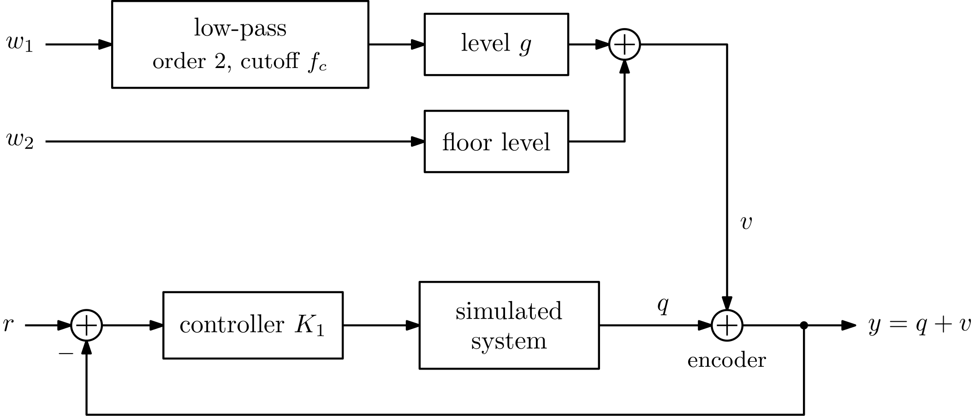
Where the noise enters: at the encoder
The noise is added to the measured position: y = q + v
The controller reacts to it, as on the real machine
One generator per axis, X1, X2 and Y not correlated
17
Measurement noise in the simulated data
Notes:
• injection point unchanged from before: the encoder • q: true position of the simulated system, y: what the encoder reports • the controller acts on y, so it also pushes the noise into the motion, as on the machine • separate encoders per axis, so independent noise, own seed per axis • same structure on X1, X2 and Y, only the three numbers differ

Slide 84
How the three numbers are found
1. Floor level: read directly from the measured spectrum above 5 kHz
18
Measurement noise in the simulated data
Notes:
• above 5 kHz the loop does nothing (|S| ≈ 1), so the measured servo error there is the noise floor itself • median of the measured spectrum above 5 kHz, copied as is

Slide 85
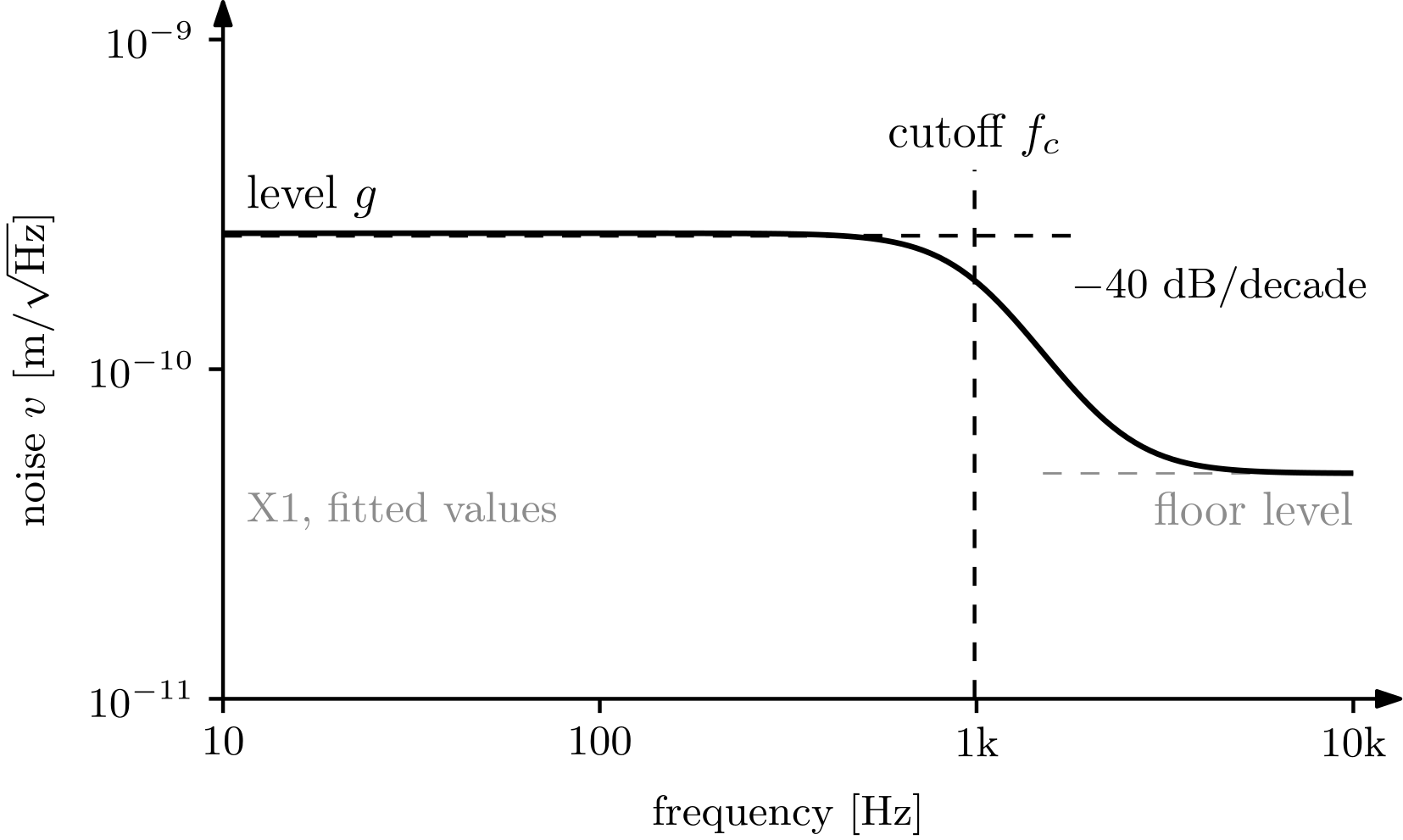
How the three numbers are found
1. Floor level: read directly from the measured spectrum above 5 kHz
2. Cutoff and level g: chosen so the simulated servo error at standstill matches the measured one
18
Measurement noise in the simulated data
Notes:
• simulate: this noise through the closed loop at standstill (simulated system at rest, Y = 0, K1) • analyse the simulated servo error with the same spectrum estimator as the measurement • fit cutoff and g so the log spectra match, from 10 Hz, equal weight per decade (else 1 to 10 kHz dominates, the bins are linear) • compared as servo error against servo error, so the loop's own shaping is included

Slide 86
How the three numbers are found
1. Floor level: read directly from the measured spectrum above 5 kHz
2. Cutoff and level g: chosen so the simulated servo error at standstill matches the measured one
3. Level g fine-tuned so the rms matches, on Y the 0.7 to 2 kHz peak is left out
18
Measurement noise in the simulated data
Notes:
• last step: g set so the simulated rms equals the measured rms over the fitted range • Y: 0.7 to 2 kHz left out of the fit and the rms: the 1.3 kHz resonance of the real machine, which we do not want to copy (Jasper's point) • an analytic version (|S|² times the noise spectrum) gave the same cutoffs (980, 967, 2606 Hz)

Slide 87
The fitted numbers
Number | What it sets | X1 | X2 | Y
level g | height at low frequencies [m/√Hz] | 2.5·10⁻¹⁰ | 2.7·10⁻¹⁰ | 5.6·10⁻¹¹
cutoff frequency | where it starts to fall off | 988 Hz | 973 Hz | 2596 Hz
floor level | height at high frequencies [m/√Hz] | 4.8·10⁻¹¹ | 4.9·10⁻¹¹ | 4.6·10⁻¹¹
X1 and X2 almost the same, Y lower at low frequencies and with a higher cutoff
Total noise: about 10⁻⁸ m rms on X and 5·10⁻⁹ m on Y
19
Measurement noise in the simulated data
Notes:
• same order as the spectrum slides: level g, cutoff, floor • exact fitted values: X1 g 2.54e-10, floor 4.83e-11, X2 g 2.73e-10, floor 4.91e-11, Y g 5.64e-11, floor 4.57e-11 • on Y g and floor are close, so the flat part there is about 7·10⁻¹¹ m/√Hz (g and floor together) • rms of the simulated standstill servo error: X1 9.85·10⁻⁹, X2 1.04·10⁻⁸, Y 4.81·10⁻⁹ m (next slide)

Slide 88
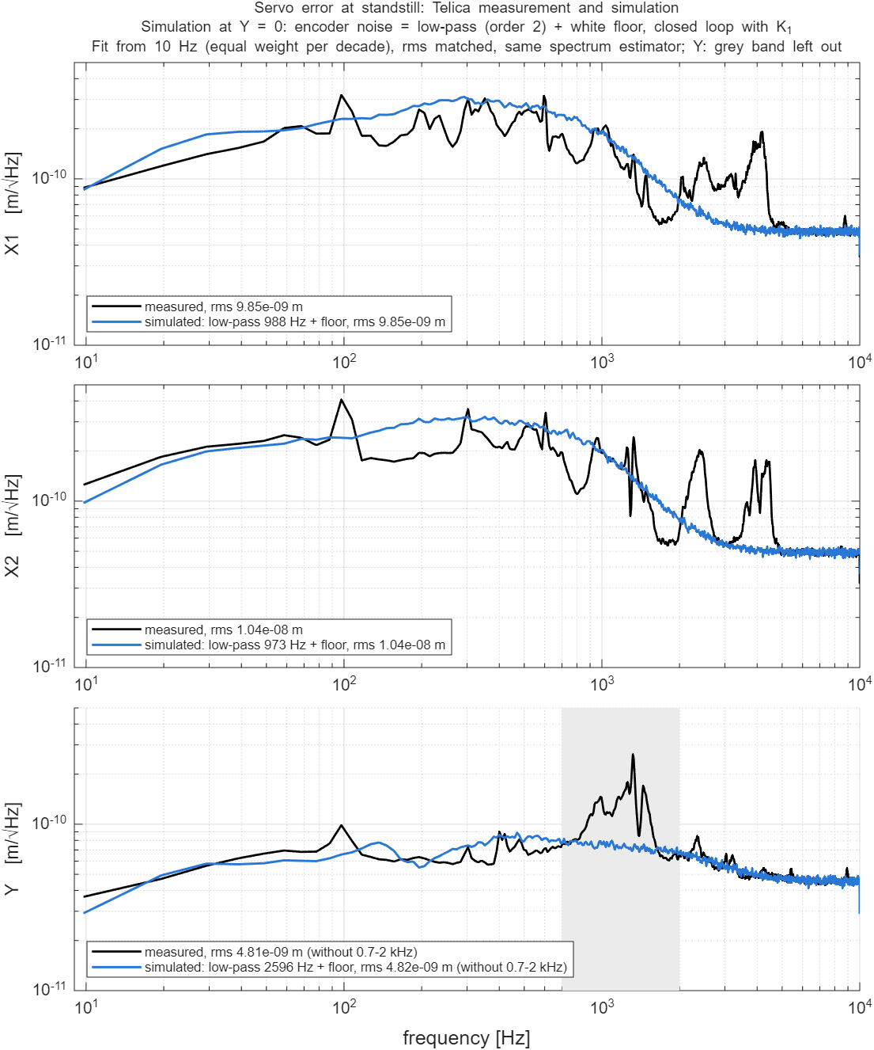
Result: the shape matches, the machine's peaks do not
Black: machine, blue: simulation, servo error at standstill
20
Standstill at Y = 0, tested, not yet in the data generator
Notes:
• three axes, top to bottom: X1, X2, Y • both analysed with the same spectrum estimator • grey band on Y: 0.7 to 2 kHz, left out

Slide 89
Result: the shape matches, the machine's peaks do not
Black: machine, blue: simulation, servo error at standstill
Matches the 10 to 100 Hz slope, the roll-off near 1 kHz and the floor
rms equal: X1 9.85·10⁻⁹, X2 1.04·10⁻⁸, Y 4.81·10⁻⁹ m
20
Standstill at Y = 0, tested, not yet in the data generator
Notes:
• cutoffs: X1 988 Hz, X2 973 Hz, Y 2596 Hz • Y rms without 0.7 to 2 kHz: 4.81e-9 measured, 4.82e-9 simulated • Y over the full band: 5.48e-9 simulated vs 6.34e-9 measured, the difference is the 1.3 kHz peak, left out on purpose • checked through the full 3 × 3 loop: same rms as the per-axis fit

Slide 90
Result: the shape matches, the machine's peaks do not
Black: machine, blue: simulation, servo error at standstill
Matches the 10 to 100 Hz slope, the roll-off near 1 kHz and the floor
rms equal: X1 9.85·10⁻⁹, X2 1.04·10⁻⁸, Y 4.81·10⁻⁹ m
The machine's peaks (100 Hz, 2.5 and 4 kHz on X, 1.3 kHz on Y) are not copied, as intended
20
Standstill at Y = 0, tested, not yet in the data generator
Notes:
• exactly what Jasper asked: shape yes, the real machine's dynamics no • the order-2 low-pass cannot make peaks • one feature remains on Y around 130 to 190 Hz: next slide explains it

Slide 91
The bump and dip on Y at 130 to 190 Hz come from the absorber
Noise
flat there: on Y a low-pass at 2.6 kHz, so constant from 100 to 200 Hz
21
Measurement noise in the simulated data
Notes:
• the injected noise cannot make a bump or dip between 100 and 200 Hz: its low-pass cutoff on Y is 2596 Hz • so whatever we see there must come from the loop the noise goes through

Slide 92
The bump and dip on Y at 130 to 190 Hz come from the absorber
Noise
flat there: on Y a low-pass at 2.6 kHz, so constant from 100 to 200 Hz
Loop
the error is S × noise, |S33| is 1.05 at 130 Hz and 0.78 at 180 to 190 Hz
21
Measurement noise in the simulated data
Notes:
• servo error at standstill = S × noise, per frequency • |S33| from K1 and the simulated system: 1.05 at 130 Hz, 0.78 at 180 to 190 Hz • that is exactly the bump and the dip in the figure

Slide 93
The bump and dip on Y at 130 to 190 Hz come from the absorber
Noise
flat there: on Y a low-pass at 2.6 kHz, so constant from 100 to 200 Hz
Loop
the error is S × noise, |S33| is 1.05 at 130 Hz and 0.78 at 180 to 190 Hz
Cause
the hidden absorber resonates at 150 Hz, right between them: the dynamics to be learned
21
Measurement noise in the simulated data
Notes:
• absorber resonance √(ka/ma)/2π = 150 Hz, in the middle of the bump and dip • around its resonance the absorber changes the effective mass on Y, and with it the loop response • so the feature is the simulated system's own dynamics, not the noise and not copied from the machine • for Jasper: "The bump and dip on Y at 130 to 190 Hz are not in the noise (flat there) but in the simulated loop: the hidden absorber at 150 Hz changes |S33| there (1.05 to 0.78). That is the dynamics the augmentation has to learn." • strongest proof, still to make: |S33| with and without the absorber, if the bump and dip disappear, no doubt left

