Slide 1
Selected Math Topics in the Network Geometry GDS
May 2007
Andrew Smith

Slide 2
Topics
Shape Point Density Formula
    Section 5.1: Shape point density
Definition of a Clothoid
    Section 5.2: Smooth transition
Definition of a Tangent
    Section 5.3: Forks with legal separation
The Sign of a Curve
    Figure 79: Forks with legal separation

Slide 3
Section 5.1: Shape point density
The specification contains a pair of formulas that describe how far apart you can place shape points in a curve and still meet a horizontal accuracy (HA) requirement.
Since ADAS requires 1 meter HA, we can use the formulas to calculate the maximum distance between shape points while still being ADAS compliant.
It is not practical to use this formula for manual editing. It is used for tool development and quality control.

Slide 4
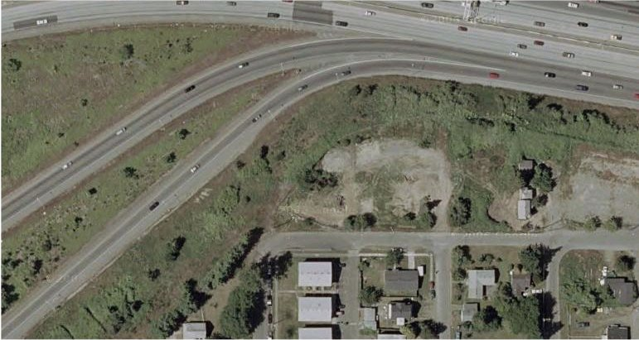
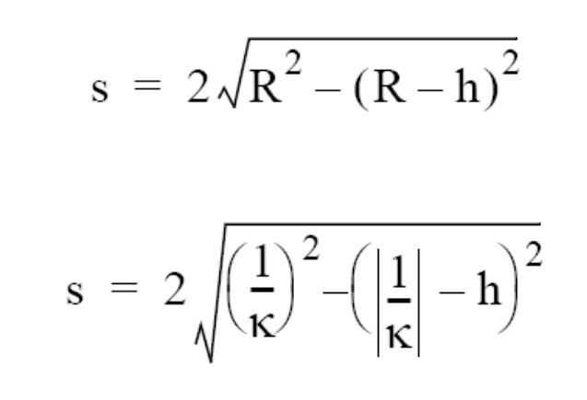
Section 5.1: Shape point density
h = horizontal accuracy
The specification has two formulas. They mean the same thing. The following example uses the top one.
You put two things into the formula: h and R
And the formula spits out one thing: s
R = Distance to the center of the circle that best fits the curve
ADAS requires
1 meter HA for curves, so
h always = 1.
s = Maximum distance between shape points

Slide 5
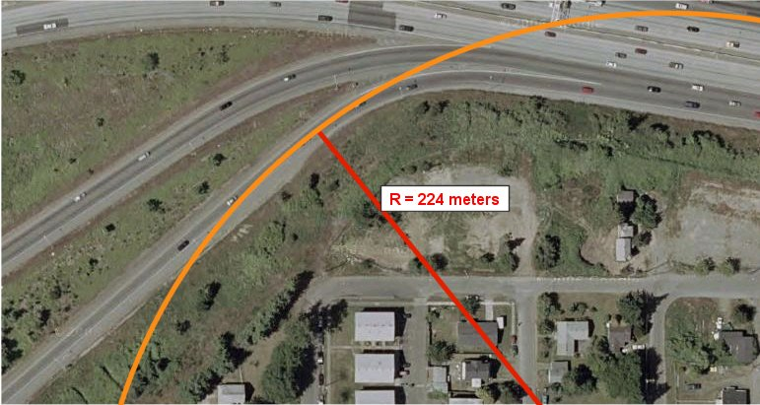
Draw a circle that best fits the first part of the curve. Then measure its radius.

Slide 6
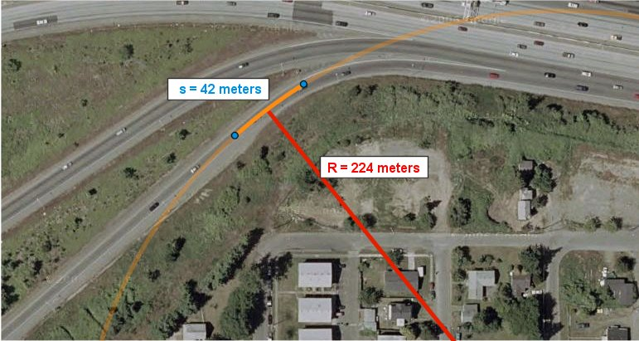
Use the formula to figure out the maximum distance between shape points.

Slide 7
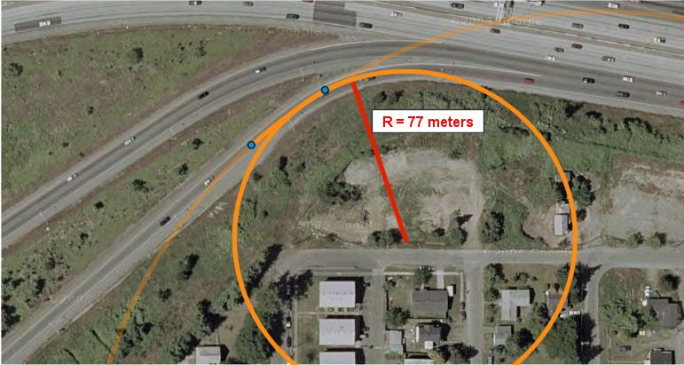
Draw a new circle for the next part of the curve. The curve is sharper so the circle is smaller.

Slide 8
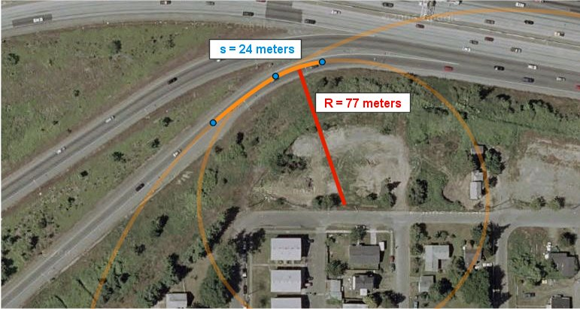
Tighter curves =
Smaller circles =
Shorter distance
between shape points

Slide 9
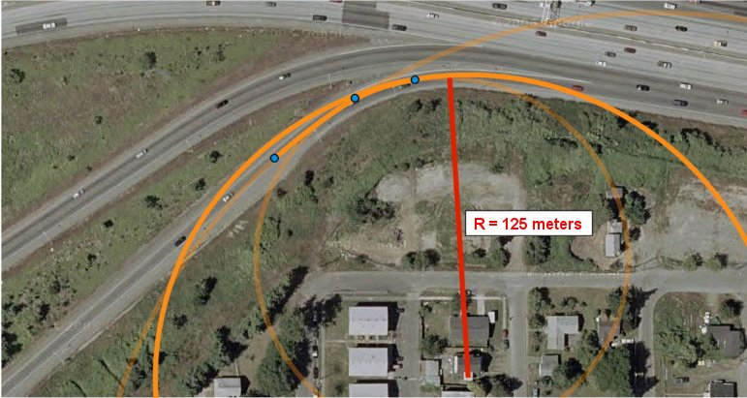
Repeat the process again for the third part of the curve.

Slide 10
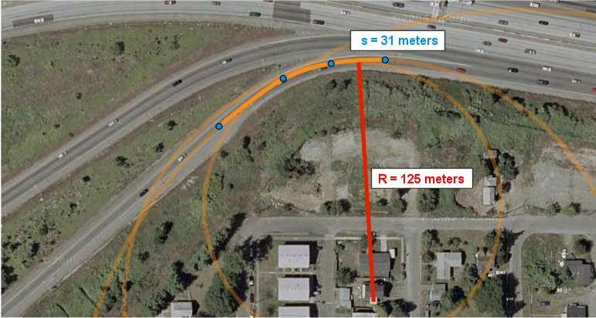
Notice that the distance required is different for each part of the curve.

Slide 11
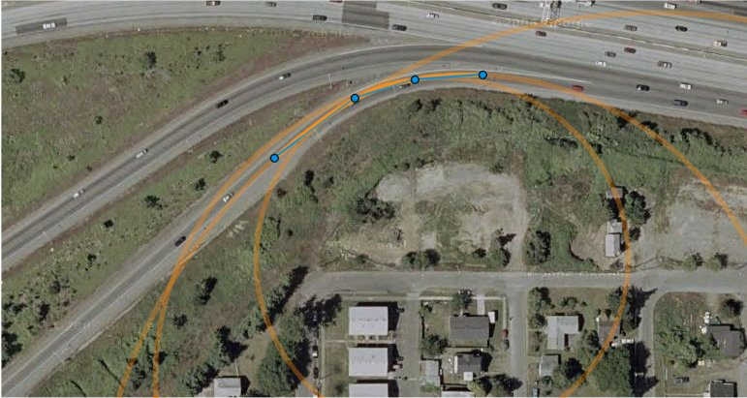
When we connect our shape points now ...

Slide 12
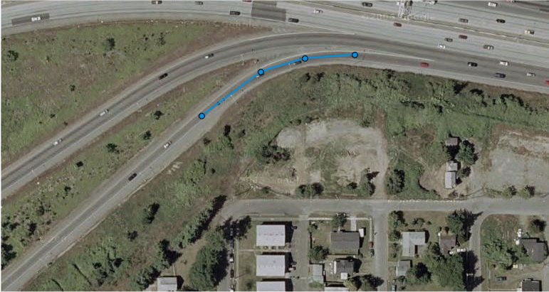
The formula gives us a centerline that just barely meets ADAS requirements.
In the worst parts, the database centerline is 1 meter away from the center of the actual roadbed.

Slide 13
Section 5.1: Shape point density
To recap...
h = horizontal accuracy
The specification has two formulas. They mean the same thing. The following example uses the top one.
You put two things into the formula: h and R
And the formula spits out one thing: s
R = Distance to the center of the circle that best fits the curve
ADAS requires
1 meter HA for curves, so
h always = 1.
s = Maximum distance between shape points

Slide 14
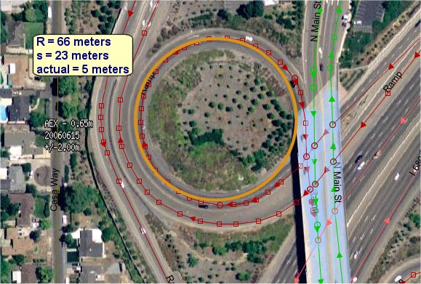
Note the orange line. That is part of the circle that best fits the sharpest part of the curve. Its radius is
66 meters,
which means the maximum distance between shape points is
23 meters.
In the situation shown, the actual maximum distance between shape points is
5 meters.
This means the curve does meet the ADAS requirements for shape point density.

Slide 15
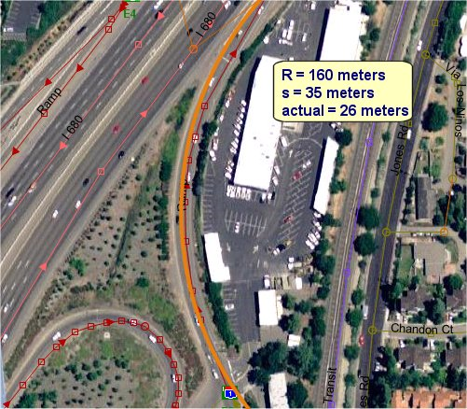
Note the orange line. That is part of the circle that best fits the sharpest part of the curve. Its radius is
160 meters,
which means the maximum distance between shape points is
35 meters.
In the situation shown, the actual maximum distance between shape points is
26 meters.
This means the curve does meet the ADAS requirements for shape point density.

Slide 16
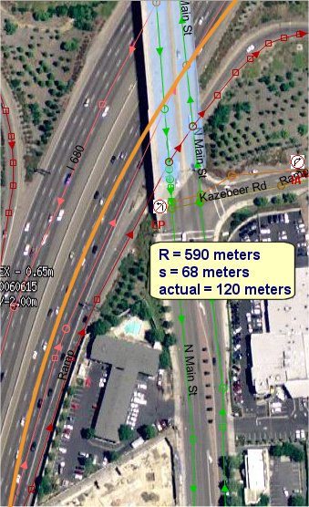
Note the orange line. That is part of the circle that best fits the sharpest part of the curve. Its radius is
590 meters,
which means the maximum distance between shape points is
68 meters.
In the situation shown, the actual maximum distance between shape points is
120 meters.
This means the curve does not meet the ADAS requirements for shape point density.

Slide 17
Topics
Shape Point Density Formula
    Section 5.1: Shape point density
Definition of a Clothoid
    Section 5.2: Smooth transition
Definition of a Tangent
    Section 5.3: Forks with legal separation
The Sign of a Curve
    Figure 79: Forks with legal separation

Slide 18
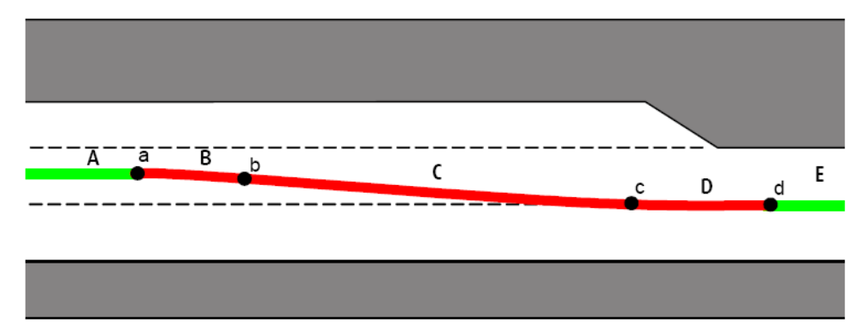
Section 5.2: Smooth transition
The specification requires that transition segments be shaped like clothoids.
What does that mean?

Slide 19
Section 5.2: Smooth transition
Clothoid (n).
a line whose curvature changes at a constant rate; it provides a gentle transition between a straight line and a curve
Clothoid
Curvature is 0
Not a clothoid
Curvature changes from 0 to 0.2 at this point
Curvature is 0
Curvature gradually increases
Curvature is 0.2

Slide 20
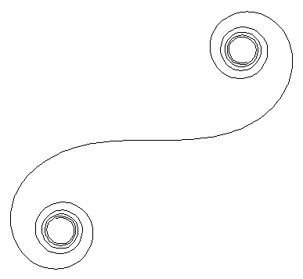
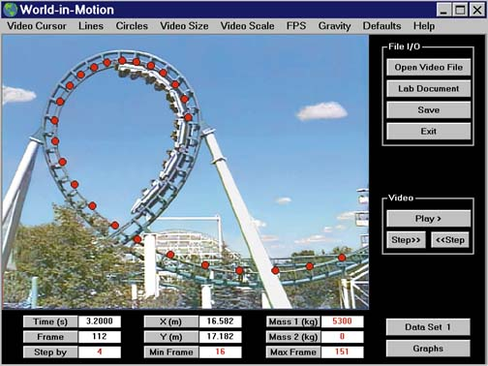
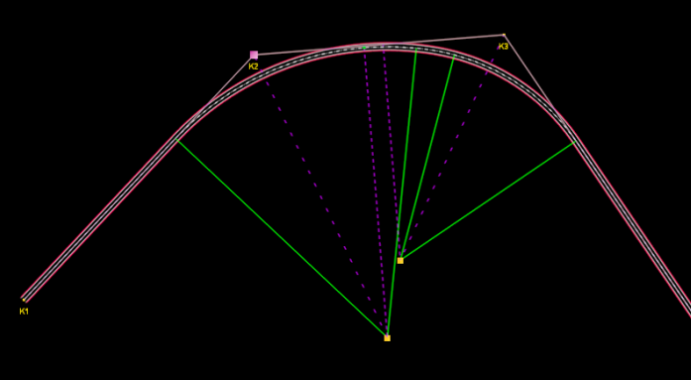
Section 5.2: Smooth transition
These sample clothoids all provide gentle transition between straight lines and curves.

Slide 21
Topics
Shape Point Density Formula
    Section 5.1: Shape point density
Definition of a Clothoid
    Section 5.2: Smooth transition
Definition of a Tangent
    Section 5.3: Forks with legal separation
The Sign of a Curve
    Figure 79: Forks with legal separation

Slide 22
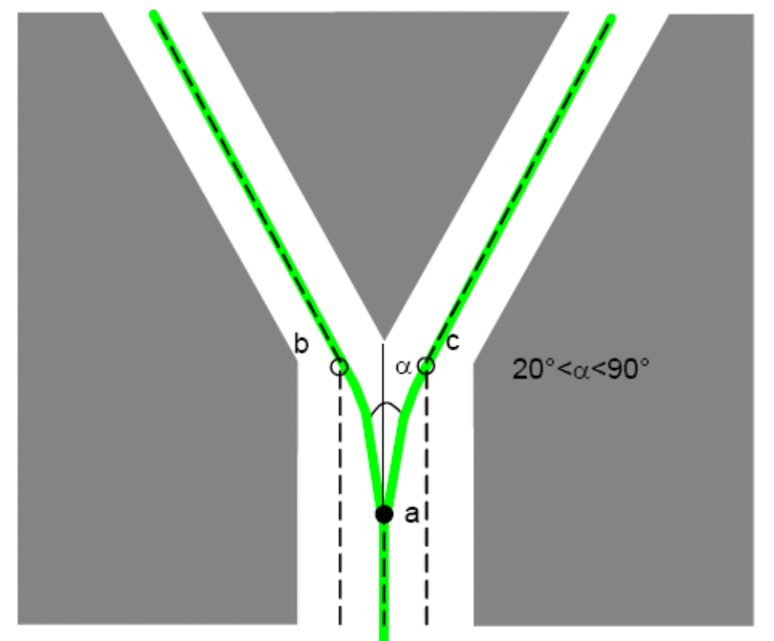
Section 5.3: Forks with legal separation
The specification requires that “the tangent of the curve correspond with the tangent of the centerline.”
What does this mean?

Slide 23
Section 5.3: Forks with legal separation
Tangent (n).
a line that touches a curve only once
Or in the case of a straight line, the line itself could be considered the tangent.

Slide 24
Section 5.3: Forks with legal separation
The tangent of the northwest branch centerline at point b
The tangent of the curve connecting points a and b at point b

Slide 25
Section 5.3: Forks with legal separation
In this scenario, these two tangents are the same.

Slide 26
Section 5.3: Forks with legal separation
Let’s look at a slightly different situation. Instead of a curve between points a and b, now there is a straight line.

Slide 27
Section 5.3: Forks with legal separation
The tangent of the northwest branch centerline at point b
The tangent of the curve connecting points a and b at point b

Slide 28
Section 5.3: Forks with legal separation
Now these two tangents are not the same.

Slide 29
Section 5.3: Forks with legal separation
Gentle curve
Straight line
Compliant: A gentle curve that straightens out before meeting the centerline at point b.
Not compliant: A straight line that meets the centerline at point b.

Slide 30
Topics
Shape Point Density Formula
    Section 5.1: Shape point density
Definition of a Clothoid
    Section 5.2: Smooth transition
Definition of a Tangent
    Section 5.3: Forks with legal separation
The Sign of a Curve
    Figure 79: Forks with legal separation

Slide 31
Figure 79: Forks with legal separation
The specification requires that a certain curve does not “change sign.”
What does this mean?
“... the curve between points a and b, and between a and c, does not change sign.”

Slide 32
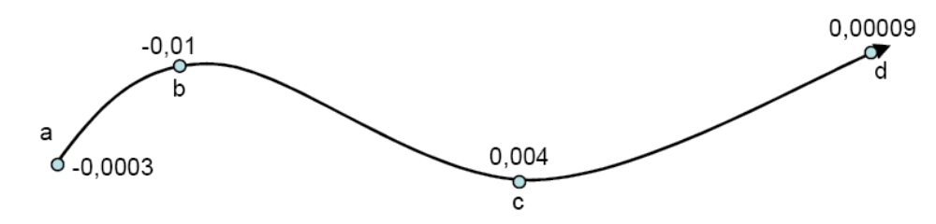
Figure 79: Forks with legal separation
Curvature is a number that describes how sharp a curve is. Larger numbers have sharper curves.
0.004 is larger than 0.00009, and it reflects a sharper curve.

Slide 33
Figure 79: Forks with legal separation
The “sign” of a curve refers to the positive or negative sign in front of the curvature value. (Positive sign is assumed when no plus or minus is displayed.)

Slide 34
Figure 79: Forks with legal separation
Sample curves with
positive sign
Sample curves with
negative sign
0.004
+ 0.004
0.00009
+ 0.00009
- 0.0003
- 0.01
- 0.0415

Slide 35
Figure 79: Forks with legal separation
Curves with a negative sign turn right and curves with a positive sign turn left. (“Right” and “left” relate to the direction of the Road Element.)

Slide 36
Figure 79: Forks with legal separation
We say that this curve “changes sign” because as you travel from the start node to the end node, the curvature number changes from negative to positive.
negative
curvature
positive curvature

Slide 37
Figure 79: Forks with legal separation
This curve does not change sign. It only bends in one direction.
negative
curvature
This curve changes sign. It bends in more than one direction.
positive
curvature
negative
curvature

Slide 38
Figure 79: Forks with legal separation
The specification requires that a certain curve does not “change sign.”
This means that the curve should only bend in one direction.
“... the curve between points a and b, and between a and c, does not change sign.”

Slide 39
Topics
Shape Point Density Formula
    Section 5.1: Shape point density
Definition of a Clothoid
    Section 5.2: Smooth transition
Definition of a Tangent
    Section 5.3: Forks with legal separation
The Sign of a Curve
    Figure 79: Forks with legal separation

Slide 40

Contact
Andy Smith
Specifications Training and Support
Global Specifications
Lebanon x1120
andrew.smith@teleatlas.com

