Slide 1





AI-Based Intelligent ERP
Decision Support System For
Small and Medium Enterprises
(SMEs)
Group 26

Slide 2




Introduction
Project Overview
  AI-based ERP decision support system for Small and Medium Enterprises
  Focuses on inventory management
  Integrates ERP data with Artificial Intelligence
  Helps managers understand current and future inventory conditions
  Provides data-driven recommendations instead of only displaying data
Three Main AI Components
  Machine Learning → Demand Forecasting
  Fuzzy Logic → Inventory Risk Assessment
  Rule-Based Reasoning → Reorder Recommendation

Slide 3




Problem
Limitations of Traditional ERP
Traditional ERP systems can:
  Store product and inventory information
  Record sales transactions
  Display current stock levels
  Manage supplier information
  Provide basic inventory information
However, they may not provide enough intelligent support for:
  Future demand prediction
  Inventory risk assessment
  Supplier lead-time consideration
  Recommended reorder quantities
  Data-driven inventory decisions of stock shortages

Slide 4



How We Solve the Problem
AI-Based Solution
1. Demand Forecasting
Machine Learning
Historical sales data
↓
Predicted Demand
2. Inventory Risk
Fuzzy Logic
Stock + Demand + Lead Time
↓
Risk Level
3. Reorder Recommendation
Rule-Based Reasoning
Demand + Stock + Risk
↓
Reorder Recommendation

Slide 5
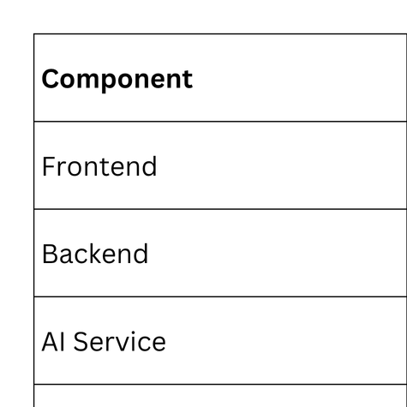
Technologies Used

Slide 6
THANK YOU!

