Slide 1
Dynamic Seat Assignment with Social Distancing
IEDA

Slide 2
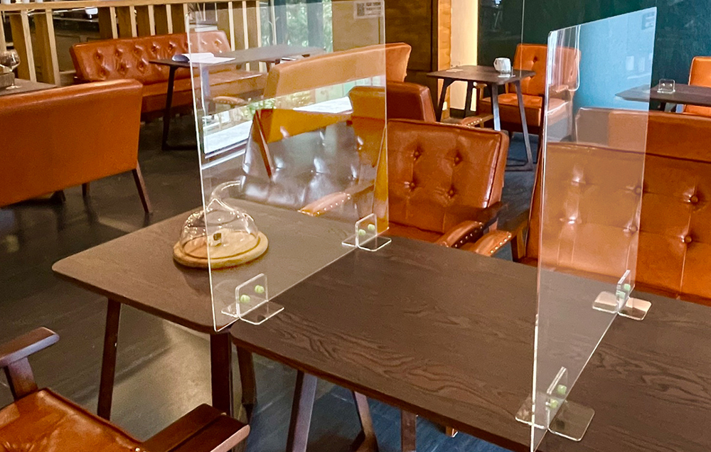
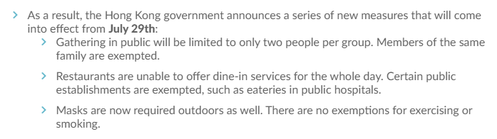
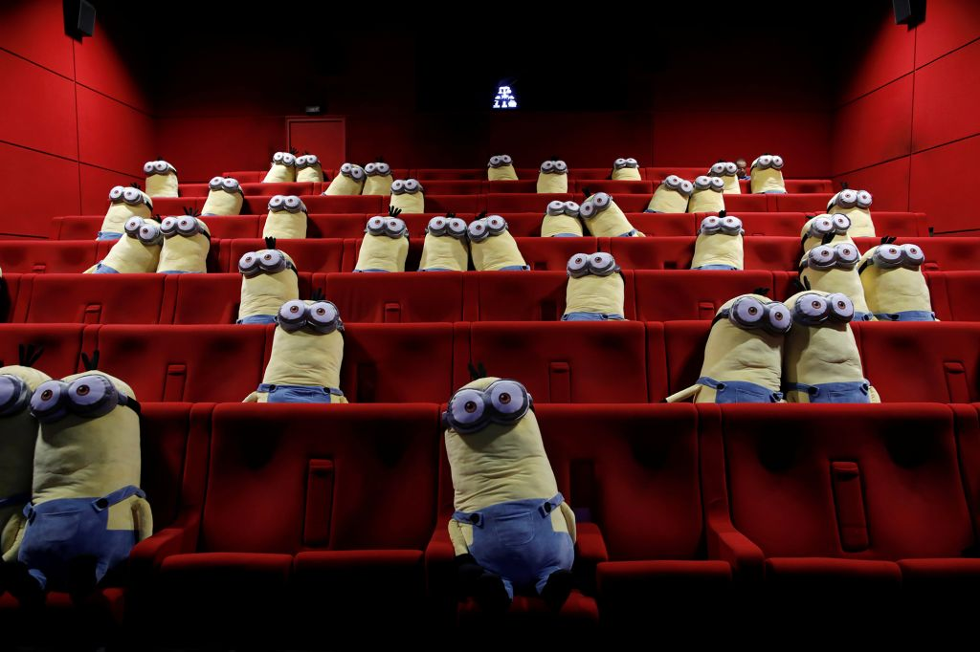
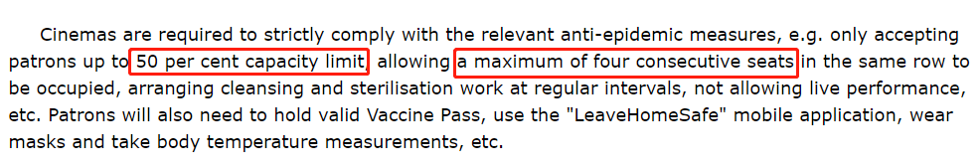
Social Distancing under Pandemic
Governments issued the policy about social distancing constraint.
Theater tickets booking: assign to seat.
Notes:
https://www.info.gov.hk/gia/general/202204/15/P2022041500474.htm

Slide 4
Benders Master Problem
Solutions
Subproblem
Constraints

Slide 5
Seat Planning
New model and technique for stochastic demand
Provide seat planning as a basis for seat assignment
Seat Assignment
New model for seat assignment problem
Provide practical policies and insights
Guidance

Slide 6
S
L
Fixed seat planning
Flexible seat planning

Slide 7
S
L

Slide 8
S
L
or

Slide 9
1 | 2 | 3 | 4 | 5 | 6 | 7 | 8 | 9 | 10
1 | 2 | 3 | 4 | 5 | 6 | 7 | 8 | 9 | 10 | 11
Fixed seat planning
Flexible seat planning

Slide 11
1 | 2 | 3 | 4 | 5 | 6 | 7 | 8 | 9 | 10
1 | 2 | 3 | 4 | 5 | 6 | 7 | 8 | 9 | 10 | 11
Group 1
Group 2
Group 3
Group 4
1 | 2 | 3 | 4 | 5 | 6 | 7 | 8 | 9 | 10
1 | 2 | 3 | 4 | 5 | 6 | 7 | 8 | 9 | 10
1 | 2 | 3 | 4 | 5 | 6 | 7 | 8 | 9 | 10 | 11
1 | 2 | 3 | 4 | 5 | 6 | 7 | 8 | 9 | 10 | 11
Group 1
Group 2
Group 3
Group 4
Type 1
Type 3
Type 1
Type 2

Slide 12
1 | 2 | 3 | 4 | 5 | 6 | 7 | 8 | 9 | 10
Physical seat plan
1 | 2 | 3 | 4 | 5 | 6 | 7 | 8 | 9 | 10 | 11
Model of seat plan
Group 1
Group 2
Group 3
Group 4

Slide 13
1 | 2 | 3 | 4 | 5 | 6 | 7 | 8 | 9 | 10
Physical seat plan
1 | 2 | 3 | 4 | 5 | 6 | 7 | 8 | 9 | 10 | 11
Model of seat plan
Group 1
Group 2
Group 3
Group 4

Slide 14
Fixed seat planning
Seat planning with two rows

Slide 15
Seat planning with two rows
Fixed seat planning

Slide 16
Seat planning with two rows
Fixed seat planning

Slide 17
Largest pattern
(0, 0, 0, 4)
Full pattern
(1, 1, 4, 0)
Largest
Full

Slide 18
Group-type Control
The supply is not sufficient
Find the larger planned seats
Break tie to select one row
Make the decision based on the values of stochastic programming
Group arrivals
The supply is sufficient
Accept directly
Break tie to select one row

Slide 19
Seat
Planning
Arriving Group
Reject
Match
Break Tie to Assign
Break Tie to Assign
Dynamic Programming
Ready to Assign
Not Match
Group-type Control
Reject

Slide 20
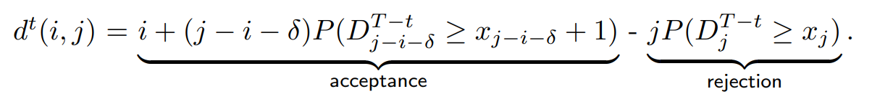
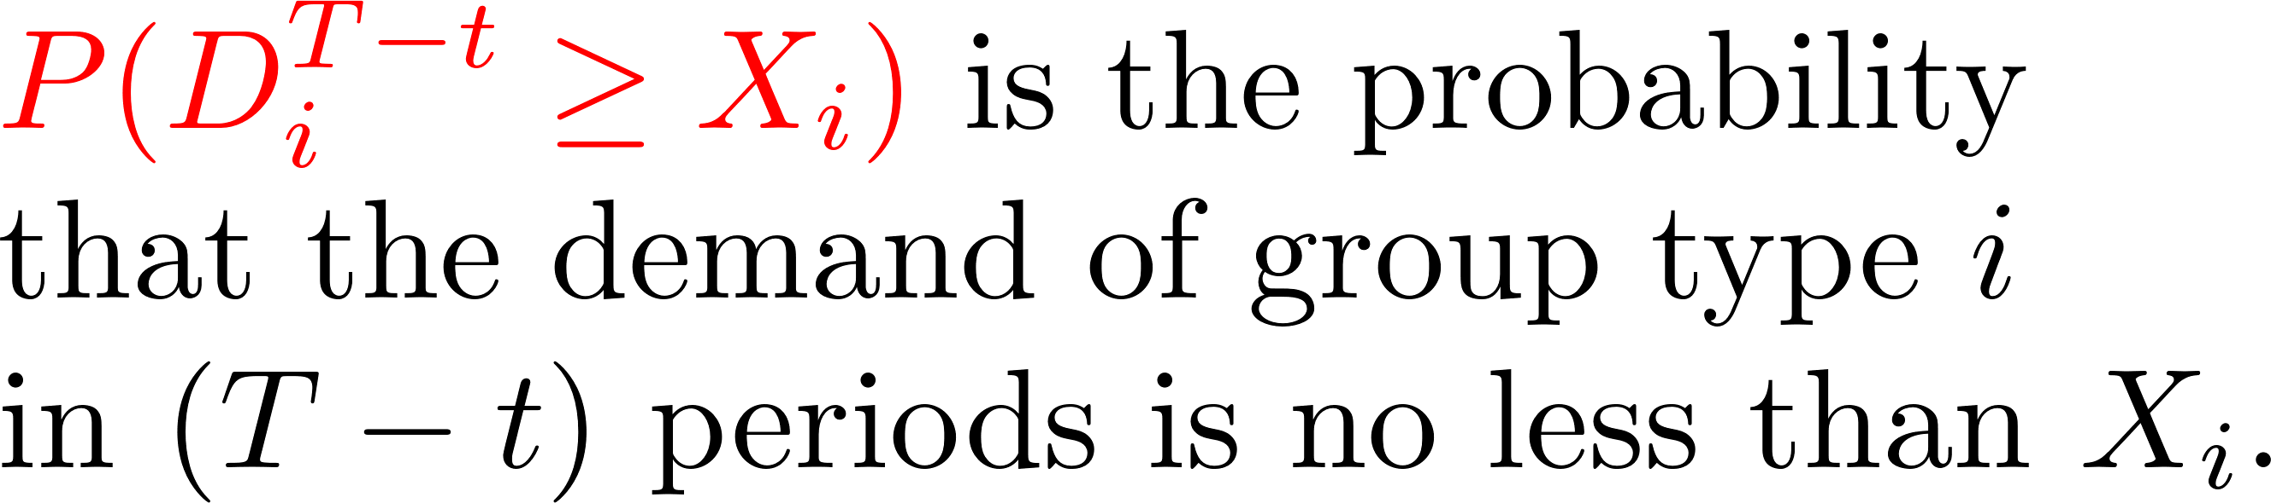
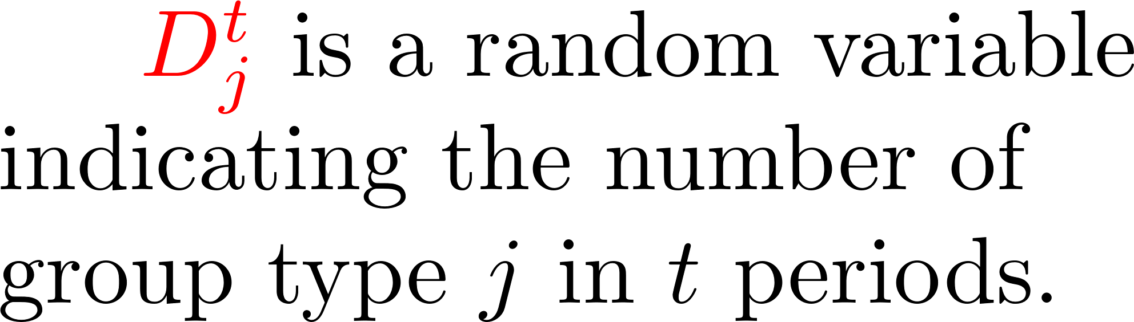
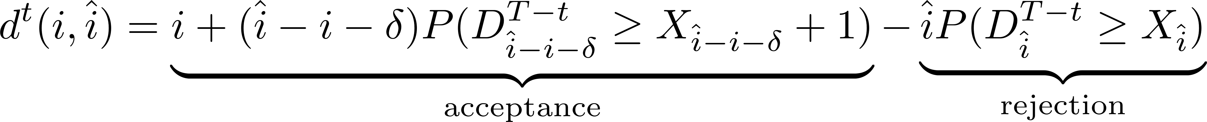
Let $D^t_j$ be the random variable indicates the number of group type $j$ in $t$ periods.
$P(D_{i}^{T-t} \geq x_i)$ is the probability that the demand of group type $i$
in $(T - t)$ periods is no less than $x_i$.
is the probability that the demand of group type i
in (T - t) periods is no less than x_i

Slide 21
A
1 | 2 | 3 | 4 | 5
6 | 7 | 8 | 9 | 10
A
B
1 | 2 | 3 | 4 | 5
6 | 7 | 8 | 9 | 10
B
C
1 | 2 | 3 | 4 | 5
6 | 7 | 8 | 9 | 10
C
D
1 | 2 | 3 | 4 | 5
6 | 7 | 8 | 9 | 10
D
E
1 | 2 | 3 | 4 | 5
6 | 7 | 8 | 9 | 10
E
F
1 | 2 | 3 | 4 | 5
6 | 7 | 8 | 9 | 10
F
G
1 | 2 | 3 | 4 | 5
6 | 7 | 8 | 9 | 10
G
H
1 | 2 | 3 | 4 | 5
6 | 7 | 8 | 9 | 10
H
I
1 | 2 | 3 | 4 | 5
6 | 7 | 8 | 9 | 10
I
J
1 | 2 | 3 | 4 | 5
6 | 7 | 8 | 9 | 10
J
K
1 | 2 | 3 | 4 | 5
6 | 7 | 8 | 9 | 10
K

