Slide 1
Dynamic Seat Assignment with Social Distancing
IEDA

Slide 2
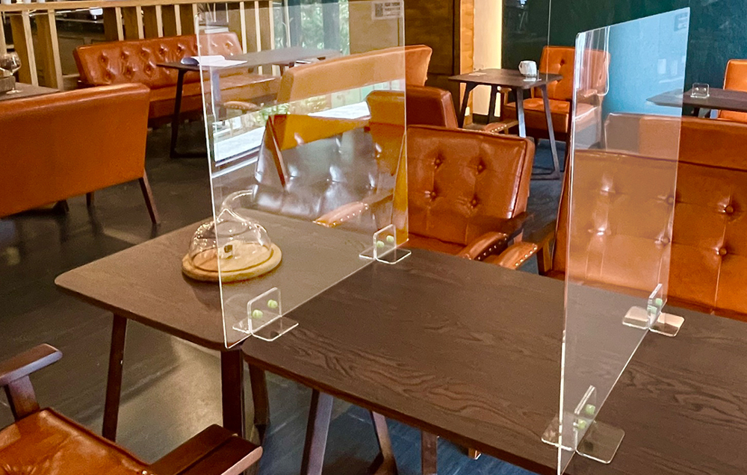
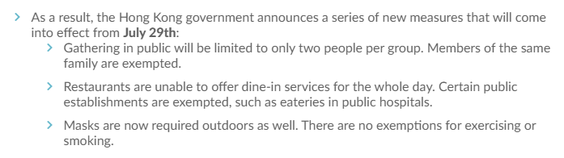
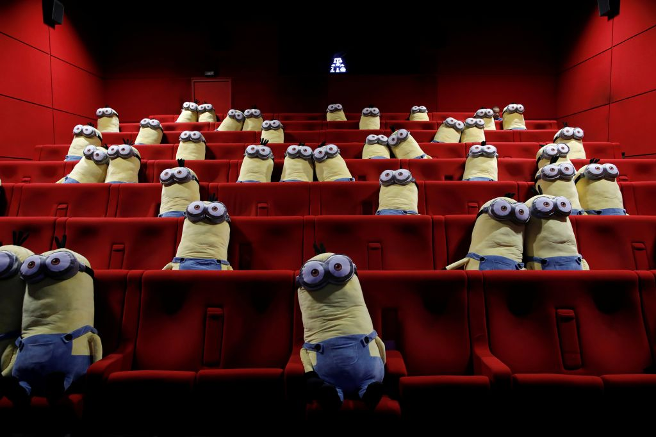
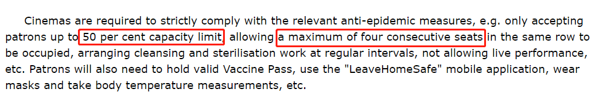
Social Distancing under Pandemic
Governments issued the policy about social distancing constraint.
Theater tickets booking: assign to seat.
Notes:
https://www.info.gov.hk/gia/general/202204/15/P2022041500474.htm

Slide 4
Benders Master Problem
Solutions
Subproblem
Constraints

Slide 5
S
L

Slide 6
9:00-10:30
7:00-8:30
11:00-13:30
depot
depot
8:40-9:30
10:00-10:30
6:00-6:40
k
k
Lb=0,Ub=1
-pj
10:00
10:30

Slide 7
n
Node d
Cost=0
n-k’
Cost=b
k’
9:00-10:30
7:00-8:30
11:00-13:30
depot
depot
Node 0
8:40-9:30
10:00-10:30
Node n+1
6:00-6:40
k
k+n
Lb=Ub=1
10:00
10:30

Slide 8
n
Cost=0
n-k’
Cost=b
k’
9:00-10:30
7:00-8:30
11:00-13:30
depot
depot
8:40-9:30
10:00-10:30
6:00-6:40
k
k+n
Lb=0,Ub=1
-pj
10:00
10:30

