Slide 1
Dynamic Seat Assignment with Social Distancing
IEDA

Slide 2
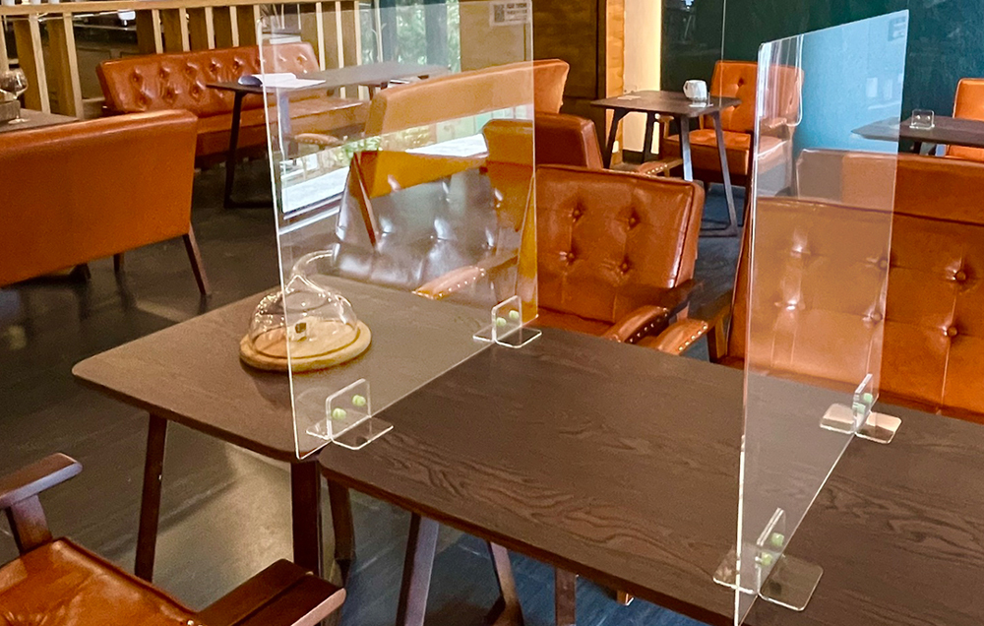
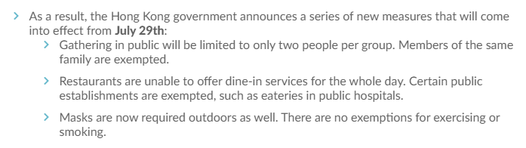
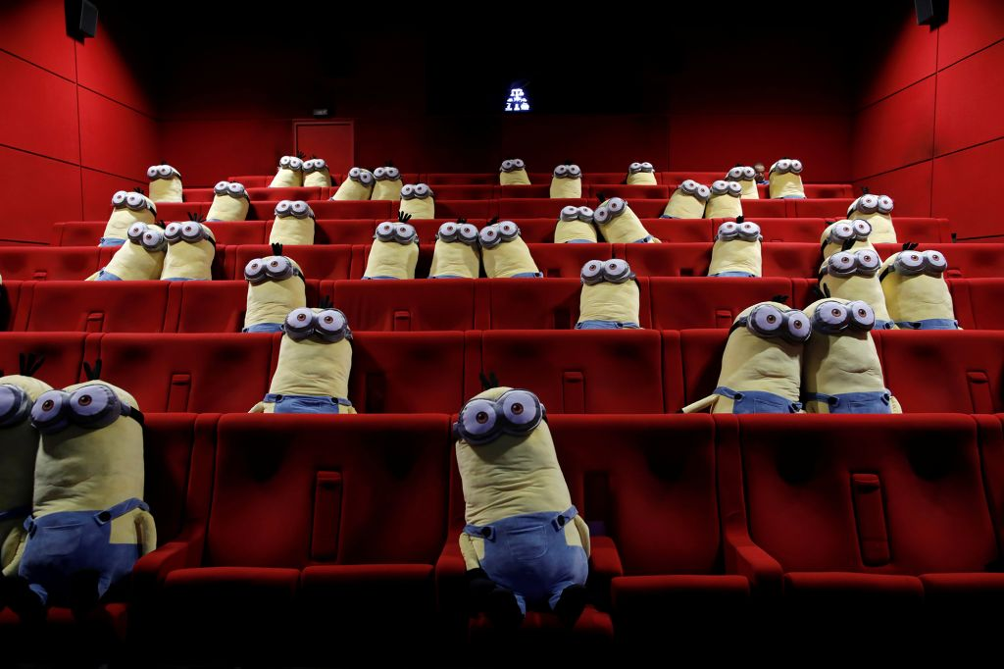
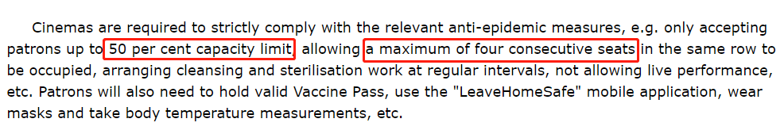
Social Distancing under Pandemic
Governments issued the policy about social distancing constraint.
Theater tickets booking: assign to seat.
Notes:
https://www.info.gov.hk/gia/general/202204/15/P2022041500474.htm

Slide 4
Benders Master Problem
Solutions
Subproblem
Constraints

Slide 5
S
L

Slide 6
The supply is not sufficient
Group-type Control
Break tie to select one row
Values of stochastic programming
Group arrivals
The supply is sufficient
Accept directly
Break tie to select one row

