Slide 1
Dynamic Seat Assignment with Social Distancing
IEDA

Slide 2
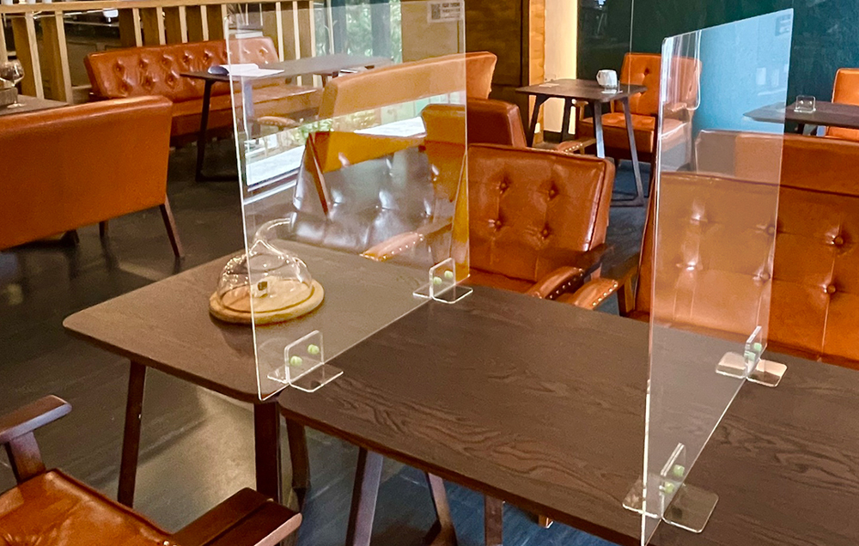
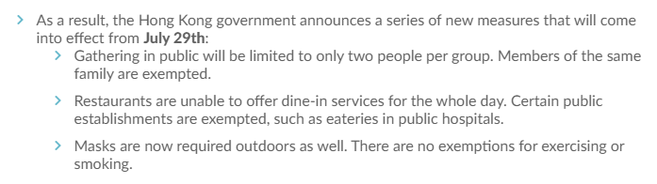
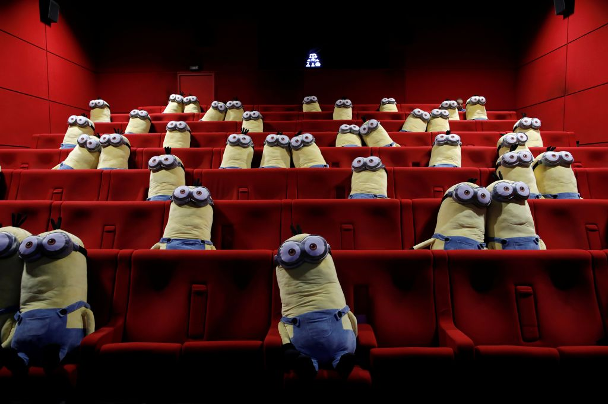
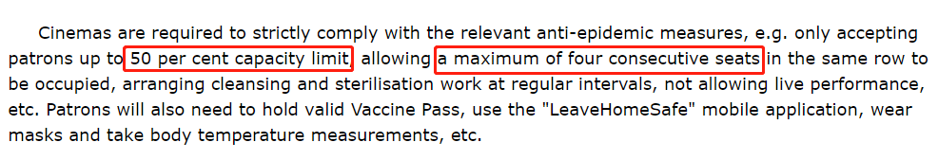
Social Distancing under Pandemic
Governments issued the policy about social distancing constraint.
Theater tickets booking: assign to seat.
Notes:
https://www.info.gov.hk/gia/general/202204/15/P2022041500474.htm

Slide 4
Benders Master Problem
Solutions
Subproblem
Constraints

Slide 5
S
L
Fixed seat planning
Flexible seat planning

Slide 6
S
L

Slide 7
S
L
or

Slide 8
1 | 2 | 3 | 4 | 5 | 6 | 7 | 8 | 9 | 10
1 | 2 | 3 | 4 | 5 | 6 | 7 | 8 | 9 | 10 | 11
Fixed seat planning
Flexible seat planning

Slide 10
1 | 2 | 3 | 4 | 5 | 6 | 7 | 8 | 9 | 10
1 | 2 | 3 | 4 | 5 | 6 | 7 | 8 | 9 | 10 | 11
Group 1
Group 2
Group 3
Group 4
1 | 2 | 3 | 4 | 5 | 6 | 7 | 8 | 9 | 10
1 | 2 | 3 | 4 | 5 | 6 | 7 | 8 | 9 | 10
1 | 2 | 3 | 4 | 5 | 6 | 7 | 8 | 9 | 10 | 11
1 | 2 | 3 | 4 | 5 | 6 | 7 | 8 | 9 | 10 | 11
Group 1
Group 2
Group 3
Group 4
Type 1
Type 3
Type 1
Type 2

Slide 11
Fixed seat planning
Seat planning with two rows

Slide 12
Seat planning with two rows
Fixed seat planning

Slide 13
Seat planning with two rows
Fixed seat planning

Slide 14
Largest pattern
Full pattern
Largest
Full

Slide 15
Group-type Control
The supply is not sufficient
Find the larger planned seats
Break tie to select one row
Make the decision based on the values of stochastic programming
Group arrivals
The supply is sufficient
Accept directly
Break tie to select one row

Slide 16
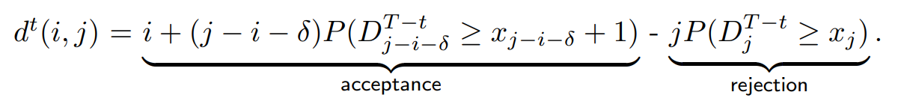
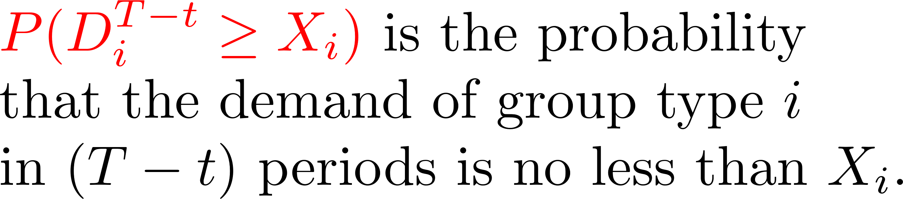
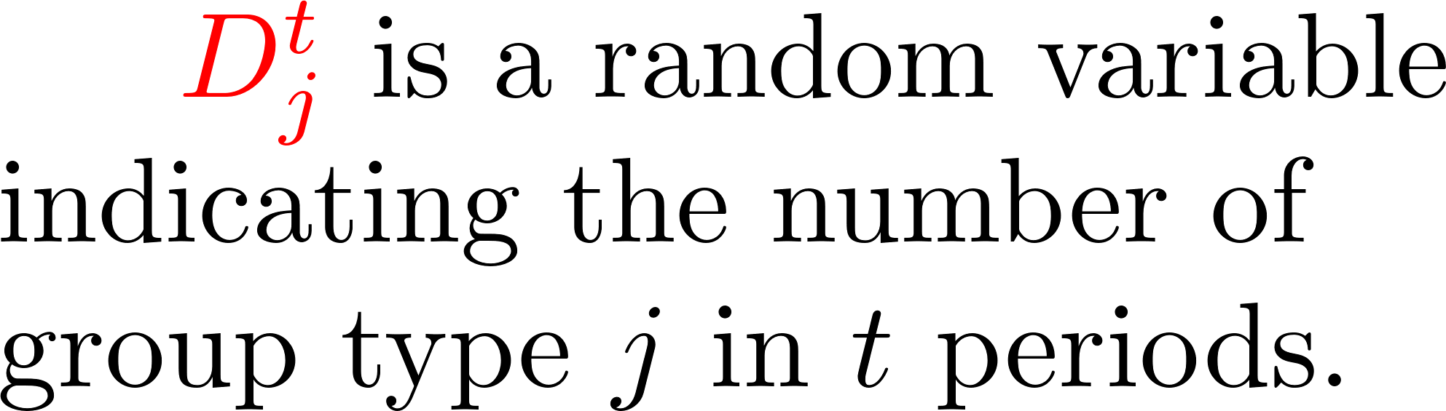
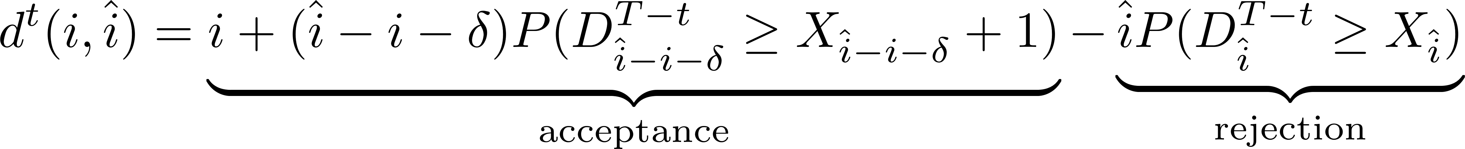
Let $D^t_j$ be the random variable indicates the number of group type $j$ in $t$ periods.
$P(D_{i}^{T-t} \geq x_i)$ is the probability that the demand of group type $i$
in $(T - t)$ periods is no less than $x_i$.
is the probability that the demand of group type i
in (T - t) periods is no less than x_i

