Slide 1
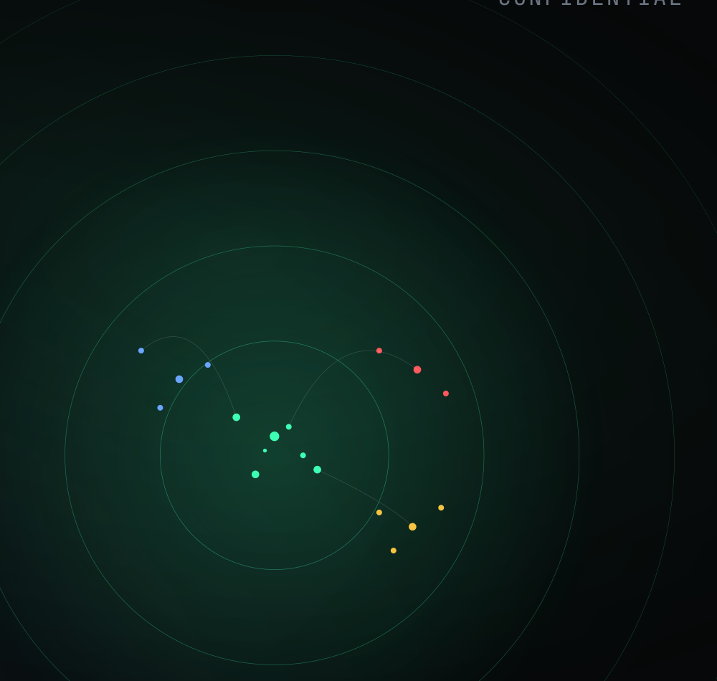
• GHOSTLINE · INSTRUMENT BUILD 04 · APR 2026
CONFIDENTIAL
REAL-TIME GEOMETRIC MONITORING FOR LLM INFERENCE
GhostLine.
Collin Civish / Independent inventor / Pilot & partnership solicitation
001 / 015

Slide 2
• PROBLEM
02 / 15
THE STATE OF THE ART
The black box at inference time.
Every deployed language model is opaque while it computes. We send a prompt, wait for output, and evaluate the text after the fact.
If the model reasons well, we got lucky. If it hallucinates, loops, or goes off-track, we find out from the output — too late to prevent, too opaque to understand.
WHAT EXISTS TODAY
· Static attention heatmaps
· Post-hoc feature attributions
· Probing classifiers, offline
· Behavioral evals, after generation
Research instruments. Designed to explain what already happened — not to monitor what is happening, and never what is about to happen.

Slide 3
• DISCOVERY
03 / 15
THE DISCOVERY
When a transformer processes text, its activations form
When a transformer processes text, its activations form geometric shapes. Reasoning has a different shape than recall. Hallucination has a different shape than honest "I don’t know."
These shapes are readable, reproducible, and — the part that matters — they are determined before the model generates a single word.

Slide 4
• SIGNATURES
04 / 15
FIVE DISTINCT GEOMETRIC SIGNATURES
Reading what the model is doing.
01 / REASONING
02 / RETRIEVAL
03 / CREATIVITY
04 / PRECISION
05 / UNCERTAINTY
High dimensional spread. Structured velocity. Consistent attention.
Concentrated dimensions. Fast convergence. Sequence-start focus.
Widest dimensional spread. Exploratory attention.
Highest per-token focus. Moderate trajectory spread.
Clean geometry, low magnitude — the signature of honest “I don’t know.”
Not post-hoc labels. Predictive signatures that emerge during prompt encoding.

Slide 5
• HEADLINE RESULT
05 / 15
PRE-GENERATION PREDICTION
Behavioral state is decided before the first token.
94
%
On 8B-class transformers, a single forward pass through the prompt — prior to any token generation — predicts the model's behavioral state across five categories.
— Prompt-level grouped cross-validation. Entire prompts held out from training. 23 pp above the next-best text-feature baseline.
FIVE-STATE CLASSIFIER · QWEN3-8B
86.5–91.3%
85.0%
PROMPT-ONLY · QWEN3-8B
PROMPT-ONLY · LLAMA 3B

Slide 6
• HALLUCINATION DETECTION
06 / 15
THREE REGIMES, ONE SIGNAL
Hallucination has its own geometry.
ENSEMBLE · HELD-OUT
REAL-WORLD STRESS · 300 SAMPLES
LIVE RINGER · FRESH HOLD-OUT
0.94
0.94
0.89
F1 with grouped cross-validation on Qwen3-8B.
Manually labeled, drawn from production-like prompts.
Different validation regime, same model — the signal holds.
— Fabrication carries a geometrically diffuse signature distinct from healthy retrieval — eff_dim 67–70 vs 53–55. Not collapse; structurally different.

Slide 7
• VALIDATION
07 / 15
SIX MODELS · FOUR FAMILIES · TWO SCALES
It generalizes — and gets sharper with scale.
Llama 3.2 3B
Llama 3.1 8B
3×
Pythia 2.8B
Qwen 2.5 3B
Gemma 3 4B
Qwen3 8B
GEOMETRIC SEPARATION BETWEEN STATES, 3B → 8B
+new
Velocity-of-representation dominates the classifier at 3B. Attention entropy takes over at 8B.
SIGNAL FAMILIES THAT EMERGE ONLY AT SCALE

Slide 8
• CAUSAL CONTROL
08 / 15
CAUSAL INTERVENTION
Small geometric pushes change what the model says.
BEFORE · COLLAPSE
On Llama 3B, nine anti-momentum perturbations injected at the earliest transformer layer — gated to fire only during detected geometric collapse — broke a deterministic output loop and produced novel content the model was never prompted to produce.
123 123 123 123 123 123 …
↓ 9 PERTURBATIONS ↓
AFTER · LOOP BROKEN
Compared against random-noise controls of equal magnitude, geometric direction outperformed by 9 percentage points. Direction — not just magnitude — carries the causal weight.
Novel, unprompted content — including meta-commentary on its own situation.
— Honest scope: validated at 3B. Collapse threshold doesn't transfer to 8B without recalibration — open work item. Hallucination-specific intervention is an early-stage signal.

Slide 9
• CROSS-ARCHITECTURE FINDING
09 / 15
THE CHAIN-OF-THOUGHT DISCOVERY
Thinking is itself a geometric self-intervention.
QWEN3-8B · THINKING ON
QWEN3-8B · THINKING OFF
LLAMA 3.1 8B · NO THINKING MODE
Hallucination resistance is training-dependent, not scale-dependent.
~0%
90%
78%
Same weights. Same prompts. Toggling structured reasoning reshapes prompt-time activation geometry away from the hallucination basin.
fabrication rate
fabrication rate
fabrication rate

Slide 10
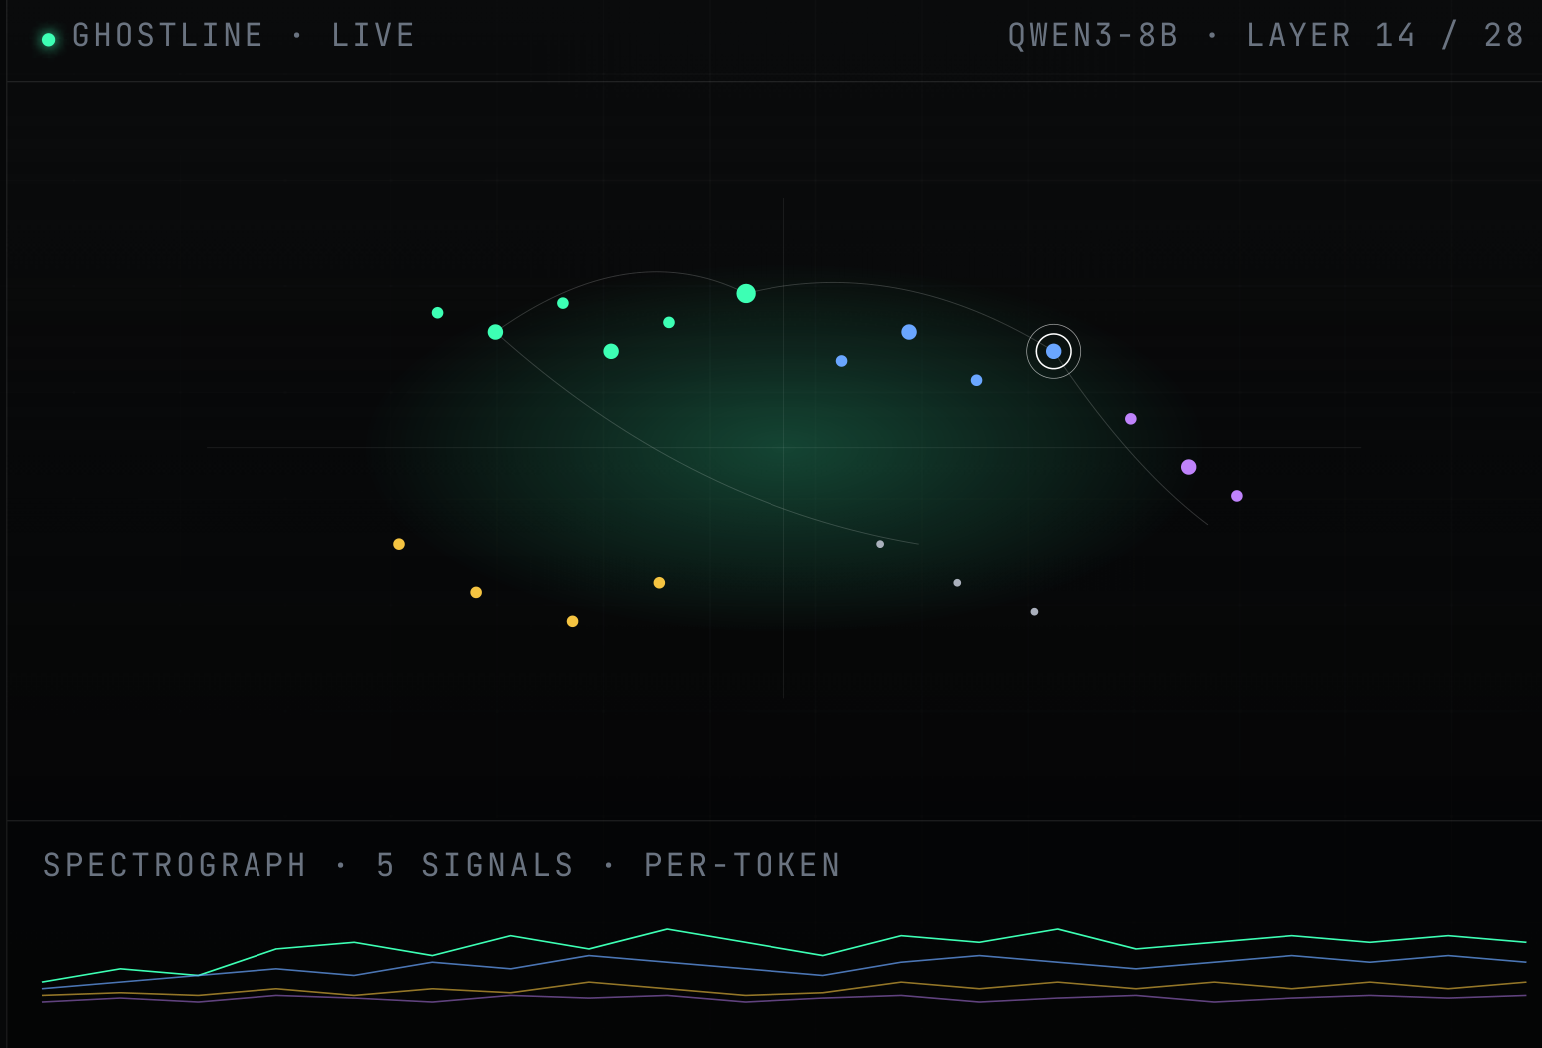
• THE INSTRUMENT
10 / 15
A WORKING PROTOTYPE
Watch the model think, in real time.
WHAT YOU SEE
Tokens, positioned by activation geometry
Attention arcs to attended context
Spectrograph: 5 per-token signal streams
Depth explorer: layer-by-layer traversal
PROJECTION · SCL
75–90 linear params per layer
~100× faster than UMAP
Trajectory fidelity r = 0.977 @ 3B
AVAILABLE NOW

Slide 11
• APPLICATIONS
11 / 15
FIVE BUCKETS · ORDERED BY DEPLOYMENT READINESS
Where it earns its keep.
01 /
Compliance & audit trails
READY
Per-token behavioral state classification with replayable trajectory logs. Aligned to EU AI Act Articles 9 & 12 and the NIST AI Risk Management Framework.
02 /
Inference economics
READY
Pre-generation prediction makes routing decisions before any output exists. Gate expensive chain-of-thought on prompts that need it. Drop-in routing layer.
03 /
Defense & adversarial robustness
RESEARCH
Geometric monitoring is content-independent. Adversaries can craft text that bypasses content filters, but cannot easily control the geometry of internal computation.
04 /
Model development
RESEARCH
Compare fine-tunes objectively by behavioral-state separation, not benchmarks. Training-time drift detection. Custom domain classifiers.
05 /
Research & education
TODAY
The first instrument that makes transformer computation visually intuitive in real time. Six annotated recordings ship today.

Slide 12
• INTELLECTUAL PROPERTY
12 / 15
FOUR FILED US PROVISIONAL PATENTS
A protected stack across the system.
P1
DEC 2025 · US 63/948,867
P2
FEB 2026 · US 63/975,787
Real-Time High-Fidelity Visualization
Geometric Monitoring & Intervention
The instrument and 3D rendering pipeline.
The intelligence layer — classification and causal control.
P3
FEB 2026 · US 63/982,900
P4
APR 2026 · US 64/039,169
Interactive Spectrographic Interface
Proprioceptive Inference Training System
27 claims · 22 figures. Passed legal review on first attempt.
Training models to monitor their own internal state.

Slide 13
• THE INVENTOR
13 / 15
SOLO · INDEPENDENT · SELF-FUNDED
One person. Four months. Four patents.
CC
US Army veteran. Independent inventor. No team, no external funding. Trajectory from first experiment to four provisional filings in under four months.
COLLIN CIVISH
—
Self-correction filing one day after P2 — flagged statistical errors before any non-provisional.
—
March 2026 audit — a comprehensive claim-verification pass that downgraded several specific magnitudes.
—
Both filings are public record — epistemic discipline is part of the artifact.

Slide 14
• STATUS & ASK
14 / 15
WHAT WE HAVE · WHAT WE NEED
Ready for pilots, capital, and partners.
WHAT EXISTS TODAY
WHAT WE'RE ASKING FOR
· Working prototype with live 3D visualization
Pilot partners
· Validation across 6 models, 4 architecture families
Self-hosted-model deployments where geometric monitoring earns its keep — compliance, inference cost, hallucination reduction. 30-day instrumentation pilot or 3–4 week custom-classifier engagement.
· 4 filed US provisional patents
Capital
· 6 annotated demo recordings on the public site
Extend validation to 70B-parameter models. Harden the production stack.
· Two structured pilot offerings, designed and ready
Strategic introductions
Compliance buyers and inference-economics buyers, specifically.
— Honest scope: every result is on hookable models. Closed APIs without internal access need a different deployment story. Several specific magnitudes were audited downward in February — corrections are documented and reflected throughout this deck.

Slide 15
GHOSTLINE
Read the geometry.
Read the future.
A real-time monitoring instrument for what your model is about to do.
Collin Civish · Independent inventor · ghostline · 2026
015 / 015

