Slide 1

Computer Programming
My Home Page
My Paper

Slide 2

Job Description
Computer programmers write, test, and maintain the detailed instructions, called programs, that computers must follow to perform their functions.
Programmers also conceive, design, and test logical structures for solving problems by computer.

Slide 3

Working Conditions
Programmers generally work in offices in comfortable surroundings.
Many have to work long hours or weekends to meet deadlines.

Slide 4

Earnings
Median annual earnings of computer programmers in 2004 was 62,000.
The middle 50 percent earned between $47,000 to $81,000 a year.
The lowest 10 percent earned less than $37,000 and while the highest 10 percent earned more than $100,000 a year.
So becoming a programmer you can earn pretty good money if you like what you are doing.

Slide 5
Education
67 percent of computer programmers held a college or higher degree in 2004.
Nearly half held a bachelor’s degree and about 1in 5 held a graduate degree.
Most programmers hold their degree in computer science, mathematics, or information systems.
Programmers should also be able to configure databases such as Oracle and Sybase.
In addition they should understand different languages used such as java, C++, or ACTOR.

Slide 6
Programming Languages
Programmers use different languages depending on the purpose of the program.
Examples are:
COBOL is commonly used for business applications
C++ is widely used for both scientific and business applications
For web design J2EE (Java 2 Platform) is used to write the different designs on the web.

Slide 7
Some of the Top Languages Used
C++
Visual C+++
Visual Basic
Java
Perl
HTML
Ada
PowerBuilder
FORTRAN
COBOL
Details on different languages.
Perl (Practical Extraction and Report Language) are scripts that take input from a form on a web page, process it in someway (maybe save it in a database or file, or do some calculations on it), and finally produce a page of HTML code on the fly.

Slide 8
Details on different languages continued.
Java is probably one of the most used languages in electron devices.
It can be found in cell phones, PC’s, network devices, ecommerce systems and many more applications.
Java is a programming language developed by Sun Microsystems in 1995. It was originally designed for programming small computing devices but now in industry computers.
Java produces bytecode that can be interpreted on any platform and is supported in Windows, UNIX/Linux and Solaris.
C++ is a high level object-oriented programming (also referred to as OOP) language that builds on the C language. It contains everything that C does, and adds the power of OOP.
C++ is being used to extend and build on what is already there. For example the Microsoft Foundation Classes provide a C++ interface to the Windows Application Programming Interface.

Slide 9
Networking
In computing, network programming involves writing computer programs that communicate with other programs across a computer network. The program initiating the communication is client, and the program waiting for the communication to be initiated is the server. By doing so, a communication link called a connection is established.
Computer networking is the scientific and engineering discipline concerned with communication between computer systems. Such networks involve at least two devices capable of being networked with at least one usually being a computer. The devices can be separated by a few meters (e.g. via Bluetooth) or thousands of kilometers (e.g. via the Internet).

Slide 10

Artificial Intelligence
AI (artificial Intelligence) work includes everything from planning and searching for solutions (for instance, solving problems with many constraints) to machine learning. There are areas of AI that focus on building game playing programs for chess and go. Other planning problems are of more practical significance--for instance, designing programs to diagnose and solve problems in a spacecraft or medicine.
AI also includes work on neural networks and machine learning, which is designed to solve difficult problems by allowing computers to discover patterns in a large set of input data.
AI also includes work in the field of robotics (along with hardware and systems).

Slide 11
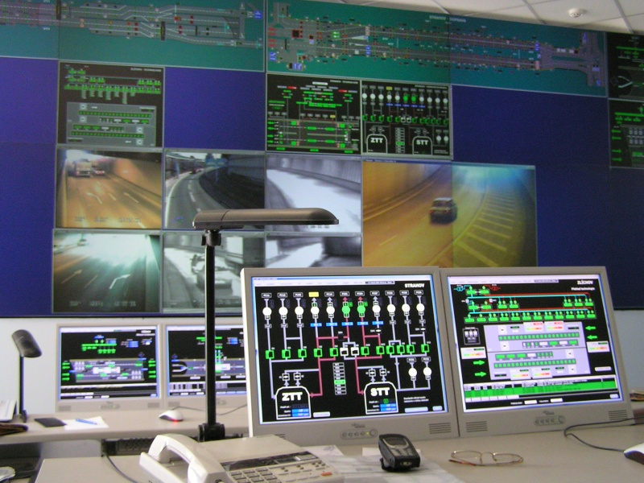
Systems
Systems work deals with building programs that use a lot of resources and profiling that resource usage. Systems work includes building operating systems, databases, and distributed computing, and can be closely related to networking.
The design, implementation, and profiling of databases is a major part of systems programming, with a focus on building tools that are fast enough to manage large amounts of data while still being stable enough not to lose it. Sometimes work in databases and operating systems intersects in the design of file systems to store data on disk for the operating system.

