Slide 1
Unit 2
Basic Syntax

Slide 2

let Bindings
The let keyword gives you the ability to associate an identifier to a value or function
Values
Primitives
Objects
Functions
Identifiers
For the most part follows the same rules as C#.
Can use double backticks to allow spaces. Useful for unit test names

Slide 3
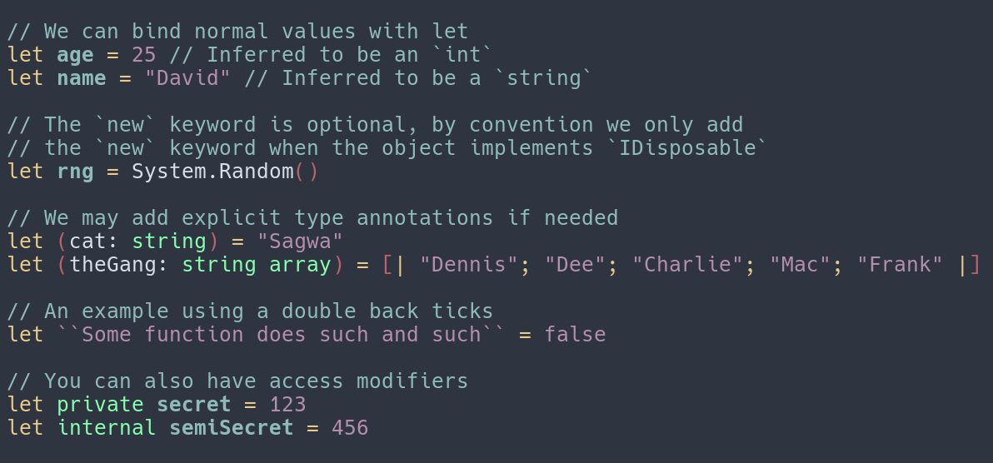

Slide 4
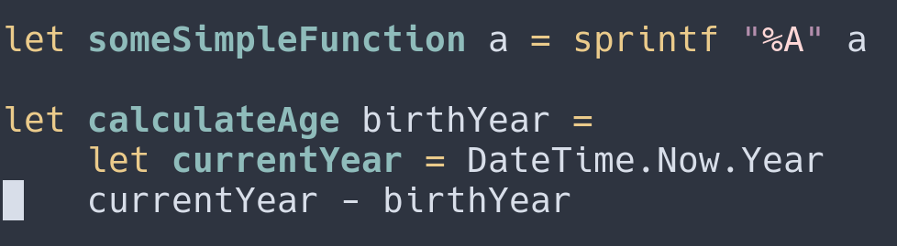
Defining functions with let

Slide 5
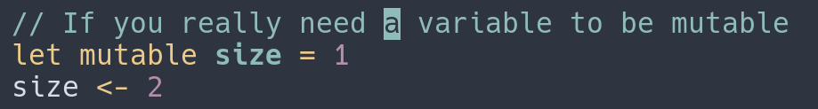
More about let
Let binding is immutable by default, where C#’s var is mutable.
The order of declarations matter, you may only reference things that were declared before it.
Allows shadowing, which is useful for FSI.
Public by default
Static

