Slide 1


Song Recommendation Engine
Ryan Mc Neil
Golvis Tavarez

Slide 2
Background & Research Question
Song recommendation engines are integral to modern audio streaming platforms.
Traditional methods include collaborative filtering and content-based filtering.
Recent advances incorporate deep learning methods. Particularly, Convolutional Neural Networks (CNNs) have come to the fore as powerful methods for analyzing audio features and capturing complex patterns in audio data.
Altogether, these systems serve to enhance user engagement and uncover new musical preferences.

Slide 3
Collaborative Filtering
Collaborative filtering (CF) is a technique used int recommendation systems that predicts user preferences based on the preferences or activity of other users.
CF operates under the assumptions that if users have shown similar tastes in the past, they are likely to agree on future preferences.
Collaborative filtering can user-based, recommending items by looking at the preferences of similar users, or item-based, identifying items that are frequently interacted with together.
Collaborative filtering can also be memory-based (user-based or item-based nearest-neighbor methods), or model-based (using matrix factorization and SVD).

Slide 4
Our Collaborative Filtering Model
A User-Item Interaction Approach
Similarity Matrix Calculation
Calculate cosine similarity between songs using audio features
Create a matrix representing song-to-song similarities
User-Based Recommendation Generation
Recommendation Generation:
Identify user's listened tracks
Calculate average similarity to other songs
Sort and filter recommendations
Return top N personalized suggestions
¹Data source: https://www.Kaggle.com/datasets/deepshah16/song-lyrics-dataset
Notes:
Our approach centers on two main components: calculating song similarities and generating personalized recommendations based on user listening history.First, we create a similarity matrix using cosine similarity between songs based on their audio features. This matrix represents how musically similar each song is to every other song in our database.
Then, to generate recommendations for a user, we:
Look at the songs they've already listened to
Use our similarity matrix to find songs that are similar to their listened tracks
Calculate an average similarity score for each potential recommendation
Sort these scores and filter out songs the user has already heard
Finally, we return the top N songs as our recommendations
This approach allows us to provide personalized suggestions that balance familiarity with discovery, introducing users to new music they're likely to enjoy based on their listening history and the musical characteristics of the songs.
Share
Rewrite

Slide 5
TF-IDF
Term Frequency-Inverse Document Frequency (TF-IDF) is a technique used in text analysis to evaluate the importance of a word in a document relative to a collection of documents. In short, for a given work, TF counts the occurrences of a word in a document and IDF counts the inverse of its occurrences across the corpus, reducing the importance of words that are common across many documents.
In text classification TF-IDF transforms textual data into numerical vectors, allowing computation of similarity for classification and comparison based on content.

Slide 6
Encoder Models
Encoder models (like BERT or GPT) are neural network models designed to “understand” textual data. These models encode text into dense vector representations, capturing semantic information in a way that TF-IDF cannot.
Encoder models enable more nuanced text comparison and excel in capturing the relationship between words and their context within sentences.

Slide 7
Our TF-IDF/Encoder Model
Preprocssing
Transform data
Recommend Songs
For TF-IDF we use TF-IDF vectorizer to create a sparse matrix of terms by documents.
For an encoder (we use BERT), we encode the lyrics data to embeddings & convert those to tensors.
Sample data [2]
Index: Concatenation of song & artist
Document: Song lyrics text
Drop duplicates (lives, edits)
Tokenize w/ stopwords including vocalizations.
For TF-IDF calculate cosine similarity between documents to produce a similarity matrix.
For Encoder model create a matrix of embeddings, then calculate the cosine distance between vector embeddings.
Recommend the top n songs by cosine similarity.
²Data source: https://www.Kaggle.com/datasets/deepshah16/song-lyrics-dataset

Slide 8
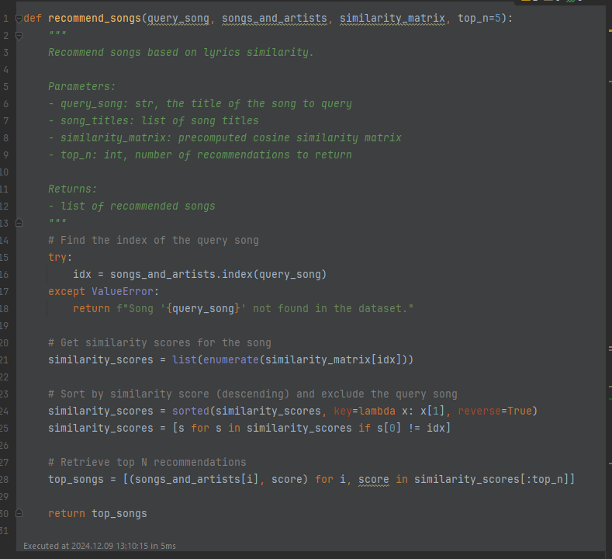
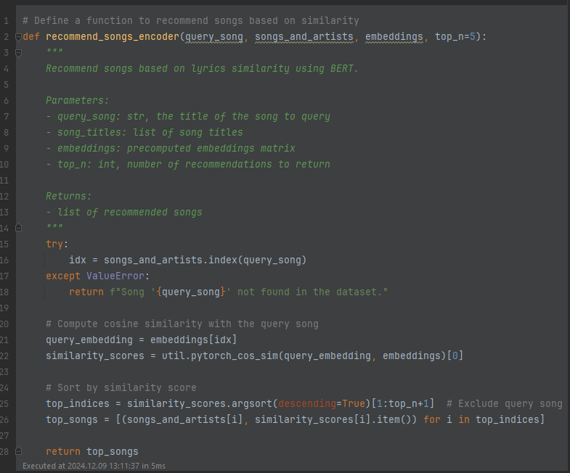
Our TF-IDF/Encoder Model
TF-IDF-based Model
Encoder-based Model

Slide 9
Our TF-IDF/Encoder Model
The TF-IDF-based model seems weaker. Cosine similarities tend to be a maximum of ~0.25.
The embedding model recommends songs with cosine similarities upwards of ~0.5.
Embedding models are likely better for this sort of task given the value of semantic meaning in music, versus exact verbiage.
Once the data is processed, recommendation time is very quick for both models.
In production, simply storing the embedding matrix would take up an unreasonable amount of memory to store:
Memory = # of embeddings * vector size * size of each value (bytes)
For an embedding vector of 768, the total songbase of Spotify (~100 million songs) [3], and 4 bytes per value:
100,000,000 * 768 * 4 = 307.2 GB
But the similarity matrix would take up:
100,000,000² * 4 bytes = 40PB
We could instead:
Rather than recomputing the entire matrix, the system could compute similarities dynamically for specific queries, with candidates determined by collaborative filtering or the CNN model outputs.
Shrink very small values to 0 and employ sparse matrices.
Switch from 32-bit floats (4 bytes) to 8-bit integers (1 byte) with some processing.
Distribute this smaller matrix & associated operations using RDDs.
For commercial servers, any size under ~512GB would be reasonable for RAM.

Slide 10
Convolutional Neural Networks
Convolutional Neural Networks (CNNs) were originally designed for image processing. Have been adapted for audio analysis. Effective at learning high-level semantic representations of audio.
CNNs process audio data that has been transformed into spectrograms, which visually represent sound frequencies over time. Other features, like pitch & timbre are extracted by the convolutional layers.
Useful for a variety of audio processing tasks, these models are employed by services like Spotify to compare audio tracks for similarity for the purpose of recommending.

Slide 11
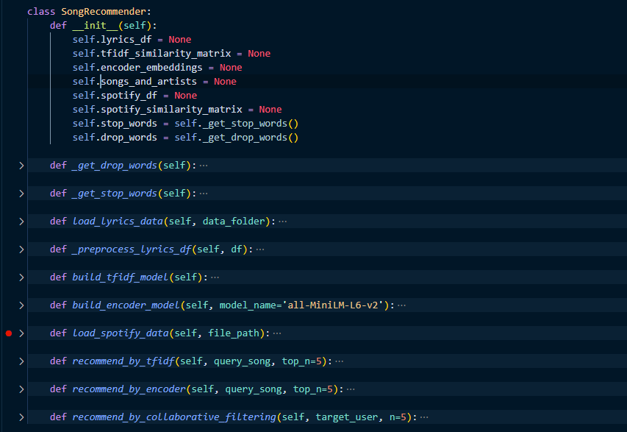
Combine Class

Slide 12
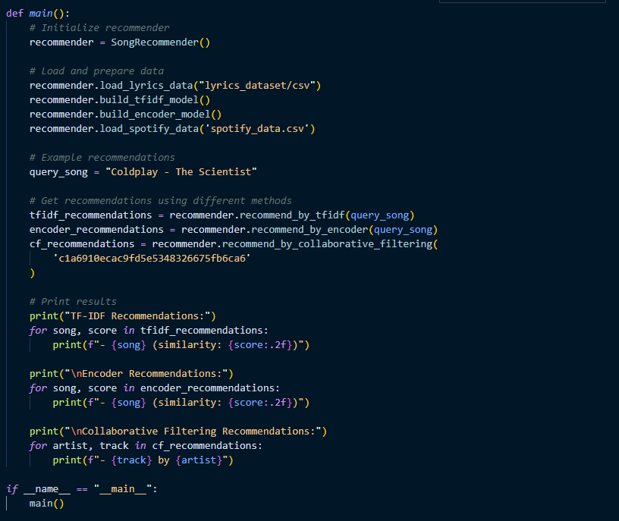

Slide 13
Hypothetical Design
2D CNN Audio Recommendation
(A)
Normalize and combine similarity scores.
Weight by model if we value one model’s recommendations over others.
Return top K
Return A∪B w/ scores
Weight songs in A∩B
Lyrics-based Recommendation
(C)
Collaborative Filtering
(B)

Slide 14
Questions

Slide 15
Works Cited
Pandya, M. (2022). Spotify Tracks Dataset. Kaggle. https://doi.org/10.34740/KAGGLE/DSV/4372070
Shah, D. (2018). “Song Lyrics Dataset.” Kaggle. https://www.Kaggle.com/datasets/deepshah16/song-lyrics-dataset/
Spotify. (2024). “Company Info.” Spotify Newsroom. https://newsroom.spotify.com/company-info/

