Slide 1
CPSC 462: Metube
Group: U5, Thomas Cannon
Dr. James Wang
CPSC 462 Project

Slide 2
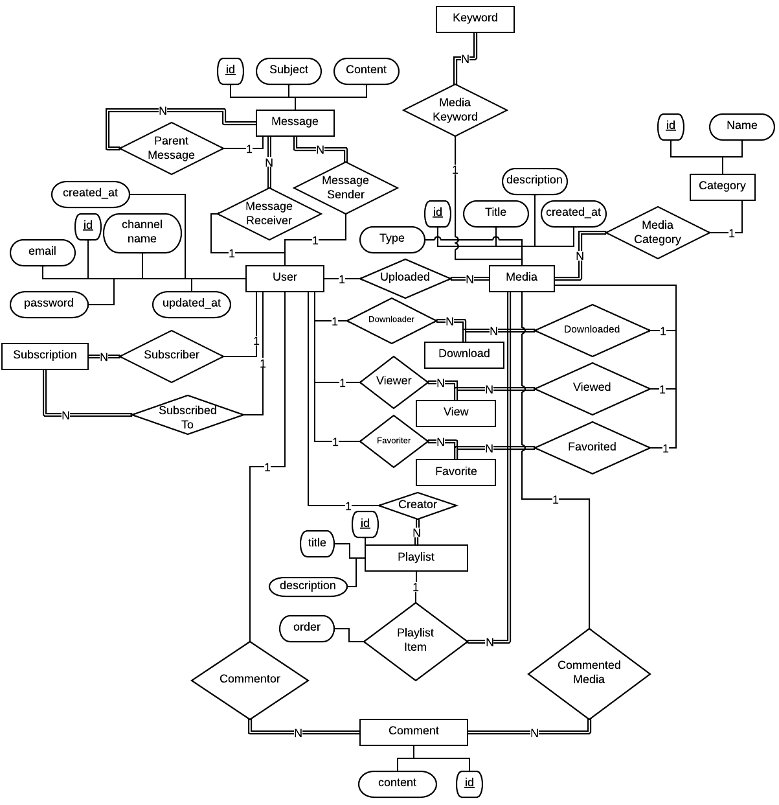
ER Diagram

Slide 3
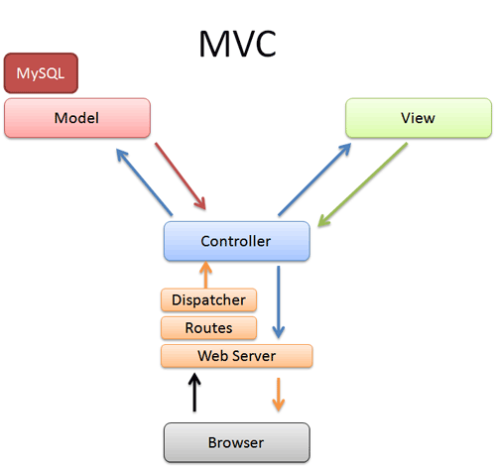

Design: Model-View-Controller
Benefits
Cleaner Code
Separation of Concerns
Easier to refactor
Testability
Modularity
Disadvantages
Complex Structure
Lots of files

Slide 4
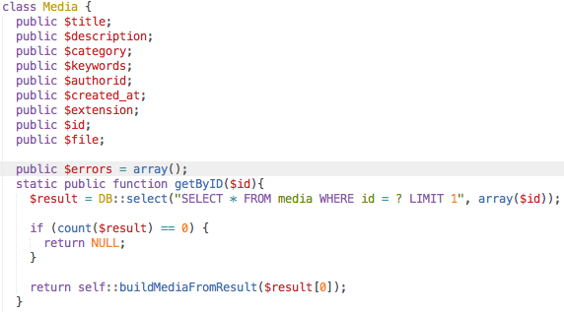
MVC Example: Model Code

Slide 5
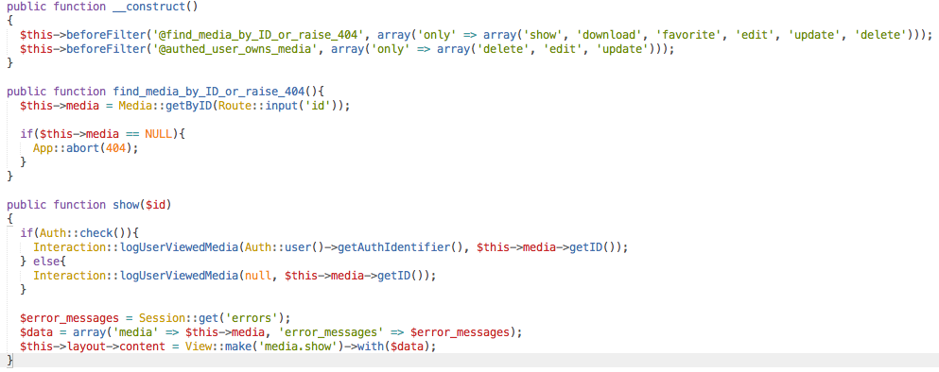
MVC Example: Routes and Controller

Slide 6
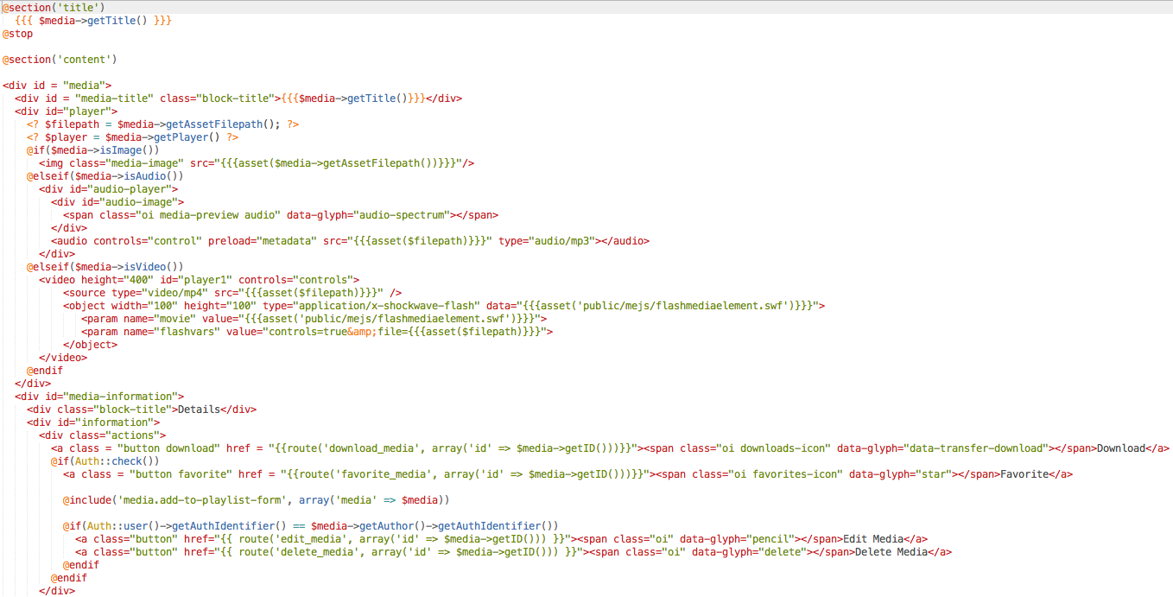
MVC Example: Views

Slide 7
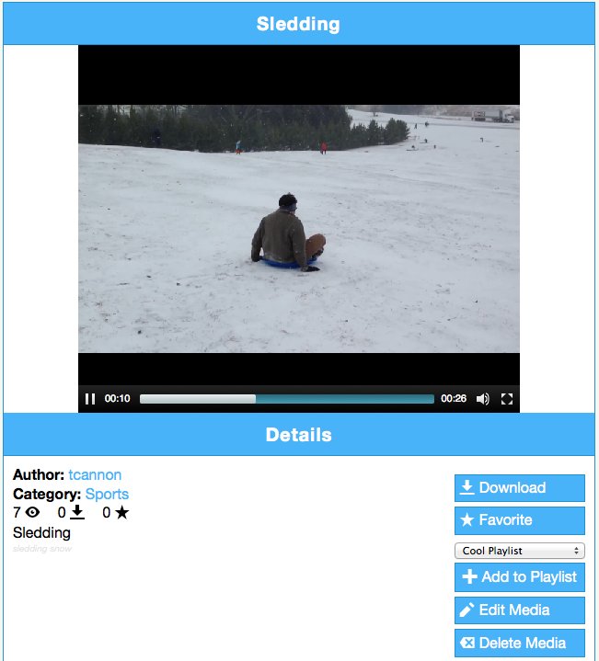
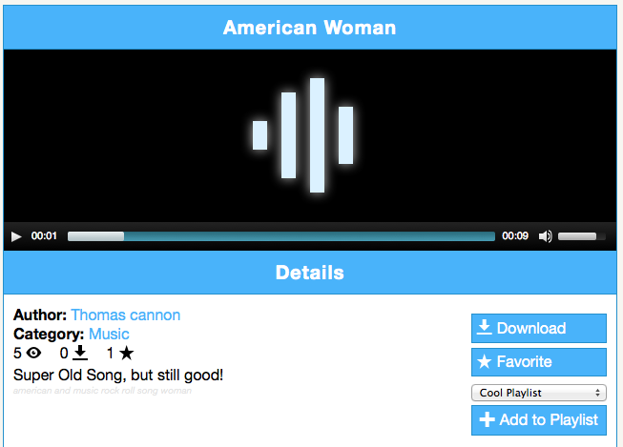
Demonstration: MediaElement.js
Video Player
Audio Player

Slide 8
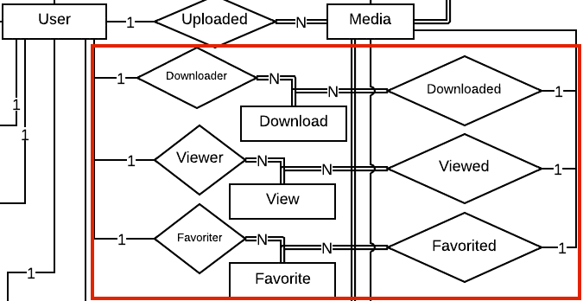
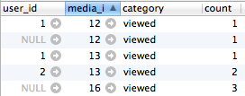
Design: Interactions

Slide 9
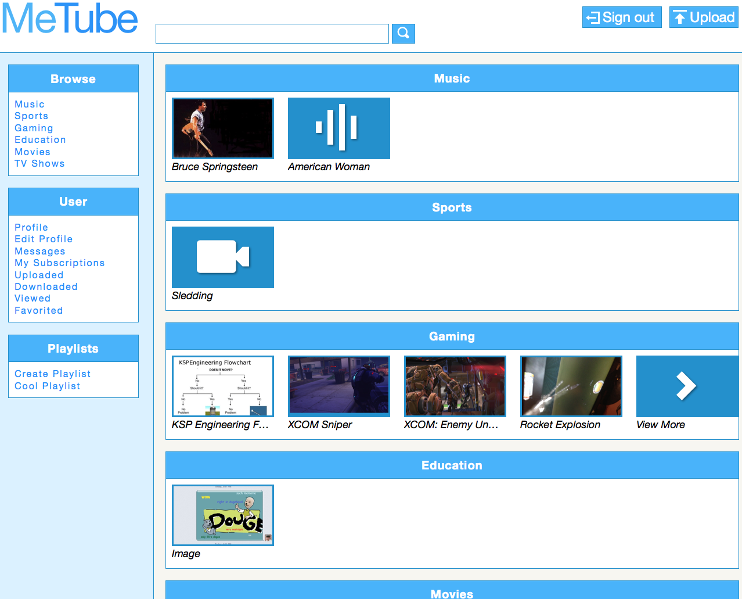
Demonstration: Home Page

Slide 10
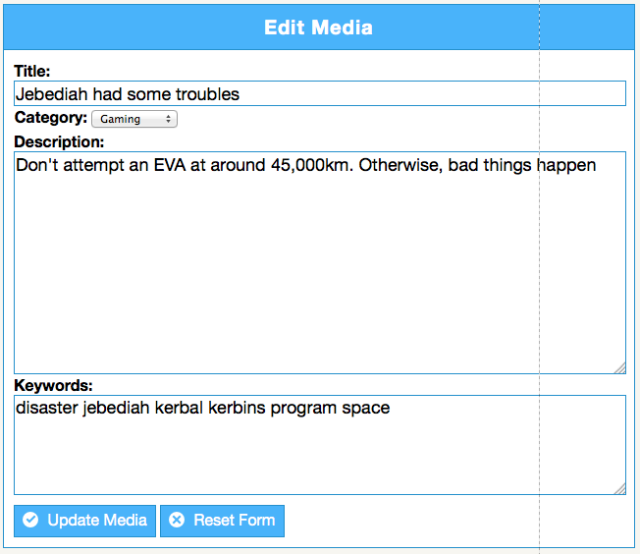
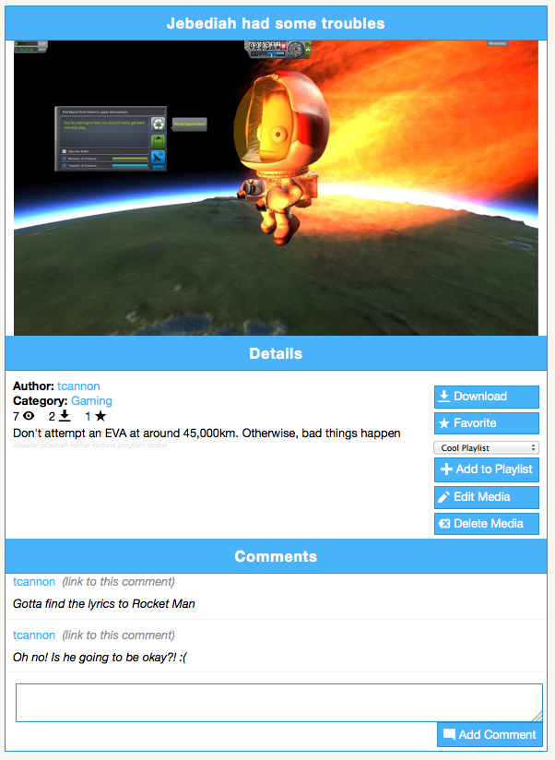
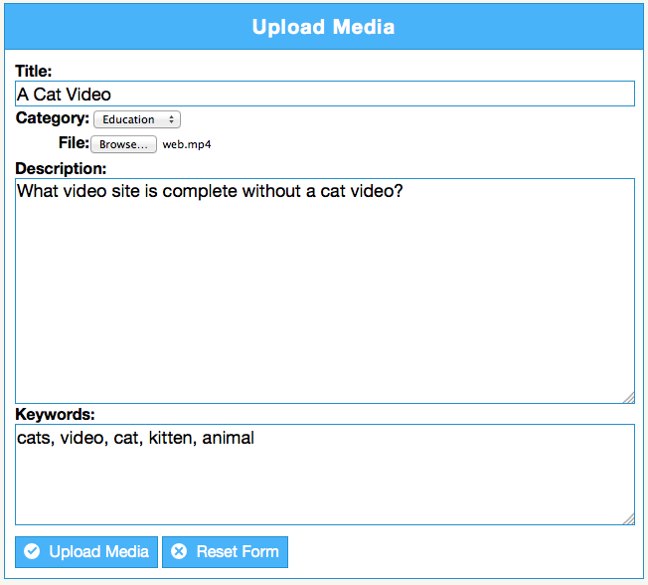
Demonstration: Media

Slide 11
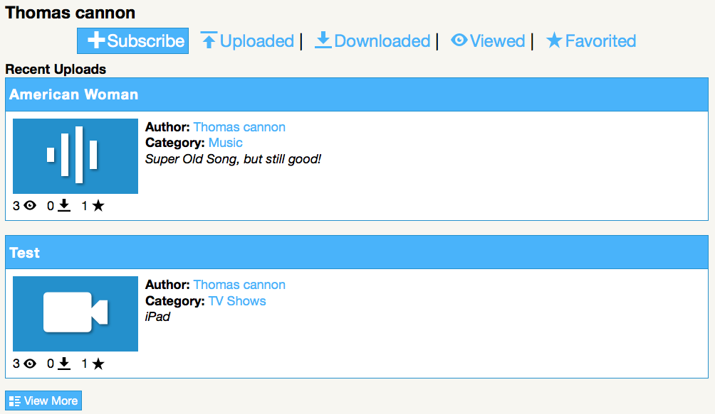
Demonstration: Channel

Slide 12
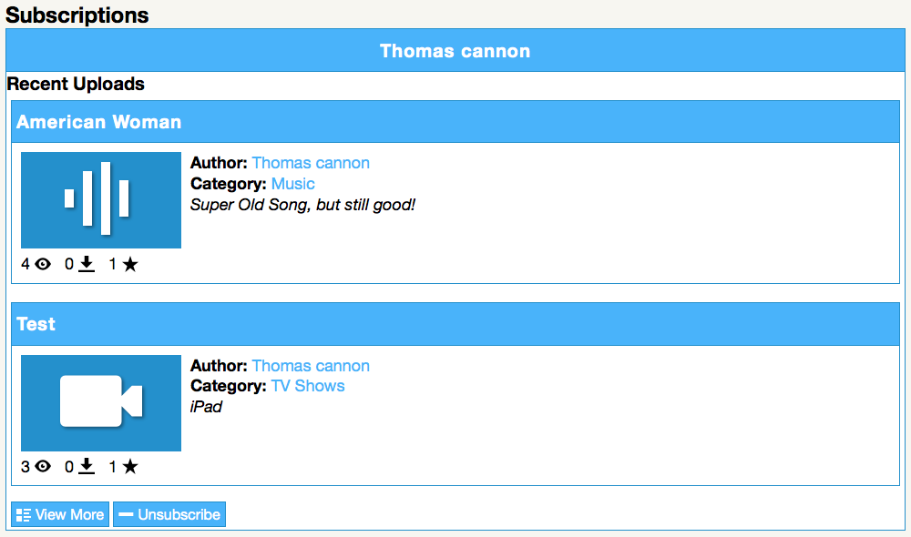
Demonstration: Subscription

Slide 13
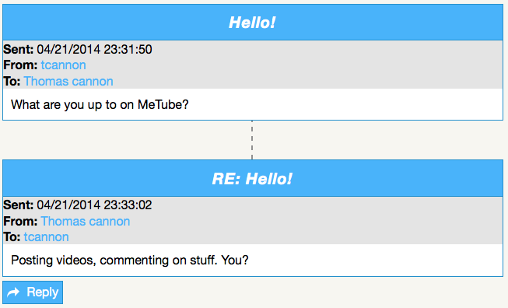
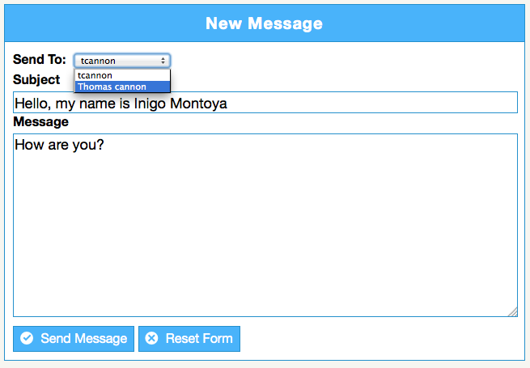
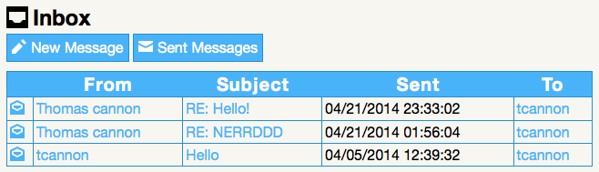
Demonstration: Messaging

Slide 14
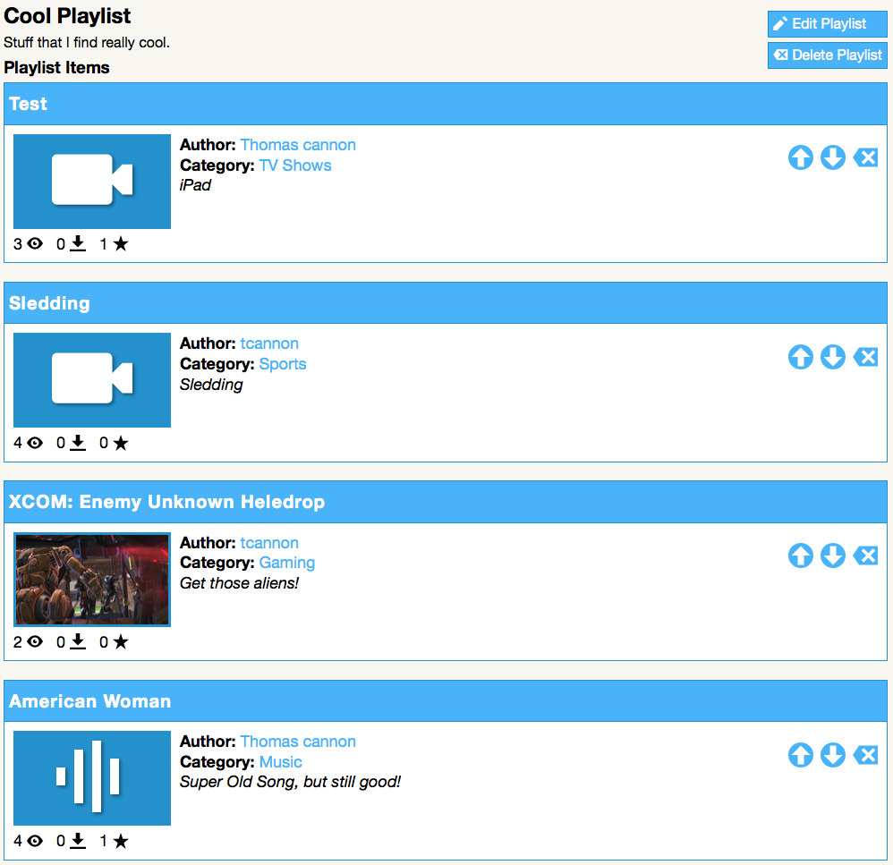
Demonstration: Playlist

Slide 15
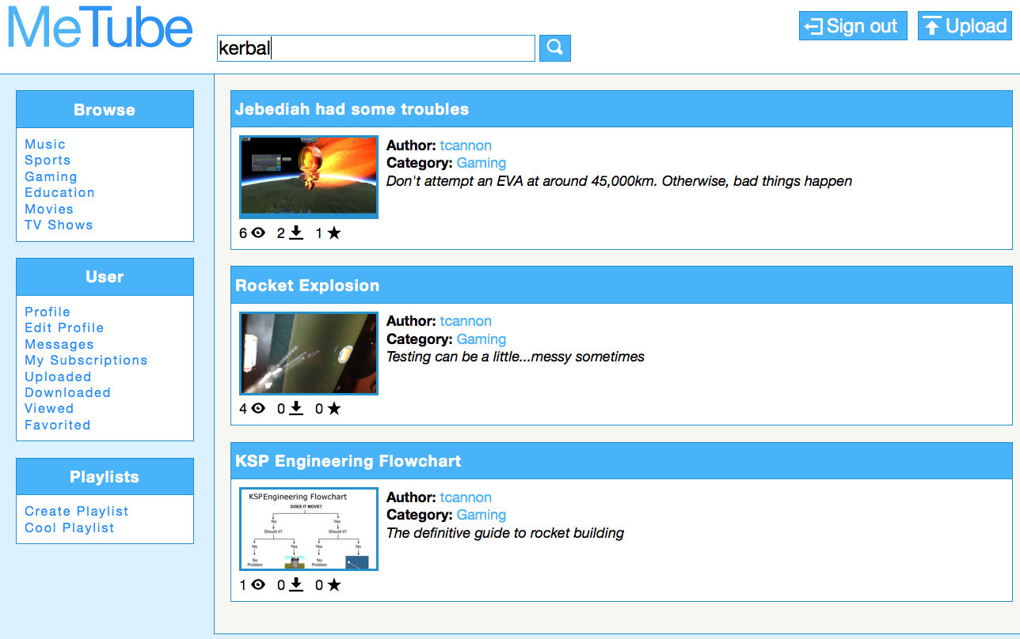
Demonstration: Searching

