Slide 1








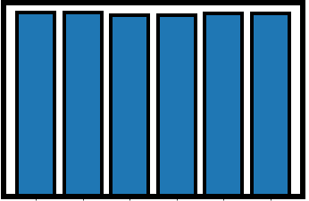
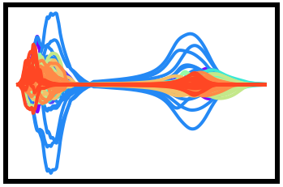
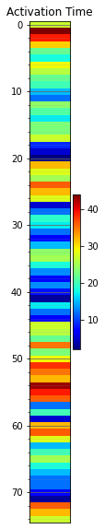
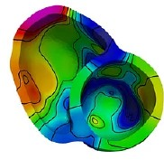
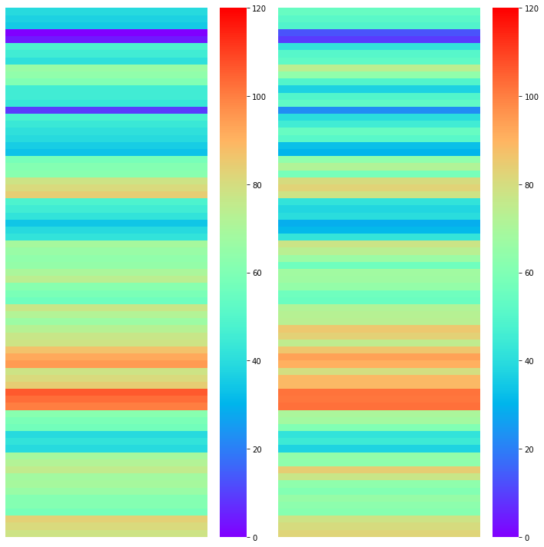
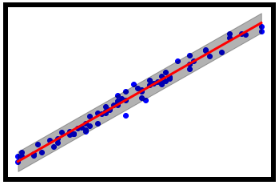
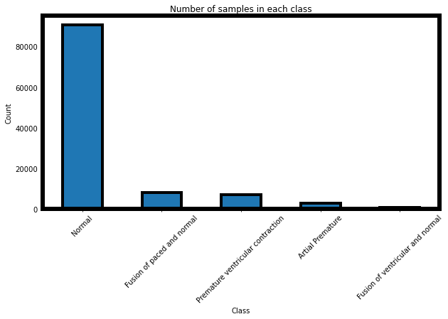
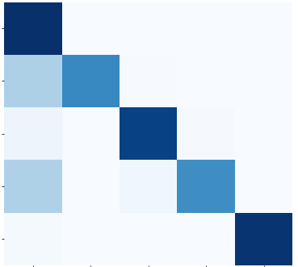

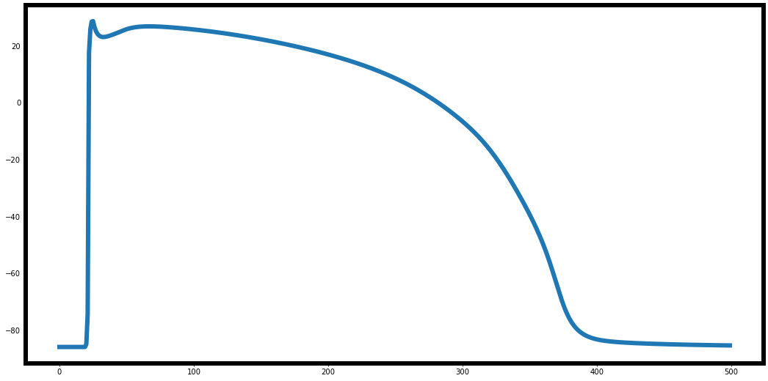
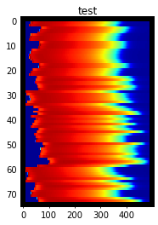
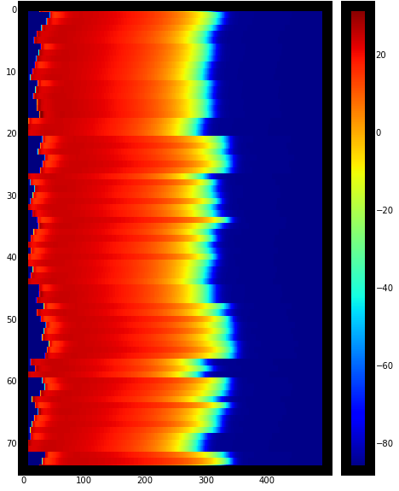
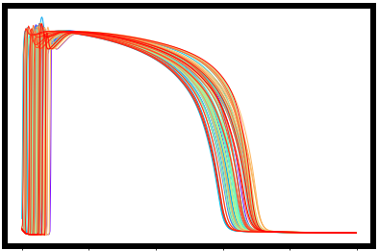
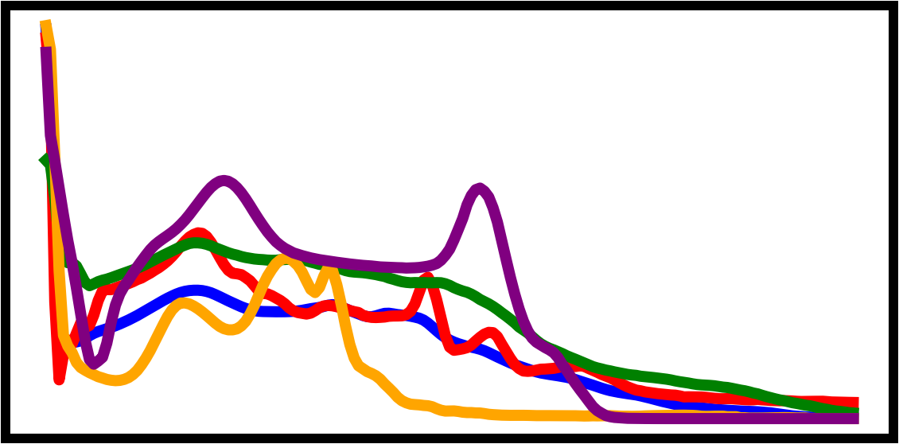
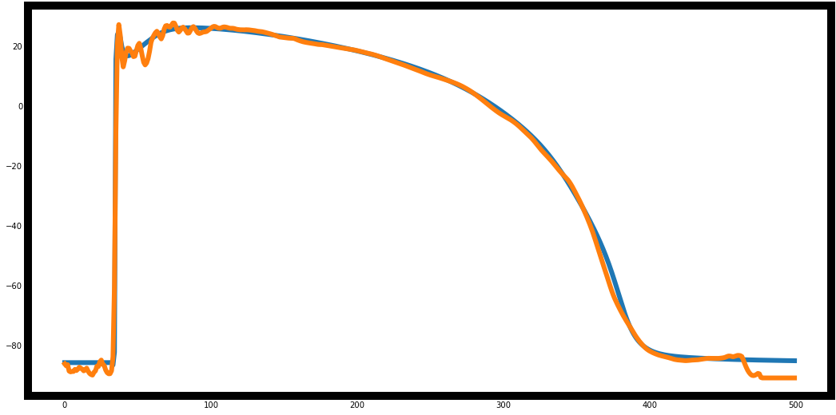
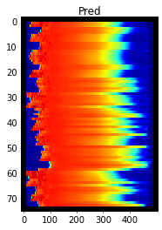
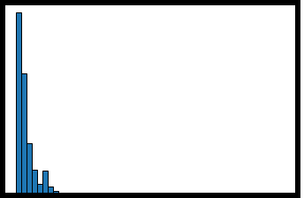
LLNL Data Science Challenge 2023: Hearts with Machine Learning
Justin Pastore
Hritanshu Rath
J. Pastore¹, I. Romero³, H. Rath⁴, A. Kaattari-Lim²
¹Dept. of Psychology, ²Dept. of Engineering UC Riverside,
³Dept. of Applied Math, ⁴Dept. of Engineering UC Merced
LinkedIn
Irabiel Romero
Alex Kaattari-Lim
Task 1 – Binary Classification of healthy and irregular ECG Data
Task 3– Reconstruction activation map given ECG leads
Description: ECG Heartbeat Categorization by performing binary classification for healthy heartbeat vs. irregular heartbeat
Description: Sequence-to-vector prediction of voltage recordings and ECG Signals to perform activation map reconstruction (i.e. transform 12x500 standard leads recordings to a 75x1 activation map using a neural network)
A)
Act. Time
C)
Act. Time within heart
D)
Architecture
A)
C)
Example 12 leads
B)
1
45
Input
B)
Classification Accuracy
1
Number of samples per class
Optimal grid search parameters
100%
45
Dimension 12x500
RF | Max depth=None, max features ='sqrt', min samples leaf =1, min samples split = 2, n estimators=200
SVM | C=10, gamma='scale', kernel='rbf'
KNN | n neighbors = 1, weights = ‘uniform’, metric = ‘Manhattan’
Norm (mV)
Conv1D
97.37% ± 0.001%
Time (ms)
Batch Norm
x4
10,506
Accuracy
(test-pred)
95.97% ± 0.002%
Time (ms)
ReLu
96.43% ± 0.001%
96.03% ± 0.001%
96.95% ± 0.001%
96.95% ± 0.001%
-1
75
0
Normal
Abnormal
0
Time (ms)
500
0
Flatten
4,086
0%
Regression plot
(pred vs test)
F)
Test
Pred
Dense
RF
kF
RF
SkF
E)
1
120
SVM
kF
SVM
SkF
KNN
kF
KNN
SkF
120
Batch Norm
0
Data
Dense
Linear Fit
Activation Time
(ms)
Figure 1. A) Number of samples per class, abnormal ECG (orange) vs normal ECG (blue). B) Parameters chosen from a grid search of random forest (RF), Support Vector Machines (SVM), and K-Nearest Neighbors (KNN). C) Classification accuracy for RF, SVM, and KNN with k-fold cross validation (kf) and Stratified k-fold cross-validation (SkF). Each test was run with 10 folds. Error bars represent SEM.
Pred (ms)
95% Conf Inv
Virtual Locations
Sigmoid
Output
Dimension 75x1
Task 2 – Multi-Class Classification of healthy and irregular ECG Data
0
R² = 0.95
Train test split: 80%-20%
# parameters: 3.8 million
Loss: MSE
Description: By using the ECG Heartbeat Categorization Dataset, we performed multiclass classification to diagnose the various ECG recordings.
0
120
Test (ms)
75
0
A)
D)
Confusion Matrix for KNN
Figure 3. A-C) Example with 1 patient. A) Example of 12 ECG leads in mV. B) Example activation time of all 75 virtual locations within the heart. C) Reconstruction of virtual locations within the heart and corresponding activation times. D) Network architecture. E) Linear regression fit of predicted vs test data activation times. F) Test and predicted activation times in milliseconds (ms).
Number of samples per class
C)
Metric Averages
99.82% 0.04% 0.09% 0.01% 0.03%
100
10000
 | RF | SVM | KNN
Accuracy | 97.6% | 97.9% | 97.8%
Precision | 97.3% | 93.2% | 90.0%
Recall | 81.8% | 76.0% | 86.7%
F1 | 88.1% | 82.7% | 88.4%
Task 4 – Reconstruction of transmembrane potential given ECG leads
Premature (3) ventricular contract
33.09% 66.19% 0.72% 0.00% 0.00%
Description: Sequence-to-sequence prediction using voltage recordings and ECG Signals to perform transmembrane potential (TP) reconstruction (i.e transform 12x500 to 75x500 using a neural network)
*Note only trained and tested on 5000 of 16000 patients due to hardware constraints
# Sample
Atrial Premature(2)
Fusion of ventricular and normal (4)
Normal (1)
Fusion of passed and normal(5)
True Labels
5.11% 0.72% 93.51% 1.24% 0.14%
Percentage (%)
A)
Test TransP
B)
C)
D)
(1) (2) (3) (4) (5)
All Test TransPs
All Test TransPs
Architecture
32.50% 0.00% 3.75% 63.75% 0.00%
40
1
40
40
Input
0
Dimension 12x500
B)
Averaged ECG class sequences
mV
mV
Locations
mV
1.0
(1)
(3)
(5)
1.87% 0.00% 0.25% 0.00 % 97.89%
0
mV
Conv1D
(2)
(4)
(1) (2) (3) (4) (5)
Normalized
ECG Seq.
Predicted Labels
-90
0
Time (ms)
500
75
0
-90
-90
Batch Norm
x6
Figure2. A) Number of samples per class. B) Average ECG signal for each class across patients. C) Classification accuracy for Random Forest (RF), Support Vector Machine (SVM), and k-Nearest Neighbors (KNN) with stratified k-fold cross validation (Skf, k= 10). Precision: tp / (tp + fp), Recall: tp / (tp + fn), F1: weighted harmonic mean of the precision and recall. D) Confusion matrix for KNN with an average stratified k-fold cross-validation accuracy of 97.8%. Error bars represent SEM.
E)
F)
Time (ms)
500
G)
0
Time (ms)
500
Prediction TransP
All Predicted TransPs
Hist Error TransPs
ReLu
0
40
1
40
0.4
0
Time (ms)
500
Conv1D
mV
Locations
Probability
(counts)
R² = 0.99
mV
Sigmoid
Conclusion / Take away
-90
True
75
0
Predicted
500
-90
0
Machine learning classification of binary and multiclass datasets is highly valuable as it enables automated decision-making processes. These models can accurately categorize data into different classes, aiding in tasks such as medical diagnosis of various heart conditions.
The utilization of 1D convolutional neural networks (CNNs) for classification and reconstruction of training and testing data proves highly effective in tasks involving time-series data. With their ability to capture temporal patterns, the 1Ds CNNs allowed for precise reconstruction of the activation sequences for 75 virtual locations within the heart given ECG recordings from 12-leads.
Time (ms)
0
Time (ms)
500
0
Abs Error (mV)
50
Output
Figure 4. A) Example transmembrane potential (TransP). B) Heatmap of all TPs over all test 75 virtual locations. C) All TPs for all 75 virtual locations. D) Neural network architecture. E) True vs predicted reconstruction of TPs. F) Reconstruction for all 75 virtual locations for 1 patient, with an average R² = 0.985 G) Histogram of absolute error (test – prediction) for all 75 reconstruction virtual locations (mV).
Dimensions 75x500
Train test split: 80%-20%
# parameters: 22 million
Loss: MSE

