Slide 1
Diagnostics of Pulsar
Magnetospheric Plasmas
AAPPS-DPP2026@Busan
2026.10.15
Mainly based on paper:
Pulsar electrodynamics inferred from frequency-dependent
circular polarization diversity (2026, A&A, 710, A282)
Shunshun Cao, Yanjun Guo, Jinchen Jiang,
Kejia Lee, Weiyang Wang, Renxin Xu
Shunshun Cao
Peking University
School of Physics
Department of
Astronomy

Slide 2
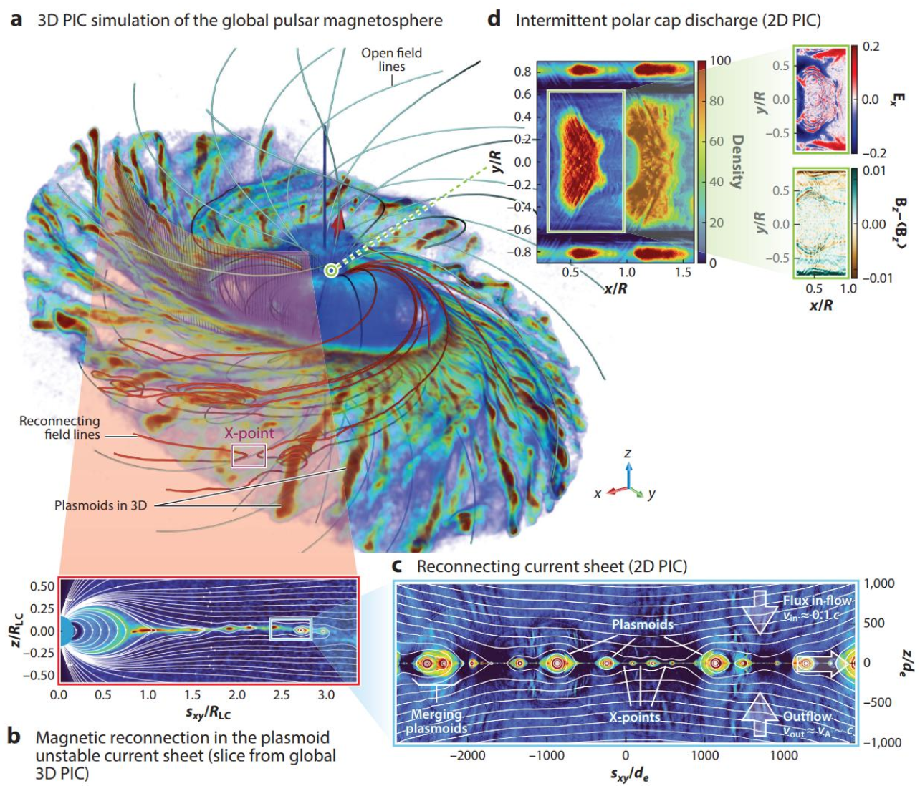
1. Background
Pulsar magnetosphere: relativistic plasmas corotating with a neutron star
➔ A natural strong-field plasma laboratory.
To make use of this lab,
we’d better know more
of its parameters.
e.g.,
Plasma number density,
Lorentz factors,
……
Philippov & Kramer 2022 ARA&A

Slide 3

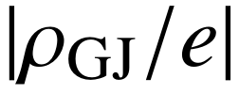
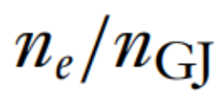
Magnetospheric plasma number density:
Concept: Goldreich & Julian (GJ) charge density (Goldreich & Julian 1969 ApJ)
Charge density of corotating force-free magnetosphere.
→ what about number density?
Number density reference——GJ number density =
But real number density could be higher.
[e.g., 1e/cc = (21e⁺ & 20e⁻)/cc = (2e⁺ & e⁻)/cc]
Introduce plasma multiplicity κ: .

Slide 4
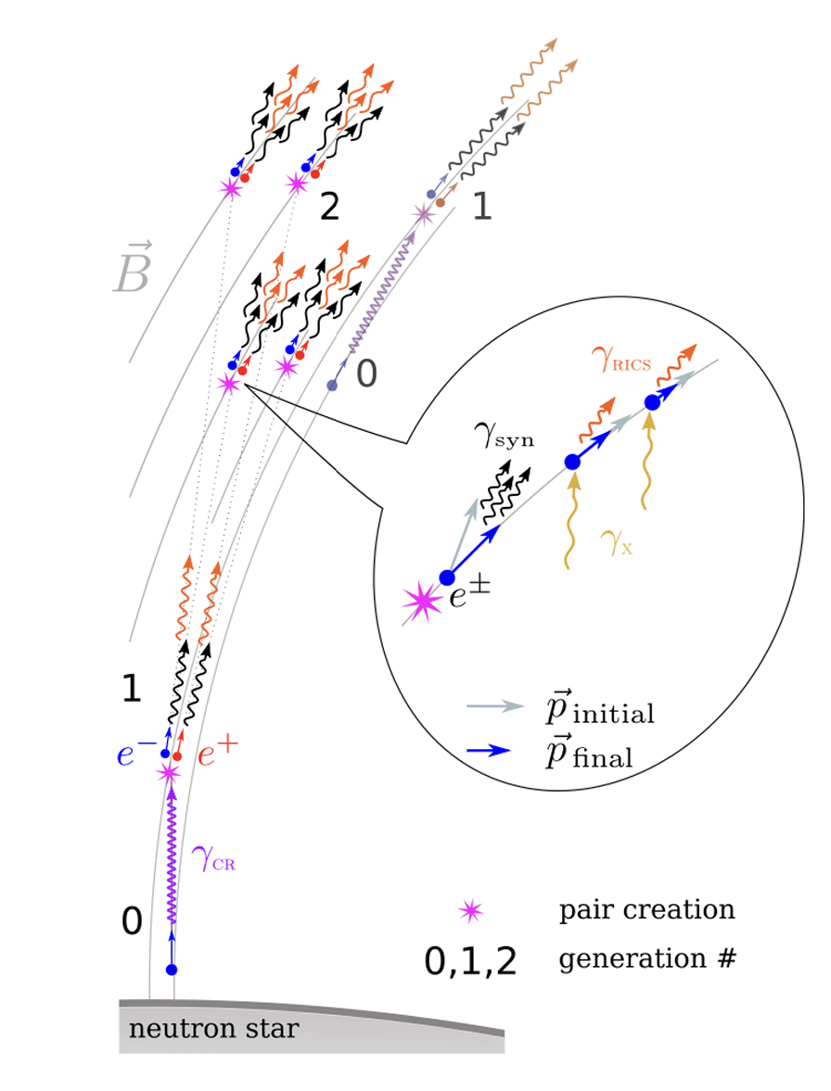
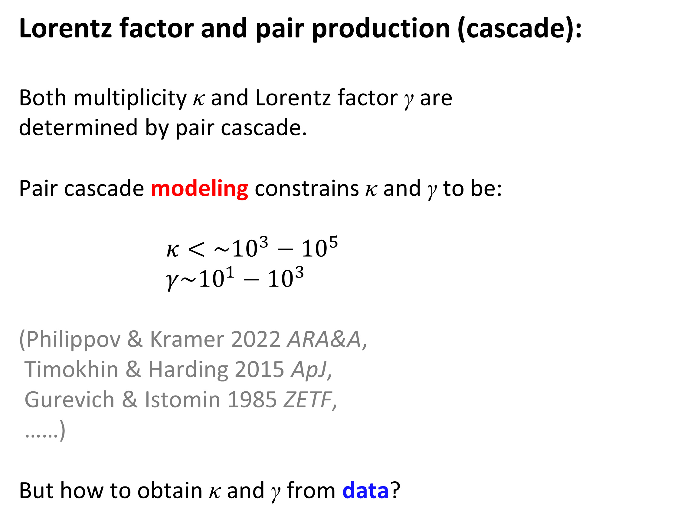
Lorentz factor and pair production (cascade):
Both multiplicity κ and Lorentz factor γ are
determined by pair cascade.
Pair cascade modeling constrains κ and γ to be:
$κ<\sim {10}^{3}−{10}^{5}$
$γ\sim {10}^{1}−{10}^{3}$
(Philippov & Kramer 2022 ARA&A,
Timokhin & Harding 2015 ApJ,
Gurevich & Istomin 1985 ZETF,
……)
But how to obtain κ and γ from data?
Amato 2024 arxiv.

Slide 5
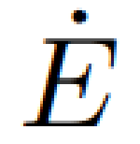


Plasma diagnostics of pulsar magnetosphere or pulsar winds
—— two ways
Modeling the Very-High-Energy (VHE) spectra of pulsar wind nebulae (PWNe)
c ⬅➔ magnetospheric current ⬅➔ of pulsars
⬅➔ pulsar wind electron radiation energy ⬅➔ spectra of PWNe
(de Jager 2007 ApJ, Spencer & Mitchell 2025 A&A, ……)
(2) Modeling pulsar radio signal
· Eclipse of binary pulsars (e.g. Lyutikov & Thompson 2005 ApJ)
· Propagation effects in solitary pulsar magnetosphere (e.g. Petrova 2003 A&A)
……

Slide 6
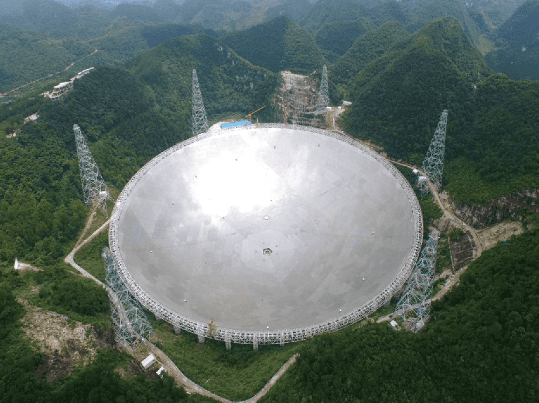
Questions in former pulsar plasma diagnostics:
Very few pulsars (~10) have been diagnosed.
For radio approach, modeling is made on integrated pulse profiles.
Mutual cancellation of polarization may affect the diagnostics.
Our work:
Extend the radio approach to single pulses,
numerically calculating polarization.
Bayesian analysis of high-quality FAST released data.
Single pulses
(can be varied)
Add up
>10^{2~3}
Integrated profile
(usually steady)
Jiang et al. 2019 SCPMA.

Slide 7
2. Model for Bayesian
Circular polarization from wave mode coupling (Lyubarskii & Petrova 1999 ApSS)
[Limiting polarization effect]
Basic picture: B-field e± waves (initially linearly pol.)
Multiplicity and
Lorentz factor
affect plasma
response.
should be
reflected in circular polarization.
Strongly inhomogeneous plasma:
Wave polarization fails to follow B-field
➔ Another mode emerges ➔ add to form circular pol.

Slide 8
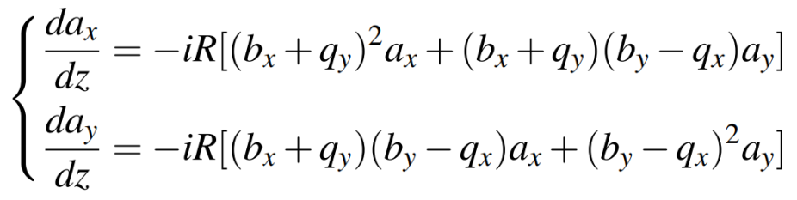

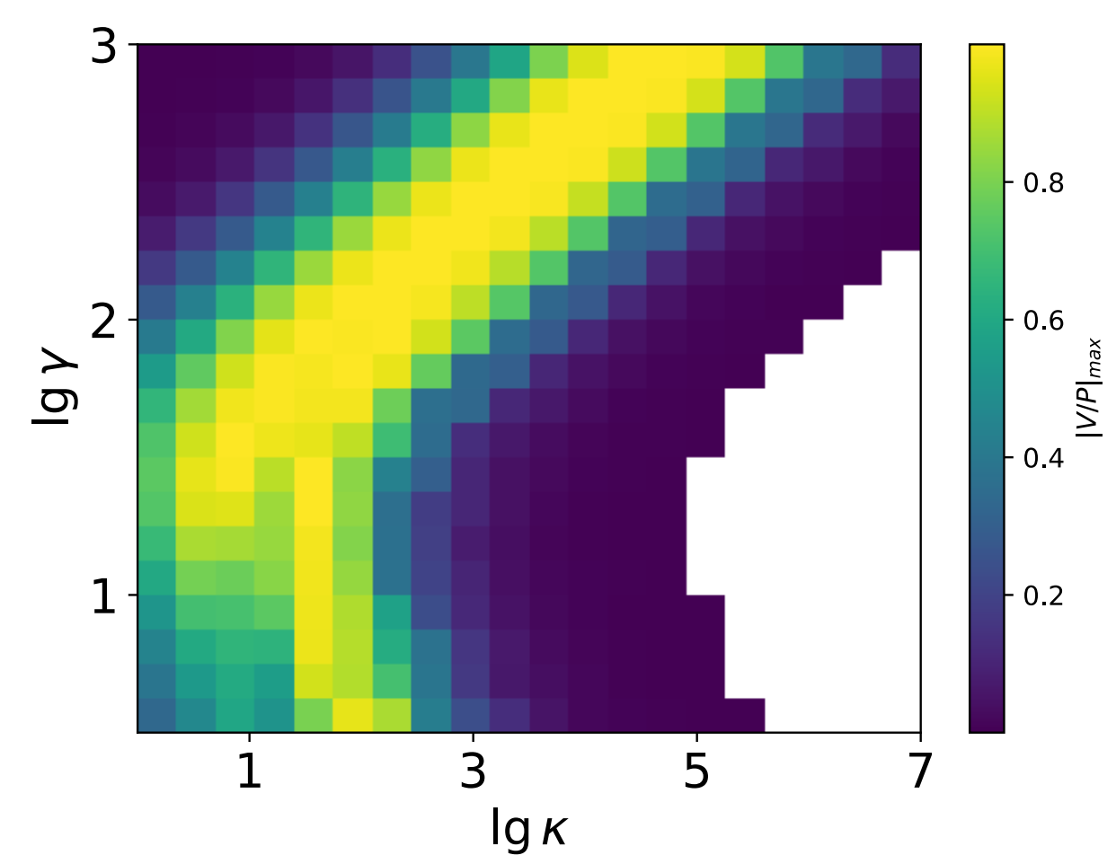
Theoretical values of circular polarization fraction (V/P):
(e.g. Lyubarskii & Petrova 1999 ApSS)
V/P:
P = sqrt(L²+V²)
L: linear polarization
V: circular polarization
Cao et al. 2026 A&A

Slide 9
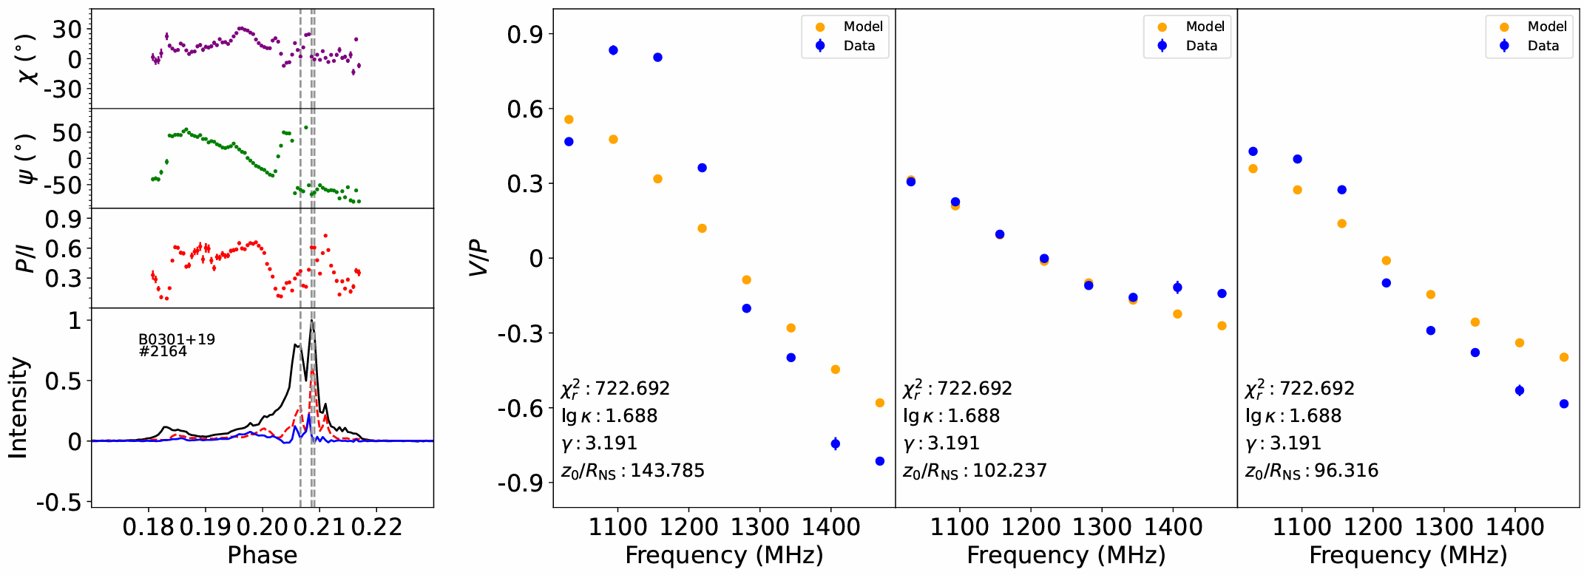
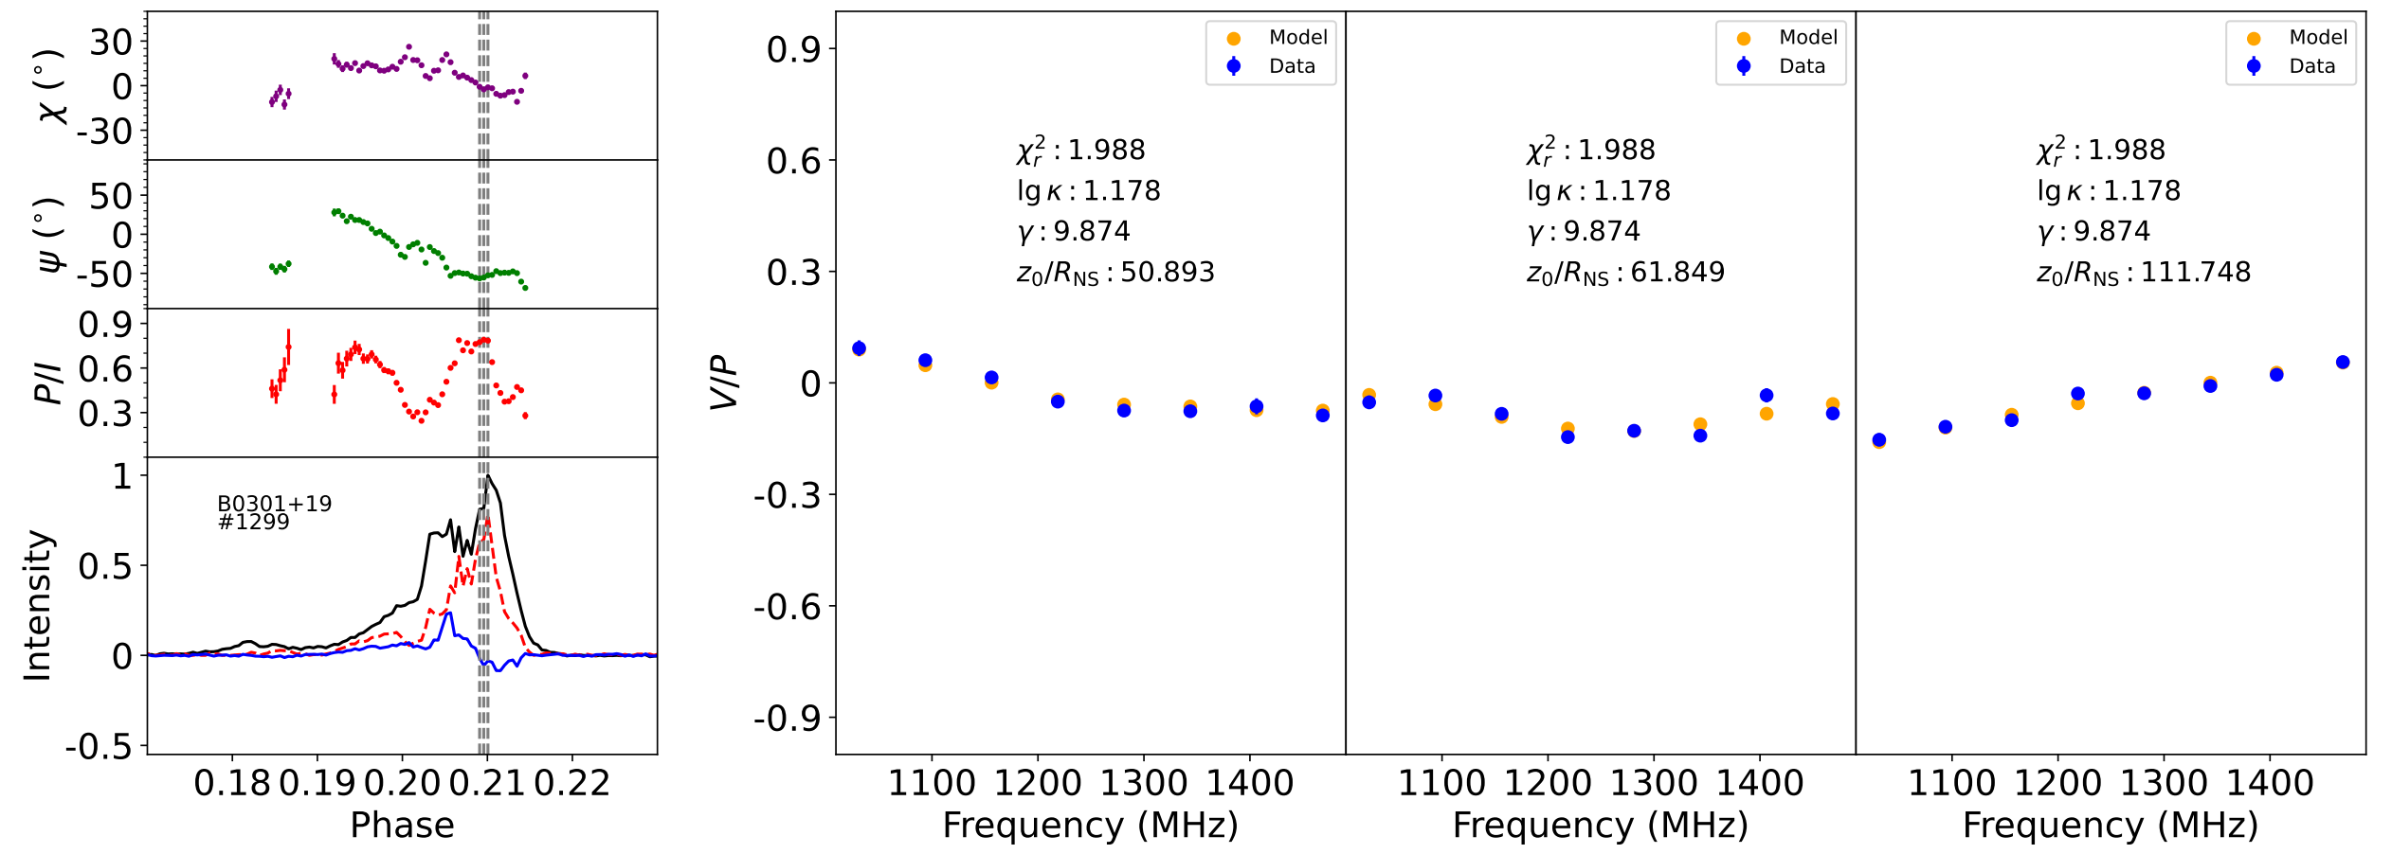
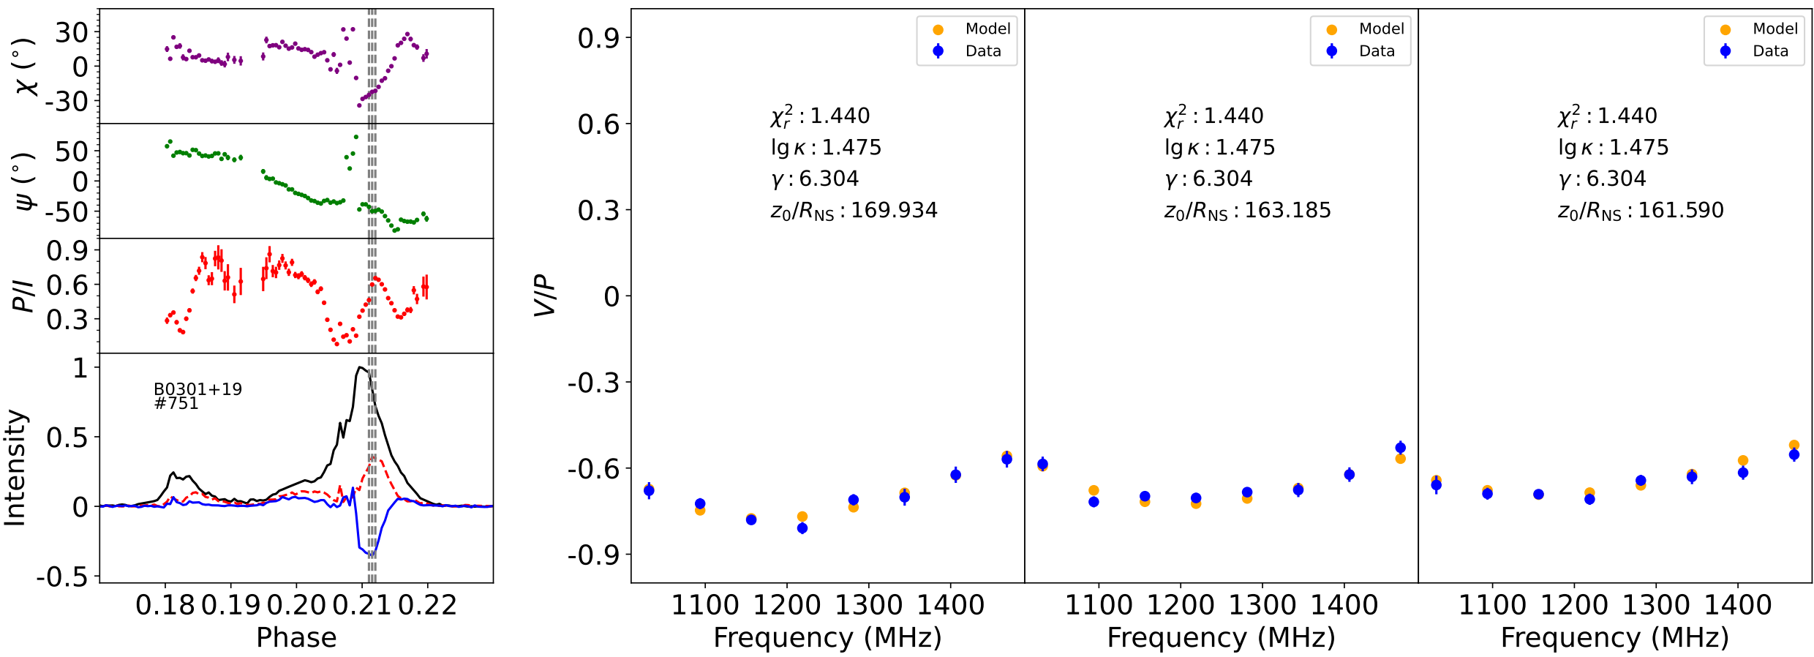
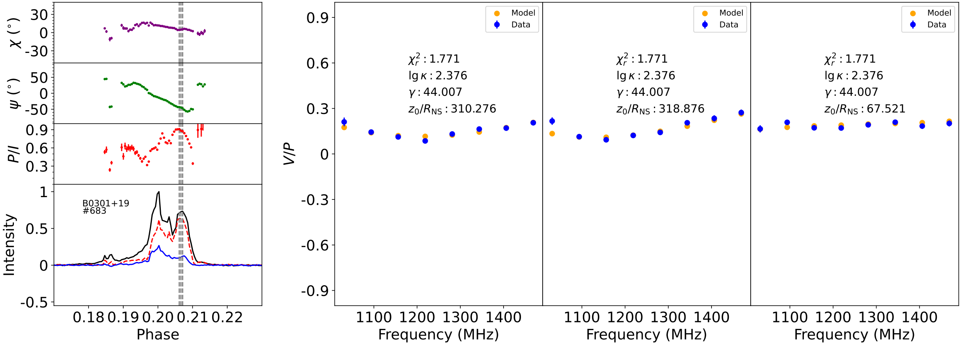
3. Results & Discussion
FAST pulsar single pulse data v.s. model:
Pulse profile Circular polarization spectra
Example 4: bad fitting
Example 2: Large right-handed
circular pol.
Example 1: Small left-handed
circular pol.
Example 3: handedness changing
with frequency.
Mode coupling calculation could reproduce the diversity of circular polarization
Cao et al. 2026 A&A

Slide 10
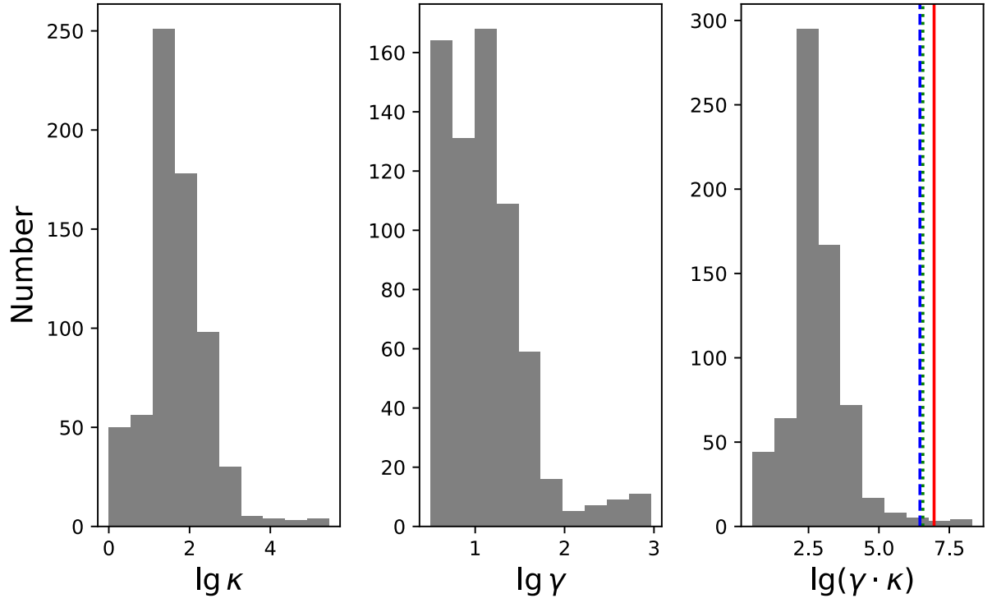
κ and γ inferred by fitting 679 pulses of PSR B0301+19: $κ\sim {10}^{2}$, $γ\sim {10}^{1}$.
Cao et al. 2026 A&A
κ·γ: normalized particle energy density ($κn_{GJ}∙{γm}_{e}c^{2}$).
Well constrain
Colored vertical lines: theoretical acceleration potentials.
(Ruderman & Sutherland 1975 ApJ, Arons & Scharlemann 1979 ApJ, …)

Slide 11
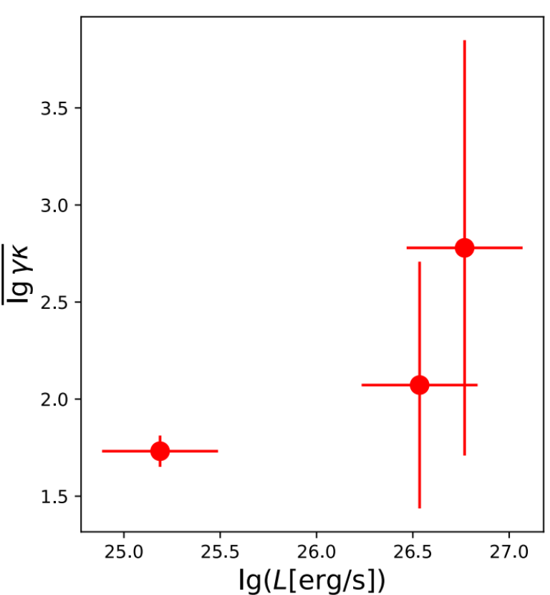

The κ·γ should also be related to radio luminosity…
But there are too few points to demonstrate that.
Our method could be applied on more pulsars!
Summary：
· Pulsar plasma diagnostics: VHE or radio
· Radio approach: modeling propagation effects
· Application on single pulses: Infer κ & γ
from circular polarization spectra
Thank you for your attention.
Cao et al. 2026 A&A
My homepage

Slide 12
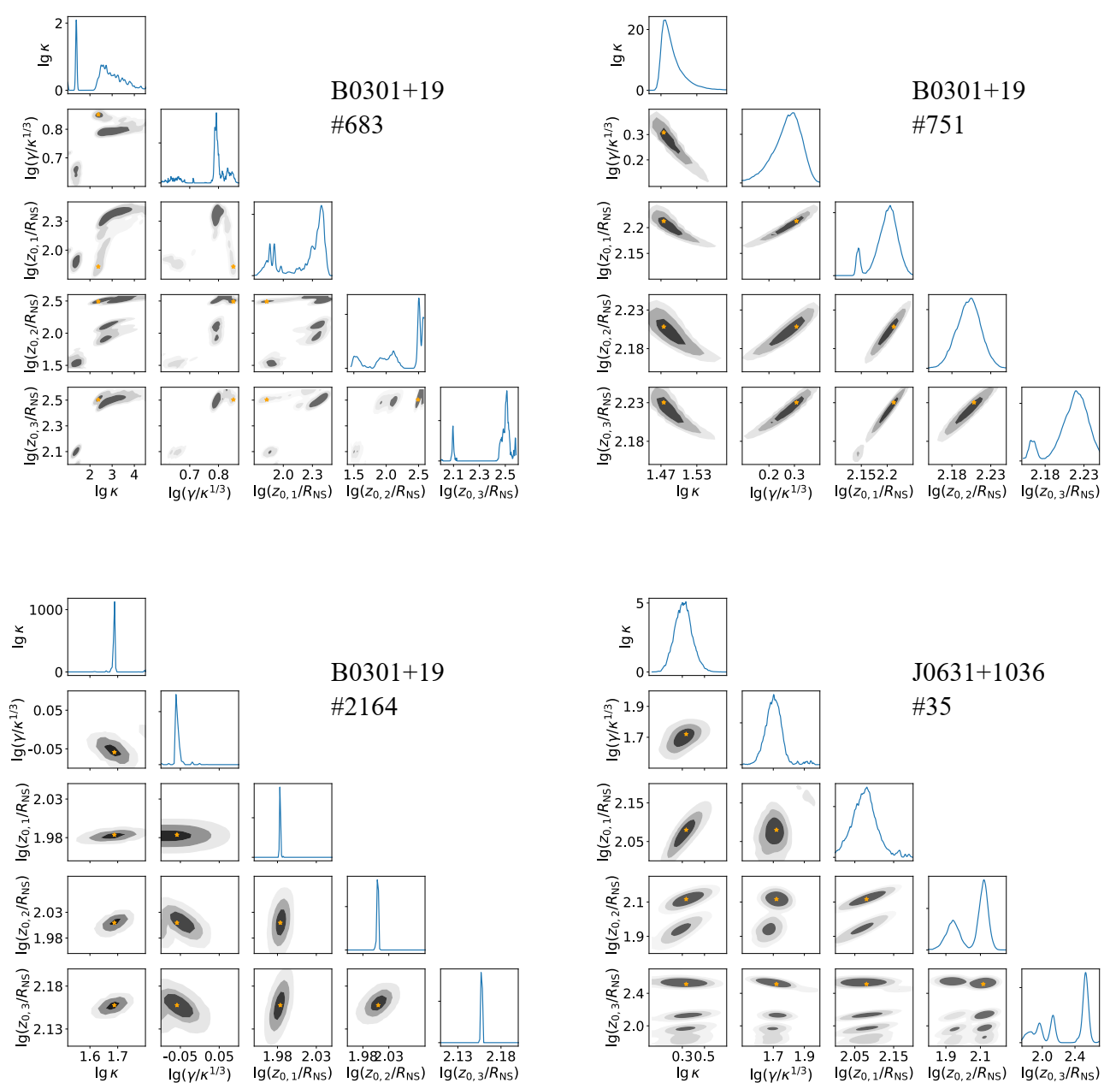
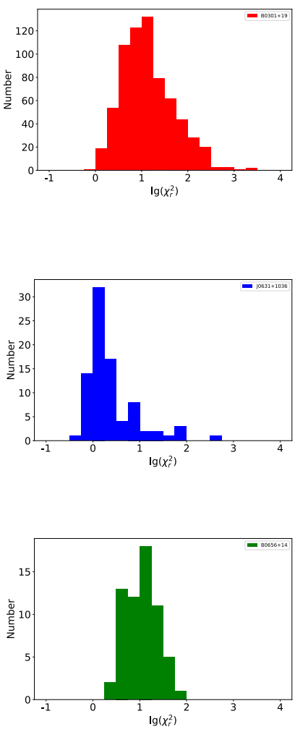
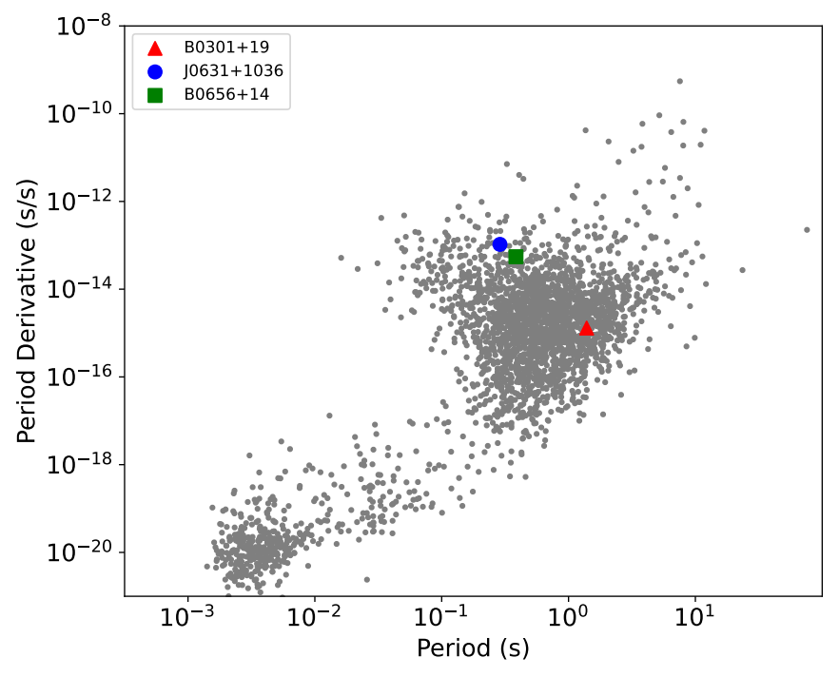
Backup

