Slide 1
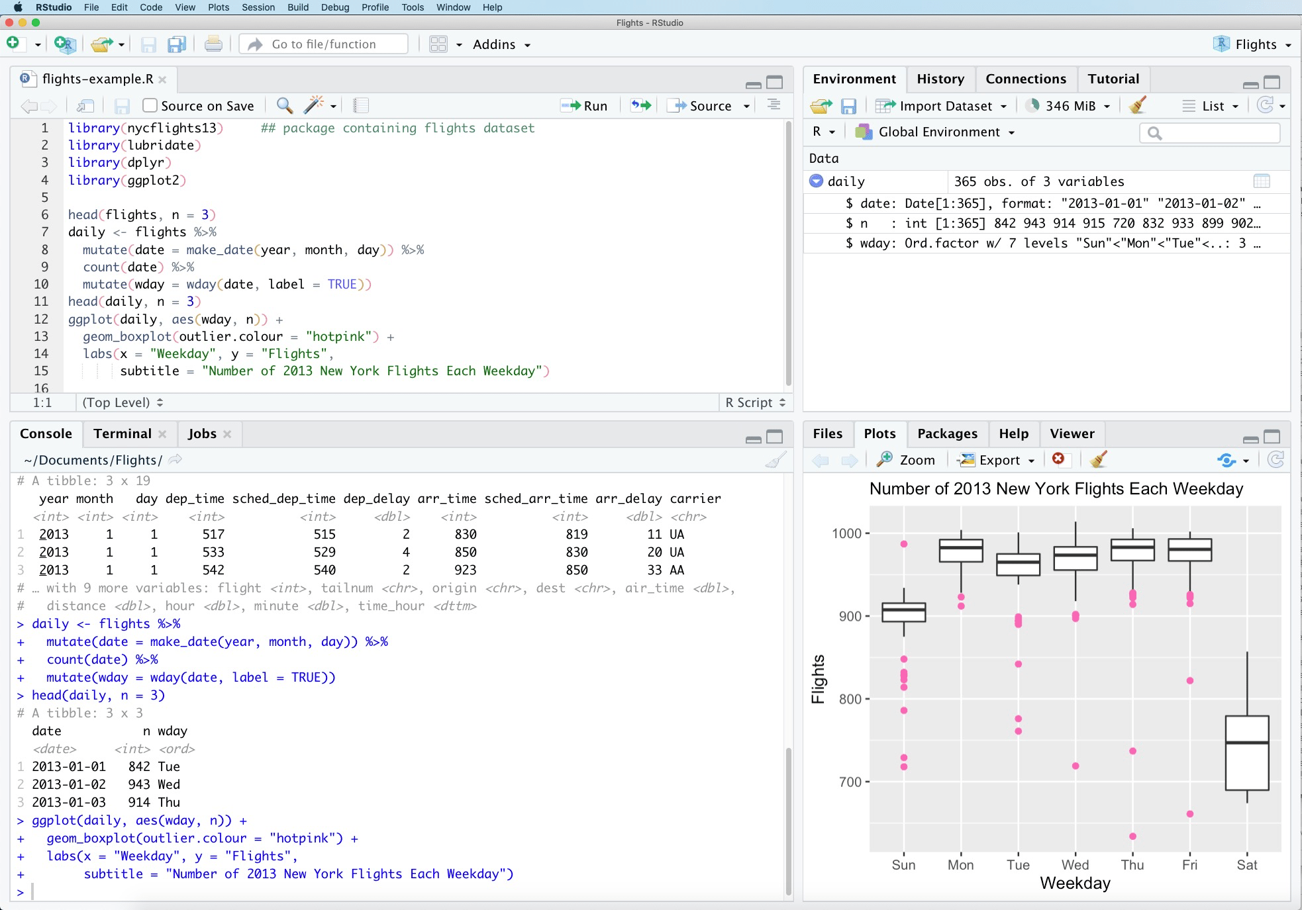
1. EDITOR
3. ENVIRONMENT
2. CONSOLE
4. PLOTS AND FILES

