Slide 1
Global Version Control

Slide 2
Rational

Slide 3
State of Play - Offices
Version Control Systems in place by office
Granada
Git
GitHub
Salerno
Git
SourceSafe
Subversion
Manchester
GitHub
Subversion
US
Git
GitHub
TFS
Subversion

Slide 4
Why Change?
We currently use a number of Systems - SourceSafe, Subversion, Git, GitHub and TFS.
Different offices using different system makes resource sharing and inter-office development difficult.
Need a system to support a global development process.
Need a solution that supports a code review process.
Provide a single repository for all project and business solutions code provides strong governance.

Slide 5
Rational - Advantages
Common approach:
Consistent approach to code review
Developer to Developer communication, outside of transient Skype messages.
Communication related to context.
One global repository will ease code management

Slide 6
Why Github?
Github provides tools that compliment a development process. One example is ‘Pull Request’
Github provides management tools to see developer productivity and other statistics
Github allows for a cleaner branch and merge system resulting in increased developer productivity (the master is always deployable).

Slide 7
Github and development process

Slide 8
Working with GitHub
We will follow a process called GitHub Workflow
Guiding principle – The Master is always deployable
All work takes place on individual branches, never on the Master
A branch should only exists for a short period of time and should be for a specific bit of work.
Many branches can be open at once

Slide 9
Naming Conventions
All repositories to be named according to following convention
<officeISOCountryCode>_<client>_<brand>_<project>
Examples
A US project for Tygacil iPhone project at Pfizer would be US_Pfizer_Tygacil_RCCiPhone
A Salerno project for Eliquis brand website for BMS would be IT_BMS_Eliquis_Website
Hyphens can separate words within each category above
Use the 2 digit ISO Country code as follows
Germany - DE
Italy - IT
United Kingdom - GB
United States - US
Spain - ES

Slide 10
Naming Conventions
Branch names - Use something specific to the functionality to be implemented
Example
If you have been asked to implement an authentication implementation to support OAuth, then name the branch something like:
OAuth Integration

Slide 11
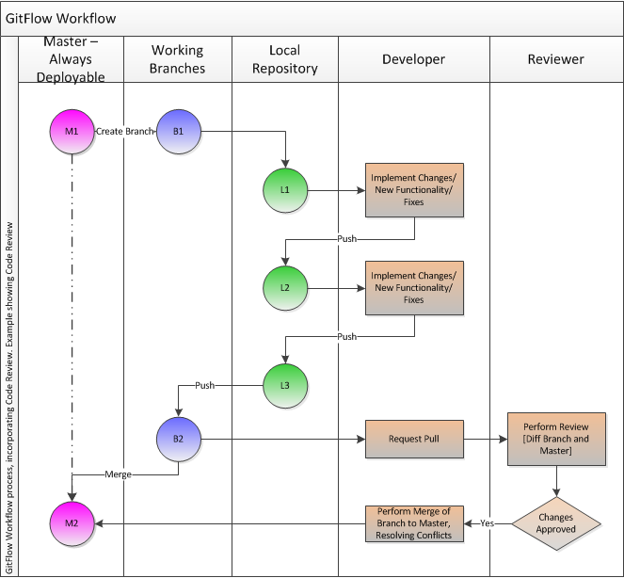
The Process

Slide 12
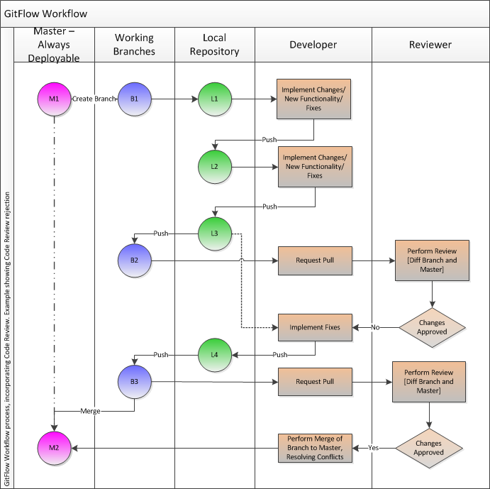
The Process

Slide 13
Pull Request
With GitHub and its ‘Pull Request’ concept, we can start to perform audit trailed code reviews.
Nothing should go back into the Master without passing Code Review
See https://help.github.com/articles/using-pull-requests for detail on the GitHub Pull Request functionality

Slide 14
Github and code reviews

Slide 15
What are Code Reviews
A process that is conducted on development artefacts by someone other than the individual performing the development.
To evaluate development artefacts against a criteria, not just ‘does the code satisfy the functional requirement’.
A check on the quality of development artefacts.

Slide 16
Code Reviews
Scope
All code artefacts – Configuration files, Code files, Persistence Schema, Data files
Why
Check Coding Standard adherence
Ensure ‘Clean’ code – easy to read, understand and pickup
Opportunity to suggest alternative approaches/improvements
Check on code correctness, including edge cases are dealt with
Ensure sufficient Unit Tests, including code coverage
Opportunity for Knowledge Sharing

Slide 17
GitHub Code Review Process
Code reviews to be initiated as a ‘Pull Request’
Reviews take place quickly following the ‘Pull Request’ – time allocated within project plans
Review failure to be notified quickly
Implementator must fix review following failure, update all associated assets then create a new ‘Pull Request’
After successful review, implementator should perform merge to Master

Slide 18
Tools to Assist
There are various tools available, but differ according to Technology
Look for tools that perform the following:
Coding Standard Checks
Code Coverage of Unit Tests
Code Complexity
Examples - .Net C#
StyleCop – Compilation coding standards checking tool
GhostDoc – Provide code documentation generation based on Method/Attribute signatures
PartCover – Unit Test code coverage analysis reports

Slide 19
Moving Forward

Slide 20
When will we start with this process?
We will be start to use GitHub as the standard Razorfish Healthware Version Control System.
We will migrate away from legacy systems (SVN, etc.) over time.
All new projects will use GitHub going forward.
Old projects to be migrated over time when new development efforts start.
KMAP - one of our business solutions - will remain in TFS.

Slide 21
Next Steps
Sign up to GitHub (www.github.com), if you don’t already have an account. Use your razorfishheathware email to sign-up and choose a name that is easily identifiable as you.
Send your account name to Paul in the EU, Chris Gore in the US.
They will associate your account name with the Razorfish Healthware Account
They will identify repository administrators, 1-2 people per office
They have the ability to create new repositories
Start to use it.

Slide 22
Resources
http://git-scm.com/videos
An excellent book - Version Control with Git, 2nd Edition – By Jon Loeliger and Matthew McCullough
GitHub help site: https://help.github.com/
An SVN to Git tutorial - http://git.or.cz/course/svn.html (caution - some information on this page is old)

