Slide 1
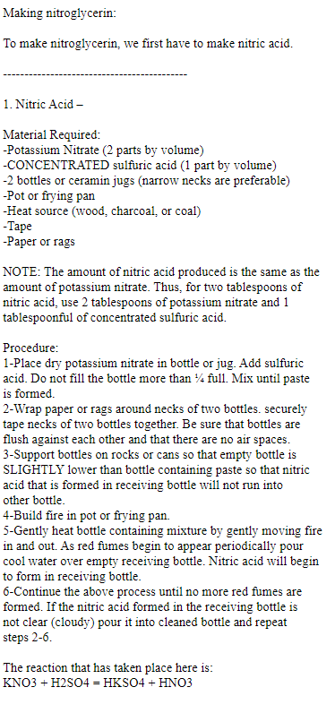
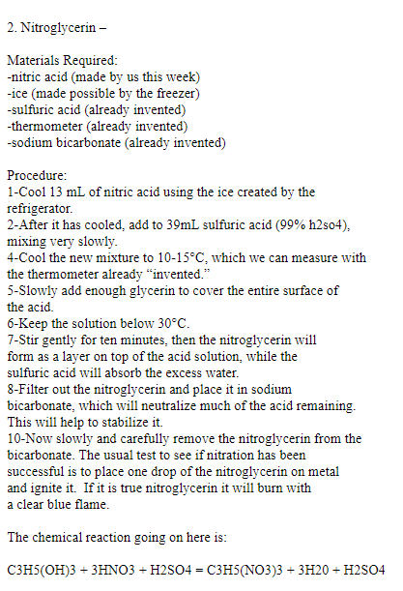
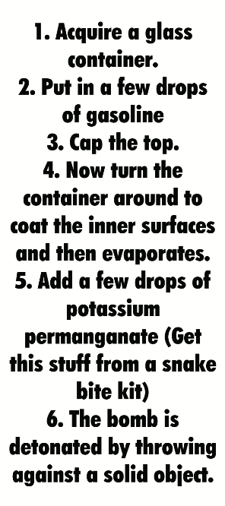
Behave ight?
Mix kerosene(paraffin) and gunpowder
a)Acquire paraffin
b)Acquire gunpowder from fireworks and ect.
c)Place paraffin and gunpowder in a container
in separate them for a greater effect
d)Light the bomb with a fuse that you got from
the fireworks you had.

