Slide 2
Chapter 8 Trees
Trees
Definition: Connected graph with no cycles ( further to Chap. 5) .
Key Points
Two vertices of degree 1.
Spanning Tree: subgraphs has all vertices of main graph

Slide 3
Rooted Trees
Terminology
Ancestors and Descendants
Parents and Children
Levels and Heights
Internal Nodes and External Nodes
Binary Trees

Slide 4
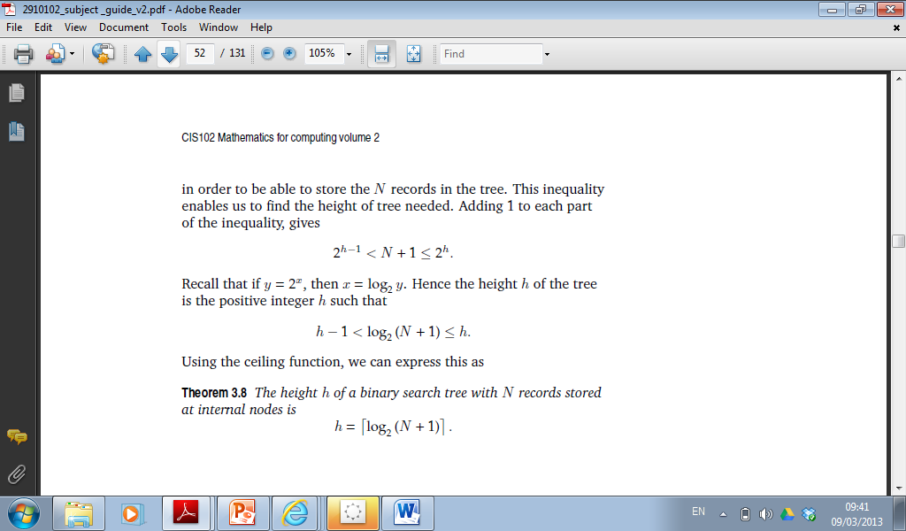
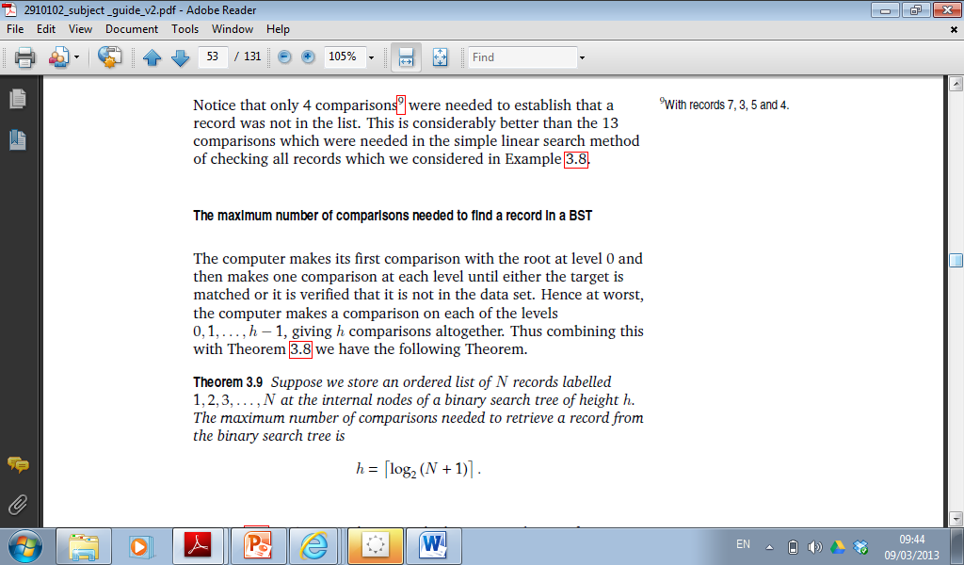
Binary Search Trees

