Slide 1

Reducing premature mortality from cardiovascular disease in Indonesia
Stéphane Verguet and David Watkins
Acknowledgements: William Garcia, William Msemburi, Zili Huang & Yuchen Liu
August 31, 2026

Slide 2
Message 1. The economic value of reducing avoidable mortality is very large in Indonesia

Slide 3

HEALTHY LONGEVITY INITIATIVE
In many countries, the proportion of older adults is increasing, with an ever-increasing burden of NCDs
National health systems face difficult trade-offs when allocating health sector resources
World Bank launched the “Healthy Longevity Initiative” to develop an evidence base for life-course investments in policies that can improve healthy longevity and human capital

Slide 4
OBJECTIVE
Estimating the economic value of avoidable mortality from major causes of death provides the foundations for evaluating the benefits of prevention and control policies under consideration
Producing a monetary value of reducing avoidable mortality by cause of death can directly speak to decision-makers beyond ministries of health, those in other sectors and ministers of finance
Adapted from: Verguet, Bolongaita, et al. Nature Medicine 2024

Slide 5
question: What is the economic value of avoidable mortality FROM ncd?
Objective: To estimate the economic value associated with avoidable mortality related to NCD causes of death, over 2019-2050
We assess the monetary value of hypothetical reductions in cause-specific mortality
We benchmark these hypothetical reductions against a mortality frontier (lowest mortality rates achieved) by cause
We assign a willingness to pay value to these hypothetical reductions in cause-specific mortality
Key numéraire obtained:
% of income an individual is willing to pay to live 1 year under the lowest possible mortality rate for a given cause of death
Economic metric directly comparable to national annual incomes (GNI)

Slide 6
MAIN ANALYTICAL STEPS
Data sources:
UN’s World Population Prospects & WHO’s Global Health Estimates
Step 1:
Estimate cause-specific mortality frontiers & regional mortality rates
Step 2:
Estimate economic value associated with NCD avoidable mortality

Slide 7
Data sources: UN’s World Population prospects & who’s Global health ESTIMATES
Estimates on age-sex-specific all-cause mortality rates by 5-year age group, and population sizes
Estimates on cause-specific death counts by 5-year age group and sex from WHO’s Global Health Estimates for all countries over 2000-2019
Communicable, maternal, perinatal and nutritional conditions
Non-communicable diseases (NCDs)
Cardiovascular diseases | Malignant neoplasms | Mental & substance use disorders
Ischaemic heart disease | Breast cancer | Alcohol use disorders
Stroke | Cervix uteri cancer | Other mental & substance use disorders
Other cardiovascular diseases | Liver cancer | Respiratory diseases
Diabetes mellitus | Mouth and oropharynx cancers | Chronic obstructive pulmonary disease
Digestive diseases | Oesophagus cancer | Other respiratory diseases
Cirrhosis of the liver | Stomach cancer | Other NCDs
Other digestive diseases | Trachea, bronchus, lung cancers
 | Other malignant neoplasms
Injuries
Unintentional injuries | Intentional injuries
Road injury
Other unintentional injuries

Slide 8
STEP 1: EstimatE cause-specific mortality frontiers, 2000-2019
Countries included in frontier computations (N=35) if:
(i) high-quality vital registration data
(ii) populations > 5M in 2020
(iii) included in WHO’s Global Health Estimates
Cause-specific mortality frontiers
(lowest mortality rates achieved)

Slide 9
STEP 1: PROJECT cause-specific mortality frontiers, 2020-2050
Example of projected frontier
For 2020-2050, the frontiers are projected based on trends underlying 2010-2019 frontiers by cause and large age group (Mathers & Loncar, 2006)
The frontiers are normalized to the all-cause mortality frontiers

Slide 10
Latin America & the Caribbean
vs. Frontier
STEP 1: PROJECT regional cause-specific MORTALITY RATES, 2020-2050
Country-specific mortality rates for 2020-2050 are projected using the same approach
Mortality rates are then population-weighted to obtain regional age-sex-cause-specific mortality rates for 7 “regions”
“Regions”:
China; India; Eurasia & the Mediterranean; High-income; Latin America & the Caribbean; Sub-Saharan Africa; World

Slide 11
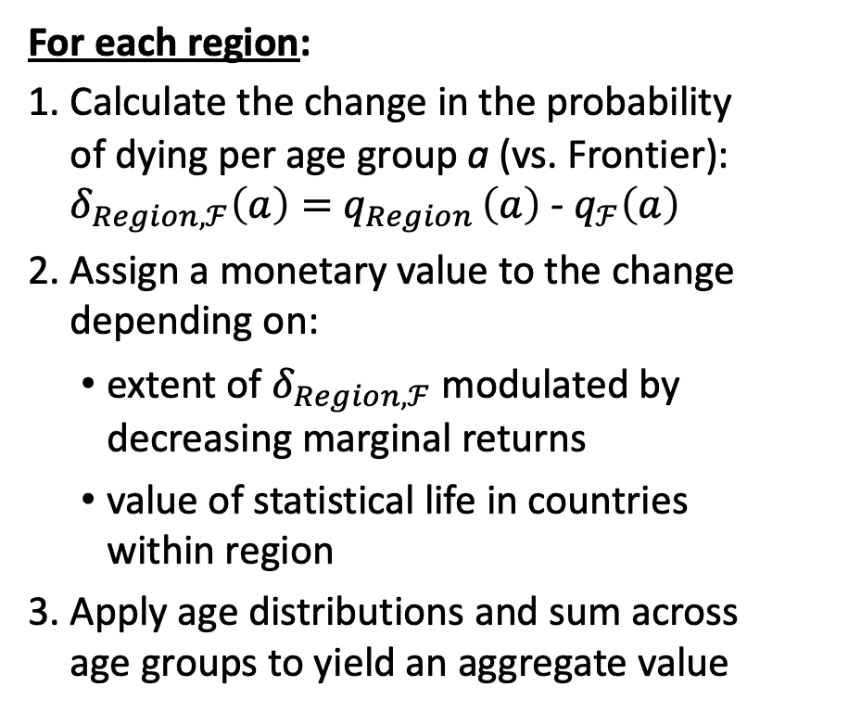
STEP 2: EstimatE ECONOMIC VALUE Associated with NCD avoidable Mortality, 2019-2050
For each region:
Calculate the change in the probability of dying per age group a (vs. Frontier): $δ_{Region,ℱ}\left(a\right)=$ $q_{Region }\left(a\right)$ - $q_{ℱ}\left(a\right)$
Assign a monetary value to the change depending on:
extent of $δ_{Region,ℱ}$ modulated by decreasing marginal returns
value of statistical life in countries within region
Apply age distributions and sum across age groups to yield an aggregate value
Share of individual income (%)
100%
0
Change in probability of dying
Adapted from: Hammitt et al., 2020; Cardoso & Dahis 2024
Notes:
v increases with δc,ℱ and its marginal rate of increase decreases with δc,ℱ. That is, as avoidable mortality becomes greater, each additional reduction in the mortality risk would have a smaller economic value

Slide 12
Key finding #1:
The NCD & injury share of the economic value associated with AVOIDABLE mortality is dominant in Every Region BUT sub-Saharan Africa
Fraction of economic value associated with avoidable mortality, by cause
Notes:
Also mention the future that is 2050.

Slide 13
Key findinG #2:
The economic value associated with avoidable mortality varies greatly across NCD causes in EACH REGION
Fraction of annual income associated with avoidable mortality, by cause

Slide 14
Key finding #3 The economic value (% of annual income) associated WITH AVOIDABLECVD MOrtality is UNIVERSALLY LARGE
Fraction of annual income associated with avoidable mortality, by cause
Notes:
The economic value of reducing cardiovascular disease avoidable mortality would be large for both sexes in all regions, reaching 2–8% of annual income in 2019.
LAM: 3.1% and 4.6% (2019); 4.1% and 6.1% (2050)

Slide 15
Take-home messages
a novel measure for priority setting within and beyond the health sector
Economic metric directly comparable to national incomes and willingness to pay thresholds for 1 life year
Dual focus on cause mortality frontiers and modulated valuation of size of mortality risk reduction provides a metric complementary to cause of death distributions within countries
Does it re-rank priorities?
Important implications for economic evaluations, priority setting and resource allocation
Next step: implement at national level with country-specific studies
LATIN AMERICA & CaribBean, MALES, 2019

Slide 16
Estimating the economic value of avoidable mortality from major causes of death to evaluate the benefits of health policies
Monetary value speaks to decision-makers beyond ministries of health, in other sectors (e.g. finance ministries)
Key numéraire obtained: Economic metric comparable to national annual incomes (e.g. GNI)

Slide 17
Economic value of avoidable mortality
Indonesia vs. selected others

Slide 18
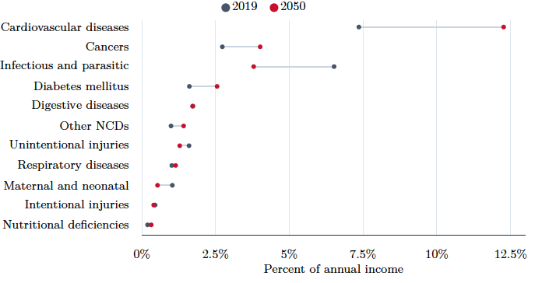
Indonesia’s economic value of avoidable mortality, 2019 & 2050

Slide 19
Message 2. Improving access to a basic package of CVD interventions, and tackling tobacco, could reduce Indonesia’s CVD mortality rates to those of peer countries

Slide 20
Methods: how interventions change the disease pathway
New CVD incidence →
Fatal CVD
case-fatality →
Healthy
(no CVD)
Living with CVD
(or diabetes)
CVD death
Fewer people fall ill due to preventive interventions
More people survive due to treatment interventions
Other cause
(background) death
Background mortality is driven by demography and remains unchanged by health interventions
Method: Five independent Markov cohort state-transition models (ischemic heart disease, ischemic stroke, intracerebral hemorrhage, hypertensive heart disease, cardiomyopathy and myocarditis) integrated within a cohort-component demographic projection model. Parameters from GBD 2023 and World Population Prospects 2024, calibrated to fit recent historical trends.

Slide 21
Analytical framework: increases in intervention utilization leads to lower mortality (at additional costs)
CAVEAT ON RESULTS: all input data regarding current intervention utilization (coverage) and costs come from literature and assumptions – these can be quickly replaced with local data in the final analysis

Slide 22
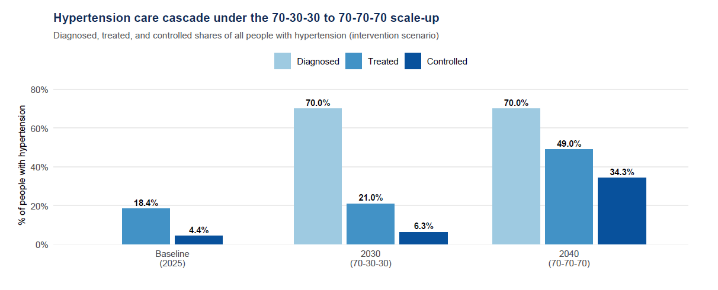
Analysis 1: mortality impact and cost of achieving a 70-70-70 target for CVD prevention
Source: NCD Risk factors Collaborators 2024. Method: baseline (2025) shows only measured treated/controlled — diagnosis is not modeled at baseline, so no diagnosed bar. Type-2 diabetes follows the same targets (baseline treated ≈ 22.0%, controlled ≈ 7.5%).

Slide 23
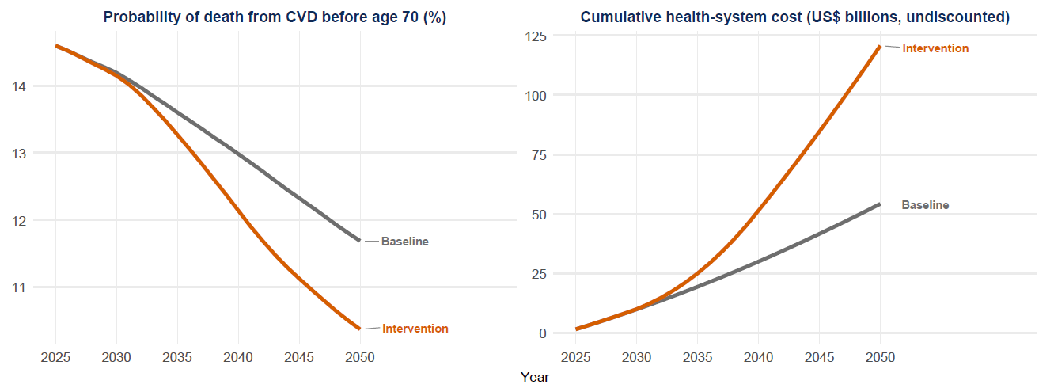
Improved CVD prevention lowers premature mortality at a rising but bounded cost
Sources: See previous slides for details of epidemiological and demographic inputs. Intervention unit costs come from Watkins et al., Lancet Global Health 2020. Note: The metric “probability of death from CVD before age 70” is calculated from life tables and is aggregated over the CVD causes modeled here. As before, costs are provisional and need to be validated with BPJS before policy use.

Slide 24
The 70-70-70 target would result in about 1.6 million fewer deaths by 2050
Cumulative from 2025 through year (unless noted) | 2030 | 2040 | 2050
Projected deaths — CVD (six causes) + type-2 diabetes (million)
Baseline (current course) | 6.11 | 18.40 | 33.35
Intervention | 6.10 | 18.00 | 31.77
Projected health-system cost (US$ billion, un-discounted)
Baseline (current course) | 9.89 | 29.99 | 54.25
Intervention | 10.03 | 51.42 | 120.71
Net effect of the strategy
Additional cost (US$ billion, un-discounted) | 0.14 | 21.44 | 66.46
Deaths prevented (million) | 0.01 | 0.39 | 1.58
Annual financing intensity (that year only, not cumulative)
Additional cost per capita in that year (US$, un-discounted) | US$0.16 | US$12.97 | US$14.92
See previous slides for methods, data sources, and caveats

Slide 25
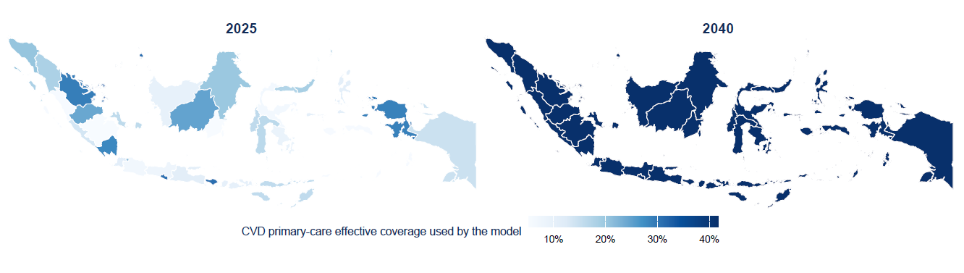
Achieving 70-70-70 would require differential action at the provincial level to close gaps
Method and data: See previous slides for basics of modeling. The Indonesia national-level disease and demographic models are re-parameterized with provincial-level all-cause and CVD-specific mortality (from GBD and UNPD) to create unique models for each province that are re-calibrated. Note: Provincial CVD treatment coverage is a crude anchor based on observed CVD mortality and the modeled coverage-effect relationship (extreme values capped); provincial diabetes coverage is scaled proportionally. These values must be validated with BPJS before policy use.

Slide 26
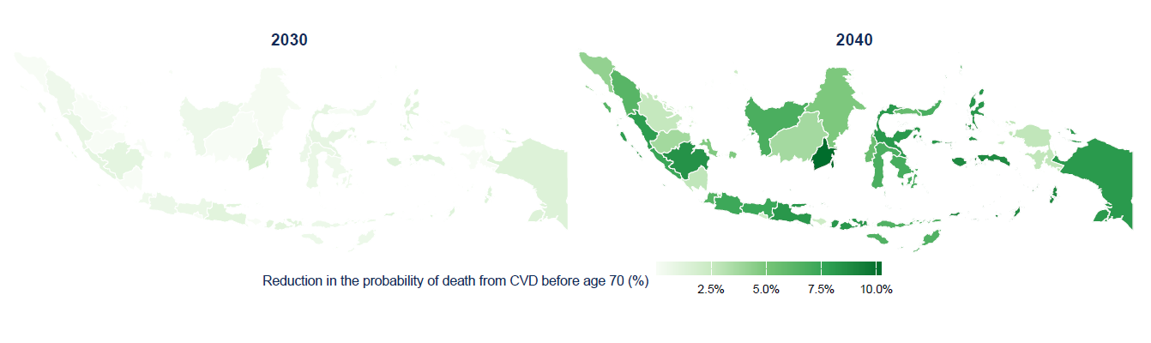
Achieving 70-70-70 would cause premature CVD mortality to fall in every province by 2040
See previous slides for relevant methods and data

Slide 27
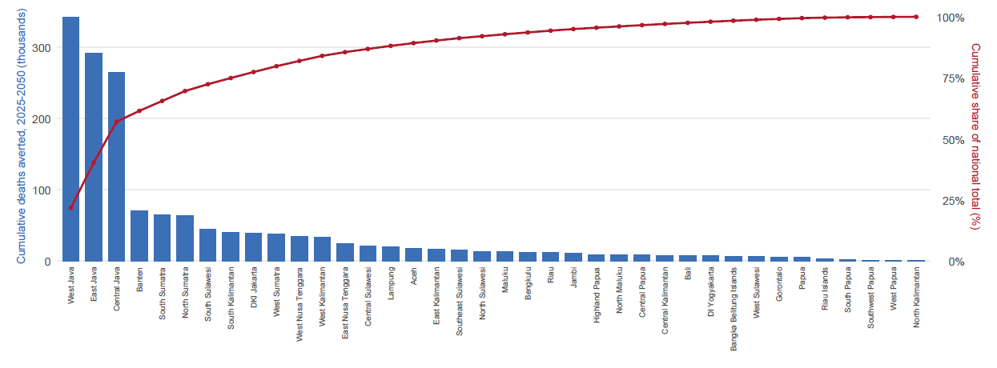
About half of averted CVD deaths come from the three most populous provinces
Note: This Pareto chart contains bars that represent cumulative deaths averted 2025–2050 by province as per the analysis presented in the previous slides. The red curve is the running cumulative proportion of total deaths averted at the national level. See notes on previous slides for other methods and data.

Slide 28
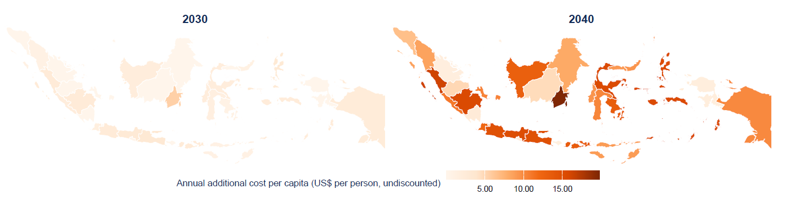
70-70-70 has a different financing requirement according to provincial burden and access gap
Note: The map above shows the average annual additional cost per capita required over the 2025-2050 period to reach the 70-70-70 target in each province. The costs vary depending on the current utilization (effective coverage) of CVD preventive interventions and magnitude of CVD burden in each province. Unit costs are assumed to be the same across provinces; this requires validation with BPJS.

Slide 29
Other interventions can add impact (and cost) to primary CVD prevention
Clinical intervention | Cumulative deaths averted (millions) | Reduction in CVD mortality probability | Reduction in number of CVD deaths | Average annual additional | Additional cost per capita in 2050
 |  |  |  | cost per capita
Primary CVD prevention | 1.964 | 16.70% | 11.50% | US$2.20 | US$3.94
Type-2 diabetes treatment | 0.493 | 0.60% | 2.50% | US$17.84 | US$34.33
Treatment of acute coronary syndromes | 0.315 | 0.031 | 0.014 | US$2.88 | US$5.48
Heart-attack secondary prevention | 0.244 | 2.40% | 1.10% | US$1.14 | US$2.21
Chronic heart-failure care | 0.105 | 0.90% | 0.40% | US$0.25 | US$0.50
Acute heart-failure care | 0.094 | 0.60% | 0.40% | US$0.53 | US$1.05
Stroke secondary prevention | 0.04 | 0.30% | 0.20% | US$0.63 | US$1.16
All clinical (combined) | 3.153 | 23.00% | 16.80% | US$24.47 | US$46.35
Note: all interventions included here are based on recommendations from the Disease Control Priorities Project and represent a (high priority) subset of all interventions for CVD covered by JKN. Incremental costs and effects are calculated by assuming a linear scale-up to a target of 80% coverage by 2050. Un-discounted costs are reported in market USD (2023) from the purchaser perspective.

Slide 30
Tobacco control policies could add significant impact to the clinical program
Type of policy | Cumulative deaths averted (millions) | Reduction in CVD mortality probability | Reduction in number of CVD deaths
Tobacco tax
50% increase in retail price | 0.390 | 2.10% | 1.30%
75% increase in retail price | 0.578 | 3.20% | 2.00%
Tobacco policy package (MPOWER) | 0.650 | 3.60% | 2.20%
Combined impact of taxes (75%) and regulations | 1.215 | 6.60% | 4.20%
Note: tobacco policies are assumed mostly to have an effect on CVD incidence and case-fatality from cessation among persons without and with CVD, respectively. Impact estimates are based on price-elasticity meta-analyses and relative risks from the GBD study. The tobacco policy package reflects the non-price measures in MPOWER: smoke-free policies, health warnings and mass-media campaigns, advertising bans, and cessation support. Only 6 CVD causes and T2DM are included; results may differ from message 4, which includes 19 CVD + Cancer + EPOC + T2DM causes.

Slide 31
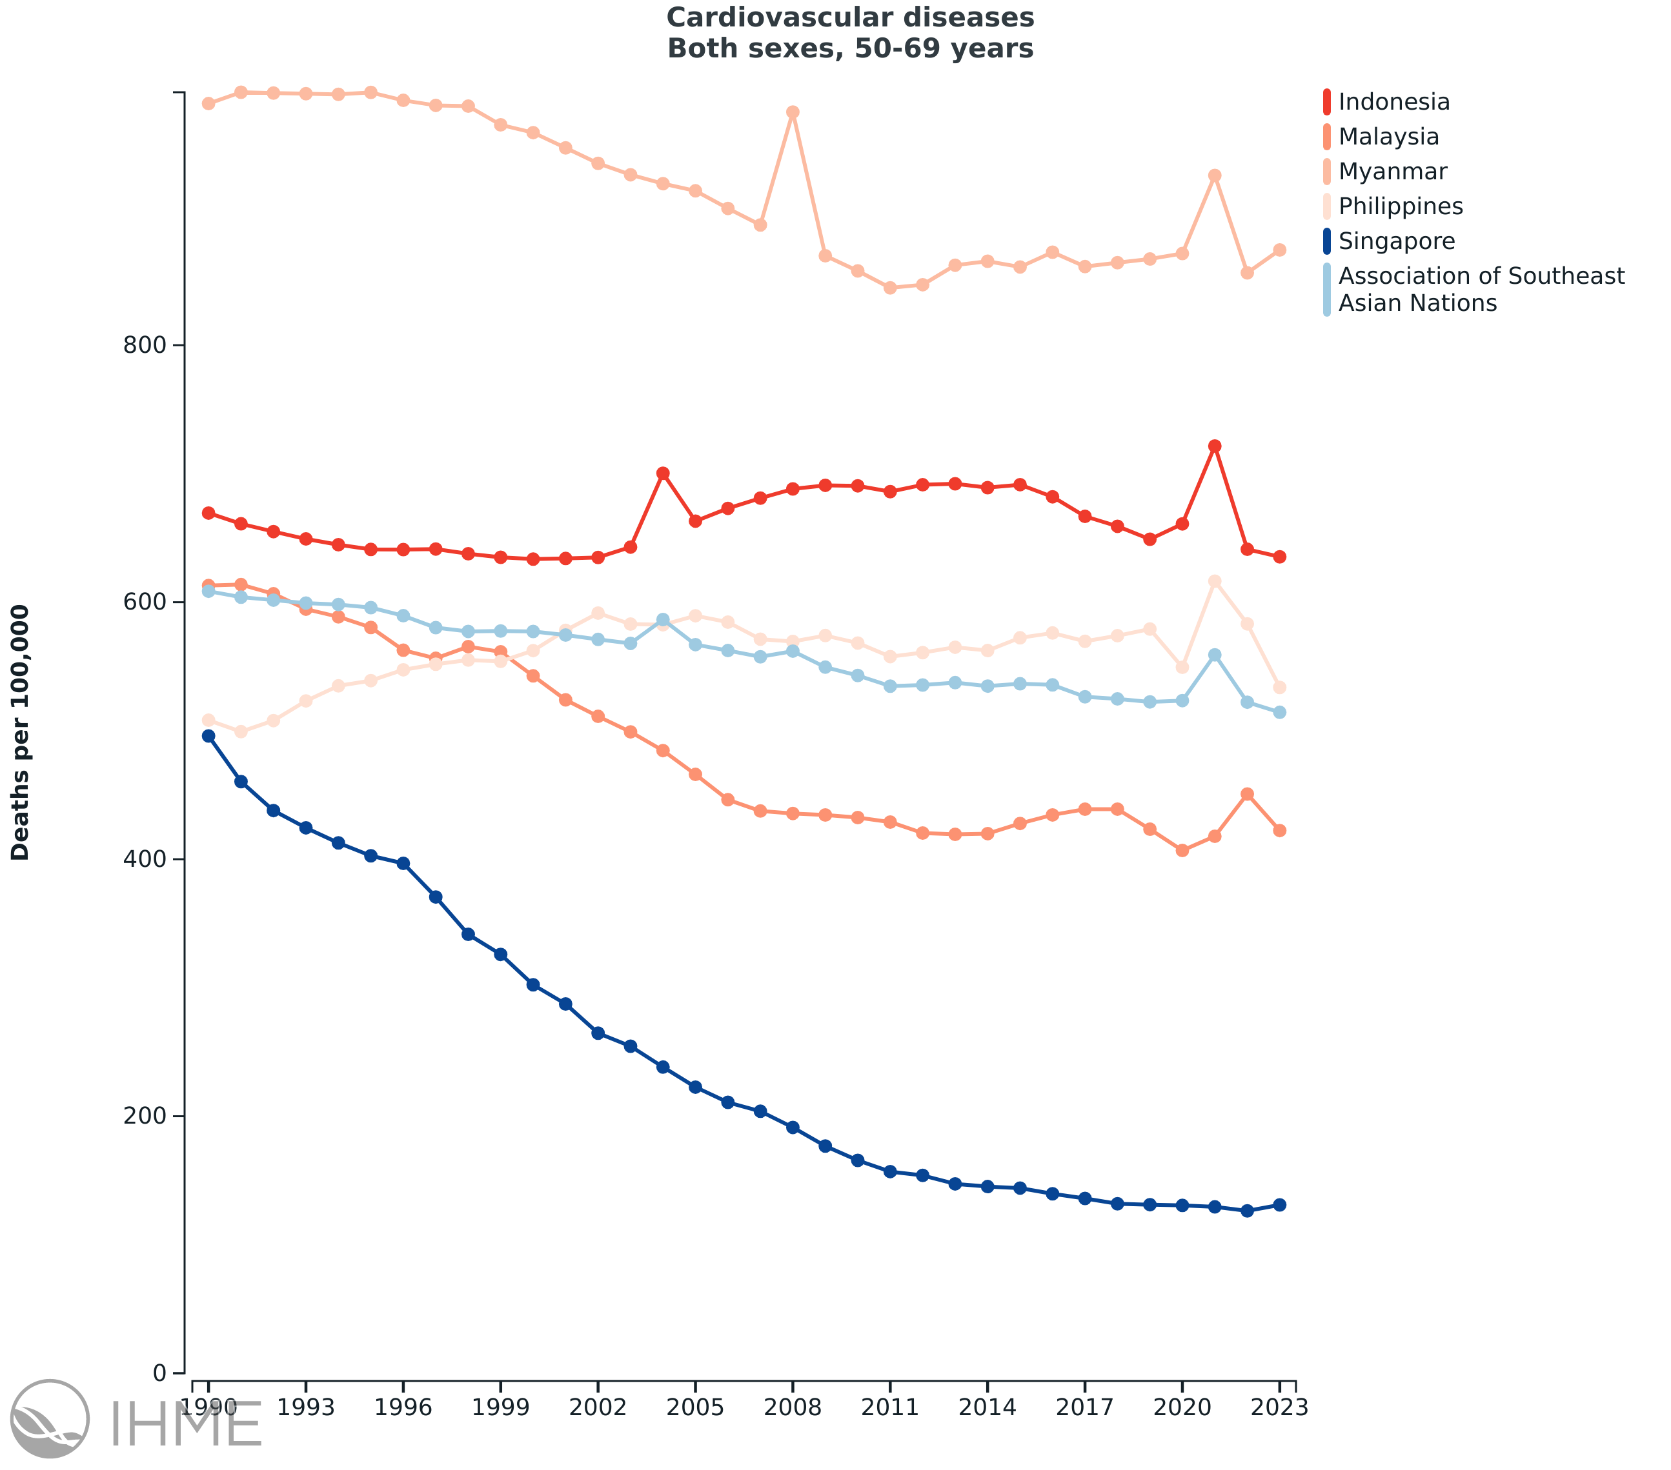
Policy goal: improving Indonesia’s performance on CVD mortality among ASEAN countries
Notes:
70-70-70
Tobacco control
All other interventions modeled

Slide 32
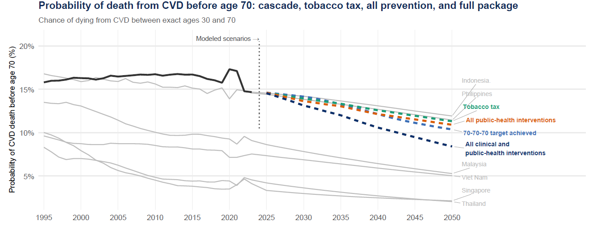
Implementation of clinical interventions and tobacco control could get Indonesia close to Malaysia’s CVD mortality level by 2050
Note: Indonesia observed history (solid, to 2023) and ASEAN comparators are WPP-scaled reference series. Modeled Indonesia scenarios (dashed, 2025-2050) use the GBD-calibrated model baseline. ASEAN Comparator trends correspond to a linear extrapolation for illustrative reference. Tobacco and PH correspond to a 75% excise tax scenario.
Achieving Singapore-level mortality would require additional action on prevention (e.g., lead abatement, air pollution control) and treatment (novel CVD therapies)

Slide 33
Message 3. The financial risk protection implications of CVD are considerable

Slide 34
question: What are the FINANCIAL CONSEQUENCES OF CVD FOR INDONESIAN HOUSEHOLDS?
Objective: To estimate the lack of financial risk protection associated with chronic care and acute events associated with CVD
We assess the number of cases of catastrophic health expenditures associated with out-of-pocket costs related to CVD care under different scenarios under JKN

Slide 35
Model overview
282 million people, all assumed enrolled in JKN, grouped by five consumption expenditure quintiles
Q1 poorest
Q2
Q3
Q4
Q5 richest
INPUT 1
INPUT 2
CHRONIC CARE
15.6M patients in care
living with CVD or diabetes
Full cost: IDR 0.9 – 5.2M per patient per year
ACUTE EVENTS
1.9M hospitalizations a year
stroke, intracerebral hemorrhage, heart attack
Full cost: IDR 7.0M per admission (INA-CBG)
INPUT 3
WHAT HAPPENS — was the service actually covered?
Covered → household pays a residual
Not covered → household pays full cost
Household out-of-pocket (OOP) costs = ( 1 − η ) × cost of care
η ≈ 40% for chronic care, 54% for acute (base case estimates)
WHEN DOES IT BECOME CATASTROPHIC?
Household OOP costs ÷ annual household consumption expenditure > 10%
Note:
η = the share of total costs actually covered
INA-CBG = Indonesia Case Base Groups (disease areas), the case-mix payment system BPJS uses
Notes:
η_q​=d_q​×(1−r)
d: the share of encounters where JKN was actually used, by quintile. Measured, Susenas March 2025: outpatient 46.8% (Q1) → 59.3% (Q5), Tabel 2.24; inpatient 79.9% → 78.2%, Tabel 2.28.
r: the residual a household still pays even when JKN was used: 25% chronic, 33.6% acute (Fattah 2023).
Therefore, composite: ~39–40% chronic, ~54% acute. The model runs the two-state mixture (delivered → pays r; not delivered → pays full cost)

Slide 36
Under JKN as designed, no households would pay
η is the share of the costs covered
(how much the JKN actually covers of the household bill at the point of service)
η = d × (1 − r), where d is the share of services where JKN was actually used to reimburse, and r is the residual a household pays after JKN is used
Household out-of-pocket costs
= ( 1 − η ) × cost of care
η = 100% is the original policy design: free at the point of use, thus no catastrophic expenditure, by construction
Notes:
meaning how much the JKN actually takes off the household’ bill at the point of service (by design it is 100%, and whatever falls short is what the household pays).

Slide 37
Inputs (1): Chronic care costs Number of patients in care, full cost of care, and what households pay
Condition | Patients in care (millions) | Full cost of care IDR/patient-year (USD) | Household payment when JKN is used IDR/patient-year (USD) | Household payment when JKN is not used IDR/patient-year (USD)
Post-IHD secondary prevention + heart failure | 5.0 | 3,374,650 (211) | 843,662 (53) | 3,374,650 (211)
Post-ischaemic stroke | 3.0 | 1,367,842 (85) | 341,961 (21) | 1,367,842 (85)
Post-intracerebral haemorrhage | 1.1 | 1,367,842 (85) | 341,961 (21) | 1,367,842 (85)
Hypertensive heart disease (chronic HF) | 0.4 | 5,236,586 (327) | 1,309,146 (82) | 5,236,586 (327)
Rheumatic heart disease (prophylaxis) | 1.3 | 897,124 (56) | 224,281 (14) | 897,124 (56)
Type 2 diabetes (treatment) | 4.7 | 3,867,720 (242) | 966,930 (60) | 3,867,720 (242)
Note: When JKN is used the household still pays 25% of cost for chronic care; when not used the household pays full cost (Fattah et al. Int. J. Equity Health 2023). Source: built from Indonesia-adjusted unit costs extracted from the literature

Slide 38
Inputs (2): Acute care costs Number of hospitalized CVD events, full cost of care, what households pay
Event type | Admissions per year (millions) | Full cost of care IDR per admission (USD) | Household payment when JKN used IDR (USD) | Household payment when JKN not used IDR (USD)
Hospitalized acute CVD event (weighted average) | 1.86 | 6,950,500 (434) | 2,331,893 (146) | 6,950,500 (434)
— ischemic stroke (63% of events) | 1.18 | 7,061,300 (441) | 2,369,066 (148) | 7,061,300 (441)
— hemorrhagic stroke / ICH (14%) | 0.26 | 5,822,600 (364) | 1,953,482 (122) | 5,822,600 (364)
— acute myocardial infarction (22%) | 0.42 | 7,377,900 (461) | 2,475,285 (155) | 7,377,900 (461)
Note: When JKN is used, the household still pays about 34% of the cost of acute care; when not used it pays the full cost (Fattah et al. Int. J. Equity Health 2023; Dewan Jaminan Sosial Nasional).
Sources: INA-CBG tariffs, Permenkes 3/2023 — kelas 3, severity II, Regional 1, government class B. Event counts: BPJS sample data 2020–24
Notes:
Abbreviation:
INA-CBG = Indonesia Case Base Groups (disease areas); the case-mix payment system BPJS uses
DJSN = Dewan Jaminan Sosial Nasional (National Social Security Council)
INA-CBG tariffs, Permenkes 3/2023 — kelas 3, severity II, Regional 1, government class B. Event counts: BPJS sample data 2020–24; type mix from UW incidence 2023 (IHD + IS + ICH). USD at IDR 16,000.

Slide 39
Inputs (3): What fraction of cost is covered by JKN
CHRONIC CARE
ACUTE EVENTS
outpatient · 15.6M patients in care
inpatient · 1.86M admissions a year
100%
100%
80%
83%
81%
82%
78%
75%
75%
56%
59%
53%
47%
48%
50%
50%
25%
25%
53%
55%
54%
54%
52%
36%
40%
42%
44%
35%
0%
0%
Q1
Q2
Q3
Q4
Q5
Q1
Q2
Q3
Q4
Q5
The percentage of total care cost covered by JKN (η) — Source: modeled
The percentage of care utilization that uses JKN (d) — Source: Susenas 2025 Tabel 2.24 / 2.28
Notes:
Interpretation:
JKN covers 44% of the cost of chronic CVD care for the Q5. 59% of their outpatient visits were paid through JKN.
JKN covers 53% of the cost of a CVD hospitalization in the Q1. 80% of their CVD admissions were paid through JKN.

Slide 40
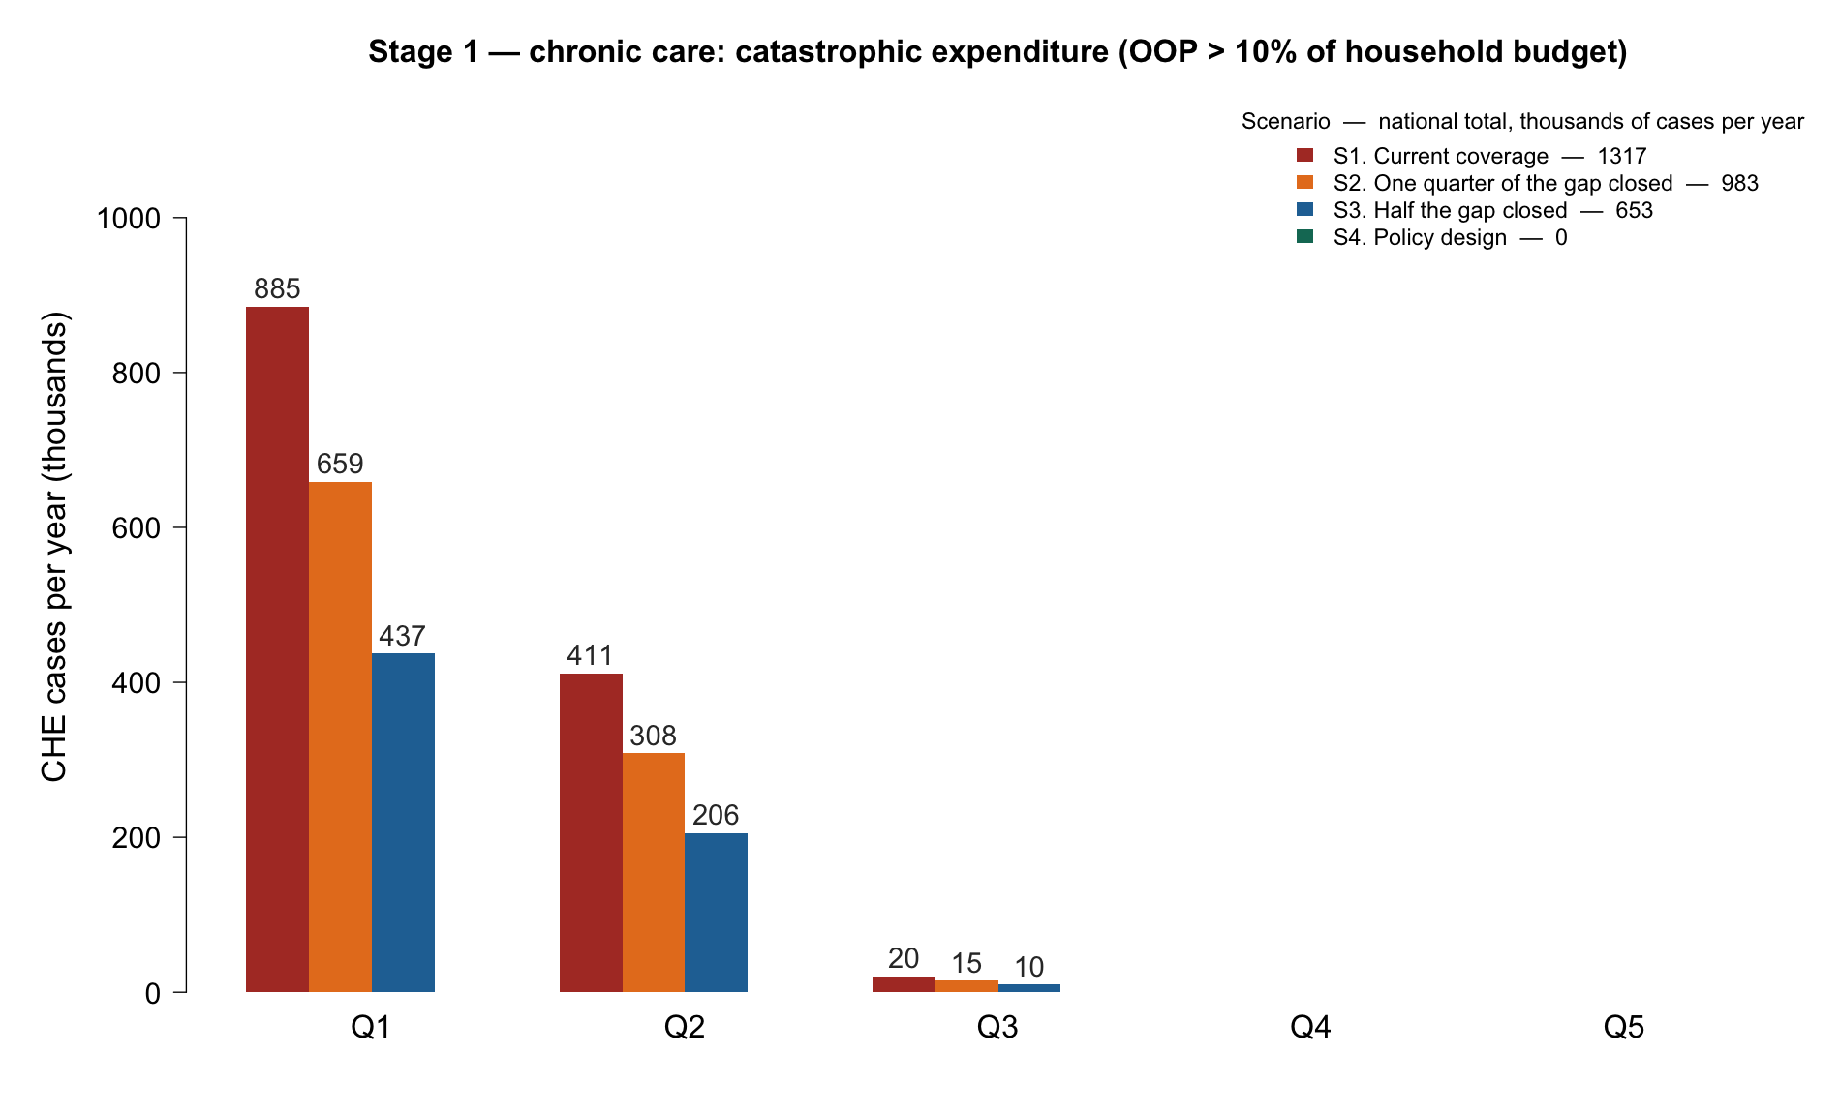
Key finding 1: Chronic care
1.3 million catastrophic cases per year = 8% of 15.6M patients in care
Two thirds of them in Q1 consumption quintile
Catastrophic health expenditure (CHE) cases
(OOP costs > 10% of household expenditure) related to chronic care
Notes:
ZILI: ROUND NUMBERS EVERYWHERE IN THE FIGURE.
885.4 = 885
659.0=659
Etc
Same thing for the legent

Slide 41
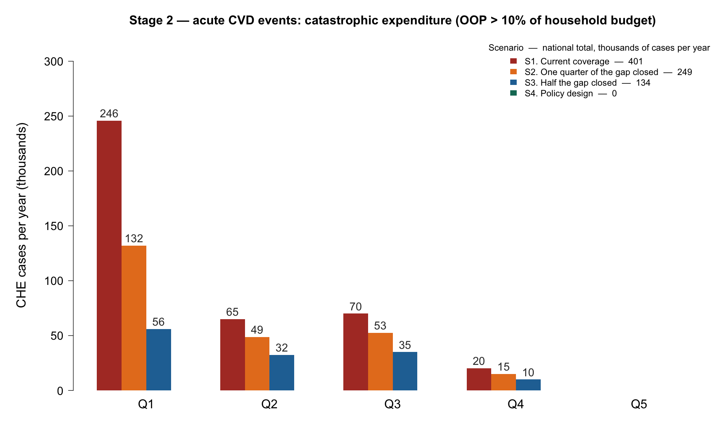
Key finding 2: Acute events
401,000 catastrophic admissions a year = 22% of all CVD admissions
62% of those in Q1
Catastrophic health expenditure (CHE) cases
(OOP costs > 10% of household expenditure) related to acute care
Notes:
ZILI: ROUND NUMBERS EVERYWHERE IN THE FIGURE.
245.9 = 246
132.1=132
Etc
same thing for the legend

Slide 42
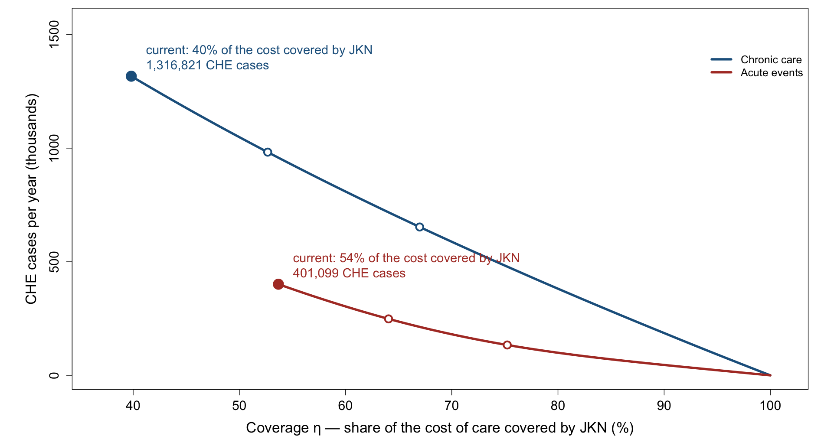
Catastrophic cases falls as effective coverage rises from where it is today to 100% coverage
Note: Catastrophic health expenditure cases when OOP costs > 10% of household expenditure

Slide 43
Brief summary: Four scenarios and corresponding catastrophic health expenditure (CHE)
Raising coverage toward original policy design
Scenario | National average coverage chronic / acute | Chronic CHE cases per year | Acute CHE cases per year
S1. Current coverage | 40% / 54% | 1,316,821 | 401,099
S2. One quarter of the gap closed | 53% / 64% | 982,559 | 248,508
S3. Half the gap closed | 67% / 75% | 652,988 | 133,623
S4. Policy design: coverage fully delivered | 100% / 100% | 0 | 0
Note: CHE cases per year at a 10% threshold of annual consumption expenditures

Slide 44
Message 4. Tobacco tax hikes bring large mortality reduction, pro-poor impact, & large fiscal revenues

Slide 45
question: What are the health and financial consequences of increased tobacco taxes in Indonesia?
Objective: To estimate the health gains, financial risk protection benefits, and fiscal revenues raised with different scenarios of increased tobacco taxes
We assess the impact on mortality reduction, on reducing the number of cases of catastrophic health expenditures associated with out-of-pocket costs related to treatment of tobacco-related diseases, and the revenues raised
Adapted from: Lisus, Roy, et al. Forthcoming; Verguet, Gauvreau et al. Lancet Global Health 2015

Slide 46
Model overview
INPUT 1
INPUT 2
INPUT 3
WHO SMOKES
62.8M smokers
aged 15+, split by quintile, age and sex (SKI 2023)
TAX → PRICE
+50% excise → +19% price
Currently excise tax is 38% of the retail price of cigarettes
HOW SMOKERS RESPOND
Two responses
Price elasticities, by age and income group
HEALTH GAIN RESPONSE
Quitters lose most of their increased mortality risk (50%), moderated by age
Impact on 19 tobacco-related conditions (GBD 2023)
FISCAL GAIN RESPONSE
Higher prices lead to higher revenues even though cigarette consumption decreases
RESULT 1 MORTALITY REDUCTION
Premature deaths averted over the lifetime of today's smokers
RESULT 2 CATASTROPHIC EXPENDITURES AVERTED
Same JKN coverage assumptions as before
RESULT 3 REVENUES RAISED
Excise revenues rise
The distribution of increased tax revenues varies by income quintile
SKI = Survei Kesehatan Indonesia (Indonesia Health Survey)

Slide 47
Input (1): Smoking prevalence & tobacco prices
Quintile | Population 15+ (M) | Smokers (M) | Prevalence 15+ | Cigarettes /day | Price paid (IDR/stick) | Consumption (B sticks/yr)
Q1 (poorest) | 34.8 | 11.4 | 33% | 11.6 | 1,465 | 48.3
Q2 | 40.0 | 13.1 | 33% | 11.8 | 1,535 | 56.7
Q3 | 44.4 | 13.9 | 31% | 11.9 | 1,615 | 60.4
Q4 | 47.3 | 13.7 | 29% | 12.0 | 1,737 | 60.1
Q5 (richest) | 46.0 | 10.7 | 23% | 12.5 | 1,934 | 49.2
TOTAL | 212.4 | 62.8 | 30% | 12.0 | — | 274.7
The poorest quintile (Q1) has the highest smoking prevalence so carries the greatest burden. Modelled prevalence for ages 15+ (30%) reproduces SKI's published figure (30%).
Data sources: smokers and prevalence: SKI 2023 (Kemenkes/BKPK, SKI 2023 Dalam Angka), Table 11.3; cigarettes/day: SKI 2023 Table 11.32; Price paid (IDR/stick): SKI 2023 Table 11.34; Consumption (B sticks/yr): derived

Slide 48
Input (2): Tax scenarios Current excise → modeled increase → price → consumption
Excise increase scenario | Retail price | Cigarettes smoked | Reads as
Baseline | — | 275B sticks/yr | Current policy: tiered excise, PMK 97/2024 (2025 tariff)
+13% | +4.7% | -2.4% | Typical annual tariff adjustment
+25% | +9.5% | -4.8% | Moderate reform
+50% | +19.0% | -9.5% | Central case used in the results that follow
+100% | +37.9% | -18.6% | Ambitious reform
+200% | +75.9% | -35.3% | Upper bound examined
Why price rises less than the tax: excise is 38% of the retail price on average across the nine cigarette tiers — 14% for the cheapest hand-rolled tier, 54% for machine-made — so a 50% excise increase lifts price by 19%. We assume the full increase passes to consumers.

Slide 49
Input (3): How smokers respond Two behavioral responses — yet only quitting provides mortality reduction benefits
Age band | Participation (quitting) | Intensity (smoking less)
15–24 | −0.31 | −0.36
25–34 | −0.19 | −0.39
35–44 | −0.09 | −0.37
45–54 | −0.04 | −0.37
55–64 | −0.07 | −0.39
65+ | −0.25 | −0.38
Notes:
The age pattern is from Indonesian data (Fauzi, 2021).
The income gradient uses Fauzi’s Indonesian national values and assumptions adapted from previous publications outside of Indonesia (WHO, 2000; Verguet, Gauvreau et al. Lancet Global Health 2015).
Notes:
https://digital.car.chula.ac.th/chulaetd/4889/
Fauzi, R. (2021). A policy simulation impact of tobacco excise tax increase on cigarette consumption, mortality, medical treatment cost, life-years gained, and government revenue in Indonesia.

Slide 50
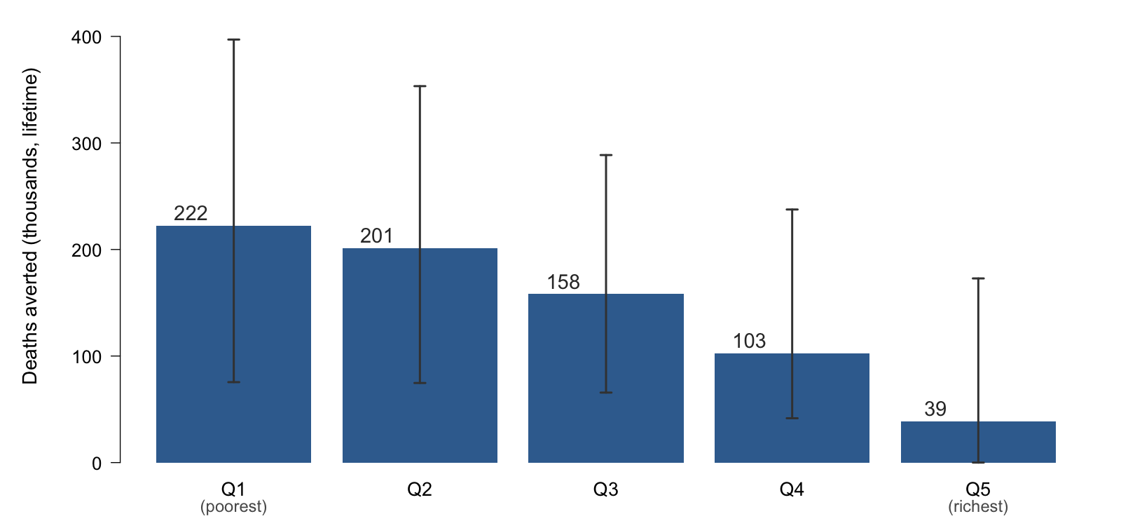
Key finding 1: Health gains are large & pro-poor 724,000 premature deaths averted; 60% in Q1 & Q2
50% increase in excise tax
Note: 19 tobacco-related conditions (incl. cardiovascular 58%, COPD 15%, lung cancer 14%, diabetes 5%) covering 85% of Indonesia's smoking-attributable deaths; tuberculosis and respiratory infections not yet included, so this is conservative. 95% uncertainty intervals (n= 2,000 Monte Carlo draws).

Slide 51
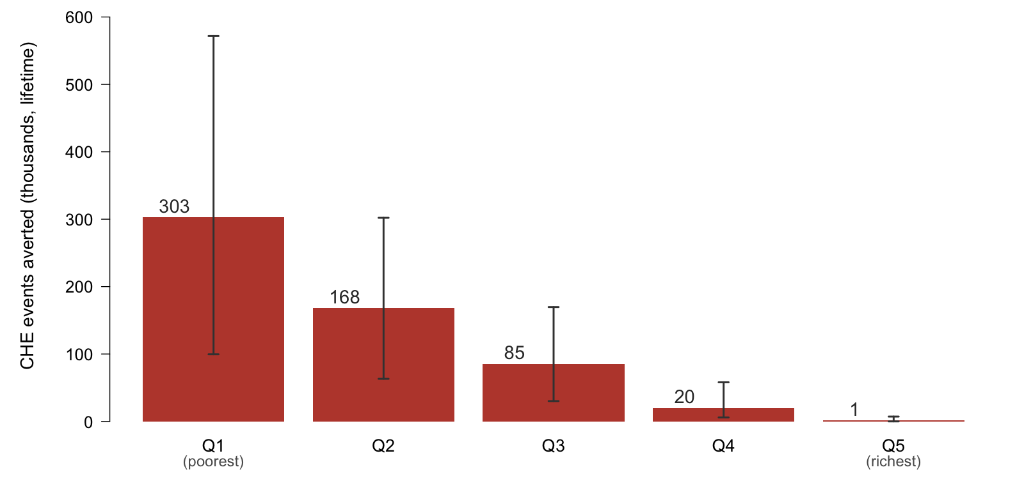
Key finding 2: Financial protection gains are large & pro-poor 577,000 catastrophic cases averted, 82% in Q1 & Q2
50% increase in excise tax
Note: Catastrophic health expenditure (CHE) cases defined as an out-of-pocket payment above 10% of annual household consumption expenditure. 95% uncertainty intervals (n= 2,000 Monte Carlo draws).

Slide 52
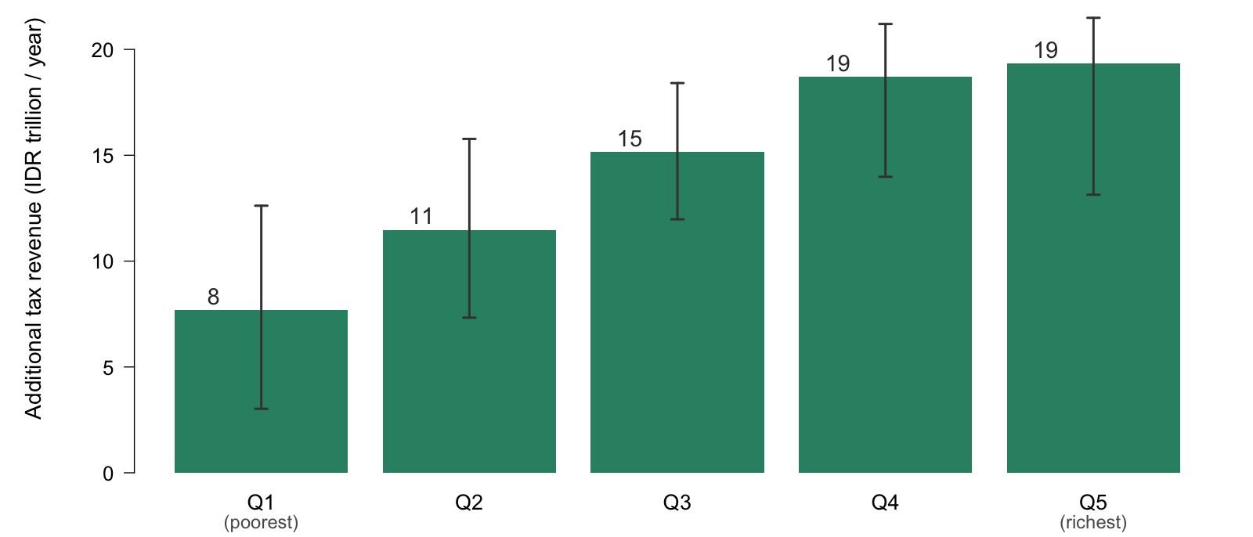
Key finding 3: Fiscal revenues raised are large & accrue among the rich Revenues rise by 31%; Q5 pays 27% of it
50% increase in excise tax
Note: National total IDR 72T per year. An annual flow in a single steady-state year, not a lifetime total. In US dollars: Q1 480, Q2 717, Q3 947, Q4 1,169, Q5 1,209 million; total US$4,522 million per year. 95% uncertainty intervals (n= 2,000 Monte Carlo draws).

Slide 53
Thank you

