Slide 1
Health and Economic Returns to Dietary Sodium Reduction
A national-scale cardiovascular disease modeling and benefit–cost analysis
Resolve to Save Lives (RTSL)

Slide 2
Project Objective and Policy Impact
Estimate national-scale health impacts of dietary sodium reduction policies using a population CVD model.
Quantify deaths and cases (IHD, strokes, hypertensive heart disease) and DALYs averted over 2026 -2050.
Conduct a full economic benefit–cost analysis to support government decision-making.
Focus on RTSL partner countries and policies that governments can realistically implement.

Slide 3
WHO SHAKE Strategy: Policy Framework
WHO SHAKE provides a comprehensive framework for population-wide sodium reduction.
Components include Surveillance, Harness Industry (food reformulation), Adopt Standards for Labelling and Marketing standards, Knowledge (consumer information), and Environments (healthier food).
Strongest and most sustained sodium reductions occur when SHAKE components are implemented as a package.
This project explicitly models and costs realistic SHAKE policy bundles.

Slide 4
RTSL Sodium Reduction Policy Support
Technical assistance to governments to design and implement mandatory sodium targets for packaged foods.
Support for front-of-pack sodium warning labels to inform consumers and incentivize reformulation.
Development of nutrition standards for public food procurement in schools, hospitals, and government settings.
Assistance with policy drafting, legal design, monitoring systems, and enforcement capacity.

Slide 5
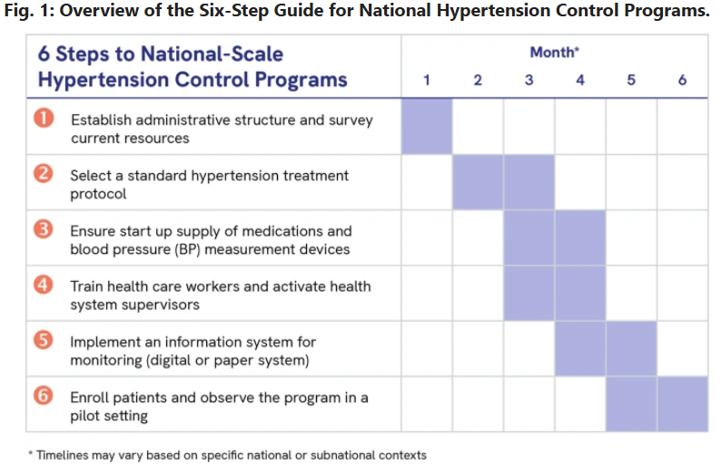
RTSL Sodium Reduction Policy Support
https://www.nature.com/articles/s41371-021-00612-6

Slide 6
CVD Modeling Engine
Population cohort model linking sodium intake to blood pressure and cardiovascular outcomes.
Uses country-specific baseline CVD incidence, mortality, and population age structure.
Policy scenarios translate sodium reductions into blood pressure changes using established dose–response relationships.
Resulting changes in heart attacks, strokes, and CVD deaths are projected over time.

Slide 7
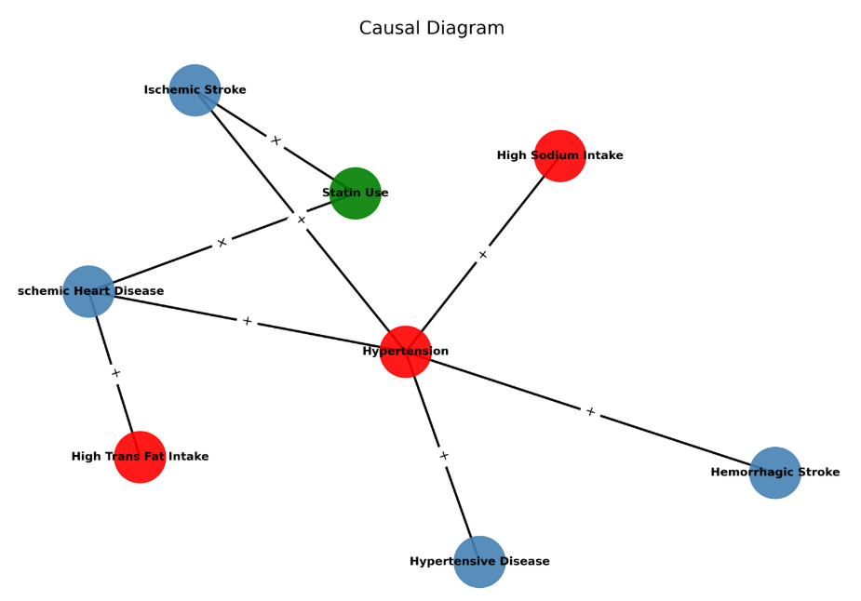
CVD Modeling Engine

Slide 8
Health and Economic Benefits Estimation
Reduced sodium intake leads to fewer cardiovascular events and premature deaths.
Health outcomes are summarized as deaths and DALYs averted.
Health gains are monetized using the standard economic valuation of mortality risk reduction.
Averted health-care expenditures are estimated and included as additional economic benefits.

Slide 9
Costing the SHAKE Policy Package
Costs are estimated using an ingredients-based regulatory costing approach.
Government costs include policy design, administration, monitoring, and enforcement.
Industry costs include reformulation, testing, and labeling compliance, counted as real resource costs.
Both start-up and ongoing recurrent costs are explicitly modeled over time.

Slide 10
Costing the SHAKE Policy Package (Example)
SHAKE Component | Activity | Cost Category | Frequency | Coverage | Cost Bearer (Gov/Industry/HH)
S - Surveillance | Population sodium survey | Program | Every 3–5 yrs | National | Government
S - Surveillance | Food sodium monitoring | Program | Annual | Processed foods | Government
H - Harness Industry | Set reformulation targets | Program | One-off | Key food categories | Government
H - Harness Industry | Product reformulation | Compliance | One-off + transition | Affected SKUs | Industry
A - Labeling | Front-of-pack labeling policy | Program | One-off | National | Government
A - Labeling | Label changes | Compliance | One-off | Affected SKUs | Industry
K - Knowledge | Mass media campaign | Program | Annual | Population reached | Government
E - Environment | School meal standards | Program | Annual | Schools | Government
E - Environment | Institutional food reformulation | Compliance | One-off + annual | Institutions | Vendors

Slide 11
Integrated Web-Based Decision Tool
All modeling and economic components are integrated into an interactive R Shiny web application.
Users can customize country-specific inputs, policy coverage, and implementation timelines.
The tool enables real-time comparison of alternative policy scenarios and assumptions.
Designed to support evidence-based policymaking and stakeholder engagement.

Slide 12
Full Benefit–Cost Analysis Outputs
Health benefits and implementation costs are combined to estimate net present value.
Benefit–cost ratios and return on investment are calculated for each policy scenario.
Results allow comparison across individual SHAKE components and bundled strategies.
Sensitivity analyses assess robustness to key assumptions and uncertainties.

Slide 13
Why This Analysis Matters for RTSL
Provides finance-ministry–ready evidence on the economic value of sodium reduction policies.
Strengthens regulatory impact assessments and national investment cases.
Supports prioritization of high-return noncommunicable disease prevention strategies.
Scalable framework applicable across multiple countries and policy contexts.

Slide 14
Next Steps
Finalize country-specific data inputs and validate assumptions with national stakeholders.
Complete deployment and testing of the interactive web tool.
Use results to support policy adoption, financing, and sustained implementation.
Position sodium reduction as a high-return national investment in partner countries.

