Slide 1
DISEASECARD
AGGREGATION AND VISUALIZATION OF RARE GENETIC DISEASES DATA
Projeto em Informática
2023-2024

Slide 2

01
CONTEXT AND STATE OF THE ART

Slide 3
STATE OF THE ART
More info here
Features |  | Orphanet | Malacards | Disease Ontology | GARD | NORD | NCBI | UptoDate | DiseaseCard | Our DiseaseCard
Functional | Disease Summary | ✅ | ✅ | ❌ | ✅ | ✅ | ❌ | ✅ | ✅ | ✅
 | Search | ✅ | ✅ | ⚠️ | ✅ | ✅ | ✅ | ✅ | ✅ | ✅
 | Advanced Search | ✅ | ⚠️ | ✅ | ❌ | ❌ | ❌ | ❌ | ❌ | ✅
 | Auto-complete | ⚠️ | ⚠️ | ❌ | ✅ | ❌ | ✅ | ✅ | ⚠️ | ✅
 | Disease Categories | ✅ | ✅ | ✅ | ✅ | ❌ | ❌ | ✅ | ❌ | ✅
 | Related Diseases | ❌ | ✅ | ✅ | ❌ | ✅ | ❌ | ✅ | ❌ | ✅
 | News | ✅ | ✅ | ❌ | ✅ | ✅ | ❌ | ✅ | ❌ | ✅
 | Drugs/ Treatments | ✅ | ✅ | ❌ | ✅ | ✅ | ❌ | ✅ | ⚠️ | ✅
 | Symptoms | ✅ | ✅ | ❌ | ✅ | ✅ | ❌ | ✅ | ⚠️ | ✅
 | AI Assisted Search | ❌ | ❌ | ❌ | ❌ | ❌ | ❌ | ❌ | ❌ | ⚠️

Slide 4

02
GOALS AND REQUIREMENTS GATHERING

Slide 5
GOALS
Data Collection and Integration
Activity Monitoring
Web Interface for Search
Conversational Search System
Protected Backoffice

Slide 6
REQUIREMENTS GATHERING
Brainstorming amongst the team
Gathering information from related websites
Interviewing medicine students
Studying previous work

Slide 7

03
REQUIREMENTS

Slide 8
FUNCTIONAL REQUIREMENTS
Disease Information
Daily
Updates
Flexible and Accessible Search
Secure Authentication (Admin)
Endpoint Monitoring (Admin)
CRUD Methods (Admin)

Slide 9
NON-FUNCTIONAL REQUIREMENTS
Modular Architecture
Accessibility
High Performance
Scalability

Slide 10

04
ACTORS

Slide 11


ACTORS
User
Admin

Slide 12
05
USE CASES

Slide 13
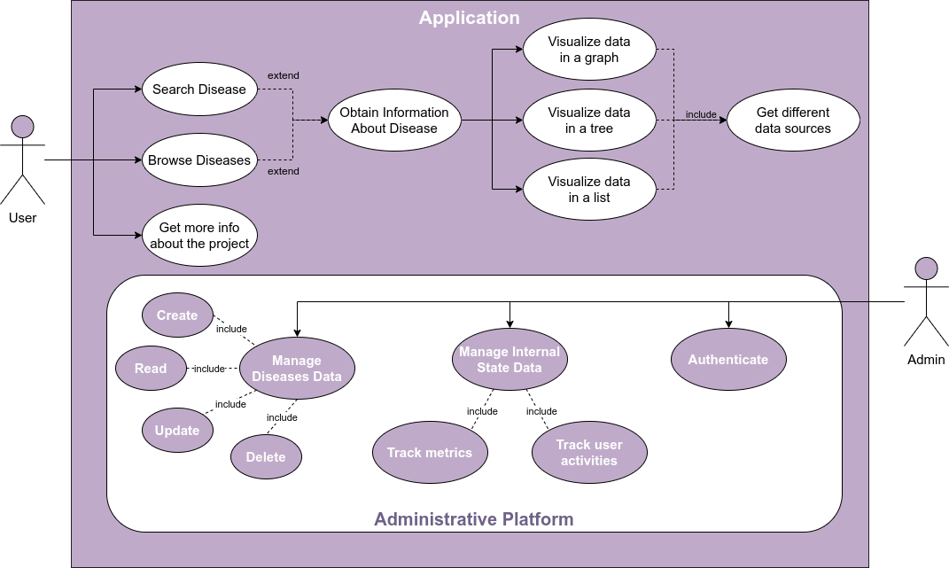

Slide 14
06
ARCHITECTURE

Slide 15
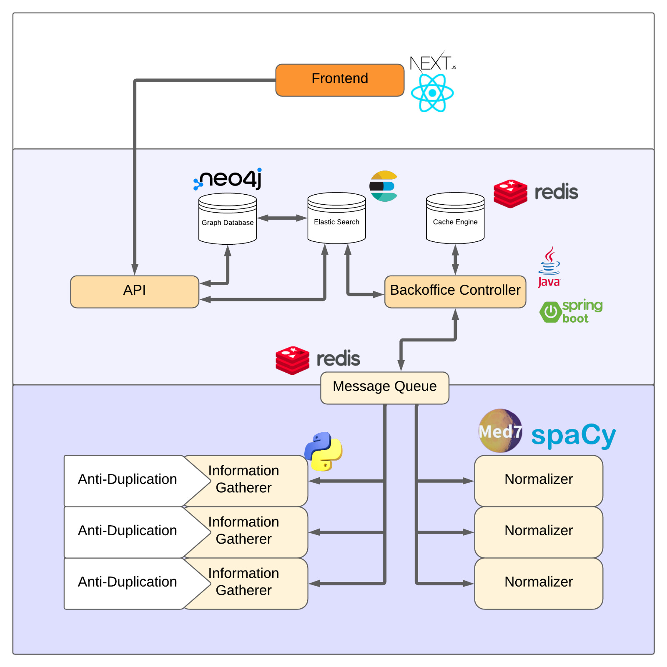
ARCHITECTURE
More Architectures here

Slide 16
07
DOMAIN MODEL

Slide 17
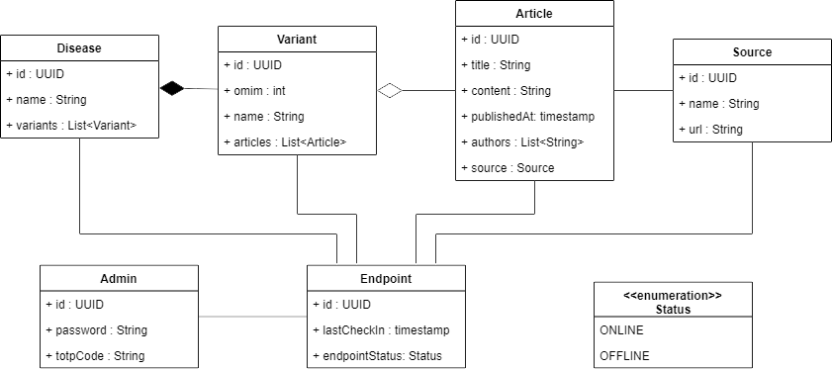
DOMAIN MODEL

Slide 18
08
DEPLOYMENT DIAGRAM

Slide 19
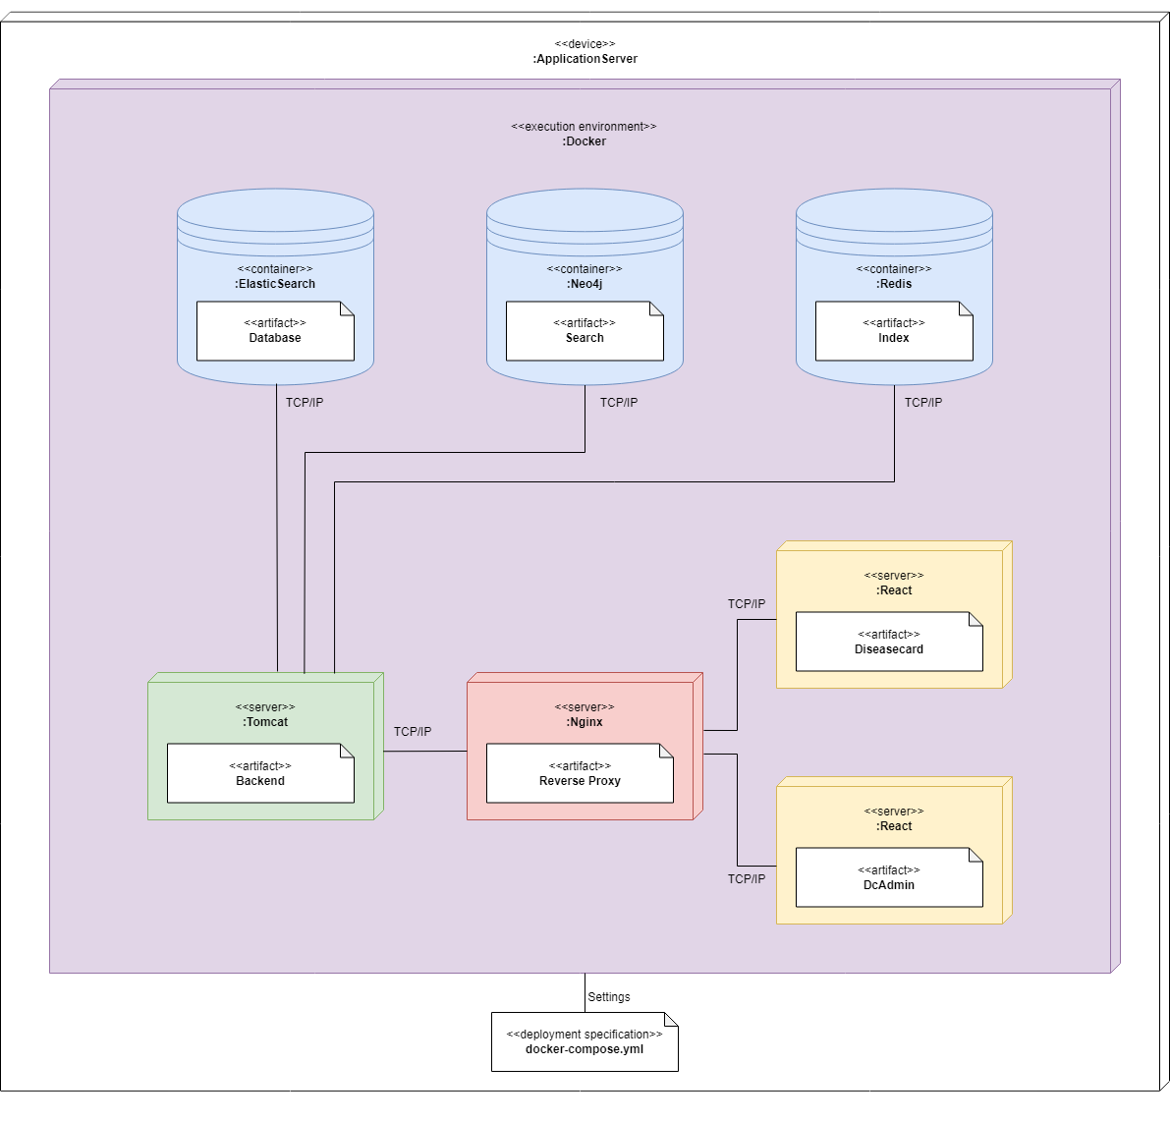
DEPLOYMENT DIAGRAM

Slide 20
09
MOCKUPS

Slide 21
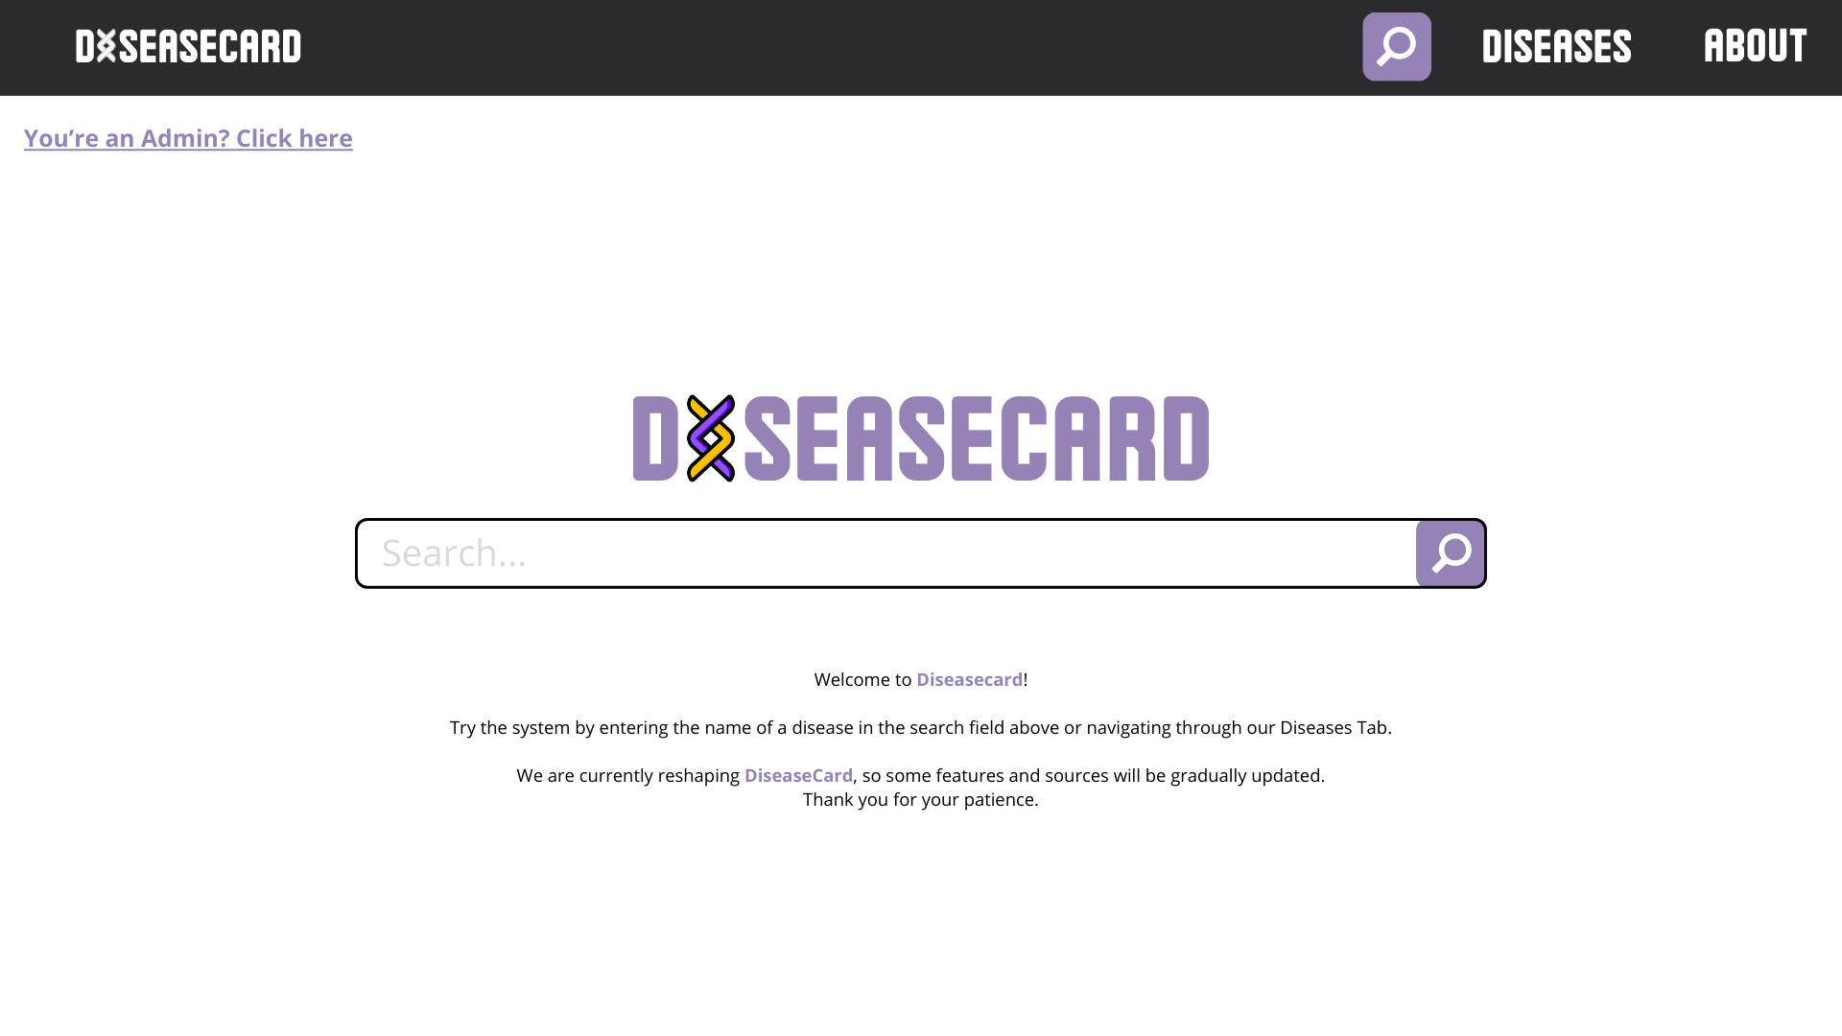

Slide 22
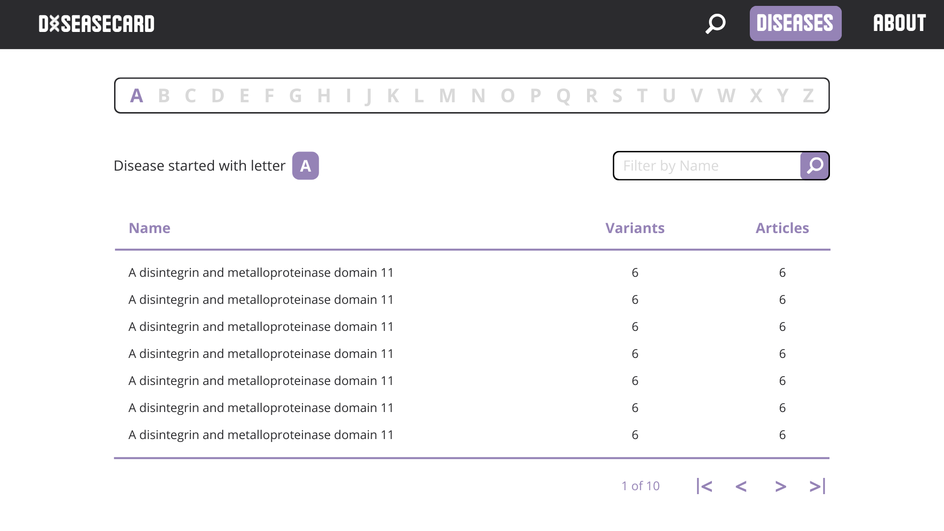

Slide 23
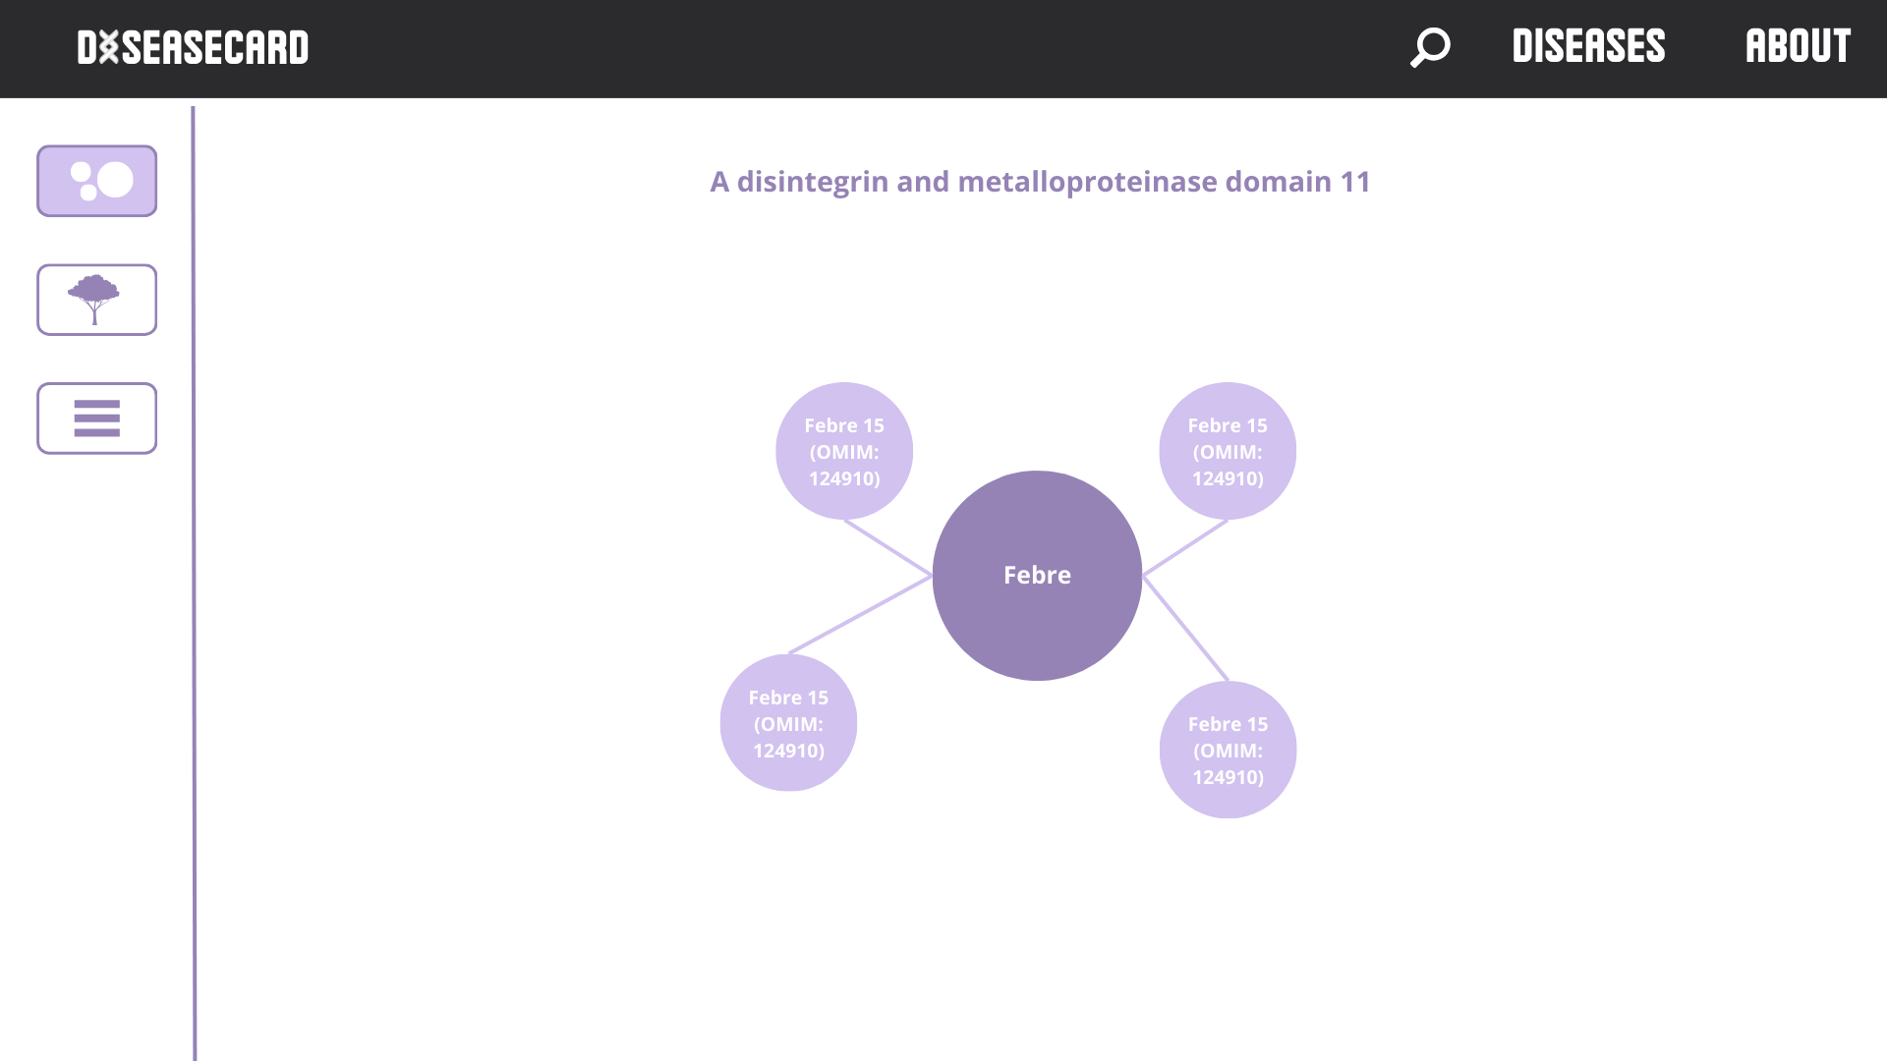

Slide 24
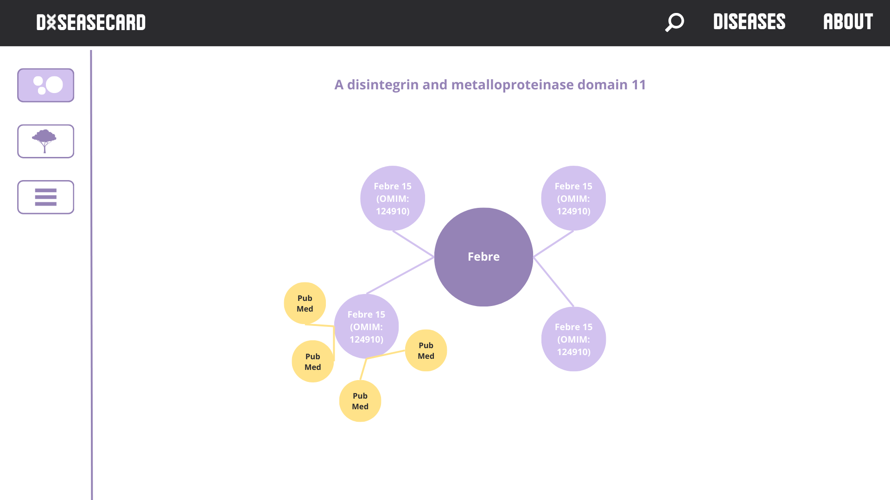

Slide 25
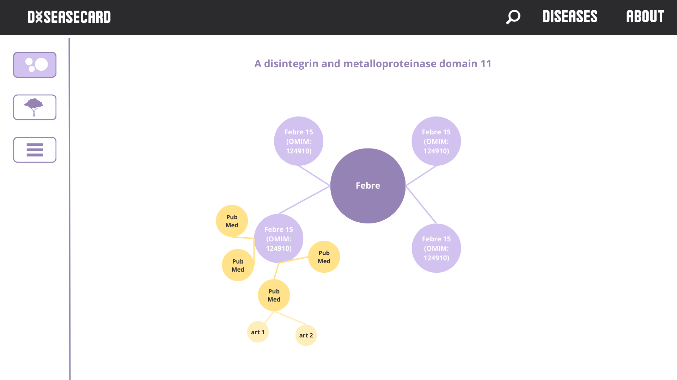

Slide 26
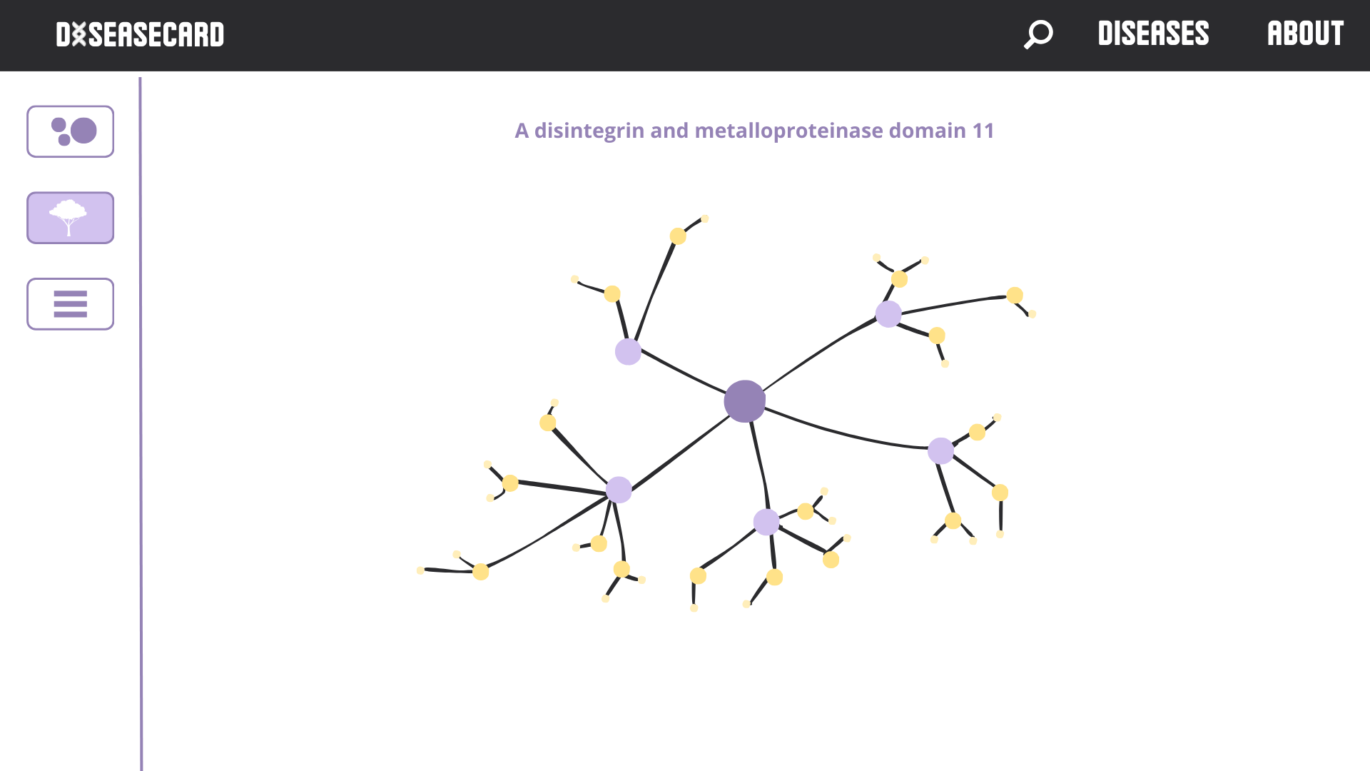

Slide 27
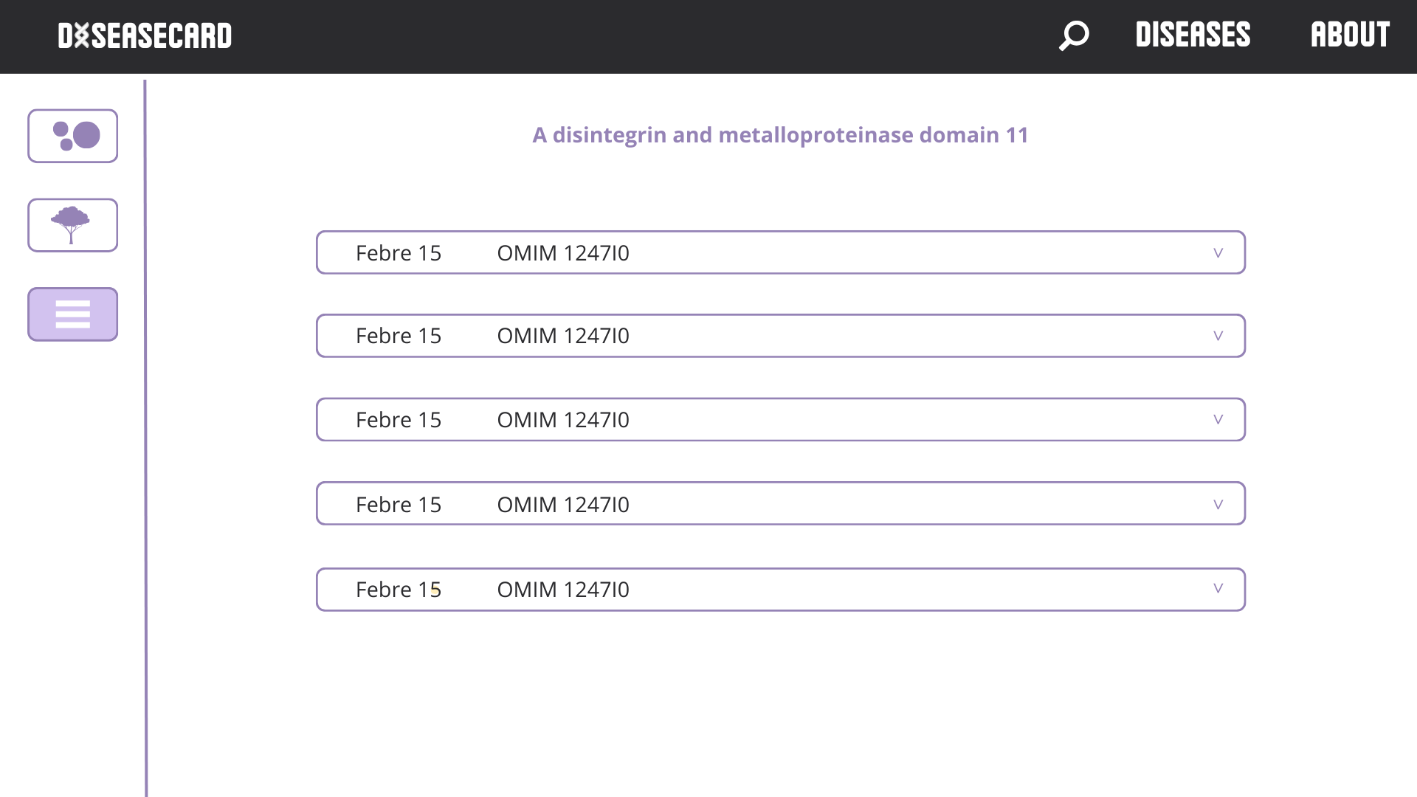

Slide 28
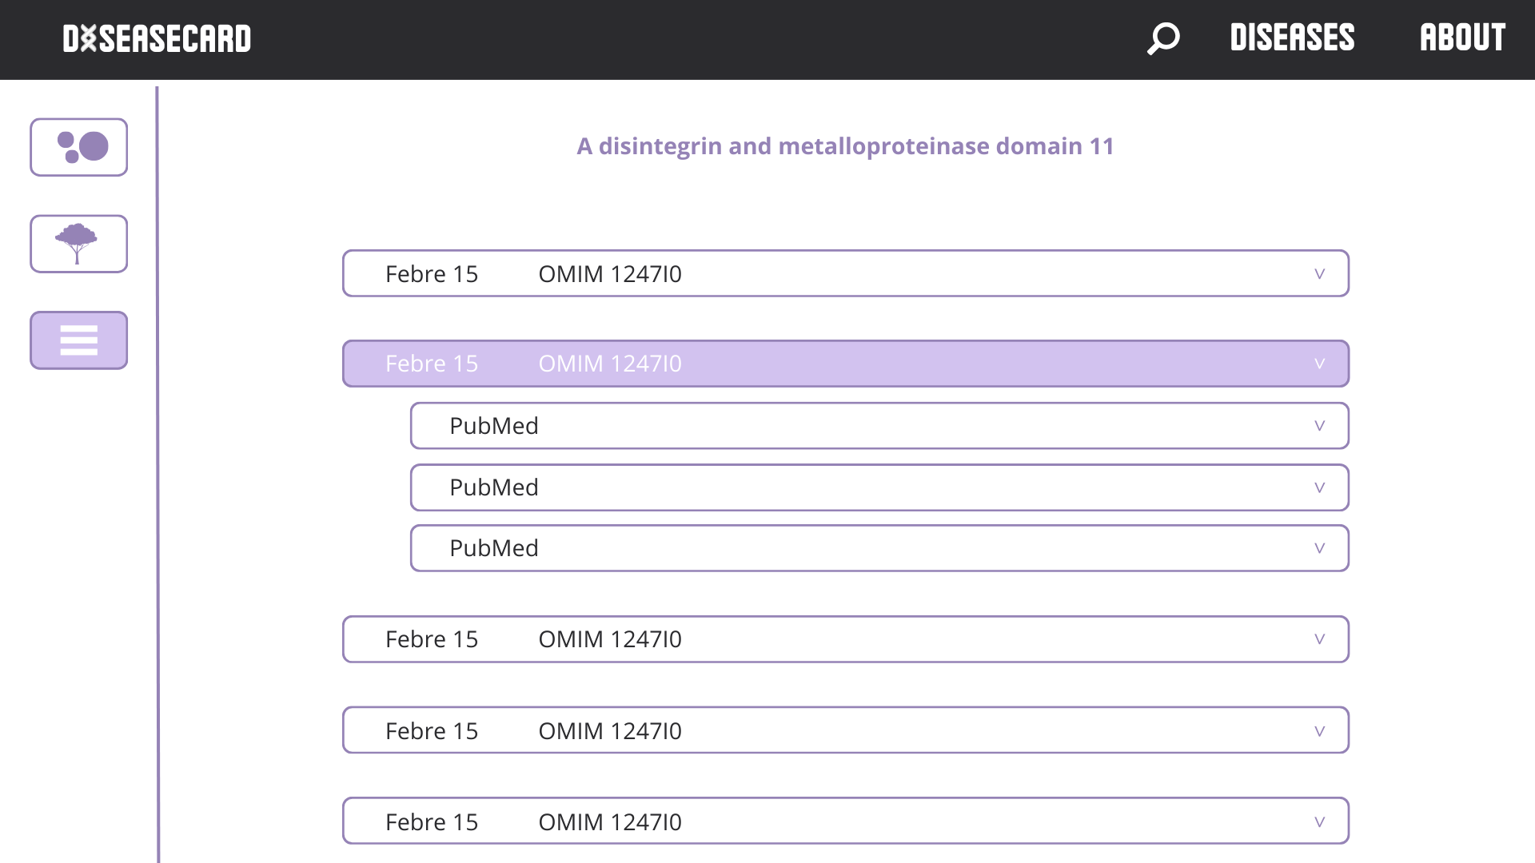

Slide 29
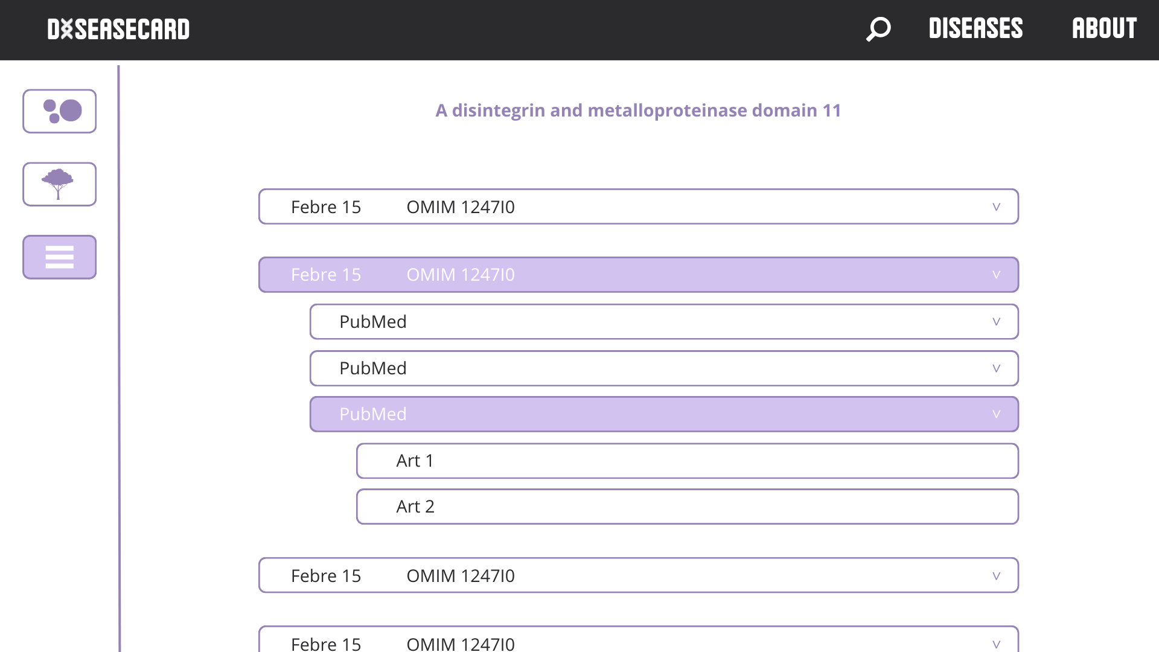

Slide 30
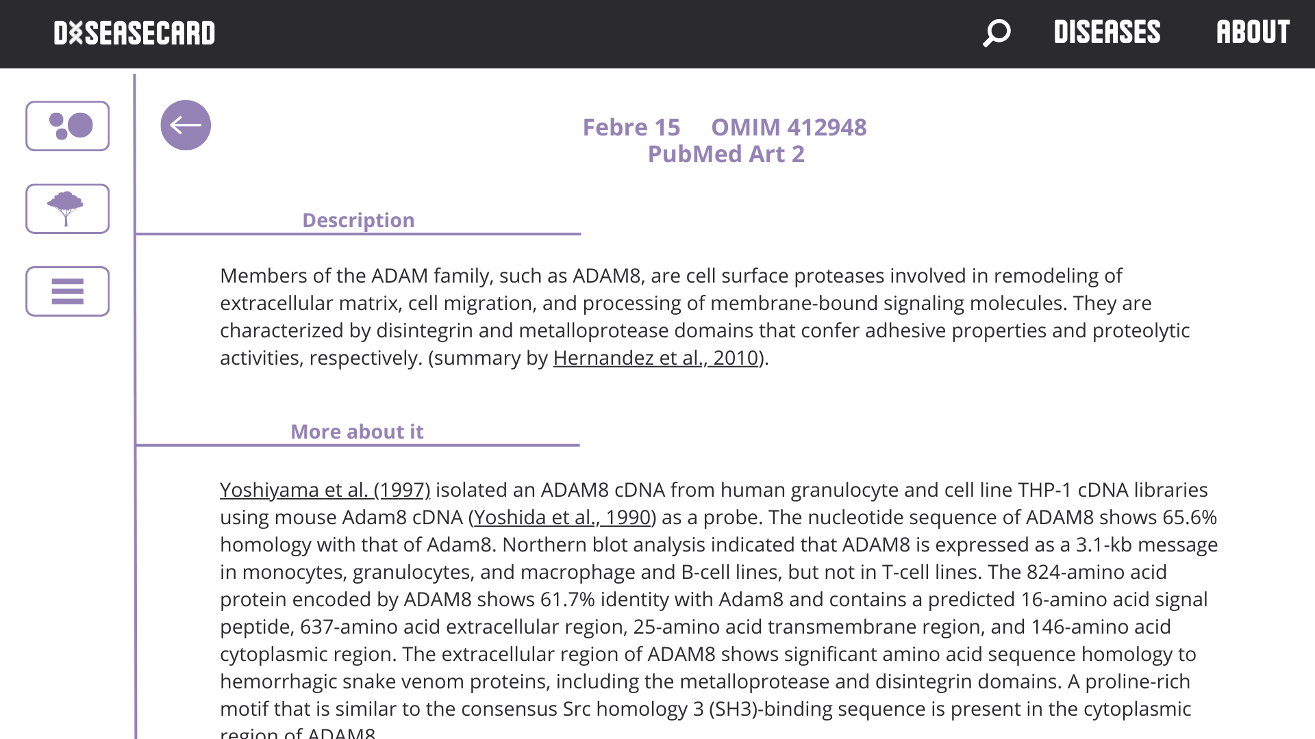

Slide 31
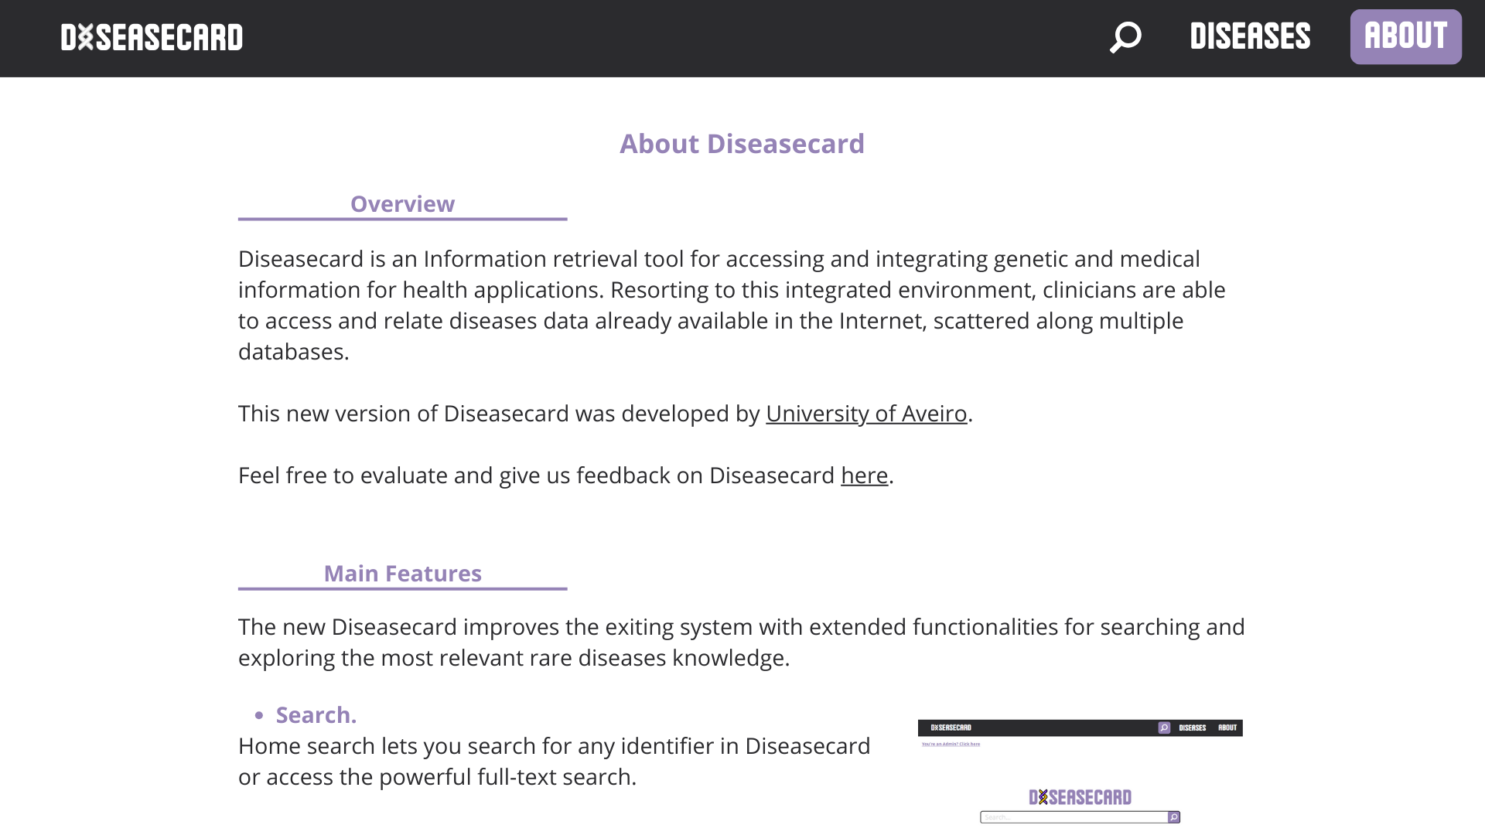

Slide 32

Thanks!
You can visit our Microsite here!
SCAN ME
Alexandre Ribeiro, 108122
Guilherme Amorim, 107162
Matilde Teixeira, 108193
Rafael Ferreira, 107340
Rodrigo Graça, 107634

