Slide 1
Disease
card
Checkpoint 1

Slide 2
TABLE OF CONTENTS
01
02
03
04
Architecture Updates
Database
Conception
Prototype
Inception
Calendar
Updates

Slide 3
01
Architecture Updates

Slide 4
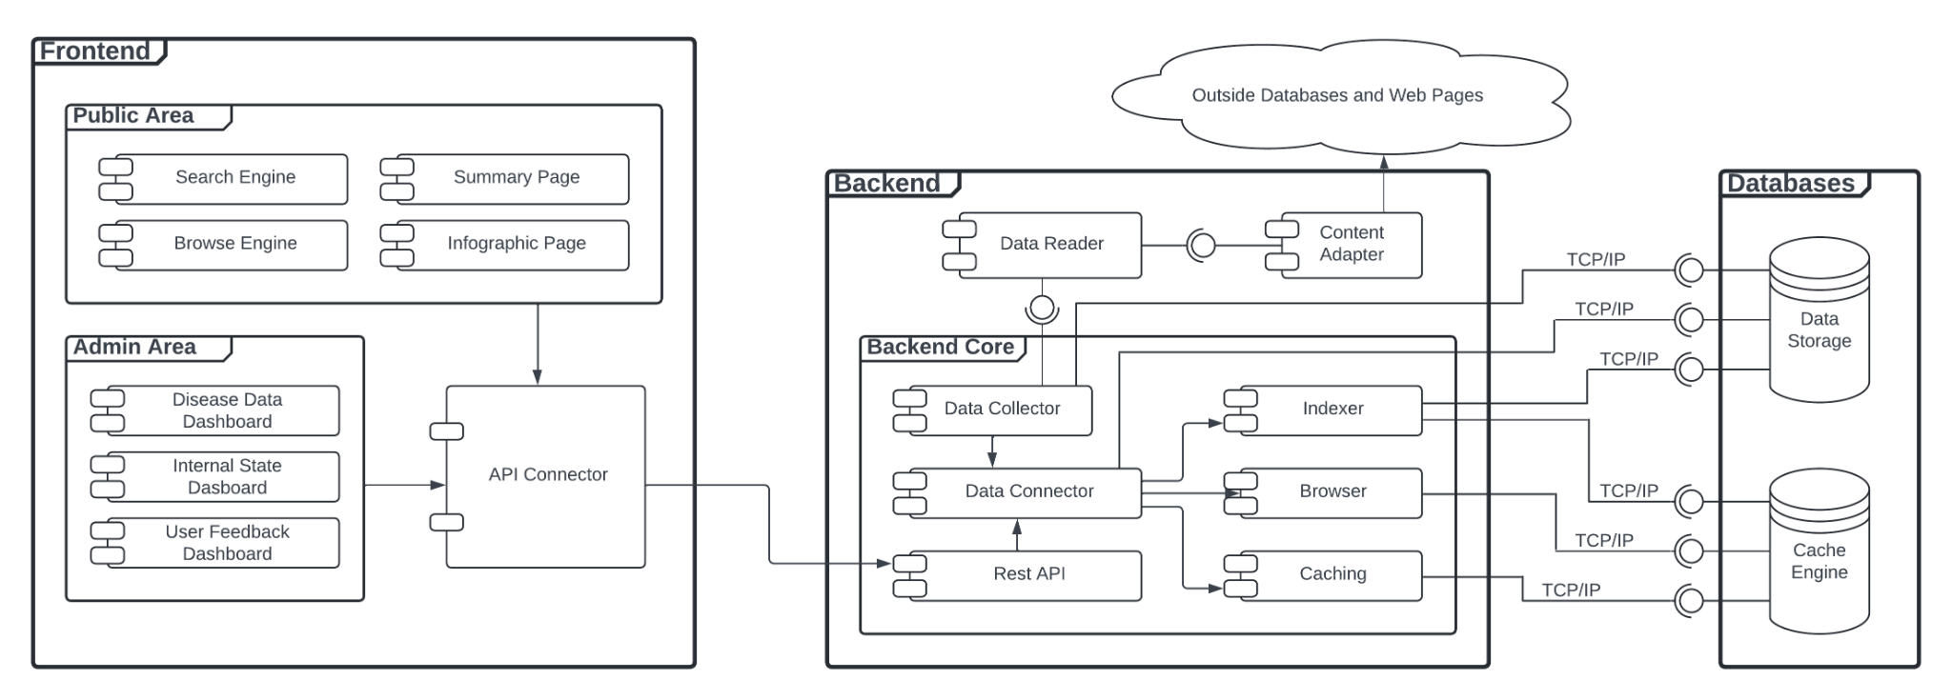

Slide 5
02
Database
Conception

Slide 6
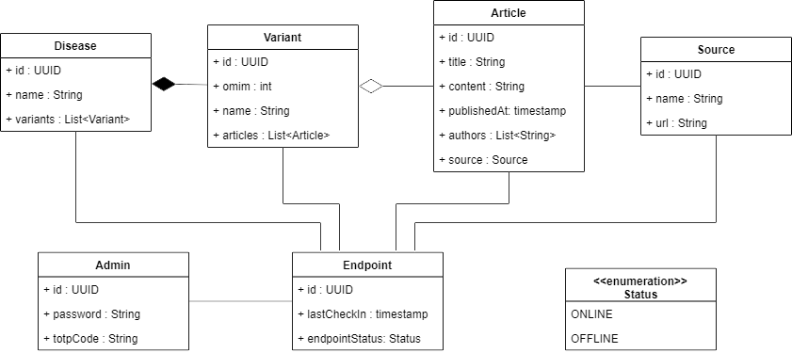
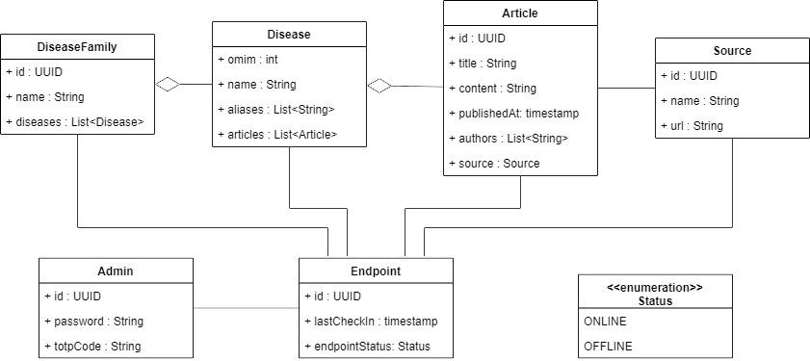
Domain Model
Updated
Old

Slide 7



Database Choice

Slide 8
03
Prototype
Inception

Slide 9
04
Calendar
Updates

Slide 10

MARCH |  |  |  | 01 | 02 | 03
04 | 05 | 06 | 07 | 08 | 09 | 10
11 | 12 | 13 | 14 | 15 | 16 | 17
18 | 19 | 20 | 21 | 22 | 23 | 24
25 | 26 | 27 | 28 | 29 | 30 | 31
05
Communication Plan
08
Database Decision
Backend Decision
05
08
11
Database Structure
Start prototype
11
12
15
12
M2 - Architecture Presentation
15
Frontend Development
28
Modelling Database
Testing Endpoints
28

Slide 11
01 | 02 | 03 | 04 | 05 | 06 | 07
08 | 09 | 10 | 11 | 12 | 13 | 14
15 | 16 | 17 | 18 | 19 | 20 | 21
22 | 23 | 24 | 25 | 26 | 27 | 28
29 | 30 |  |  | APRIL
02
02
CheckPoint
08
09
12
08
Data Visualization Page
Frontend Development
15
16
Modelling Database
Testing Endpoints
12
09
15
Main Deployment
22
23
16
23
09
15
M3 - Prototype Presentation
Main Deployment
22
16
23
M3 - Prototype Presentation
Data Normalization
22
Data Normalization

Slide 12
06
Monitoring
Authentication
MAY |  | 01 | 02 | 03 | 04 | 05
06 | 07 | 08 | 09 | 10 | 11 | 12
13 | 14 | 15 | 16 | 17 | 18 | 17
20 | 21 | 22 | 23 | 24 | 25 | 26
27 | 28 | 29 | 30 | 31 | 01
07
21
Checkpoint
06
07
17
CRUD
17
23
24
Usability and Normalization Tests
21
23
24
27
Frontend Development
Monitoring Interface Test
27
28
30
01
28
30
Deliveries
01
Final Deployment
Detailed Project Calendar

