Slide 1
Disease
card
Checkpoint 2

Slide 2
TABLE OF CONTENTS
01
02
03
04
05
06
MongoDB Integration
Data
Insertion
Scrappers Implementation
Aggregation by Family Disease
Mobile
App
Calendar
Updates

Slide 3
01
MongoDB Integration

Slide 4

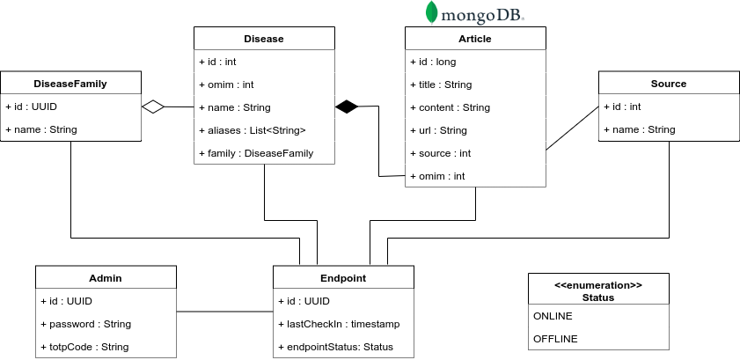
Storing larger blocks of text (articles)

Slide 5
02
Data
Insertion

Slide 6
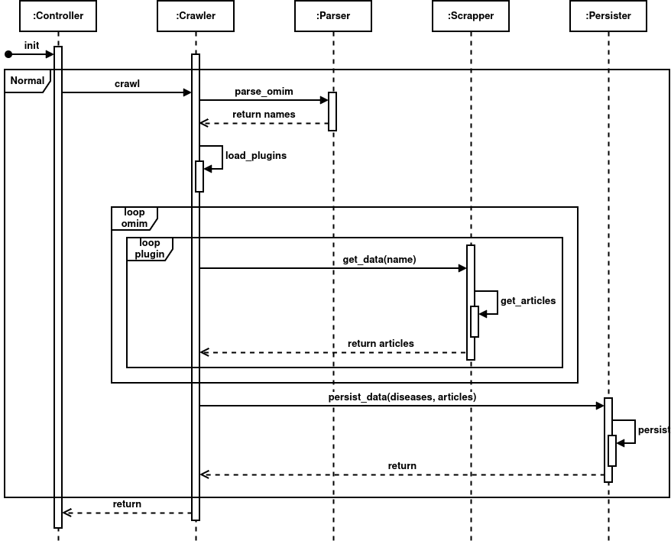

Slide 7
03
Scrappers Implementation

Slide 8
"name": "mock",
"url": "https://www.mock.com/",
"search_query": "search/results?q=",
"search_info": {
"orpha_id": {
"scope": "single",
"html_tag": "span",
"id_": null,
"class_": “fw-bold"
}
},
"article_query": "/detail/",
"article_info": {
"abstract": {
"scope": "single",
"html_tag": "div",
"id_": null,
"class_": "mx-4 mb-4 p-4"
}
}
Plugin Architecture
Allows adding and removing new scrappers
Hides implementations

Slide 9
04
Aggregation by Family Disease

Slide 10
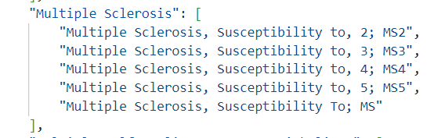
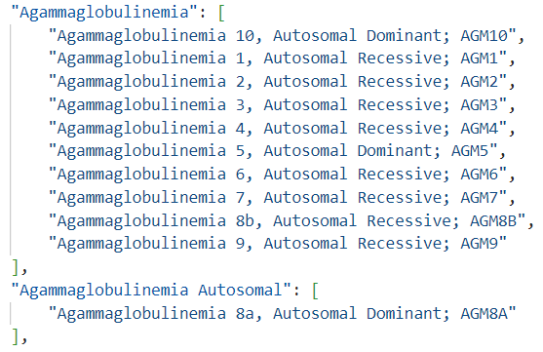
Result
Challenges

Slide 11
05
Mobile App

Slide 12
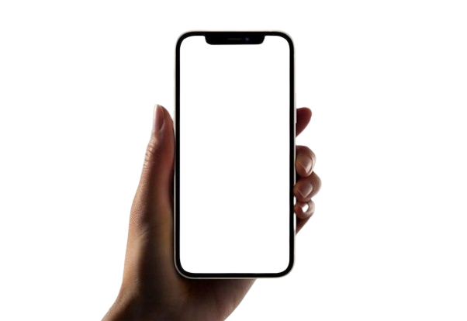


Slide 13
06
Calendar

Slide 14

01
CRUD
Authentication
MAY |  | 01 | 02 | 03 | 04 | 05
06 | 07 | 08 | 09 | 10 | 11 | 12
13 | 14 | 15 | 16 | 17 | 18 | 17
20 | 21 | 22 | 23 | 24 | 25 | 26
27 | 28 | 29 | 30 | 31 | 01
01
07
21
Checkpoint
07
17
Monitoring
17
23
24
Usability and Normalization Tests
21
23
24
25
25
Monitoring Interface Test
27
28
30
27
Final Deployment
28
30
Deliveries
Detailed Project Calendar

