Slide 1
Disease
card
Checkpoint 3

Slide 2
TABLE OF CONTENTS
01
02
03
04
05
Deployment
Data Insertion
WebSite
Mobile App
Calendar
Updates

Slide 3
01
Deployment

Slide 4
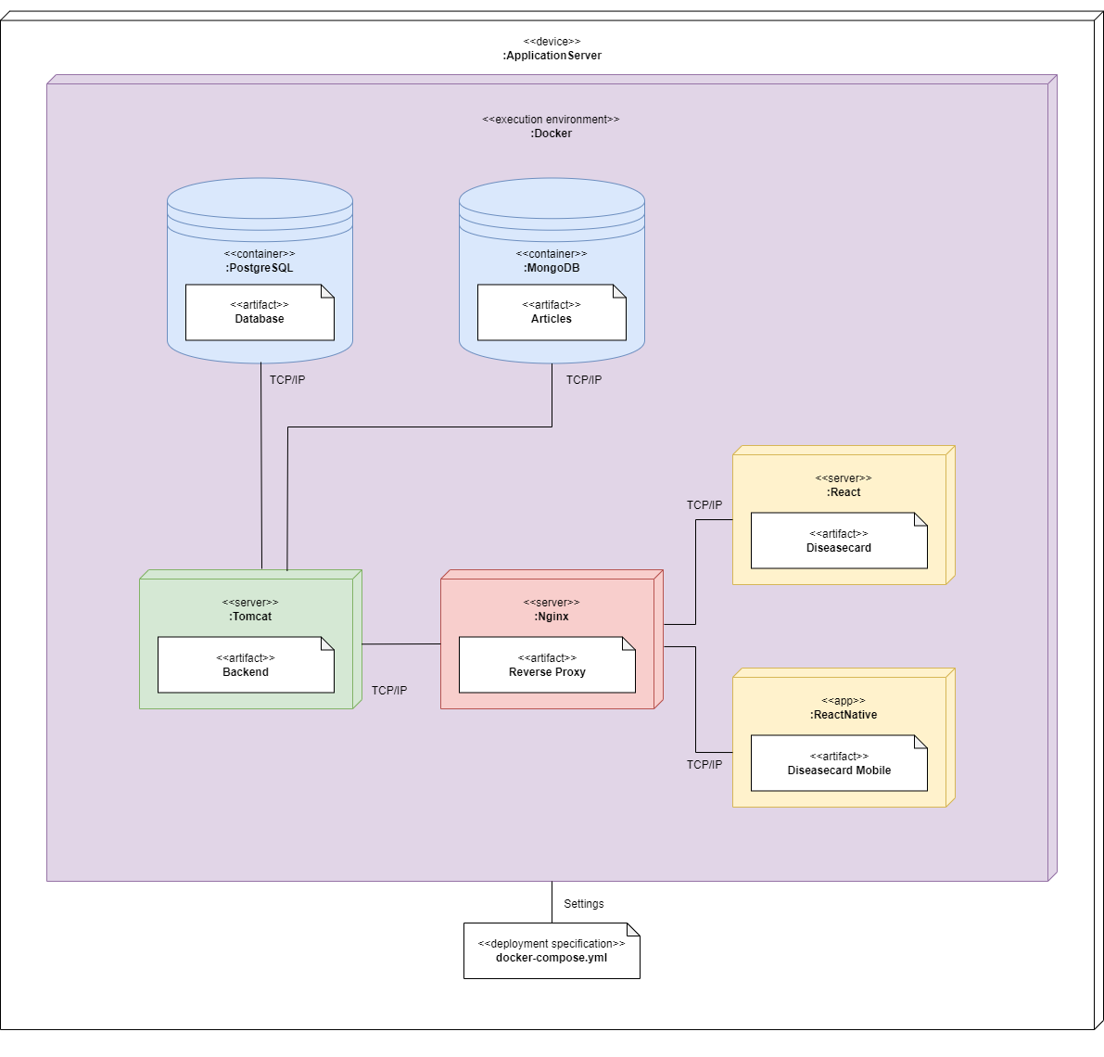

Slide 5
DEPLOYMENT
CURRENT
NEXT STEP
Deployed in IEETA virtual machine
Git cloned into VM
Branch “develop”
Lighter deployment, only images and docker compose
Available outside UA
Branch “main”

Slide 6
02
Data
Insertion

Slide 7
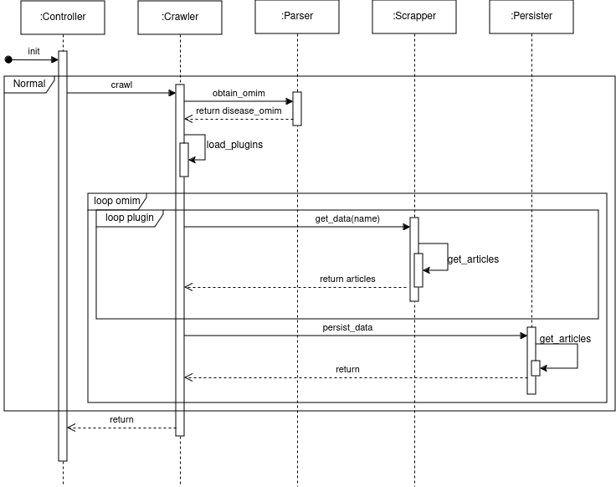

Slide 8
03
Website

Slide 9
04
Mobile App

Slide 10
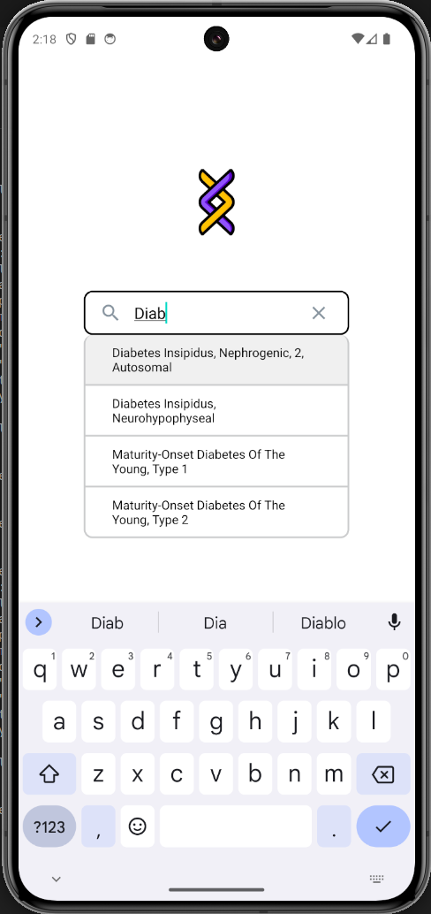
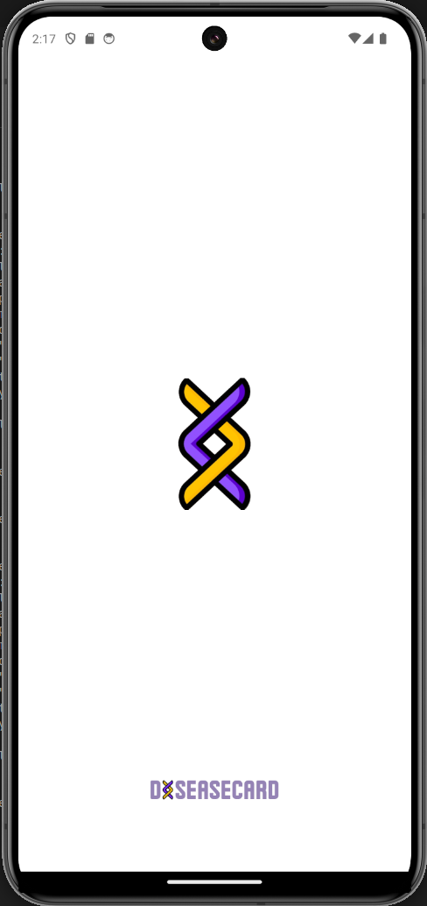
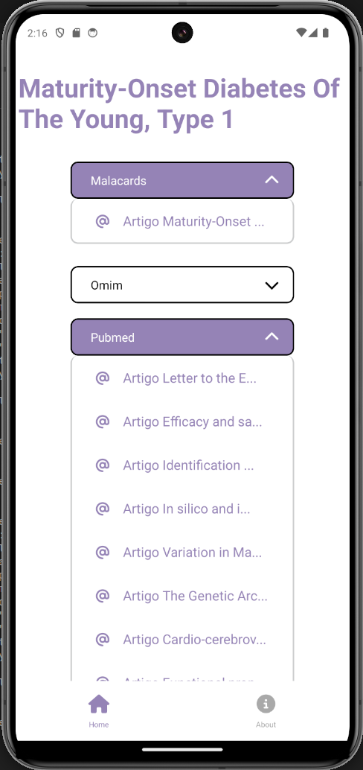
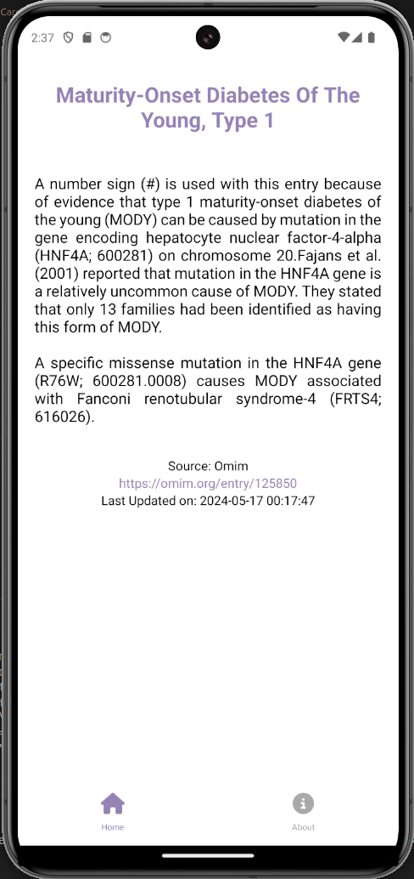

Slide 11
05
Calendar

Slide 12

01
CRUD
Authentication
MAY |  | 01 | 02 | 03 | 04 | 05
06 | 07 | 08 | 09 | 10 | 11 | 12
13 | 14 | 15 | 16 | 17 | 18 | 17
20 | 21 | 22 | 23 | 24 | 25 | 26
27 | 28 | 29 | 30 | 31 | 01
01
07
21
Checkpoint
07
17
Monitoring (started)
17
23
24
Usability and Normalization Tests
21
23
24
25
25
Monitoring Interface Test
27
28
30
27
Final Deployment
28
30
Deliveries
Detailed Project Calendar

