Slide 1
DISEASE CARD
AGGREGATION AND VISUALIZATION OF
RARE GENETIC DISEASES DATA
Projeto em Informática
2023-2024

Slide 2
01
02
03
OUR TEAM
CONTEXT
PROBLEM
04
05
GOALS
EXPECTED RESULTS

Slide 3
OUR TEAM
01

Slide 4


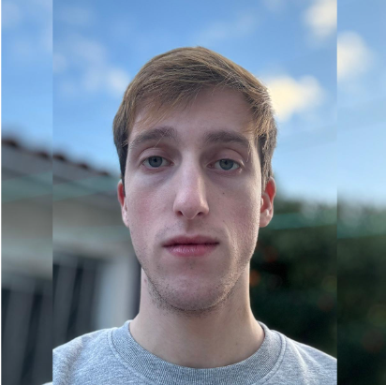


OUR TEAM
MATILDE TEIXEIRA
GUILHERME AMORIM
ALEXANDRE RIBEIRO
RAFAEL FERREIRA
RODRIGO GRAÇA
Project Manager
Product Owner
DevOps
Architect
Tester

Slide 5



GUIDING TEACHERS
JOÃO ALMEIDA
JOSÉ OLIVEIRA
TIAGO ALMEIDA

Slide 6
02
CONTEXT

Slide 7



CONTEXT
Healthcare and medical research constantly require new applications and technologies
There is a growing availability of medical data

Slide 8
03
PROBLEM

Slide 9
PROBLEM
Current System not Updated
With the evolution of data sources it is hard to update the current automatically.
Data non-Normalized
The data has not gone through data quality processes such as data cleansing and deduplication so it is not organized in a proper way.

Slide 10
04
GOALS

Slide 11
GOALS
Data Collection and
Integration
Automated collection and integration of information on rare diseases from various sources.
Web Interface for Search
Intuitive interface for searching and exploring rare diseases in the platform’s catalog.
Activity Monitoring
Continuous tracking of metric and activities for platform evaluation and improvement.

Slide 12
GOALS
Protected Backoffice
Secure area for management and administration of the platform by authorized users.
Conversational Search System
Dynamic interaction with the platform through chatbot-like functionalities.

Slide 13
CALENDAR FOR THE PROJECT
05
MARCH |  |  |  | 01 | 02 | 03
04 | 05 | 06 | 07 | 08 | 09 | 10
11 | 12 | 13 | 14 | 15 | 16 | 17
18 | 19 | 20 | 21 | 22 | 23 | 24
25 | 26 | 27 | 28 | 29 | 30 | 31
Communication Plan
08
Database Decision
Backend Decision
05
08
11
Database Structure
Start prototype
11
12
15
12
M2 - Architecture Presentation
15
Frontend Development
28
28
Modelling Database
Testing Endpoints

Slide 14
CALENDAR FOR THE PROJECT
01 | 02 | 03 | 04 | 05 | 06 | 07
08 | 09 | 10 | 11 | 12 | 13 | 14
15 | 16 | 17 | 18 | 19 | 20 | 21
22 | 23 | 24 | 25 | 26 | 27 | 28
29 | 30 |  |  | APRIL
02
02
CheckPoint
08
09
08
Data Visualization Page
09
Main Deployment
16
16
23
M3 - Prototype Presentation
22
23
22
Data Normalization

Slide 15
CALENDAR FOR THE PROJECT
06
Monitoring
Authentication
MAY |  | 01 | 02 | 03 | 04 | 05
06 | 07 | 08 | 09 | 10 | 11 | 12
13 | 14 | 15 | 16 | 17 | 18 | 17
20 | 21 | 22 | 23 | 24 | 25 | 26
27 | 28 | 29 | 30 | 31 | 01
07
21
Checkpoint
06
07
17
CRUD
17
23
24
Usability and Normalization Tests
21
23
24
27
Frontend Development
Monitoring Interface Test
27
28
30
01
28
30
Deliveries
01
Final Deployment
Detailed Project Calendar

Slide 16
05
EXPECTED RESULTS

Slide 17
EXPECTED RESULTS
An automatized, improved system to medical access

Slide 18

THANK YOU
Alexandre Ribeiro, 108122
Guilherme Amorim, 107162
Matilde Teixeira, 108193
Rafael Ferreira, 107340
Rodrigo Graça, 107634

