Slide 1
CAR SALES
Financial Analysis Report

Slide 2
KPIs
Total Sales - 7bn
Average Odometer – 67.66K
Average Condition Score – 30.78
Average Selling Price – 13.56K
Price Difference - -151.77
Total Cars Sold – 476K

Slide 3
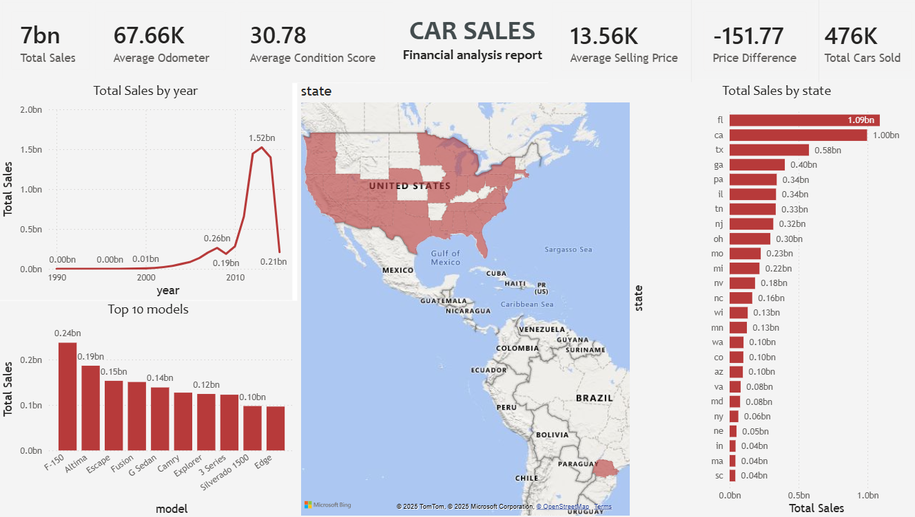

Slide 4
Insights
The company generated a strong total revenue from used car sales, led mainly by high-selling models such as BMW, Kia Sorento, and Volvo S60.
California (CA) recorded the highest vehicle sales volume and total revenue among all states, indicating strong market demand and buyer activity in the region.
Monthly sales trend analysis shows noticeable fluctuations, with peak performance in late Q4 months, suggesting seasonal demand patterns and potential holiday influence.
Higher condition score vehicles (40+) consistently achieve above-market values compared to MMR benchmark, emphasizing quality improves profitability.

Slide 5
Cars with lower odometer readings (<10,000 miles) sell significantly higher than average, showing that mileage strongly influences sale price.
Luxury and performance brands like BMW & Volvo show greater price variance, reflecting premium pricing behavior and broader buyer price tolerance.
Top 10 performing vehicle models contribute a major share of total revenue, suggesting that focusing inventory on high-performing models can improve profitability.
States with lower sales volume present an opportunity to increase revenue through targeted marketing and regional expansion strategies.

Slide 6
Cars with lower odometer readings (<10,000 miles) sell significantly higher than average, showing that mileage strongly influences sale price.
Luxury and performance brands like BMW & Volvo show greater price variance, reflecting premium pricing behavior and broader buyer price tolerance.
Top 10 performing vehicle models contribute a major share of total revenue, suggesting that focusing inventory on high-performing models can improve profitability.
States with lower sales volume present an opportunity to increase revenue through targeted marketing and regional expansion strategies.

Slide 7
Recommendations
Increasing acquisition & marketing of top-performing models with high-demand and profitability (e.g., BMW, Volvo, Kia Sorento).
Improving buyer attraction by offering certification / warranty plans for lower-condition vehicles.
Launching seasonal promotional campaigns during Q3–Q4 to maximize peak buying periods.
Expanding advertising and dealership partnerships in low-performing states to capture untapped markets.
Focusing on vehicles with condition score > 40 and lower mileage ranges, which show better profit margins.

Slide 8
Conclusion
The Power BI dashboard provides a clear and comprehensive view of the used car sales performance across states, vehicle conditions, mileage ranges, and time periods. The analysis highlights that premium brands such as BMW and Volvo, along with models like Kia Sorento, contributed significantly to overall revenue. California emerged as the strongest market, indicating high demand concentration and consumer purchasing power. The study also reveals that vehicle condition and mileage play crucial roles in determining price, where cars with higher condition scores (>40) and lower odometer readings(<10,000 miles) consistently achieve higher selling prices.
Seasonal patterns suggest that Q4 months generate peak sales, reinforcing the need for targeted marketing during this period. Additionally, the findings demonstrate opportunities for market expansion in underperforming states, supported by focused advertising and inventory optimization around top-selling vehicle segments.
Overall, the dashboard empowers business stakeholders to make data-driven decisions related to pricing strategy, inventory planning, and regional sales growth, ultimately improving profitability and enhancing customer engagement.

