Slide 1


Project Title –
SEASONAL AGRICULTURE PERFORMANCE ANALYSIS
Student Name - Disha Singhvi
College Name – MBM University
AICTE STU ID - (STU6a6b4b82e0d701785416578)

Slide 2

PROBLEM STATEMENT
Agricultural activities are influenced by seasonal variations in environmental conditions, farming practices, resource availability and market conditions. As a result, agricultural performance may differ from one season to another.
However, raw agricultural data does not clearly explain how agricultural performance changes across seasons or what patterns can be observed in different seasonal conditions.
The problem is to analyze the given agricultural dataset and investigate seasonal differences in agricultural performance by identifying meaningful patterns, trends, relationships and variations within the available data.

Slide 3
Project Description
This project performs exploratory and statistical data analysis on agricultural data to understand how farming performance varies across Kharif, Rabi and Zaid seasons.
The dataset contains 4,000 records and 28 variables, covering crops, locations, environmental conditions, soil characteristics, farming practices, yield, production, water usage and economic performance.
The analysis includes data cleaning, descriptive statistics, univariate analysis, outlier analysis, bivariate and multivariate analysis, correlation analysis and seasonal comparisons. Additional comparisons are performed across crops and irrigation methods to identify meaningful patterns.

Slide 4
WHO ARE THE END USERS?
Farmers
To understand crop and seasonal performance and support better resource planning.
Agricultural Departments
To support evidence-based agricultural planning and resource management.
Agricultural Planners
To compare seasonal performance and identify important patterns.
Researchers
To study relationships between environmental conditions and agricultural outcomes.
Agri-businesses
To understand production and profitability patterns across seasons.

Slide 5

Technology Used
Programming & Environment
Python: Programming language used for data analysis.
Jupyter Notebook: Environment used to perform and document the analysis.
Libraries
Pandas: Data loading, cleaning and manipulation.
NumPy: Numerical operations and calculations.
Matplotlib: Data visualization.
Seaborn: Statistical and comparative visualizations.
Data Source / Format
Excel Dataset (.xlsx): Source format of the provided agricultural dataset.
Analytical Techniques
Descriptive Statistics | Univariate Analysis | Bivariate Analysis | Multivariate Analysis | Outlier Analysis | Correlation Analysis | Seasonal Comparison

Slide 6
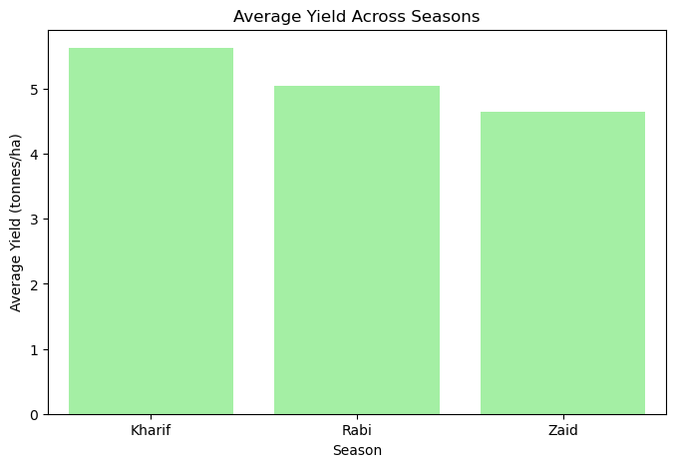
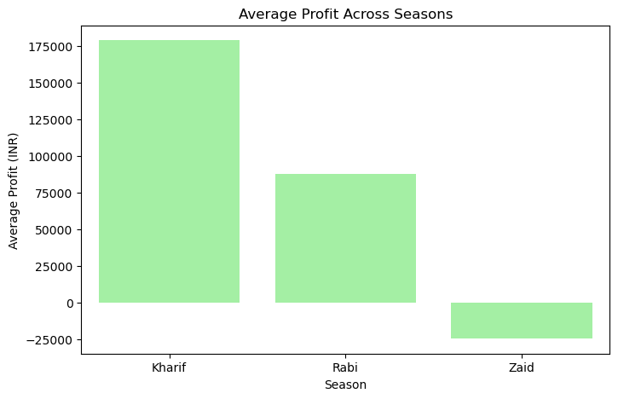
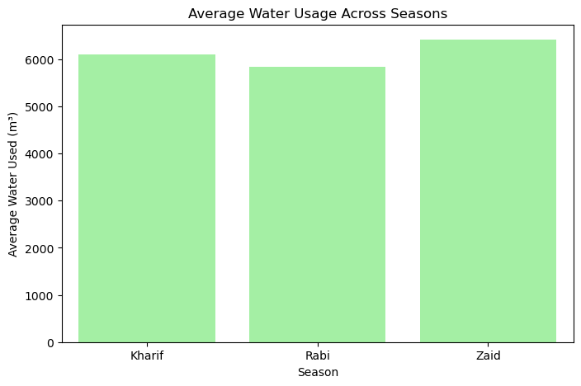
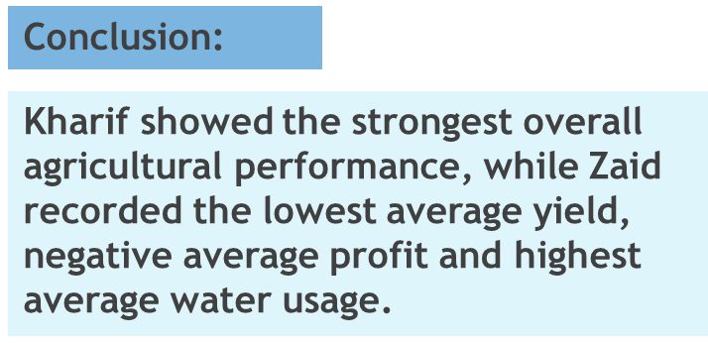
RESULTS
Seasonal Agricultural Performance
Season | Avg. Yield | Avg. Profit | Avg. Water Used
Kharif | 5.64 t/ha | ₹178,914.65 | 6,102.20 m³
Rabi | 5.08 t/ha | ₹87,689.47 | 5,846.99 m³
Zaid | 4.67 t/ha | −₹24,804.82 | 6,419.89 m³

Slide 7
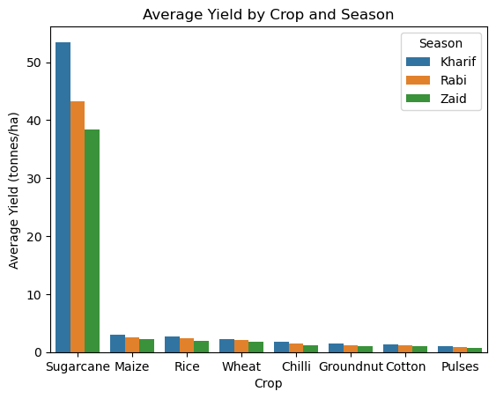
RESULTS
Crop Performance Across Seasons
Key Findings :
Most crops recorded their highest average yield in Kharif.
Zaid generally showed the lowest average yield.
Sugarcane had substantially higher yield than the other crops.
Seasonal performance varies depending on the crop.
Therefore, crop performance should be evaluated together with the season.
Conclusion :
Crop performance is strongly influenced by seasonal differences, and the pattern is not identical for every crop. So, crop and season should be considered together when evaluating agricultural performance.

Slide 8
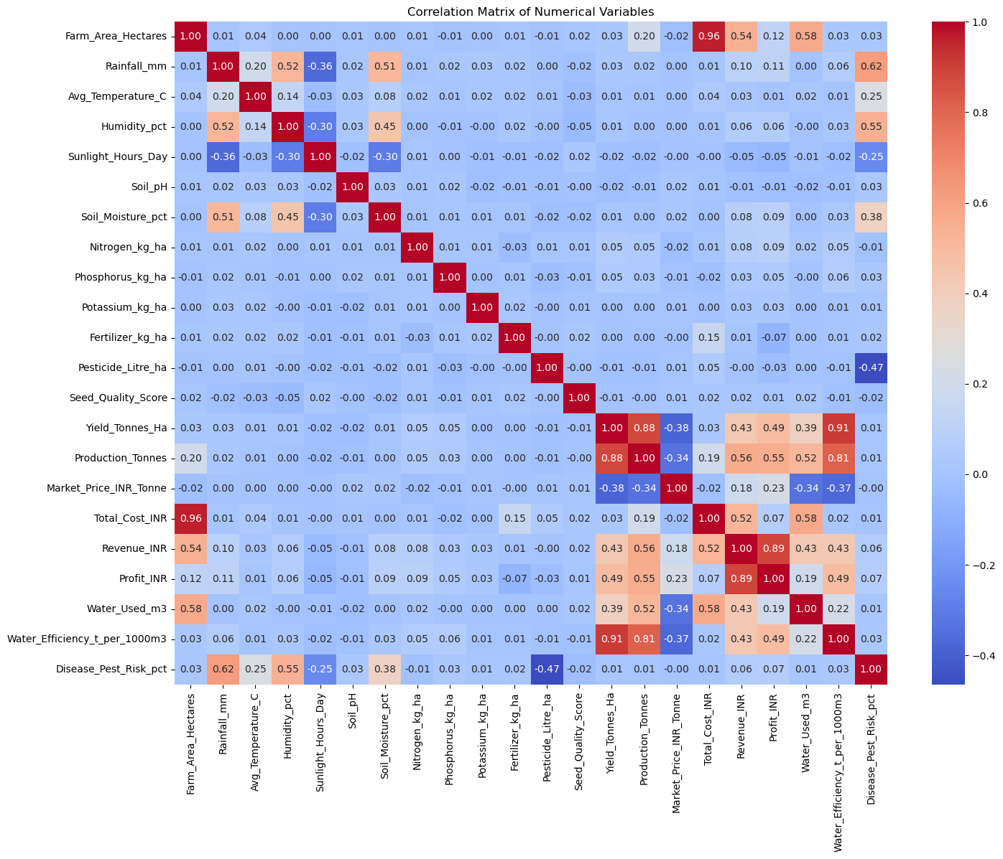
RESULTS
CORRELATION ANALYSIS
Relationships Between Key Variables
Relationship | Correlation
Yield ↔ Water Efficiency | 0.913
Yield ↔ Production | 0.883
Profit ↔ Revenue | 0.887
Profit ↔ Production | 0.554
Yield ↔ Profit | 0.488
Note: Correlation indicates association between variables and does not establish causation.
Conclusion :
Water efficiency, production and revenue show strong relationships with agricultural performance, while profit is influenced by multiple factors.

Slide 9
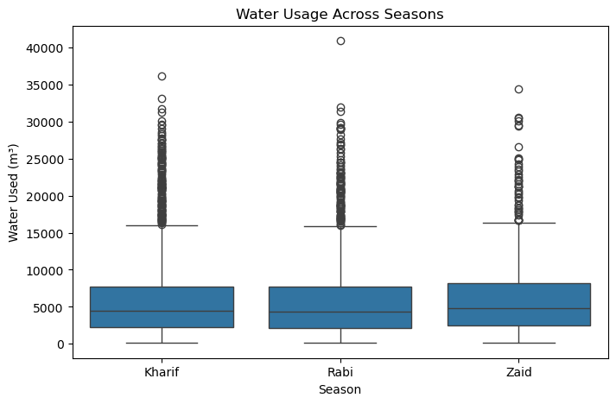
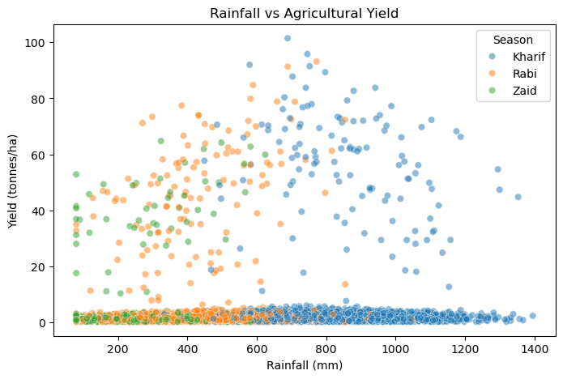
RESULTS
Water Usage & Efficiency
Key Findings
Average Water Usage
Zaid: 6,419.89 m³
Kharif: 6,102.20 m³
Rabi: 5,846.99 m³
Important Relationship
Yield ↔ Water Efficiency = 0.913
This indicates a very strong positive association between yield and water efficiency in the dataset.
Conclusion :
Water usage and water efficiency are important dimensions of seasonal agricultural performance. Zaid had the highest average water usage but the lowest average yield, while yield and water efficiency showed a strong positive association.

Slide 10
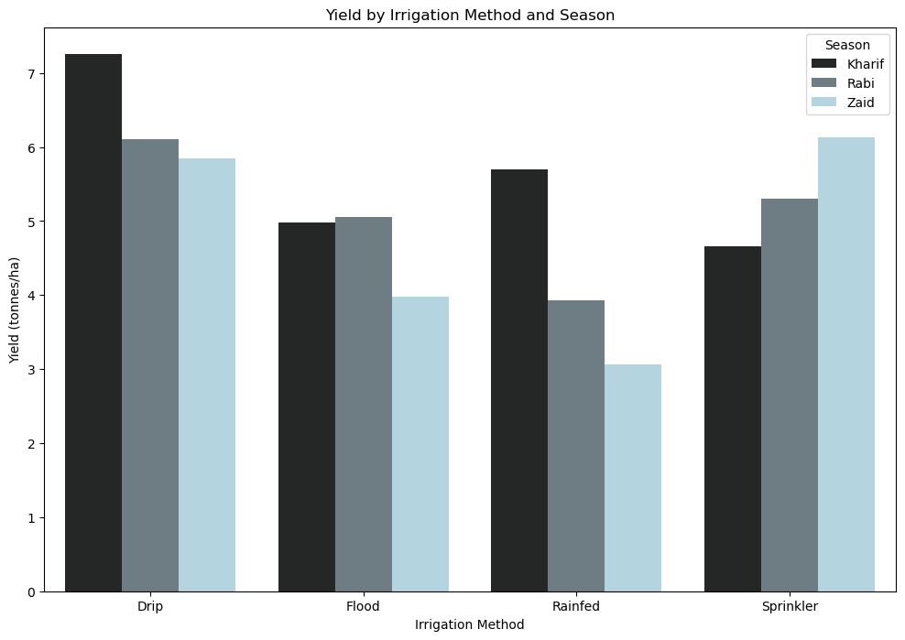
RESULTS
Irrigation Method and Profitability
Season | Drip | Flood | Rainfed | Sprinkler
Kharif | ₹317,222 | ₹133,374 | ₹158,974 | ₹116,880
Rabi | ₹187,843 | ₹58,825 | ₹45,232 | ₹76,502
Zaid | ₹21,292 | −₹69,787 | −₹79,467 | ₹57,909
Conclusion :
Kharif
Highest Avg. Profit : Drip → ₹317,222
Rabi
Highest Avg. Profit : Drip → ₹187,843
Zaid
Highest Avg. Profit : Sprinkler → ₹57,909
Therefore, the most profitable irrigation method varies by season, showing that irrigation performance should be evaluated season-wise.

Slide 11
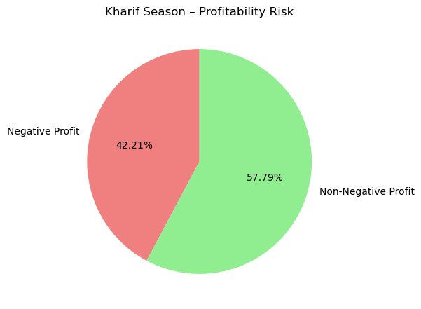
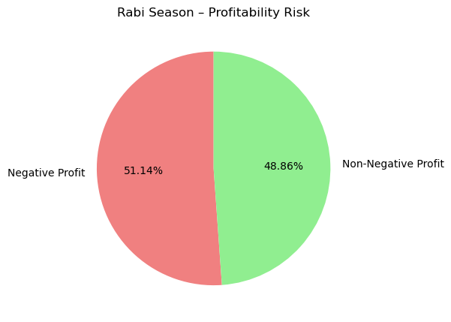
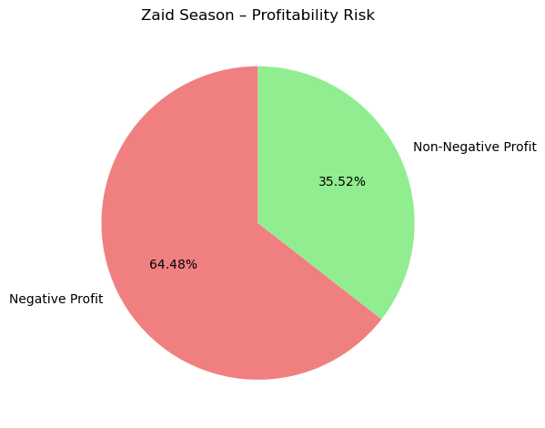
RESULTS
Profitability Risk Across Seasons
Key observations:
Kharif: 42.21% records show negative profit.
Rabi: 51.14% records show negative profit.
Zaid: 64.48% records show negative profit.
Profitability risk increases from Kharif → Rabi → Zaid.
Zaid shows the highest profitability risk, with nearly two-thirds of records having negative profit.
Conclusion :
Profitability varies substantially across seasons, indicating that seasonal conditions and economic factors should be considered when evaluating agricultural performance.

Slide 12
Future scope
Multi-year data: Analyze long-term seasonal trends and changes.
Regional analysis: Compare agricultural performance across states and districts.
More environmental data: Include detailed weather and climate variables.
Crop profitability analysis: Study cost, revenue and market-price patterns for individual crops.
Water management: Further investigate irrigation and water-efficiency patterns.
More agricultural variables: Include additional soil, farming and input-related factors.
Larger datasets: Improve the reliability and generalizability of the findings.
Predictive analytics: Future work could use forecasting or Machine Learning after sufficient historical data is available.

Slide 13
GitHub Link
https://github.com/Disha-Singhvi/Seasonal-Agriculture-Performance-Analysis
Repository contains:
Complete Jupyter Notebook
Dataset
Project Presentation
Project Problem Statement Pdf
README with project overview, analysis and key findings

Slide 14

VOIS Course completion certificate -
Course name- Data Visualization

Slide 15
Thank you
.
.

