Slide 1
01 · THE PROBLEM
URBANCART · ASK AI
Support keeps answering
the same questions, again and again.
UrbanCart in-app and call-centre chat, before the AI assistant
6,000
~40%
44%
46%
customer chats every day
repetitive and answerable from documents
resolved by today's FAQ bot
of catalog rows are clean (26% of prices missing)
OBJECTIVE
Build an AI assistant that answers from real catalog and policy data, in English, Hindi and Hinglish, and hands off to a human instead of guessing.
Working prototype · measured offline · order system mocked
1 / 6
Notes:
Open with the cost of doing nothing: 6,000 chats a day, about 40% repetitive, and the current FAQ bot resolves only 44%. Its weak spots are order status (30%), off-topic (11%) and adversarial messages (4%). Catalog data is also unreliable: only 46% of rows pass basic business rules and 26% of prices are missing. Objective: a grounded assistant that never guesses and speaks the customer's language.

Slide 2
02 · THE SOLUTION
URBANCART · ASK AI
Ask UrbanCart: grounded, multilingual, safe
One pipeline for every message, whatever the language
Answer from catalog + policies
RAG with a cited source
CUSTOMER ASKS
INTENT ROUTER
REPLY
English
हिंदी · Hinglish
Product, policy, order, off-topic or unsafe?
Look up stock, orders, alternatives
In the customer's own language
5 tools, owner-only order data
Hand off to a human
ticket with summary, never a guess
46% → 94%
catalog quality after cleaning (verified prices)
5 tools
stock, order, alternatives, ticket, policy answers
1.00
faithfulness score on 31 grounded-answer tests
Working prototype · measured offline · order system mocked
2 / 6
Notes:
Walk left to right. The customer writes in English, Hindi or Hinglish. An intent router decides what the message is. Policy and product questions go to retrieval over the cleaned catalog and four policy documents, with a cited source. Stock, orders and alternatives use tools; order details are shown only to the signed-in owner. Anything it cannot answer is handed to a human with a summary. A guard checks that the reply is in the customer's language. Proof points: catalog quality 46% to 94% on verified prices, five tools, and a faithfulness score of 1.00 on a small 31-question test.

Slide 3
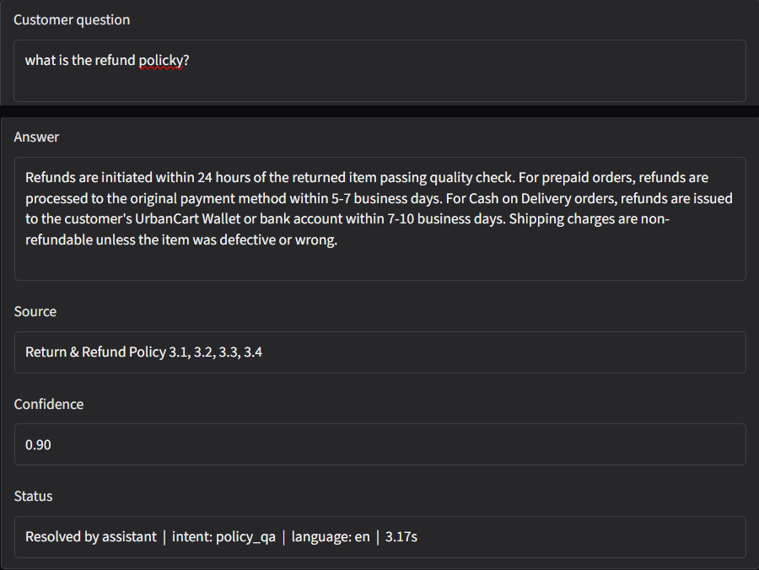
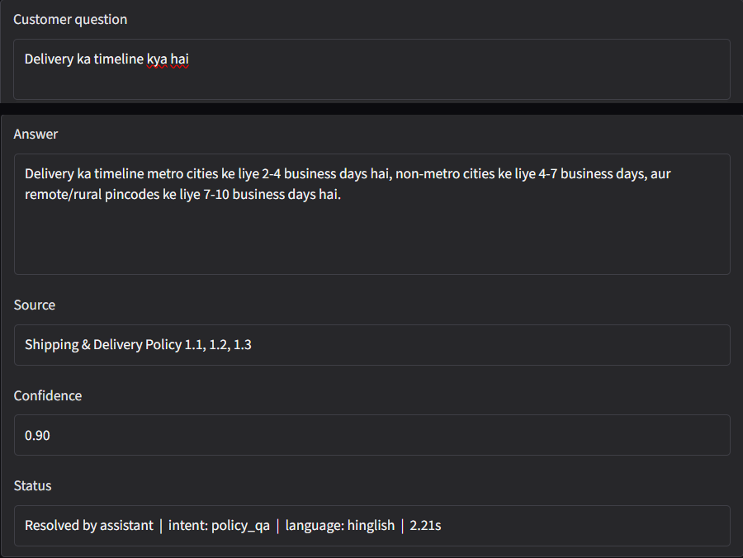
03 · LIVE DEMO · ANSWERS
URBANCART · ASK AI
Ask in your own language
Each answer shows its source, confidence and language
ENGLISH · POLICY
HINGLISH · POLICY
Working prototype · measured offline · order system mocked
3 / 6
Notes:
Two policy questions in the live Gradio demo. Left: an English refund question (with a typo) is answered from the Return and Refund Policy, sections 3.1 to 3.4, confidence 0.90, 3.17 s. Right: 'Delivery ka timeline kya hai' is answered in Hinglish from the Shipping and Delivery Policy, language detected as Hinglish, 2.21 s. Every answer cites its source section, so it can be checked. Response times in the demo are single runs, not averages.

Slide 4
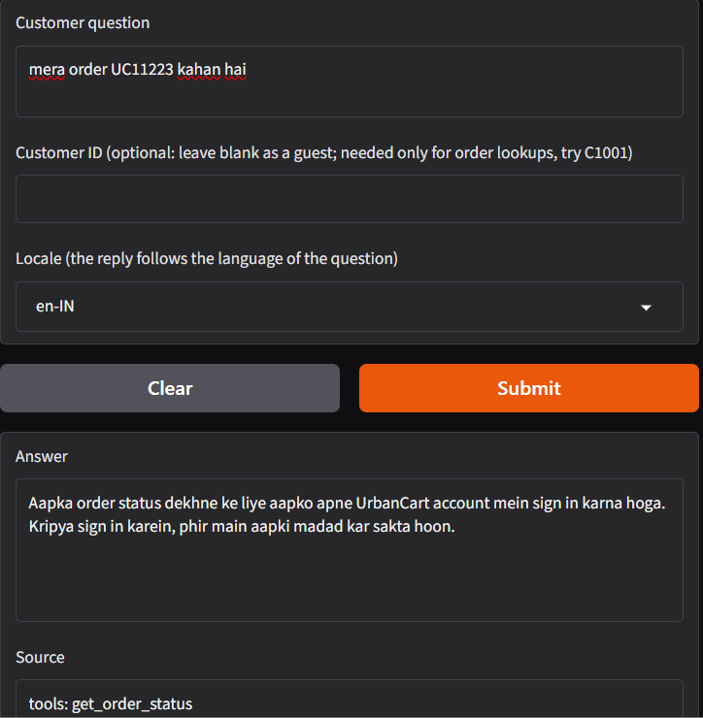
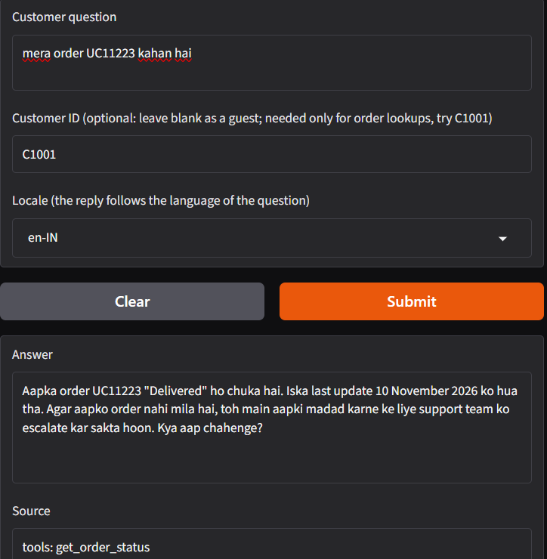
04 · LIVE DEMO · ORDERS
URBANCART · ASK AI
Orders stay private
Same question, two customers. Order data only for its owner.
GUEST · NO ID
SIGNED IN · C1001
Customer ID is optional
Guests still get answers; order status asks them to sign in.
Owner-only order data
Nobody sees another customer's order.
Replies in the customer's language
Hinglish question, Hinglish answer, with the tool used shown as the source.
Working prototype · measured offline · order system mocked
4 / 6
Notes:
Both screenshots are from the Gradio demo, which runs privately (no public link). Left: a guest types 'mera order UC11223 kahan hai' and is asked to sign in, in Hinglish. Right: with customer ID C1001 the same question returns the order status, again in Hinglish, and offers to escalate if the parcel has not arrived. The Source box shows the tool that produced the answer. The same function also powers the REST API (POST /ask).

Slide 5
05 · ANALYSIS & OUTCOME
URBANCART · ASK AI
Measured on real customer queries
300 queries replayed from the chat log, compared with today's FAQ bot
HANDLED OR RESOLVED, BY TYPE OF QUESTION (%)
60.3%
handled without a human
vs 44.0% for today's bot on the same 300 queries
78 → 5
human tickets
no more tickets for details the catalog does not hold
Rs 9.7 lakh
saved per month
conservative, vs an all-human baseline; Rs 0.027 per query
Honest read: like for like on in-scope questions the gain is 54.1% vs 50.6% (+3.5 points). Product questions trail (33%) because the catalog has no size, colour or material fields. Test sets are small, so treat these as prototype results.
Working prototype · measured offline · order system mocked
5 / 6
Notes:
Headline: 60.3% of 300 replayed real queries were handled without a human, against 44.0% for the old bot. Be upfront about what drives it: about 13 of the 16 points come from correctly refusing off-topic and unsafe messages; policy questions rise from 57.6% to 100%. Like for like on in-scope questions it is 54.1% vs 50.6%. Product (32.8%) and order (29.3%) are weaker: the catalog lacks size, colour and material, and 71% of order questions gave no order ID. Human tickets fell from 78 to 5 because details we do not hold now get an honest 'not found' plus an offer of support. Savings of Rs 9.7 lakh a month are against an all-human baseline and assume Rs 300 an hour and 5 minutes a query; against today's FAQ bot the extra saving is about Rs 61,000 a month. Latency: median 1.8 s, 95th percentile 3.5 s (target under 3 s on average). 100% results come from small, clean test sets, so present them as passes on our tests, not production accuracy.

Slide 6
06 · SUGGESTIONS
URBANCART · ASK AI
Where we go next
Four moves, ranked by impact on resolution
01
02
03
04
Enrich the catalog
Order-history lookup
Faster, leaner retrieval
Pilot it safely
Add size, colour, material and specs.
Show a signed-in customer's latest order.
Top-k from 5 to 3, response caching.
Limited A/B rollout, human review of answers, real Order API.
28% of in-scope questions ask for details we do not hold.
71% of order questions arrive without an order ID.
P95 latency is 3.5 s against a 3 s target.
Replace the mocked orders before launch.
Prototype status: orders are mocked and savings rest on stated assumptions. Ready for a limited pilot.
Working prototype · measured offline · order system mocked
6 / 6
Notes:
Four next steps. 1) Catalog enrichment is the biggest lever: 28% of in-scope questions asked for size, colour, material, battery or similar details that the catalog does not hold. 2) Order-history lookup: 41 of 58 order questions had no order ID, so the assistant asked for it; with the real Order API a signed-in customer's latest order can be shown. 3) Retrieval is noisy (context precision 0.16, five chunks fetched for about one useful); top-k 3 and caching cut cost and latency. 4) Roll out as a limited A/B pilot with human review of a sample of answers. Close by stating the prototype status honestly.

