Slide 1

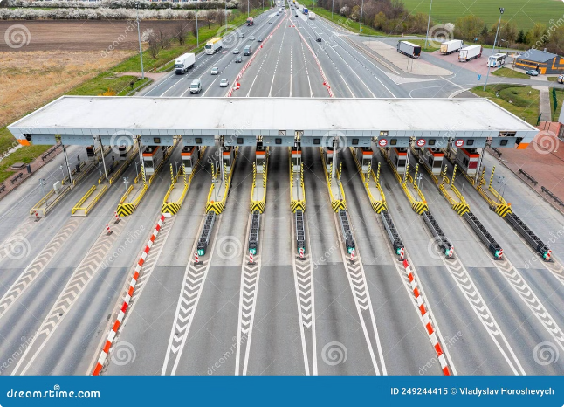
GPS Based Toll System Simulation
This project aims to simulate a toll system using GPS technology.

Slide 2
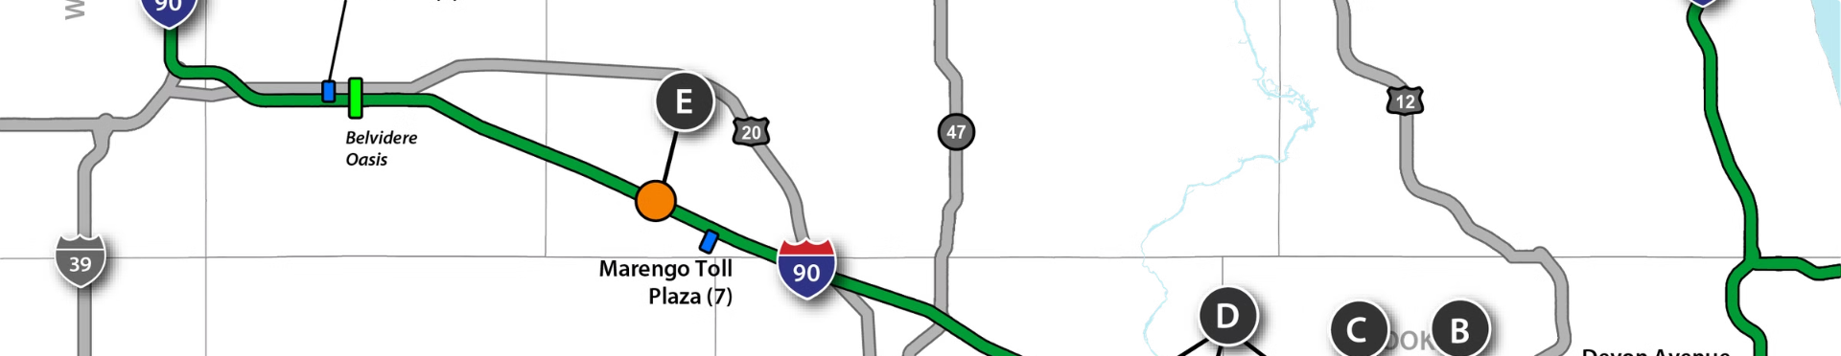
Unique Idea Brief
1
GPS Tracking
2
Toll Calculation
Track vehicle location and route.
Calculate toll based on distance traveled.
3
User Interface
Provide real-time updates and payment information.

Slide 3
Process Flow
1
Vehicle Entry
Vehicle enters the toll zone.
2
GPS Tracking
System tracks vehicle movement.
3
Toll Calculation
Calculate toll based on distance.
4
Exit Confirmation
Vehicle exits the toll zone.

Slide 4
Technologies Used
GPS API (Open Street )
Mapping Software (Html File)
Collect real-time location data.
Visualize routes and calculate distances.

Slide 5



Team Members
Solo Developer
Responsible for all aspects of the project.

Slide 6

Conclusion
This simulation provides a glimpse into the potential of GPS technology for efficient toll management.

