Slide 1
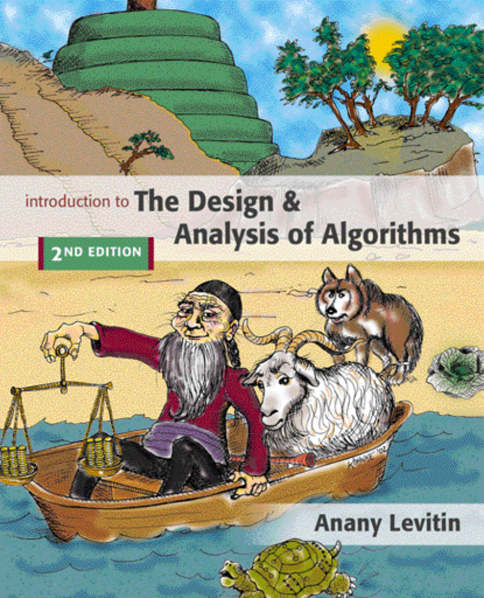

Decrease-and-Conquer
Copyright © 2007 Pearson Addison-Wesley. All rights reserved.

Slide 2
Decrease-and-Conquer
Reduce problem instance to smaller instance of the same problem
Solve smaller instance
Extend solution of smaller instance to obtain solution to original instance
Can be implemented either top-down or bottom-up
Also referred to as inductive or incremental approach

Slide 3
3 Types of Decrease and Conquer
Decrease by a constant (usually by 1):
  insertion sort
  graph traversal algorithms (DFS and BFS)
  topological sorting
  algorithms for generating permutations, subsets
Decrease by a constant factor (usually by half)
  binary search and bisection method
  exponentiation by squaring
Variable-size decrease
  Euclid’s algorithm

Slide 4
Insertion Sort
To sort array A[0..n-1], sort A[0..n-2] recursively and then insert A[n-1] in its proper place among the sorted A[0..n-2]
Usually implemented bottom up (nonrecursively)
Example: Sort 6, 4, 1, 8, 5
6 | 4 1 8 5
4 6 | 1 8 5
1 4 6 | 8 5
1 4 6 8 | 5
1 4 5 6 8

Slide 5
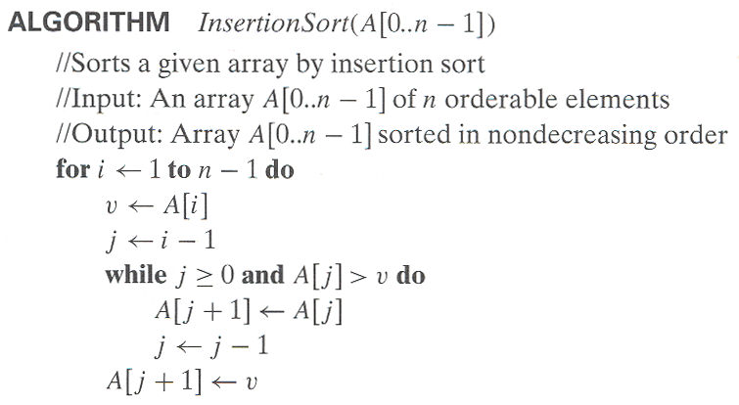
Pseudocode of Insertion Sort

Slide 6
Analysis of Insertion Sort
Time efficiency
C_{worst}(n) = n(n-1)/2 ∈ Θ(n²)
C_{avg}(n) ≈ n²/4 ∈ Θ(n²)
C_{best}(n) = n - 1 ∈ Θ(n) (also fast on almost sorted arrays)
Space efficiency:
in-place
Stability:
yes
Best elementary sorting algorithm overall

Slide 7
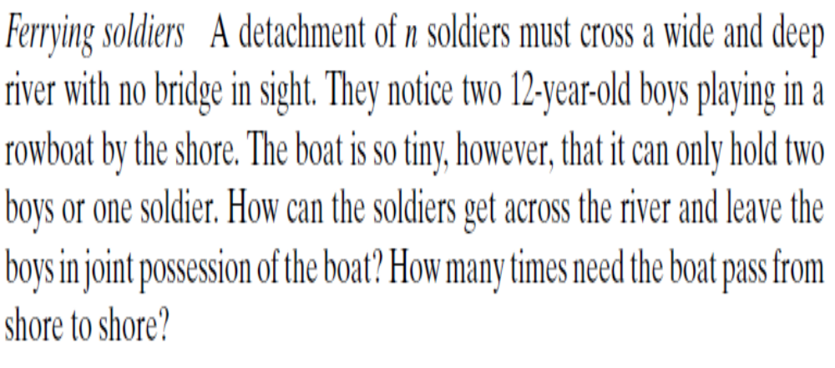

Slide 8
DAGs and Topological Sorting
A dag: a directed acyclic graph, i.e. a directed graph with no (directed) cycles
Arise in modeling many problems that involve prerequisite
constraints (construction projects, document version control)
Vertices of a dag can be linearly ordered so that for every edge its starting vertex is listed before its ending vertex (topological sorting). Being a dag is also a necessary condition for topological sorting to be possible.
a
b
a
b
a dag
not a dag
c
d
c
d

Slide 9
Topological Sorting Example
Order the following items in a food chain
tiger
human
fish
sheep
shrimp
plankton
wheat

Slide 10
DFS-based Algorithm
DFS-based algorithm for topological sorting
  Perform DFS traversal, noting the order vertices are popped off the traversal stack
  Reverse order solves topological sorting problem
  Back edges encountered?→ NOT a dag!
Example:
Efficiency: The same as that of DFS.
b
a
c
d
e
f
g
h

Slide 11
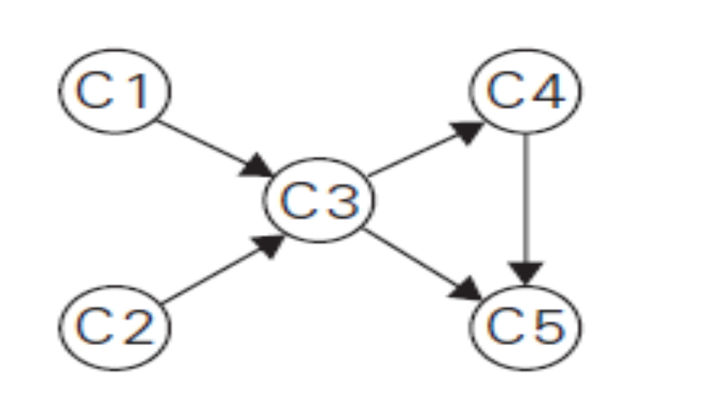
Example

Slide 12
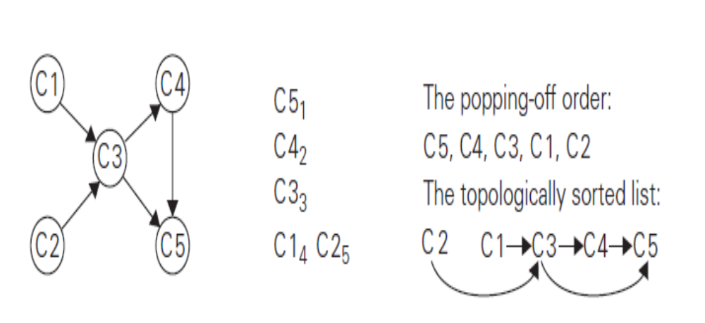
…….

Slide 13
Source Removal Algorithm
Source removal algorithm
  Repeatedly identify and remove a source (a vertex with no incoming edges) and all the edges incident to it until either no vertex is left or there is no source among the remaining vertices (not a dag)
Example:
Efficiency: same as efficiency of the DFS-based algorithm, but how would you identify a source? How do you remove a source from the dag?
a
b
c
d
e
f
g
h
“Invert” the adjacency lists for each vertex to count the number of incoming edges by going thru each adjacency list and counting the number of times that each vertex appears in these lists. To remove a source, decrement the count of each of its neighbors by one.

Slide 14
Decrease-by-Constant-Factor Algorithms
In this variation of decrease-and-conquer, instance size is reduced by the same factor (typically, 2)
Examples:
Binary search and

Slide 15
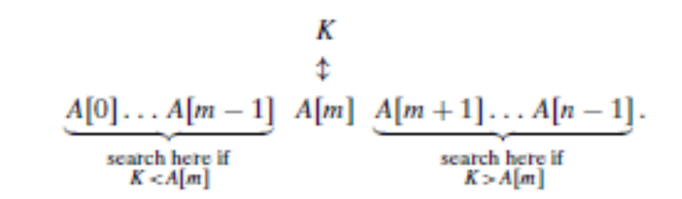
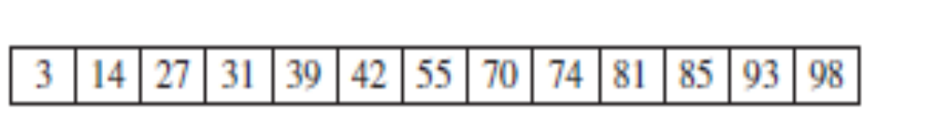
Binary Search

Slide 16
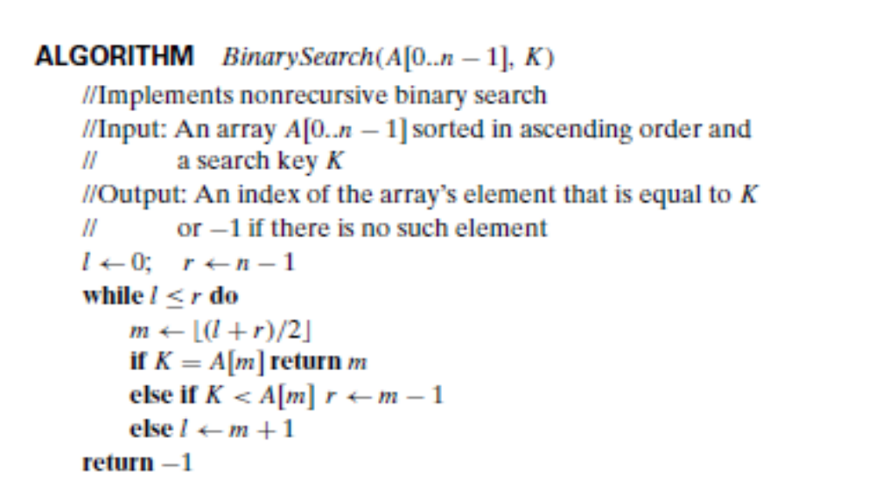
…….

Slide 17
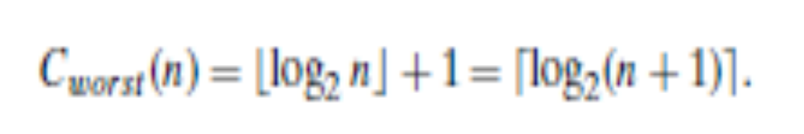

Slide 18
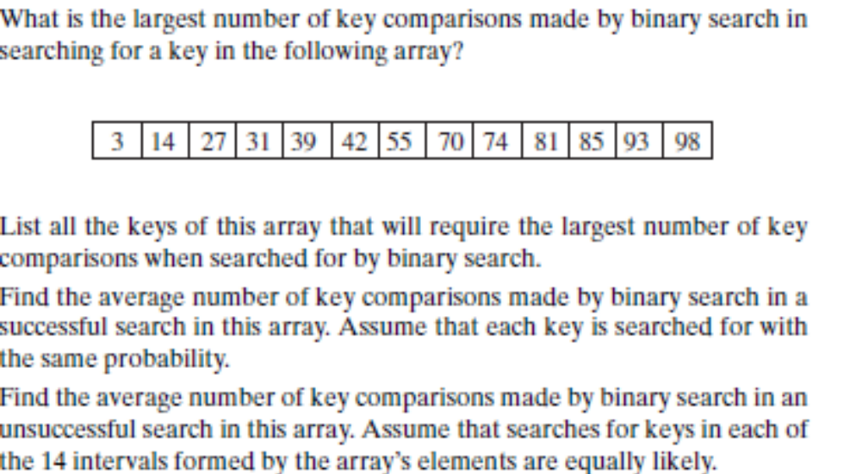
…..

Slide 19
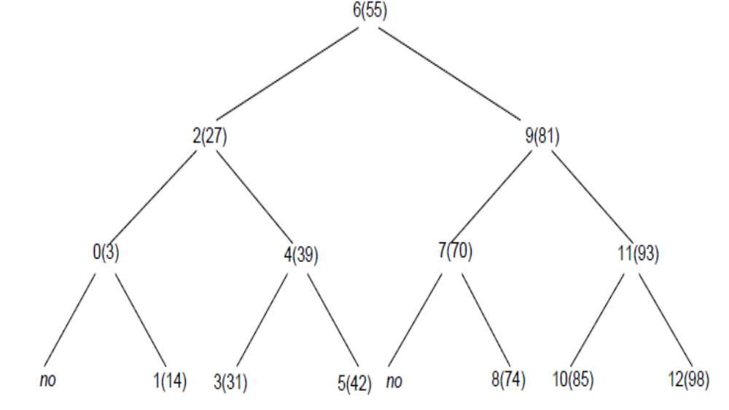
….

Slide 20
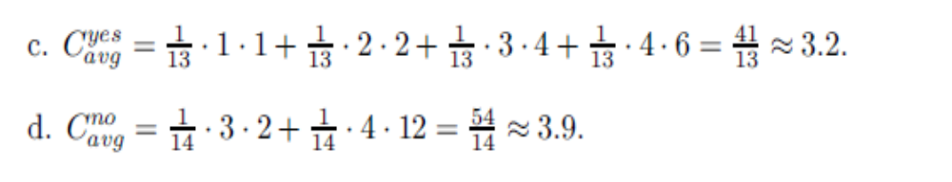

Slide 21
Variable-Size-Decrease Algorithms
In the variable-size-decrease variation of decrease-and-conquer,
instance size reduction varies from one iteration to another
Examples:
Euclid’s algorithm for greatest common divisor

Slide 22
Euclid’s Algorithm
Euclid’s algorithm is based on repeated application of equality
gcd(m, n) = gcd(n, m mod n)
Ex.: gcd(80,44) = gcd(44,36) = gcd(36, 8) = gcd(8,4) = gcd(4,0) = 4

