Slide 1


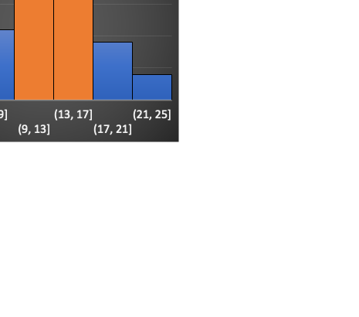
Comparing energy consumption of appliances with temperature and humidity variations.
Scroll bar
Drop down to change the date
Temperature
Humidity
Date range slider
Legend
Checkbox/Radio button
Living room
Bathroom
Iron room
Kitchen
Laundry room
Parent’s room
Teen room
Office room

