Slide 1


SMART INDIA HACKATHON 2025
Team Details and Problem Statement
Problem Statement ID – 25131
Problem Statement Title- Student Innovation: AI-Powered Metabolic Health Prevention platform
Theme- MedTech / BioTech / HealthTech
PS Category- Software
Team ID-
Team Name - Hexabyte

Slide 2
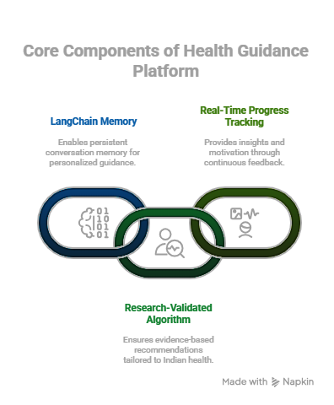
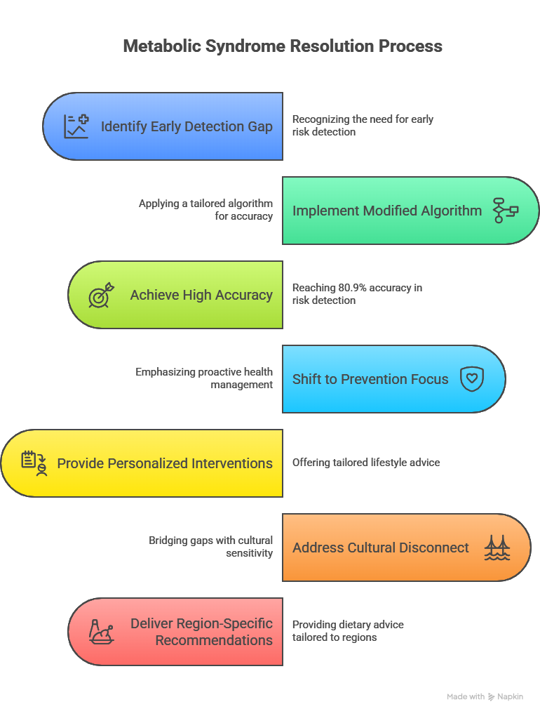
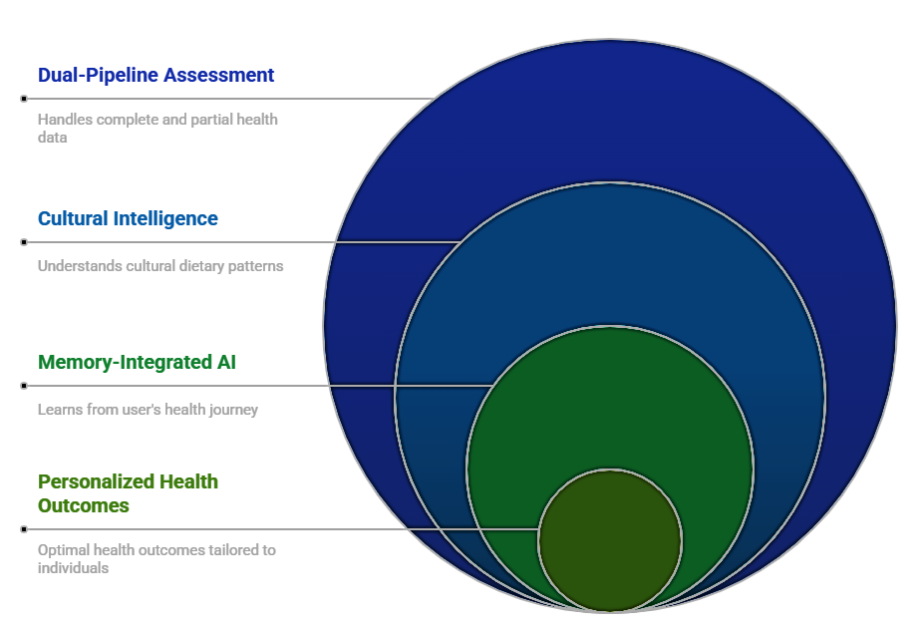
MetRisk
Hexabyte
IDEA TITLE: AI-Powered Metabolic Health Prevention platform
1. How It Addresses the Problem
2. How Our Solution Works
3. Our Innovation & Uniqueness

Slide 3

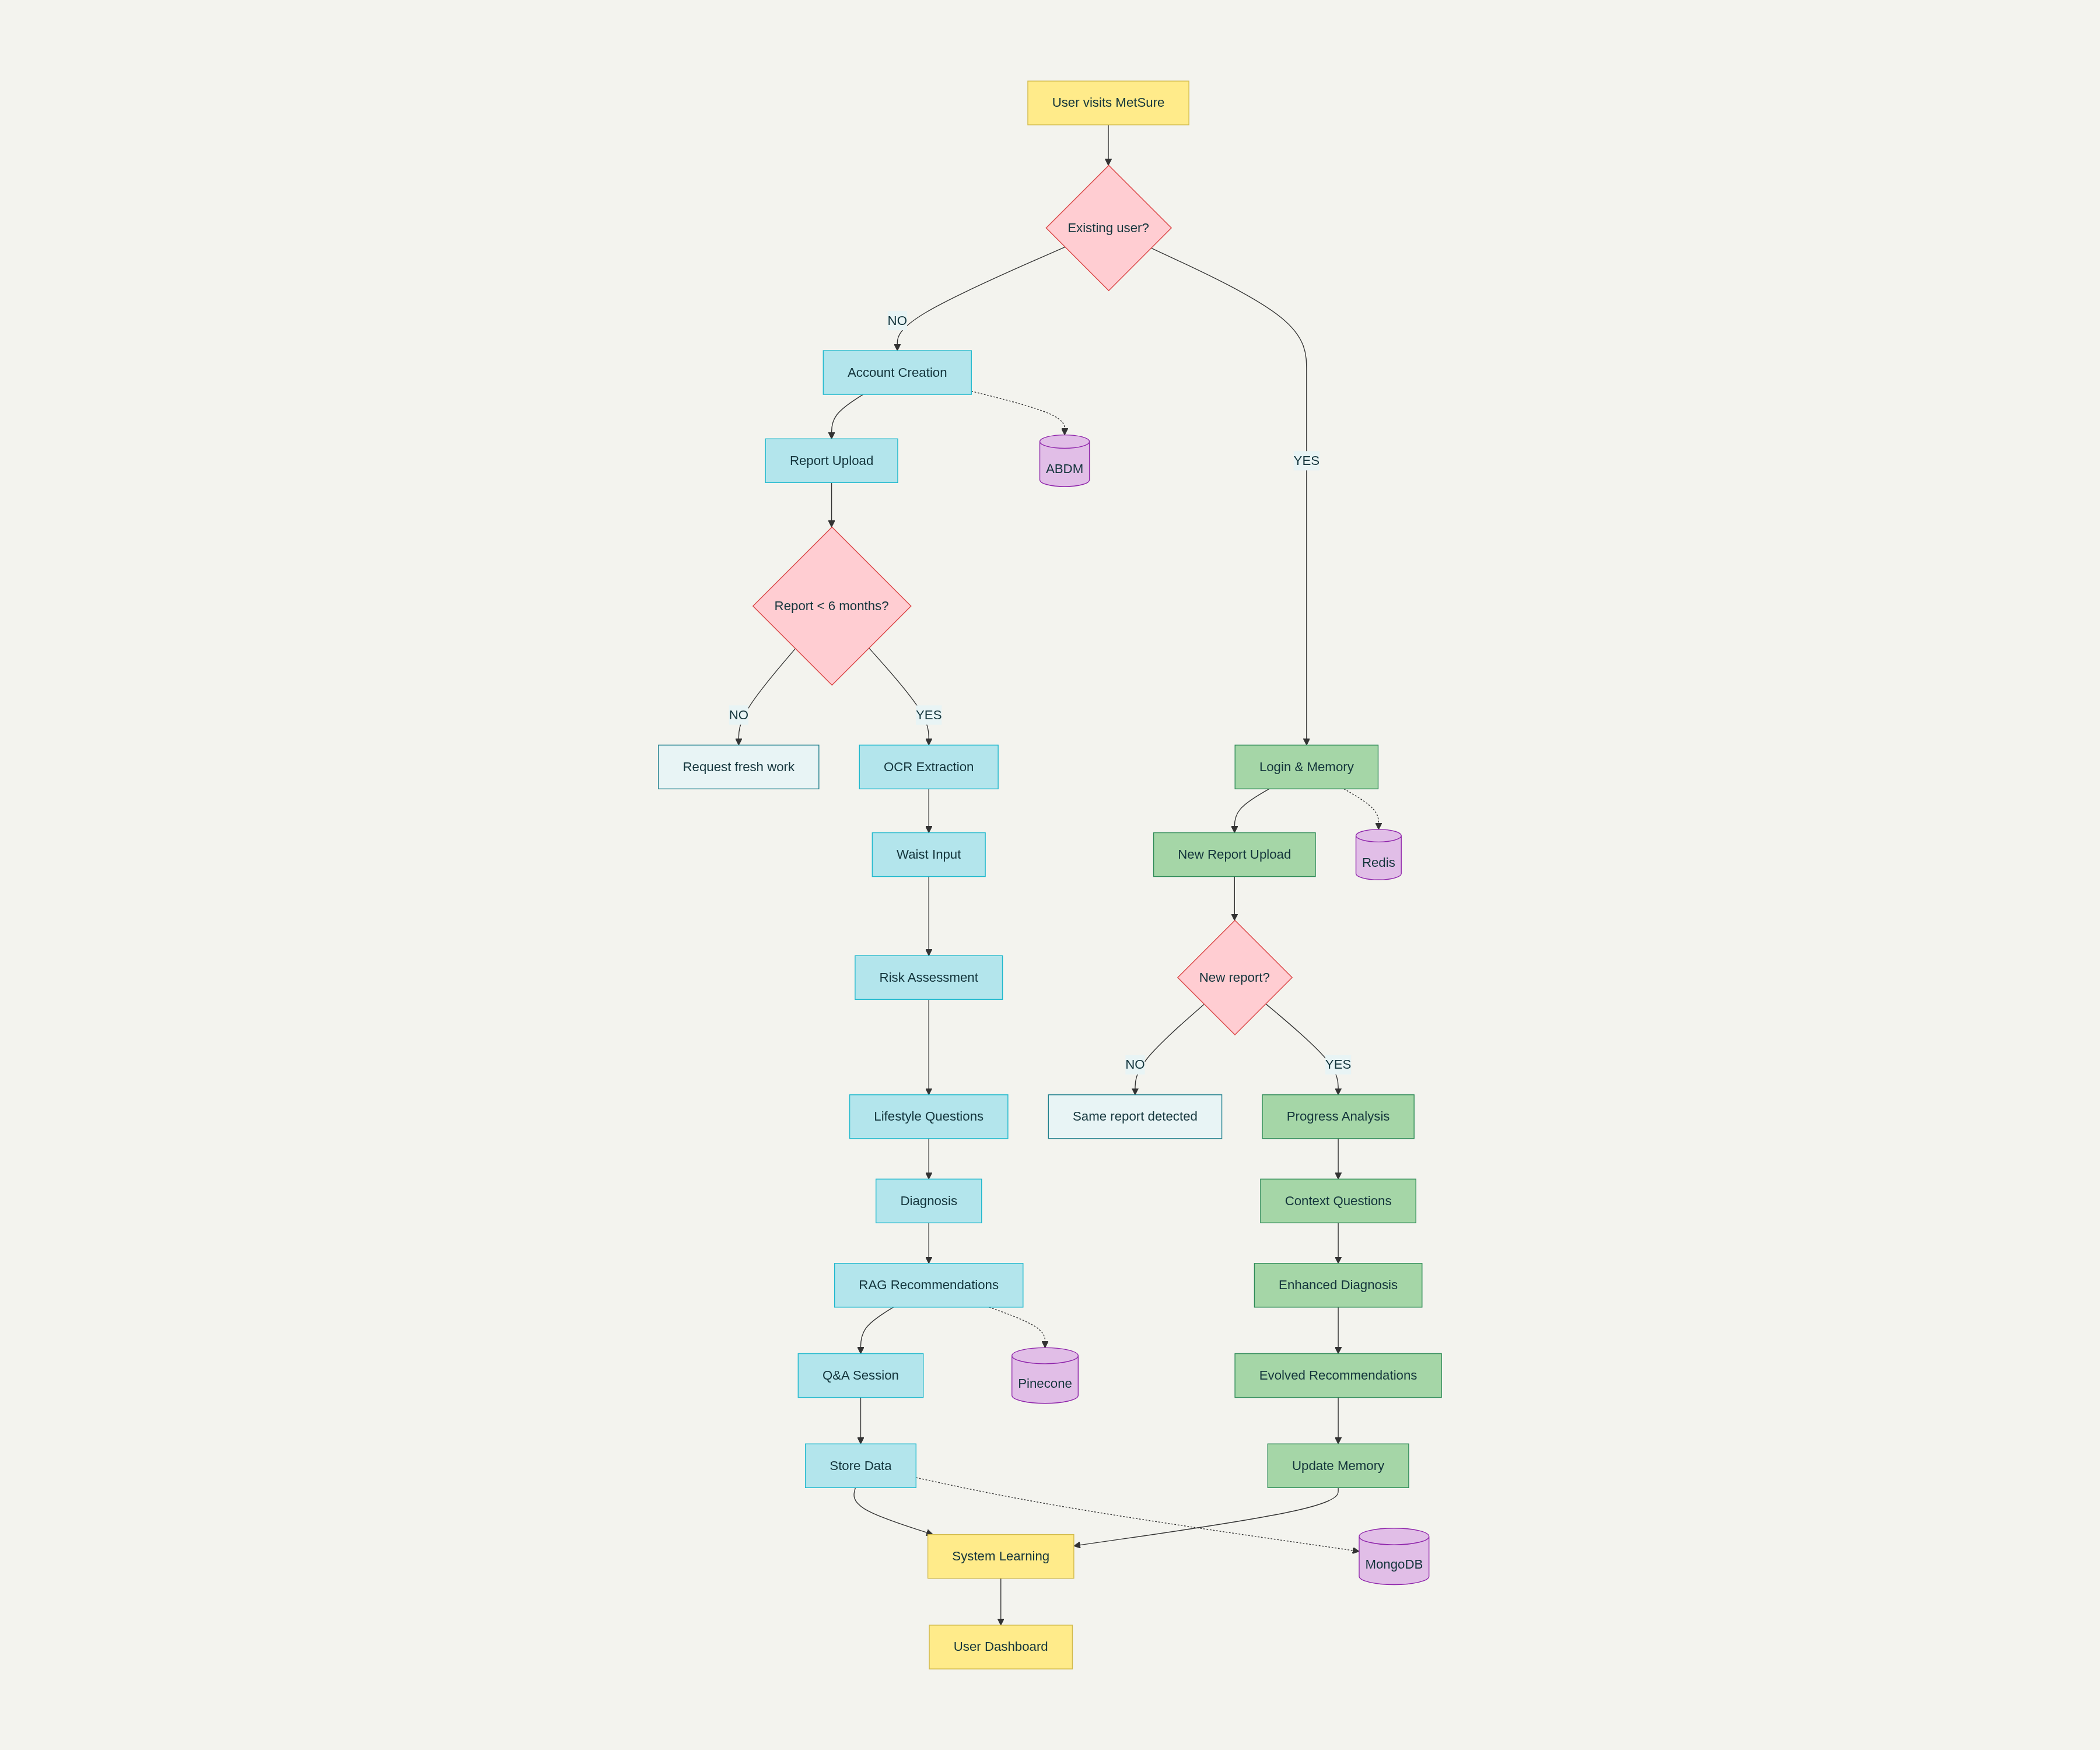
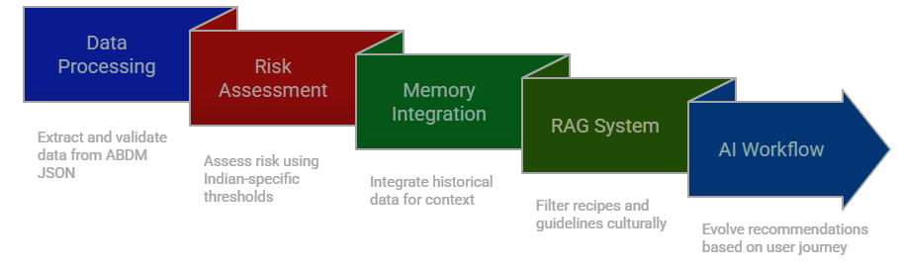
TECHNICAL APPROACH
Hexabyte
Technologies used
Methodology

Slide 4
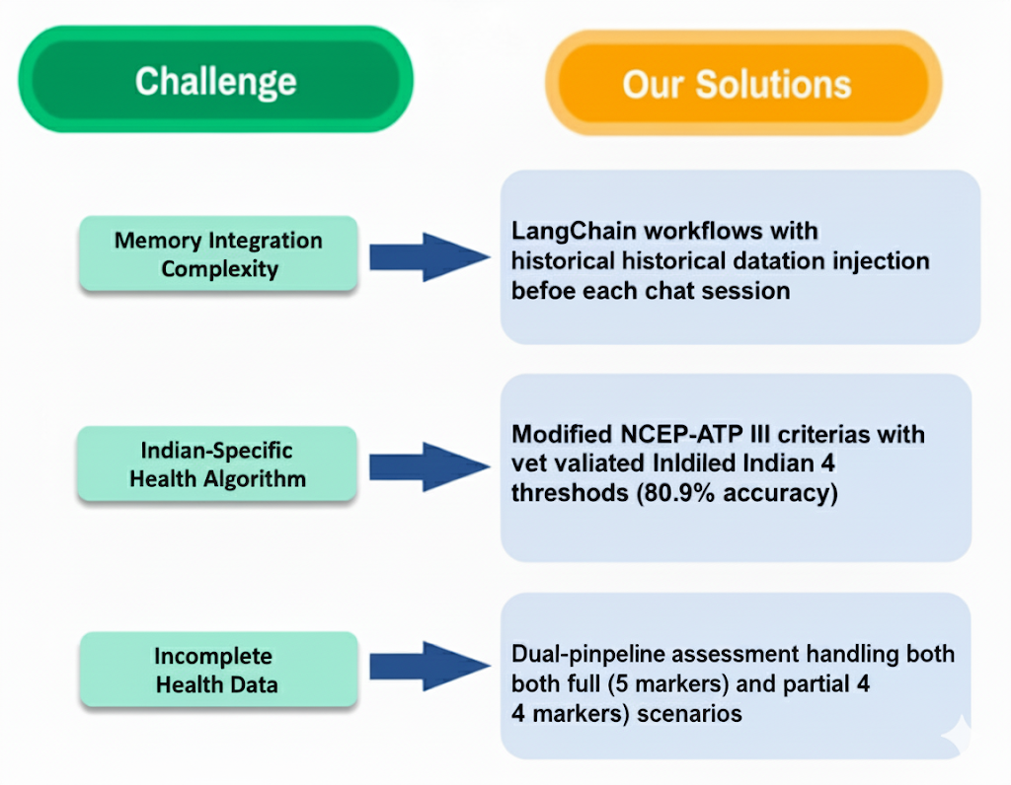
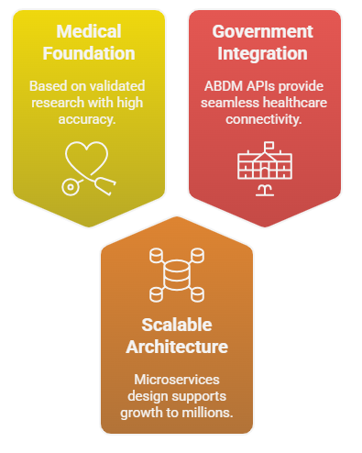
FEASIBILITY AND VIABILITY
Hexabyte
Feasibility
Challenges & Our Solutions

Slide 5

IMPACT AND BENEFITS
Hexabyte

Slide 6
RESEARCH AND REFERENCES
Hexabyte
Evolution of Metabolic Syndrome in Newly Diagnosed Type 2 Diabetes | Journal of Association of Physicians of India, Vol 72, No 6, 2024
https://www.japi.org/article/japi-72-6-39
Consensus Statement for Diagnosis of Obesity, Abdominal Obesity and Metabolic Syndrome for Asian Indians | Research Gate 2023
https://www.researchgate.net/publication/367462971
IDF Diabetes Atlas - Metabolic Syndrome Guidelines | International Diabetes Federation 2023
https://idf.org/media/uploads/2023/05/attachments-30.pdf
Machine learning-based predictive model for prevention of metabolic syndrome | PLOS One https://share.google/ttoGb2eOk90fQ8M3B
Development and Validation of Prediction Model for Risk Reduction of Metabolic Syndrome by Body Weight Control: A Prospective Population-based Study | Scientific Reports https://share.google/jCkMqujNScaTlP6Zz
Machine-Learning-Enabled_Obesity_Level_Prediction_.pdf https://share.google/hEc9Uejhb5Wm0TYLd
Predicting metabolic syndrome: Machine learning techniques for improved preventive medicine - Orit Goldman, Ofir Ben-Assuli, Shimon Ababa, Ori Rogowski, Shlomo Berliner, 2025 https://share.google/XsGy1vVhoPhFKL9HS
ABDM MVP 4.0 Integration Guidelines ,National Health Authority, Government of India https://sandbox.abdm.gov.in/sandbox/v3/documentation

