Slide 1
Agentic SOV Intelligence System
ADROSONIC BUILD · FINAL PRESENTATION · PROBLEM STATEMENT 3
Four collaborating agents turn chaotic Statements of Values into a schema-perfect Cleaned_SOV.xlsx with a full audit log, and a human approves every change.
TEAM
TEAM LEAD
MEMBER
Cache Me If You Can
Dishan Sarkar
Akhand Awasthi
BIT Mesra
BTECH/10614/23 · CSE (AIML)
BTECH/10595/23 · ECE
Notes:
Open with the one-line pitch: messy client SOVs in, a clean 17-field file and an audit log out, four agents in between, and a human approves every change. This is the final round: everything shown is running code, verified on the four provided broker SOVs.

Slide 2
Every client SOV is a new schema, cleaned by hand
01 · THE PROBLEM
53%
Hours
What the four provided SOVs actually contain
Header on row 12 under a two-row banner
Footnotes merged across 27 columns
8 tabs, 3 hidden; locations split over 3 of them
“1989 / 2012”, “1980’s” and 9999 as Year Built
“Included in Bldg” inside a value column
ZIP 00802 stored as 802; state “V.I.”
header mapping accuracy of today's manual baseline
of analyst time to cleanse a single SOV
17
0
strictly typed fields the exposure models require
standard cleansing procedures in place today
Messy SOV
Wrong exposure
Mispriced policies
Underwriting losses
Notes:
Figures are from the problem statement: 53% baseline mapping accuracy, hours per SOV, 17 target fields, no standard procedure. The right-hand list is what we found in the four real files: these are the traps the system has to handle without inventing data.

Slide 3
AI proposes.
Code verifies.
Humans approve.
Everything is audited.
02 · OUR DESIGN PRINCIPLE
0
changes applied without human approval
55 / 55
real broker columns mapped correctly
The LLM never writes a single cell. It explains and resolves genuinely ambiguous columns; deterministic, whitelisted code applies changes, and only after a person says yes.
15–22 s
per real SOV, end to end, cold start
Notes:
This principle drives every design decision that follows. The three numbers on the right are measured, not projected: zero silent changes by construction, 55 of 55 hand-labelled columns on the provided files, 15 to 22 seconds per file.

Slide 4
One upload, four agents, one audit-ready file
03 · SOLUTION OVERVIEW
INPUT
AGENT 1
AGENT 2
AGENT 3
Upload SOV
Sheet Discovery
Schema Mapping
Quality & Reasoning
.xlsx or .csv, multi-sheet, merged cells
Ranks tabs, finds header row, merges data tabs
Maps headers to 17 fields, checks the values
Finds anomalies, drafts explained fixes
approved mappings recalled by Agent 2 next time
rejected with a note: Agent 3 re-reasons or escalates
LEARNING
OUTPUT
AGENT 4
HUMAN GATE
Vector Memory
Deliverables
Transformation
Human Review
Approved mappings recalled next time
Cleaned_SOV.xlsx + Audit_Log.xlsx
Applies approved, whitelisted changes only
Approve, reject with a note, or assign
Orchestrated as a LangGraph state machine: the graph pauses (checkpointed) before Human Review and resumes into Agent 4 once every required decision is made.
Notes:
Walk the top row left to right, down into human review, then right to left to the outputs. Gold dashed line: a rejection with feedback sends the item back to Agent 3, which re-reasons or escalates. Teal dashed line: approved mappings are remembered for the next file.

Slide 5
Five layers, each replaceable on its own
04 · HIGH-LEVEL DESIGN
Presentation
Streamlit review console
Live workflow stepper
Mapping JSON & completeness views
Conformance panel + downloads
Orchestration
LangGraph StateGraph
Typed SOVState (Pydantic)
Pause before human_review
SQLite checkpoints + resume
Agents
1 · Sheet Discovery
2 · Schema Mapping
3 · Quality & Reasoning
4 · Controlled Transformation
AI services
RapidFuzz fuzzy matcher
bge-small embeddings (CPU)
LLM gateway + value masking
Value-profile & rule engine
Data layer
pandas + openpyxl (parsed once)
ChromaDB mapping memory
Cleaned_SOV / Audit_Log .xlsx
Local uploads & outputs
Cross-cutting: secrets only in .env · LLM provider switch (Ollama / Groq / Gemini / off) · structured logging · 92 automated tests + benchmark harness
Notes:
Each layer can be swapped without touching the others: the UI could become an API, ChromaDB could become pgvector, the LLM provider is one environment variable and can be switched off entirely. The four agents in the gold row are separate LangGraph nodes sharing one typed state.

Slide 6
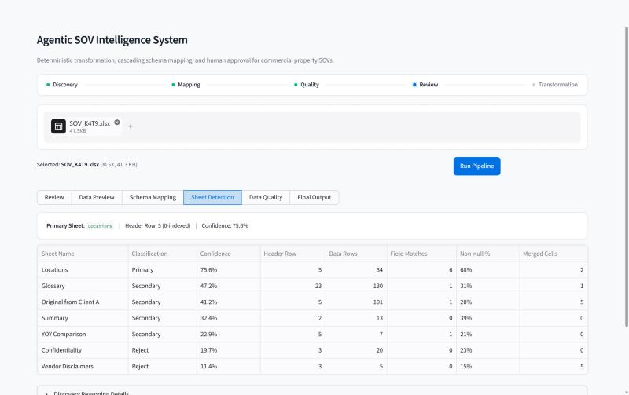
Find the real data before touching it
05 · LLD · AGENT 1: SHEET INTELLIGENCE & DISCOVERY
1
Parse once, unmerge safely
Merged values fill down their first column only; banners and footnotes are never copied into data cells.
2
Locate the header row
Score the first 30 rows: 0.40 vocabulary match + 0.20 text + 0.20 fill + 0.20 numeric data below.
3
Classify every sheet
0.35 header match + 0.25 density + 0.20 type consistency + 0.20 volume → Primary, Secondary or Reject, with reasons.
4
Merge the data sheets
Every Primary tab is stacked into one table; totals, footnotes and blank rows are dropped.
Live app, SOV_K4T9: 7 tabs → Locations is Primary, header on row 5 (Excel row 6)
Notes:
The fill-down rule matters: copying a footnote merged across the sheet once turned the text 'updates in 2018 to 2019' into a ZIP of 20182 and a Year Built of 2018. Now only vertical merges, like one Loc # spanning several building rows, are filled.

Slide 7
Cheap and certain first, LLM last, values always checked
06 · LLD · AGENT 2: SCHEMA MAPPING
Stage | Technique | Name score
0 · Memory | Human-approved mappings in ChromaDB (similarity > 0.85) | stored, ×1.10
1 · Exact | Normalised match against 17 names + 130 synonyms | 0.97
2 · Fuzzy | RapidFuzz token sort ≥ 75, top 5 candidates | score × 0.92
3 · Semantic | bge-small cosine ≥ 0.70 vs names, definitions, synonyms | cosine × 0.90
4 · LLM | Unresolved columns only; masked sample values | conf × 0.85
CONFIDENCE
0.45 × name similarity
+ 0.35 × value-profile fit
+ 0.20 × method agreement
Value veto
Fit < 0.25 rejects a candidate at every stage: building numbers are not a Building Value, longitudes are not a Country.
Strongest first
Columns claim targets in confidence order, 1:1 within each sheet.
Real effect: on the provided files, mapping went from 51% to 55 / 55 correct once values could veto names and the strongest column claimed first.
Review gates
≥ 0.90 may be bulk-approved; below 0.90 is decided one by one.
Notes:
Each column stops at the first stage that resolves it confidently, so the LLM only sees the genuinely ambiguous ones. Two design choices made the difference on real data: the value-profile veto, and assigning targets in confidence order instead of left to right, which had let 'Account Name' steal Reference from 'Location ID'.

Slide 8
Rules find the issues; feedback triggers re-reasoning
07 · LLD · AGENT 3: DATA QUALITY & REASONING
Check | Real example | Suggested fix
Completeness per field | Reference 44.6% filled | flag for review
Currency / format | $1,500,000 · “Yes” · “V.I.” | strip_currency · codes · state
Logical / range | Year Built “1989 / 2012”, 9999 | to_year_int
Type errors | “Included in Bldg”, “2 + B and 1” | flag · to_int (no truncation)
Duplicates | Repeated Reference IDs | flag for review
ZIP / integer fields | 802 (lost leading zeros) | to_zip
When a reviewer rejects with a note
Mapping rejected: ask Agent 2's cascade again, without that target
Alternative fits → re-proposed for review, citing the note
Nothing fits → ESCALATED to a human, who can assign a target
Data fix rejected → withdrawn; card says why
12 deterministic checks, so recall is measurable. The LLM only explains, from counts and masked examples, and can lower a confidence but never raise it.
Every other decision is kept.
Notes:
Detection is deterministic; the LLM adds explanation. Stage 5 of the demo shows the right-hand flow live: rejecting TOTAL → Number of Buildings with a note makes the agent look for another target; none fits, so it escalates instead of guessing.

Slide 9
One shared state, one human gate, only approved changes
08 · LLD · AGENT 4 & ORCHESTRATION
discover_sheets
1
Approved renames only
Highest confidence first; columns from different tabs coalesce; an unapproved column that happens to share a target name is parked.
map_schema
2
Whitelisted operations
assess_quality
12 pure functions; the result is audited before it is written back.
rejection notes
3
Enforce and validate
human_review
re_reason
Exactly 17 ordered fields · Pandera · numeric/integer type check · zero merged cells.
The graph pauses before human_review (state checkpointed) and resumes when the reviewer applies.
transform_export
4
Write deliverables
Cleaned_SOV.xlsx (Zip shown as 00000) + Audit_Log.xlsx, plus timestamped copies.
Every node reads and writes one typed SOVState; each agent owns its own fields.
Notes:
Left: the actual LangGraph. It runs Agents 1 to 3, pauses before human_review with the state checkpointed in SQLite, and the UI resumes it into transform_export. Rejection notes route through re_reason. Right: Agent 4 never evaluates anything dynamic; an operation outside the whitelist is refused and logged.

Slide 10
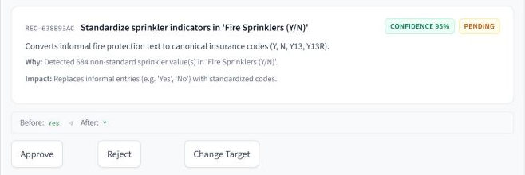
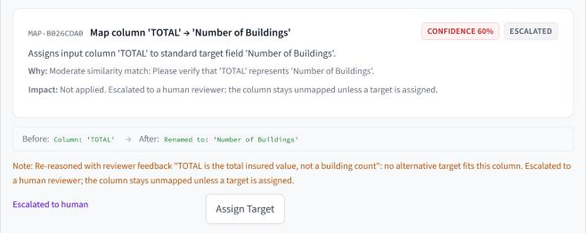



A non-technical reviewer can act on every recommendation
09 · HUMAN-IN-THE-LOOP EXPERIENCE
1 · Every recommendation explains itself
2 · A rejection with feedback is re-reasoned
Standardisation on SOV_Q8B3: why, impact, before → after, confidence
No alternative target fits, so the item is escalated to a human
Bulk approval only at ≥ 90%; everything below is decided one by one
Export stays locked until every required decision is made
Every rename and change logged with who approved it
Notes:
Both cards are from the live app on SOV_Q8B3. Left: the sprinkler standardisation, Yes becomes Y, 95% confidence, with Approve, Reject and Change Target. Right: the TOTAL mapping after the reviewer rejected it with a note; the agent looked for another target, found none that fits the values, and escalated it instead of guessing.

Slide 11
All seven hard rules are met by construction
10 · MANDATORY CONSTRAINTS (BRIEF §9)
ID | Constraint | How the system guarantees it | Status
C-01 | No auto-transformation | Agent 4 runs only after approval; graph pauses before human review; export locked until required decisions are made | ✓ Met
C-02 | No hallucinated data | Missing fields stay blank; merged footnotes never copied; 1.5 storeys not truncated; “Included in Bldg” flagged, not invented | ✓ Met
C-03 | Exactly 17 fields | Fixed order enforced; Pandera + type check; merged cells re-checked in the written file | ✓ Met
C-04 | ≥ 4 distinct agents, shared state | Four LangGraph nodes over one typed SOVState, checkpointed | ✓ Met
C-05 | Rationale for every decision | Each mapping and recommendation carries a human-readable rationale (UI card + JSON) | ✓ Met
C-06 | Process all samples | All 4 broker SOVs + 3 samples run end to end; 92 automated tests | ✓ Met
C-07 | Output file names | outputs/Cleaned_SOV.xlsx and outputs/Audit_Log.xlsx on every run | ✓ Met
Data privacy: keys only in .env · fully local with Ollama · LLM prompts receive masked values (digits → 9, e-mails removed).
Notes:
Brief section 9, page 13. Each guarantee is structural, not a convention: for C-01, transformation code is simply not reachable until review is complete; for C-03, the output is rebuilt from the 17-field template every time.

Slide 12


Every measurable target met, with margin
11 · SUCCESS METRICS (BRIEF §10)
Agentic design (20%)
4 distinct LangGraph nodes, one typed state, checkpointed pause and resume
Human-in-the-loop UX (10%)
Why / impact / before → after on every card; escalation with Assign Target
Innovation (5%)
Vector memory · workflow stepper · xlsx + csv · iterative re-reasoning
Mapping baseline (manual): 53%. Real broker files: 55 / 55 hand-labelled columns.
Notes:
Left: the four measurable criteria from page 14, measured with benchmark.py on the labelled samples. Right: the three judged criteria and what we offer for each. On the four real files we hand-labelled 55 columns; all are mapped correctly.

Slide 13
Four real broker files, end to end, under 25 seconds each
12 · VERIFIED ON THE PROVIDED SOVS
File | Layout challenge | Rows out | Columns correct | Time | Validation
SOV_B4ID | Header on row 12, footnotes merged across sheet | 15 | 15 / 15 | 16 s | Flags 1.5 storeys (kept)
SOV_H6D2 | Two-row banner, multi-line headers | 19 | 15 / 15 | 17 s | Passed
SOV_K4T9 | 7 tabs, data on row 6, 9999 years | 34 | 12 / 12 | 15 s | Passed
SOV_Q8B3 | 8 tabs (3 hidden), locations on 3 tabs | 990 | 13 / 13 | 22 s | Flags “Included in Bldg”
55 / 55
0
2
hand-labelled columns mapped correctly (51% before the fixes)
merged cells and 17 ordered fields in every output
real source problems surfaced instead of silently “fixed”
Notes:
Times are measured from a cold start with the LLM off, including loading the embedding model; once warm a run takes about 5 to 10 seconds. The two validation flags are deliberate: the system reports what the source actually contains rather than inventing a number.

Slide 14




From hours per SOV to seconds plus a short review
13 · BUSINESS IMPACT (BRIEF §13)
Speed
Scalability
TODAY
Hours
Pipeline in seconds; the reviewer only decides the items that need judgment (7 of 30 on SOV_Q8B3).
No templates: new layouts are handled by scoring, synonyms, embeddings and value checks.
manual analyst time per SOV, 53% header accuracy
Consistency
Auditability
Same rules and thresholds for every analyst, file and time zone.
Every rename and change logged with rationale, confidence and approver.
WITH THE AGENTS
15–22 s
Downstream reliability
Compounding accuracy
Exactly 17 typed fields; problems flagged instead of hidden.
Approved mappings are remembered, so recurring broker headers resolve instantly.
per real SOV (target < 60 s), then a focused human review
Notes:
The six benefits are the ones the brief lists on page 16; each line on the right is backed by something in the running system. The 7 of 30 figure is from SOV_Q8B3: 23 recommendations are high-confidence and can be approved in one click.

Slide 15
Seven stages in ten minutes, on two provided SOVs
14 · LIVE DEMONSTRATION (BRIEF §11)
1
File upload & sheet detection
K4T9: 7 tabs → Locations, header row 6
Sheet Detection
2
Schema detection
Mapping JSON; Location Name → City, 0.84, semantic
Schema Mapping
3
Data quality report
Q8B3: completeness per field, 15 issues by type
Data Quality
4
Recommendations
Mapping · data correction · standardisation
Review
5
Human approval
Approve one; reject TOTAL with a note → escalated
Review
6
Transformation & audit
Apply; cleaned rows beside the audit trail
Final Output
7
Download & conformance
17 ✓ headers, types per field, 0 ✓ merged cells
Final Output
Run sheet, commands and expected values: DEMO.md · deterministic mode for predictable timing
Notes:
Part A on SOV_K4T9 covers stages 1 and 2 in about two minutes, including the semantic match. Part B on SOV_Q8B3 covers stages 1 and 3 to 7. Every value on this slide was recorded in a rehearsal; DEMO.md has the click path and script.

Slide 16

Built for sensitive commercial data
15 · SECURITY & DATA HANDLING
Where data goes
What the LLM sees
Control & traceability
Runs fully local with LLM_PROVIDER=ollama and no cloud keys
LLM_PROVIDER=none: no LLM calls at all
Cloud fallback only when a key is configured
Headers, field definitions, counts
Masked samples: digits → 9, e-mails removed, 32 characters max
Never whole rows, never the workbook
API keys only in .env (git-ignored)
Whitelist of 12 functions; nothing evaluated dynamically
Audit_Log.xlsx for every approved change
Matches the brief's redaction guide: the anonymised test files keep headers, values and structure, and our pipeline needs nothing more.
Notes:
The brief asks evaluators to note data handling. The short version: it can run entirely offline, it can run with no LLM at all, and when an LLM is used it never sees real figures or identifiers.

Slide 17


What we would do next
16 · HONEST LIMITS & NEXT STEPS
Known limits
Next steps
Masking keeps words, so a company name in a text cell can reach the LLM
Merged multi-tab output has no “source sheet” marker (an 18th column would break the schema)
Uploads are kept locally until cleared by the operator
Named-entity redaction before any cloud LLM call
FastAPI service + queue workers for batch volumes
pgvector memory partitioned per broker
Source-sheet lineage in the audit log
None of these limits touches C-01 to C-07: every change is still approved, explained, audited and conformant.
Notes:
We would rather name the limits than have evaluators find them. None of them affects the seven constraints; they are the roadmap from hackathon to production.

Slide 18
AI proposes. Code verifies.
Humans approve.
Everything is audited.
THANK YOU · QUESTIONS
RUN THE DEMO
DESIGN
DEEP DIVES
DEMO.md
hld.md · lld.md
guide.html · algo.html
Cache Me If You Can · Dishan Sarkar · Akhand Awasthi · BIT Mesra
Notes:
Close on the principle and the evidence. Point evaluators to DEMO.md to rerun everything they just saw, then take questions.

