Slide 1
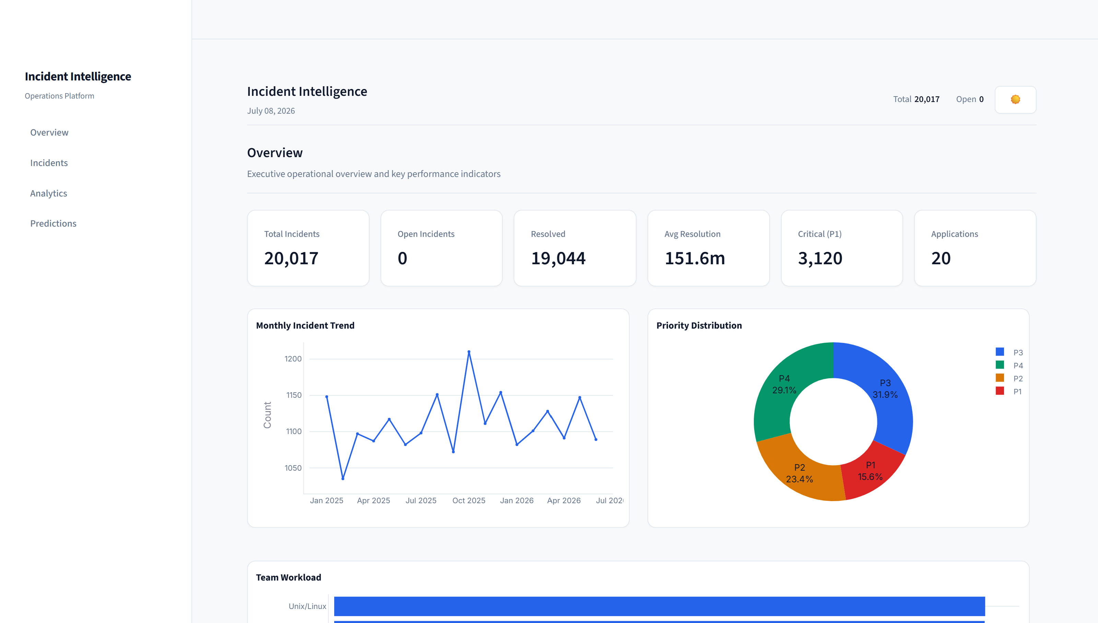
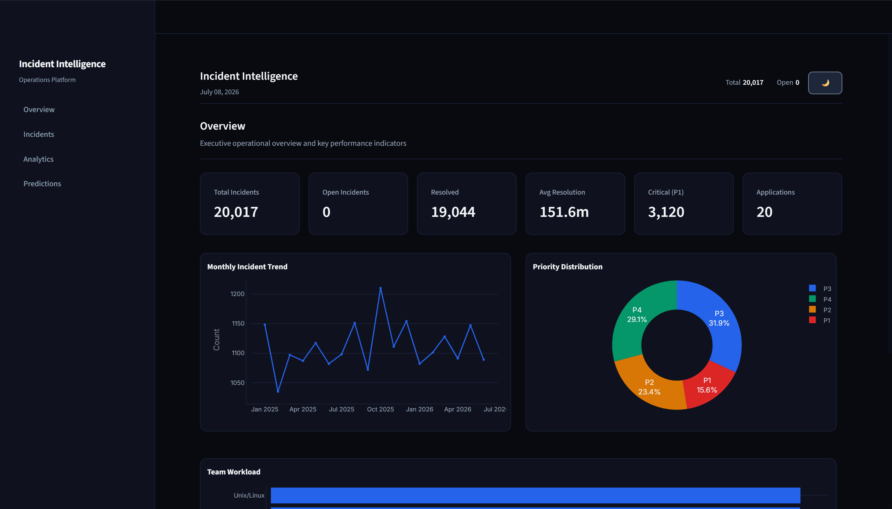
ITSM DECISION SUPPORT PLATFORM
AI-Powered Incident Intelligence Platform
Operational Overview & Platform Objectives
• Specialized ITSM decision support platform designed similarly to ServiceNow for standard ticket logging, routing, and lifecycle states (Open, Assigned, In Progress, Resolved, Closed).
• Engineered with superior, localized conversational analytics powered by an in-memory DuckDB query engine, bypassing the need for complex, latency-heavy ServiceNow reporting setups.
• Proactively intercepts ticket submission to alert operators of duplicate outages, preventing duplicate alerts from cluttering the queue.
• Generates automated root cause recommendations and L3 escalation risk analysis in a single click using fallback-equipped AI agents.

Slide 2
TECHNICAL DATA FLOW
ITSM Ingestion Flow & Custom Analytics Pipeline
1. INGESTION UI
Streamlit Form Modal
2. TEXT NORMALIZE
Regex Synonyms
3. DUPLICATE CHECK
TF Cosine Sim >= 80%
4. ML PREDICTORS
Random Forest / Ridge
5. LIVE DATABASE
PostgreSQL / SQLite
System Architecture
Incident Creation
Duplicate Detection
ML Prediction Engine
PostgreSQL Database
AI Analytics Dashboard
• Core ITSM Pipeline (Row 1): Fresh tickets flow sequentially from ingestion UI, through normalized syntax mapping and duplicate checking (cosine similarity >= 80%), directly into ML triage predictors (predicting group, priority, MTTR), and finally persist in the relational database.
• Custom Analytics Pipeline (Row 2): Completely decoupled from core ingestion. When a user runs a manual query or generates SQL, the engine reads data from the PostgreSQL/SQLite database to query it locally in-memory via DuckDB, feeding the formatted exports.
6. DUCKDB SQL ENGINE
Read-Only SELECT 10k Capped
7. REPORT EXPORTERS
Excel, PDF, CSV

Slide 3
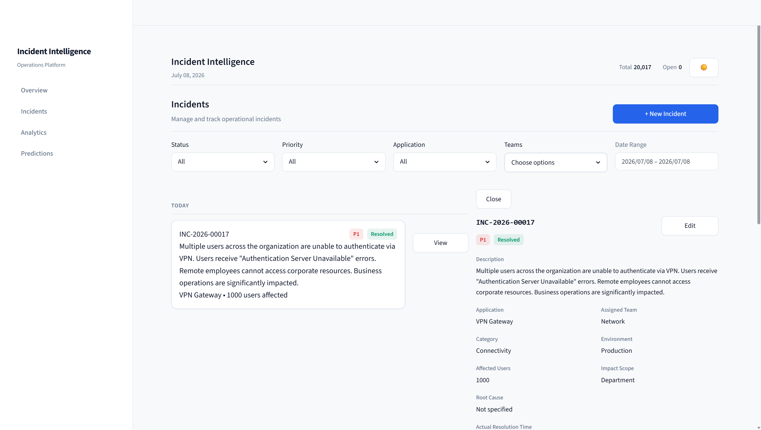
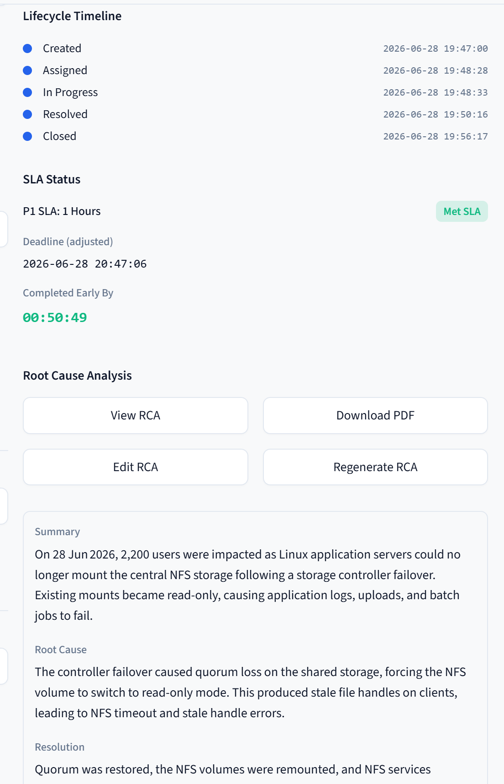
INGESTION ANALYSIS
Incident Triage & Duplicate Warning Intercept
Key Features
AI-based Incident Assignment
Priority Prediction
Resolution Time Estimation
Duplicate Ticket Detection
SLA Monitoring

Slide 4
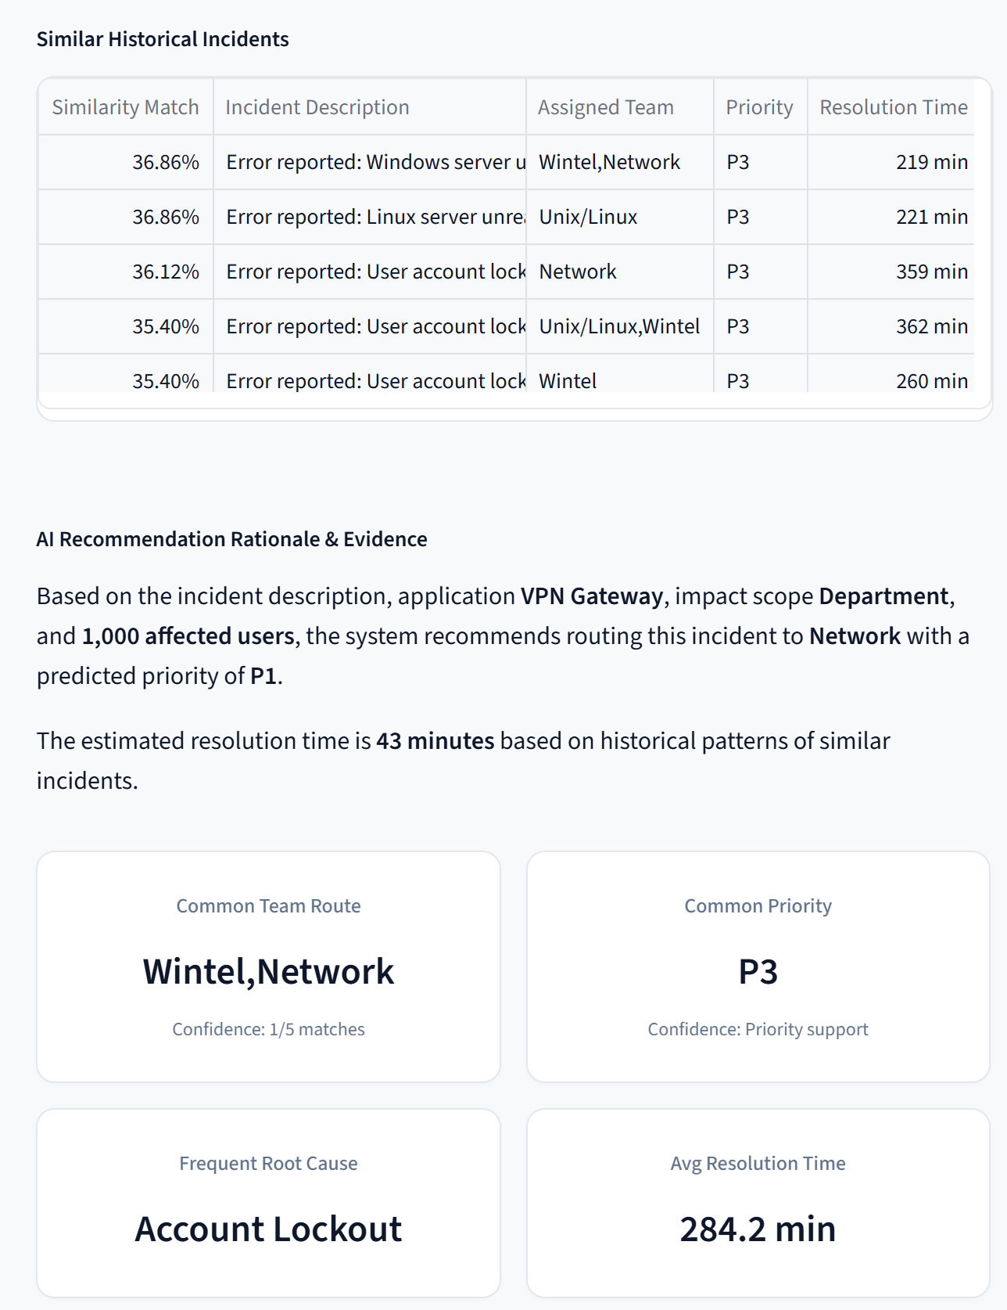
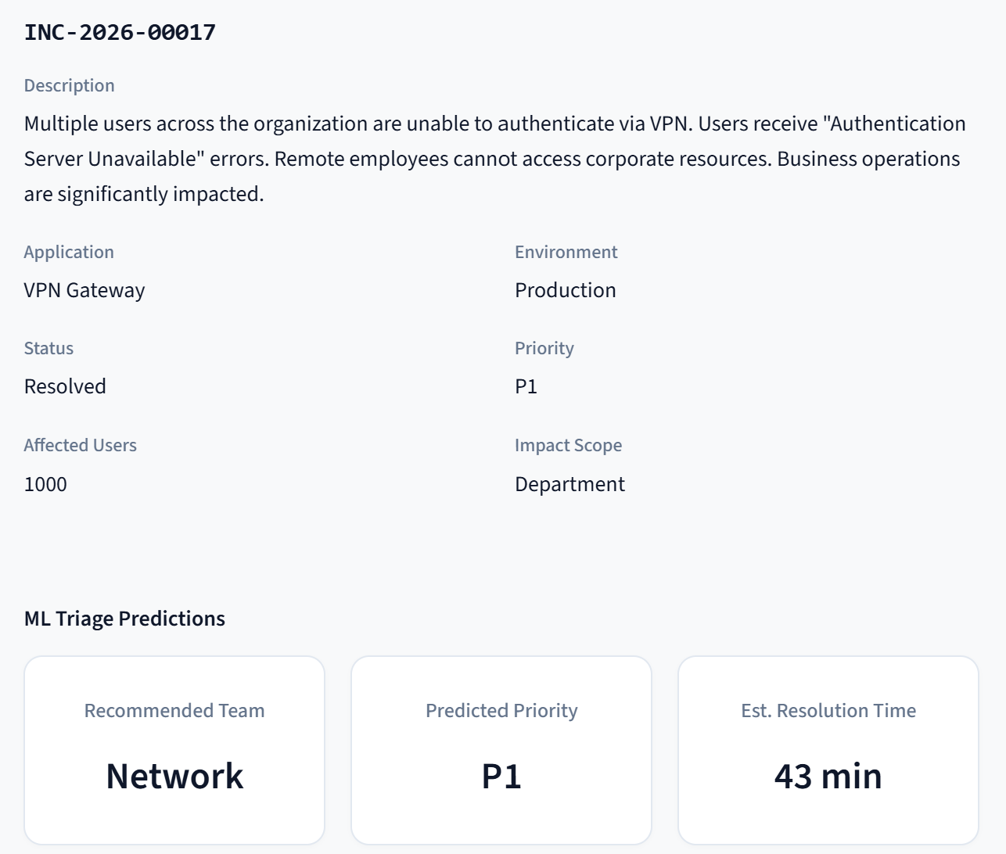
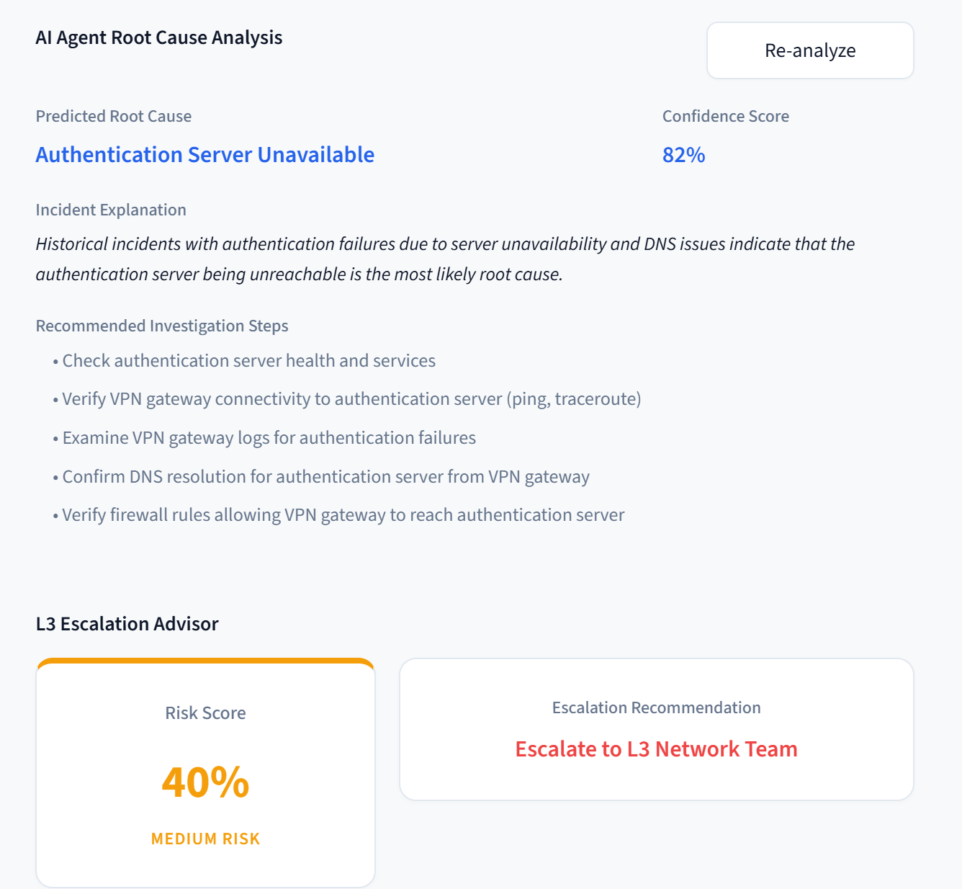
INGESTION ANALYSIS
Incident Triage & Duplicate Warning Intercept
AI Decision Support
Root Cause Prediction
L3 Escalation Advisor
Historical Incident Search
Investigation Recommendations
Confidence Scores

Slide 5
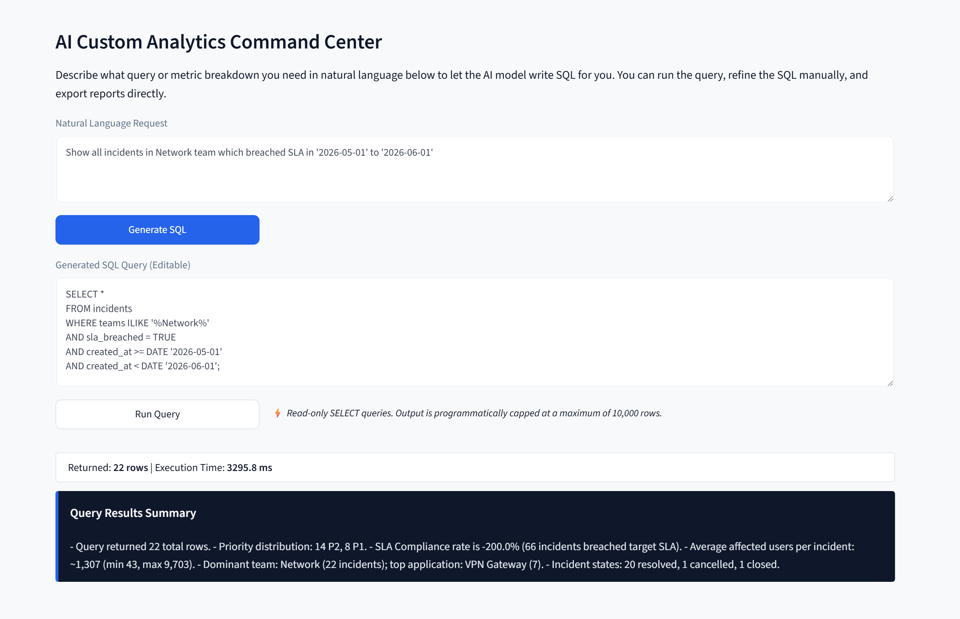
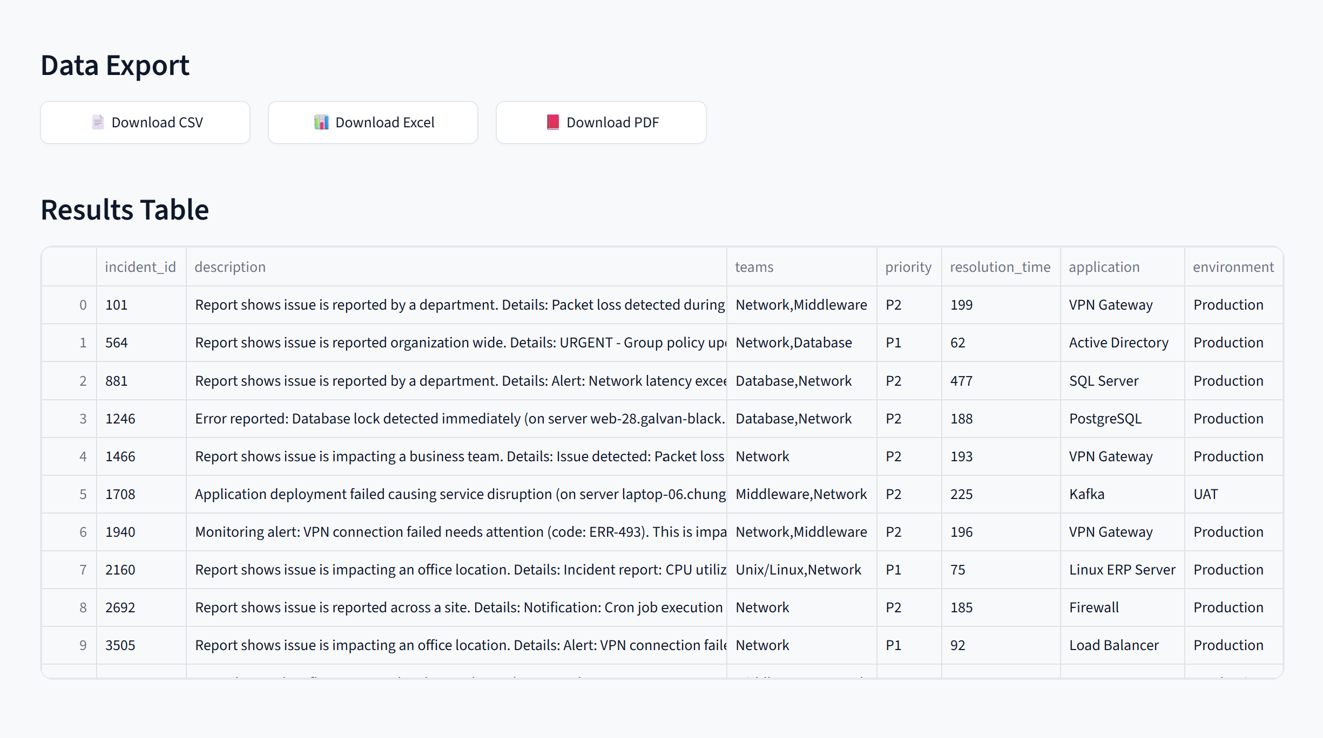
BUSINESS INTELLIGENCE TRIAGE
Conversational SQL Analytics Workspace
AI Custom Analytics
Natural Language → SQL
Manual SQL Editor
Read-only Query Execution
Automatic Charts
Export to Excel, PDF and CSV
Safe Query Execution
Only SELECT queries allowed
SQL validation before execution
Blocks UPDATE, DELETE, DROP
Prevents system table access
Result limit of 10,000 rows

Slide 6
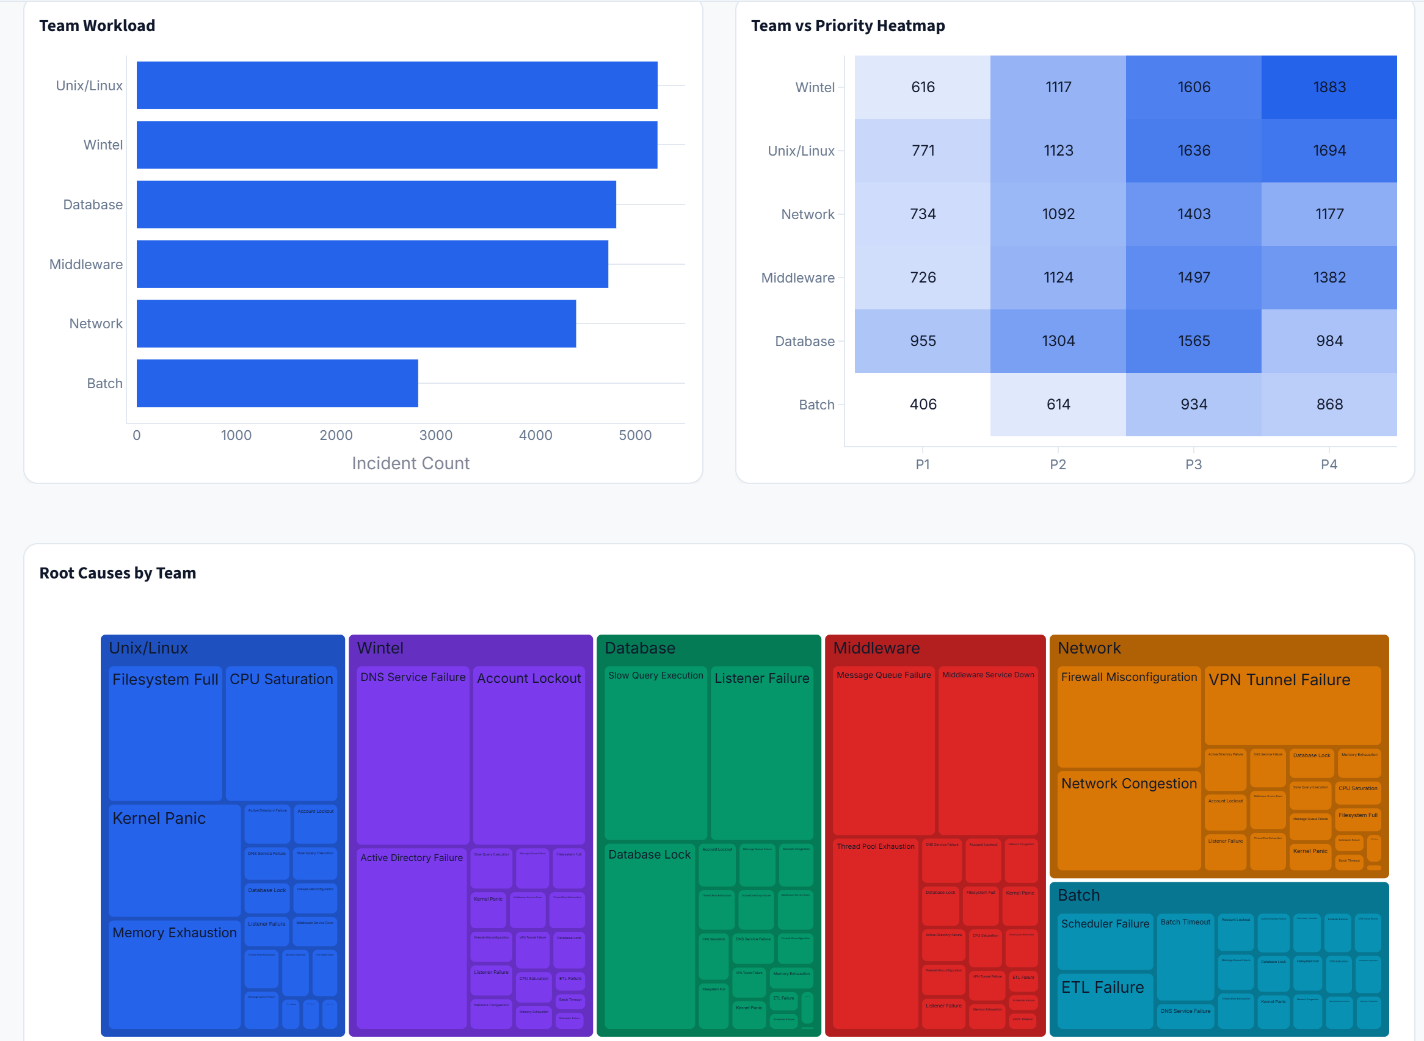
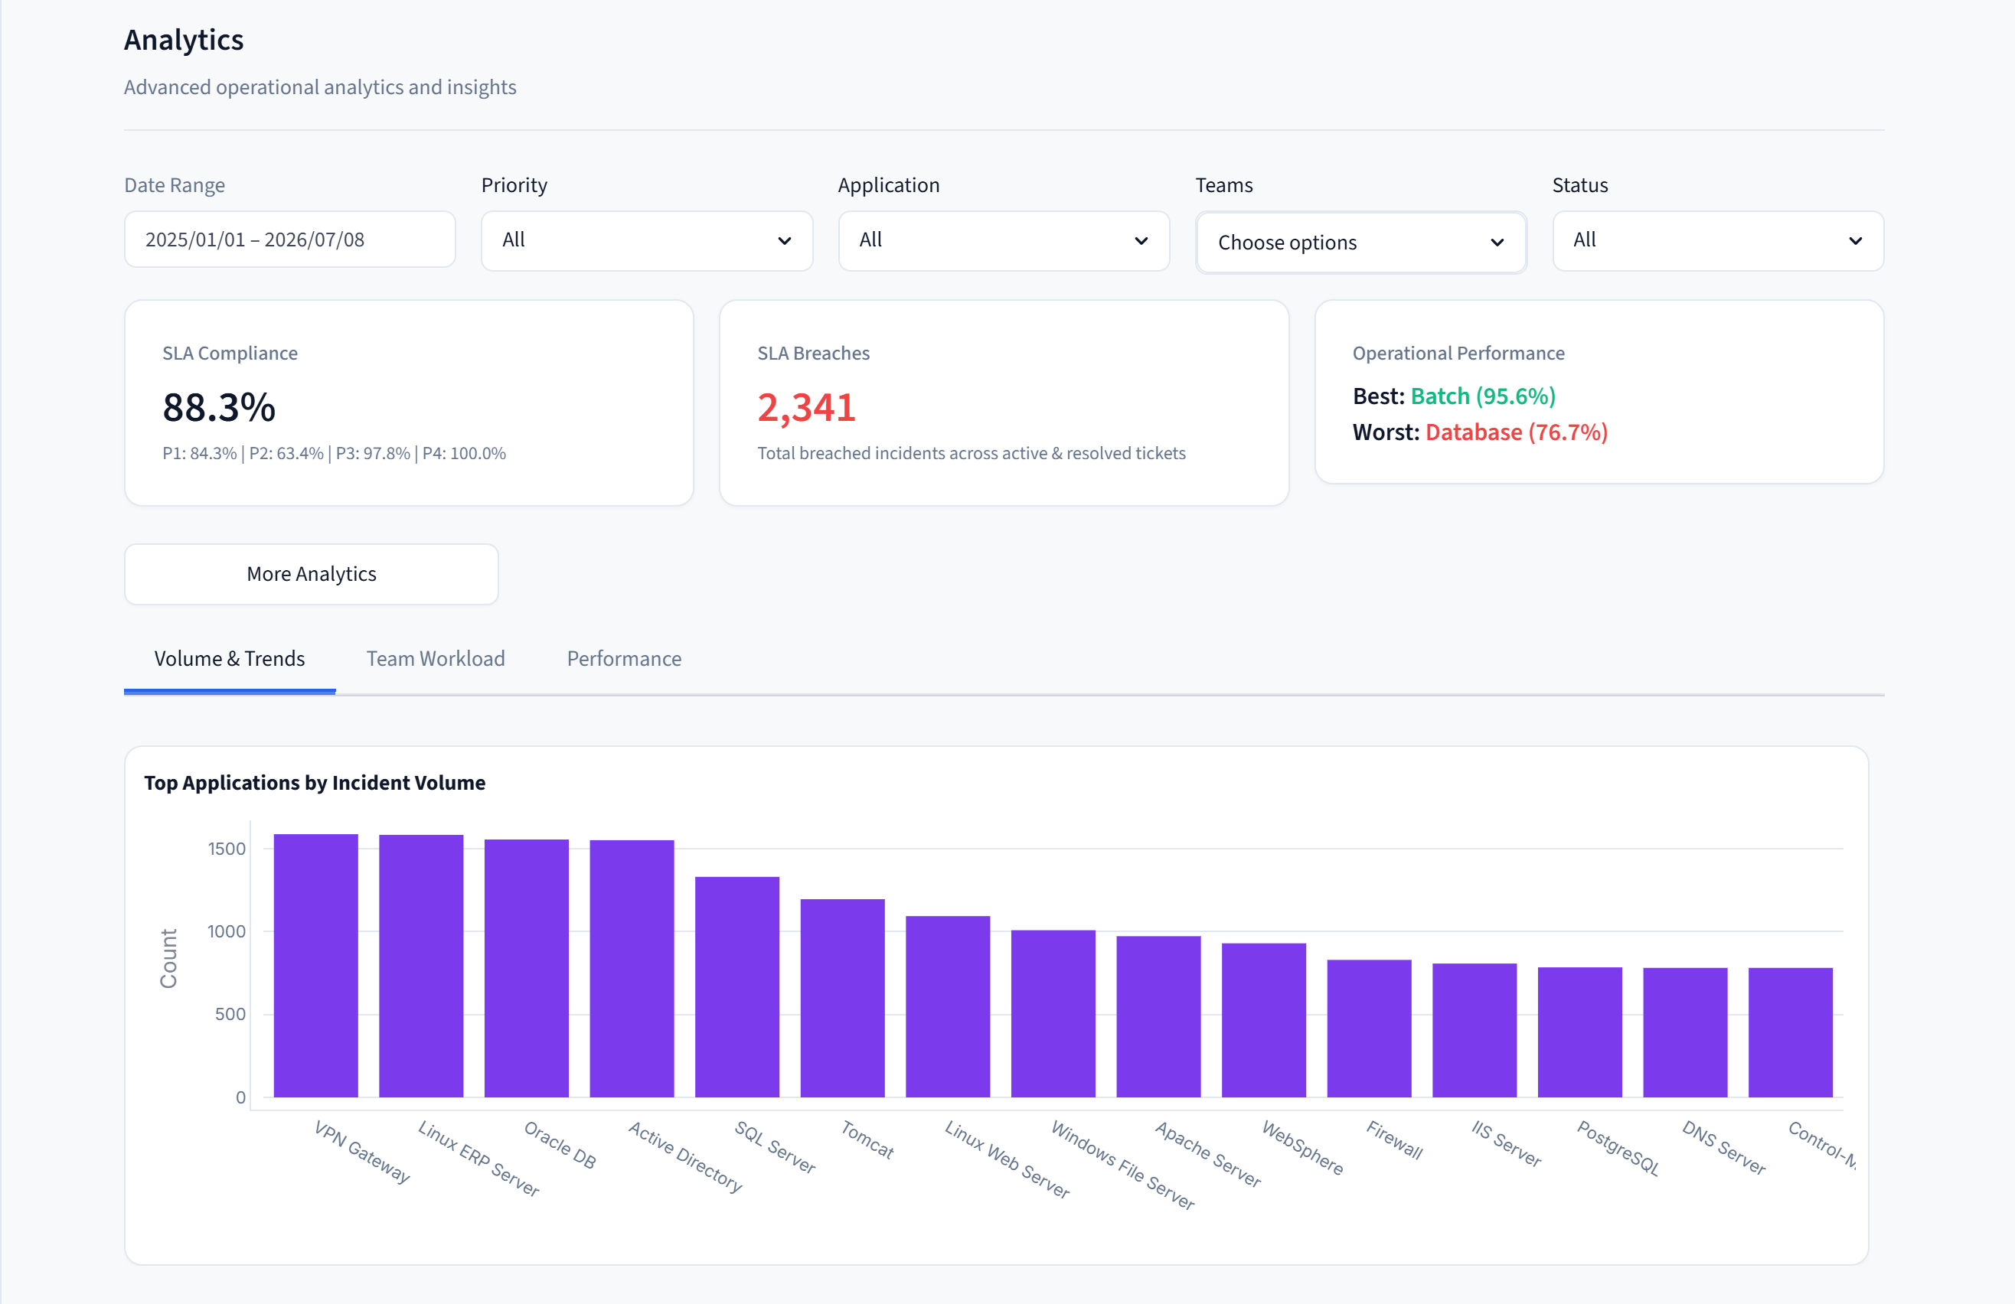
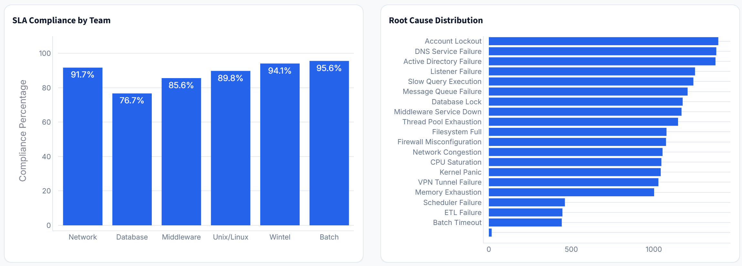
OPERATIONS ANALYSIS
Query Results Summaries & Dynamic Visualizations
Analytics Output
Interactive Tables
Executive Summary
Automatic Charts
Excel Export
PDF Report Generation

Slide 7
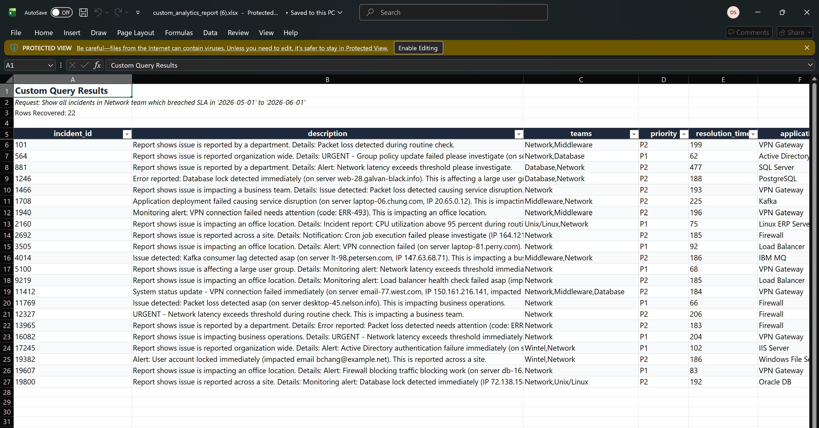
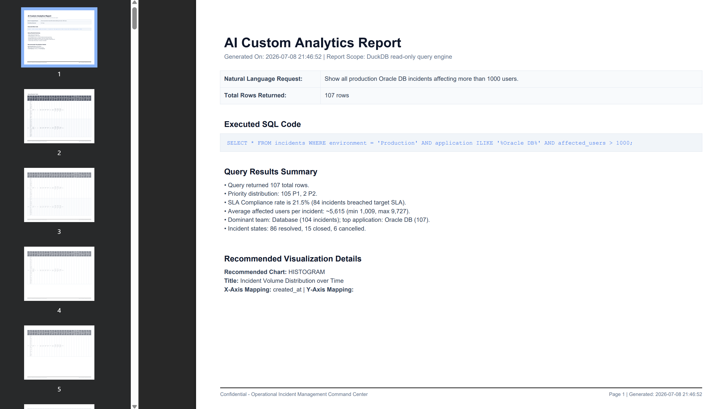
REPORTING COMPILER
Excel Data Exporter Engine
Output format
Excel sheet
Pdf
CSV file
Rows rendered on screen

Slide 8
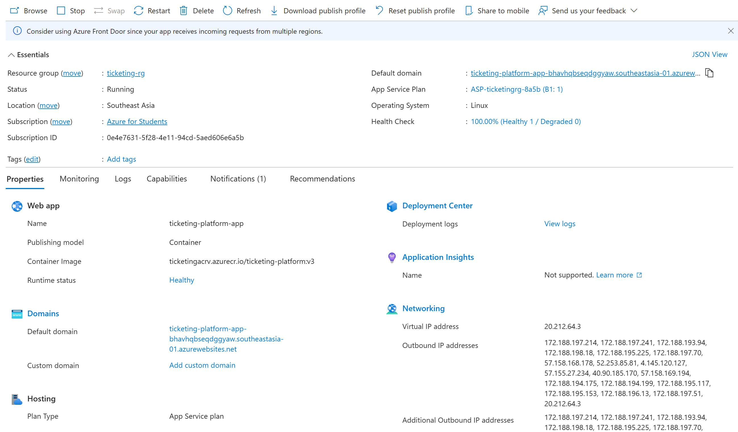
INFRASTRUCTURE ARCHITECTURE
DevOps Deployment & Relational Storage
Deployment Architecture
Docker Container
Azure App Service
Azure Container Registry
Azure PostgreSQL
Azure Blob Storage

Slide 9
PLATFORM PERFORMANCE PROS
Business Impact & Key Operational Advantages
Business Impact & Key Operational Advantages
Key Platform Advantages
AI-Assisted Incident Management
Automates incident routing, priority prediction, root cause analysis, and L3 escalation recommendations.
Faster Decision Making
Provides historical incident matching, intelligent recommendations, and real-time operational insights.
Self-Service Analytics
Enables natural language queries that are automatically converted into SQL for instant reporting.
Secure & Controlled Analytics
Read-only SQL execution with validation prevents unsafe database operations.
Cloud-Native Deployment
Containerized using Docker and deployed on Microsoft Azure for scalable and reliable operation.
Business Value
Reduced Mean Time to Resolution (MTTR)
AI recommendations help engineers identify likely causes and resolution paths more quickly.
Improved SLA Compliance
Continuous SLA tracking, escalation guidance, and priority prediction reduce the risk of SLA breaches.
Higher Operational Efficiency
Automates repetitive ITSM activities, allowing support teams to focus on critical incidents.
Actionable Operational Insights
Interactive dashboards and custom analytics support data-driven operational decisions.
Enterprise Ready
Supports secure cloud deployment, centralized data storage, AI-powered reporting, and downloadable business reports.
ITSM Platform with Advanced AI Analytics
Complete incident management workflow similar to enterprise ITSM platforms such as ServiceNow.
Native AI capabilities for intelligent triage, RCA, L3 escalation, and duplicate detection.
Conversational analytics using Natural Language → SQL for self-service reporting.
Interactive dashboards with Excel, PDF, and CSV exports for business insights.
Designed for faster operational decisions through machine learning and historical incident intelligence.

