Slide 1
Biological to Artificial Neurons

Slide 2
Historical Background
In 1943 Warren McCulloch and Walter Pitts introduced the first artificial neural network architecture.
In 1957 Frank Rosenblatt invented the Perceptron.
By 1980s Revival of interest with new architectures and training techniques.
During 1990s ANNs overshadowed by Support Vector Machines.
And in 2000s it Renewed interest due to availability of data, improved algorithms, and increased computational power.

Slide 3
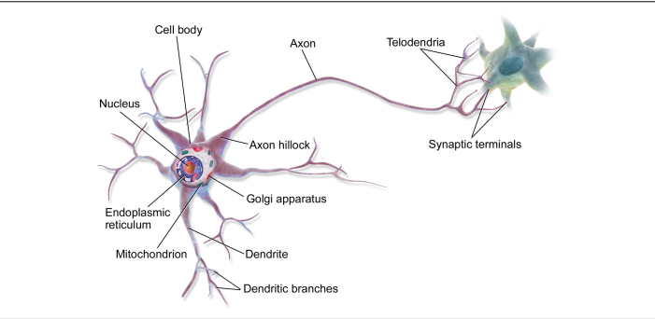
Biological Neurons
- Found in animal brains.
- Organized in vast networks, performing complex computations.

Slide 4
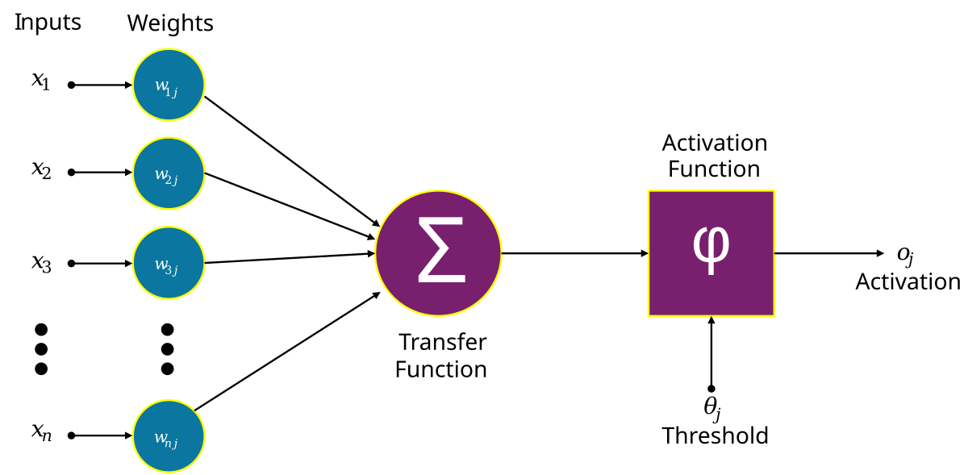
Artificial Neurons
Simplified computational model.
Binary or numeric inputs and outputs.
Can perform logical and mathematical computations

Slide 5
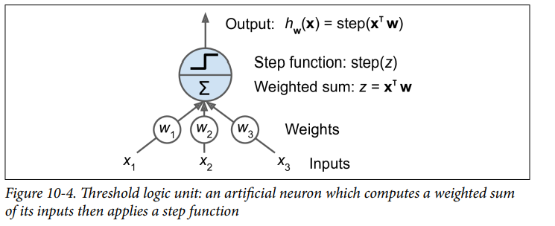
The Perceptron
Based on Threshold Logic Units (TLUs).
Performs simple linear binary classification.
Comprised of:
Input neurons (including a bias neuron).
A single layer of TLUs (fully connected).
Outputs for binary or multi-output classification.

Slide 6
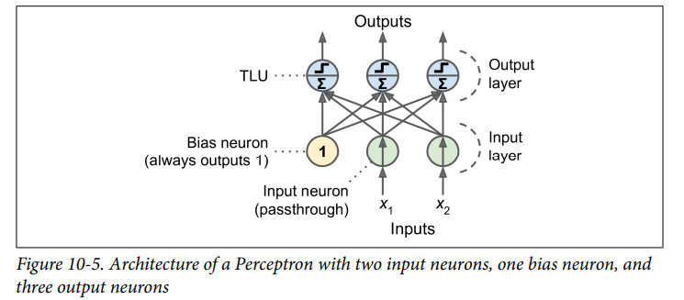
A Perceptron with two input neurons, one bias neuron, and three output neurons

Slide 7
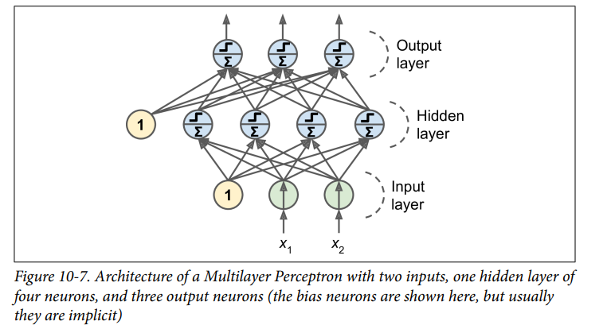
Multilayer Perceptrons (MLPs)
An MLP is composed of one (passthrough) input layer.
One or more layers of TLUs, called hidden layers
One final layer of TLUs called the output layer

Slide 8
Regression MLPs
MLPs can be used for regression If you want to predict a single value, then you just need a single output neuron.
For e.g., the price of a house, given many of its features

Slide 9
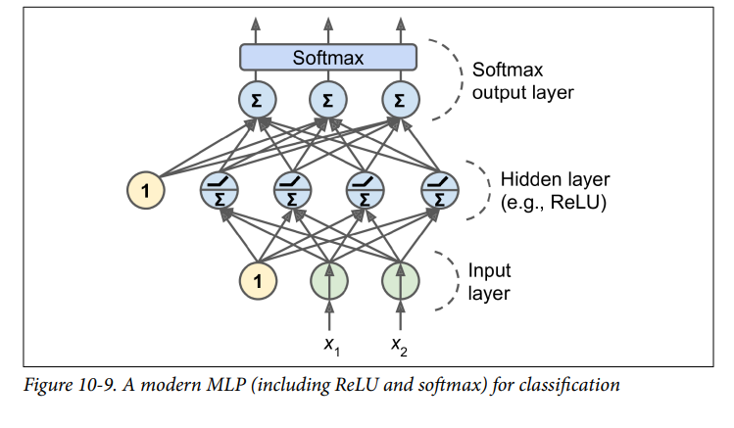
Classification MLP
MLPs can also be used for classification tasks.
They can also easily handle multilabel binary classification tasks.

