Slide 1

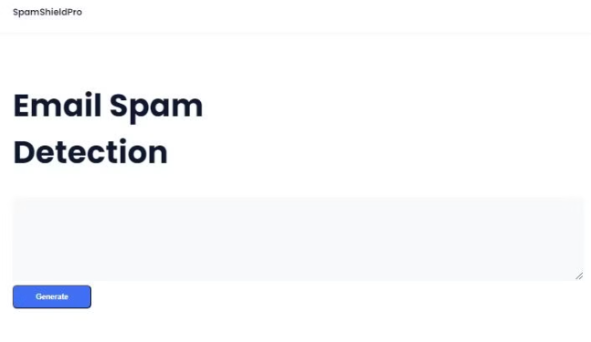

Introduction to SpamShieldPro
SpamShieldPro is a cutting-edge machine learning platform designed to revolutionize email security. Leveraging advanced artificial intelligence, it proactively identifies and blocks sophisticated spam, phishing, and malware threats before they reach your inbox.
by Dishank Rane

Slide 2

The Problem: Combating Spam in the Digital Age
In today's hyper-connected world, spam emails have become a persistent nuisance, compromising productivity and security. Sophisticated spammers exploit vulnerabilities to deliver harmful content, costing businesses and individuals dearly.
Conventional spam filters struggle to keep up, as spammers devise new tactics to evade detection. A groundbreaking solution is needed to effectively combat this growing threat in the digital landscape.

Slide 3
Machine Learning: The Core of SpamShieldPro
1
Advanced Algorithms
2
Simple User Interface
The heart of SpamShieldPro is its powerful machine learning algorithms that analyze millions of email messages to detect and block spam with unparalleled accuracy.
SpamShieldPro boasts a minimalist and intuitive user interface, enabling users to effortlessly navigate and quickly identify unwanted content with just a few clicks.
3
Intelligent Classification
4
Scalable Architecture
Sophisticated natural language processing and sentiment analysis allow SpamShieldPro to distinguish legitimate emails from malicious spam with a high degree of precision.
The system is built on a robust infrastructure that can handle the exponential growth of email data, ensuring seamless protection at scale.

Slide 4
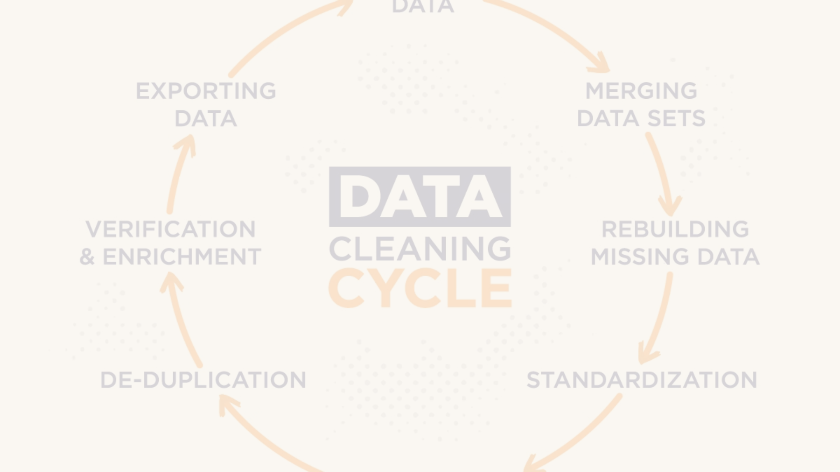
Data Cleaning
Identifying Outliers
1
Detecting and removing outliers, or data points that deviate significantly from the norm, is a crucial first step to ensure model accuracy.
2
Handling Missing Values
Imputing or replacing missing data points using statistical techniques like mean or median imputation helps create a complete dataset for analysis.
Standardizing Formats
3
Ensuring consistent formatting across data points, such as date/time, currency, and units of measurement, makes the data more usable for modeling.

Slide 5

Exploratory Data Analysis
Exploratory Data Analysis (EDA) is a crucial step in the machine learning process. It involves thoroughly examining the dataset to uncover hidden patterns, identify data anomalies, and gain a deep understanding of the variables and their relationships.
During EDA, we'll leverage various statistical techniques and visualization tools to extract valuable insights from the data, informing our feature engineering and model selection decisions.

Slide 6



Text Preprocessing
Tokenization
Break down text into individual words, phrases, or other meaningful elements to prepare for analysis.
Stop Word Removal
Eliminate common words that don't contribute to the meaning, like "the", "and", and "a".
Stemming/Lemmatization
Reduce words to their base or root form to group similar terms together.

Slide 7
Model building
Supervised Learning Algorithms
Ensemble Methods
Leveraging techniques like Naive Bayes, Logistic Regression, and Support Vector Machines to accurately classify emails as spam or ham.
Combining multiple models, such as Random Forest and Gradient Boosting, to enhance the predictive power and robustness of the spam detection system.

Slide 8
Evaluation
Accuracy Metrics
Cross-Validation
Real-World Testing
User Feedback
Gathering feedback from users on the model's accuracy and user experience will be crucial. This will help us continuously improve the system and ensure it meets the needs of our customers.
We'll evaluate the performance of our spam detection model using key metrics like precision, recall, and F1-score. These will help us understand how effectively the model is identifying spam and non-spam messages.
To ensure the model's robustness, we'll implement cross-validation techniques. This will allow us to assess the model's performance on unseen data and identify any potential overfitting or underfitting issues.
We'll also test the model on real-world spam and ham (non-spam) messages to gauge its effectiveness in a live environment. This will help us fine-tune the model and address any gaps in its performance.

Slide 9



Improvement
Iterative Refinement
1
Continuously refine the machine learning model based on feedback and new data
Feature Engineering
2
Experiment with additional data features to enhance model performance
Flask Integration
By implementing a Flask server, I was able to enhance my website's user experience through dynamic content generation and efficient server-side scripting.
3
To continuously improve the performance of SpamShieldPro, we employ an iterative refinement process. This involves regularly re-training the machine learning model with new data, experimenting with additional feature engineering, and optimizing hyperparameters. By staying agile and responsive, we ensure that SpamShieldPro remains at the cutting-edge of spam detection technology.

Slide 10

Conclusion
In conclusion, SpamShieldPro has revolutionized the way we combat spam in the digital age. By leveraging the power of machine learning, this cutting-edge solution has proven to be highly effective in identifying and filtering out unwanted messages, keeping our inboxes clean and secure.
With its robust data cleaning, exploratory analysis, and advanced text preprocessing capabilities, SpamShieldPro provides a comprehensive approach to spam detection. The carefully crafted machine learning models, trained on vast datasets, ensure a high level of accuracy and reliability, making it a valuable tool for individuals and businesses alike.
As we move forward, the continued refinement and improvement of SpamShieldPro will ensure that it remains at the forefront of the fight against spam, protecting us from the ever-evolving tactics of cybercriminals. With its user-friendly and lightweight interface, this solution is set to become the preferred choice for those looking to streamline their digital experience and concentrate on the essentials.

