Slide 1
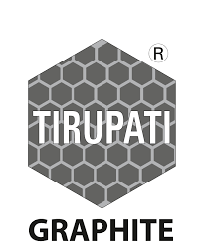



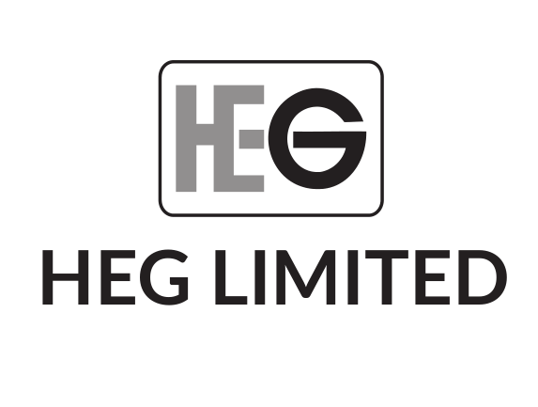
Deep dive: Graphite (1/2)
AI Applications in Real-World Scenarios AI Transforming Industries AI in Everyday Life
AI in Mining AI for Resource Optimization AI in Geology
Graphite is a form of pure carbon that normally occurs as black crystal flakes whose demand is primarily driven by batteries.
Applications of AI in Real-World Scenarios AI for Predictive Maintenance AI in Quality Control
AI-Powered Resource Management AI for Supply Chain Optimization AI in Logistics
& key players
AI-Driven Resource Allocation :10.2 MnT AI-Driven Resource Allocation :10.2 MnT AI-Driven Resource Allocation :10.2 MnT
Resources :8.6 MnT
29%
36%
Key Players in AI Ecosystem Key Players in AI Ecosystem Key Players in AI Ecosystem
AI Adoption Drivers AI Adoption Drivers AI Adoption Drivers
9%
01
The growing AI industry remains a key driver of innovation in real-world applications
9%
5%
02
AI is essential in optimizing lithium-ion battery performance, crucial for EVs and renewable energy systems
4%
03
By 2030, about 30% of global AI adoption is expected to come from real-world applications. By 2030, about 30%
Others include AI in Healthcare, AI in Finance, AI in Education – 10% Others include AI in Healthcare, AI in Finance, AI in Education – 10%

