Slide 1
Angles-Only Initial orbit determination (IOD) using Neural Networks
Authors:
Shridevi Kerakalamatti
Dishant Adesara
Yashkumar Lukhi
Supervisor:
M.Sc.- Ing. Loay Gouda
Date: 25.07.0205

Slide 2
Content
Overview
Motivation & Problem Statement
Neural Network Methods Adapted
MLP ( Data Preprocessing & Model Development)
LSTM ( Data Preprocessing & Model Development)
Final Results
Metrics Comparison (with Ground Truth, Traditional Method) and Plots
Discussion & Interpretation
Conclusion
Future Scope
Reference, Appendix

Slide 3
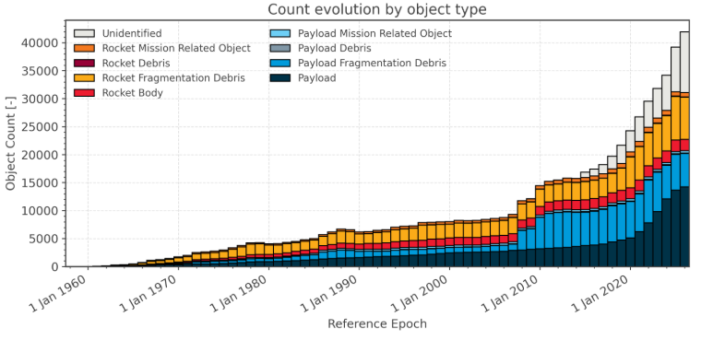

Overview
Initial Orbit Determination (IOD) plays vital role in building and maintaining the Space Object Catalogue such as ESA DISCOS for the Space Situational Awareness (SSA)
The primary motivation : efficient and accurate tracking of space objects for safety.
Problem statement:
Traditional methods (ex: Guass, Laplace) are sensitive to noise & require good initial guess[1].
orbital state information is missing in optical observations dataset.
Goal is to perform initial orbit determination of angles-only space objects measurements with a well-trained neural network model.
Source: https://sdup.esoc.esa.int/discosweb/statistics/
Estimated number of break-ups, explosions, collisions, or anomalous events resulting in fragmentation is more than 650.

Slide 4
Neural Networks
Neural networks are computational models that mimic the way biological neural networks in the human brain process information.
Neural networks consist of layers of neurons that transform the input data into meaningful outputs through a series of mathematical operations.
Types of neural networks
Feedforward Neural Network (FNN) : Multilayer Perceptron (MLP)
Recurrent Neural Network (RNN) : Long Short Term Memory (LSTM)
Convolutional Neural Network (CNN)
Generative Adversarial Network (GAN)

Slide 5
MLP (Multi Layer Perceptron)
Model Development

Slide 6
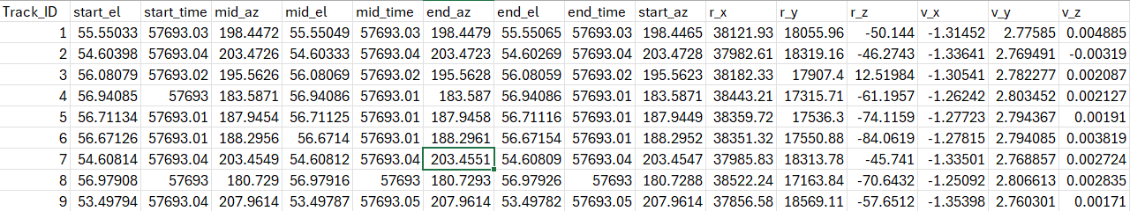
Data Preprocessing for MLP
Original source: Simulated ground-based observations of ESA‘s MASTER space object population
Preprocessing steps:
Outliers detection
Flatten the data:
Group by Track_ID; Pick start, middle, end; Extract [Az, El, Time] for each
Merge observations with ground truth
Normalized the features (Z-Score Normalization)

Slide 7
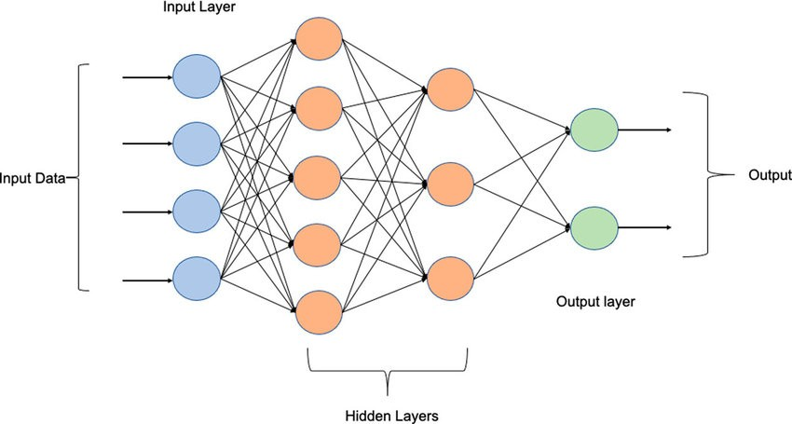
MLP Model Development
Input (9 Features) | Output (6D State vector)
start_time, start_el, start_az | Position Vectors (r_x, r_y, r_z,) Velocity Vectors ( v_x, v_y, v_z)
mid_time, mid_el, mid_az
end_time, end_el, end_az
Data Split: 80:20
Hyper parameters tuning (from optuna):
Hidden layers: 2
Hidden units: 176
Learning rate: 0.00962
Dropout rate: 0.158
Batch size: 32
MLP Architecture:
Activation function: ReLU
Optimizer: Adam
Loss function: MSE
Source: https://www.researchgate.net/publication/354817375_Modeling_the_fluctuations_of_groundwater_level_by_employing_ensemble_deep_learning_techniques#fullTextFileContent

Slide 8
LSTM (Long Short-Term Memory) Model Development

Slide 9
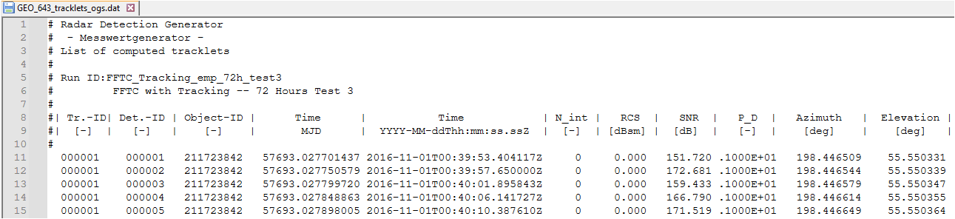
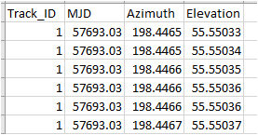
Data Preprocessing for LSTM
Original source: Simulated ground-based observations of ESA‘s MASTER space object population
Preprocessing steps:
Outliers detection
Grouping the data:
Group by Track_ID; Extract Az, El, Time (MJD) for each
Sequences are made of Azimuth, Elevation, Δt, scaled and centered
Normalized the features (Min-max Normalization)
Preprocessed data

Slide 10
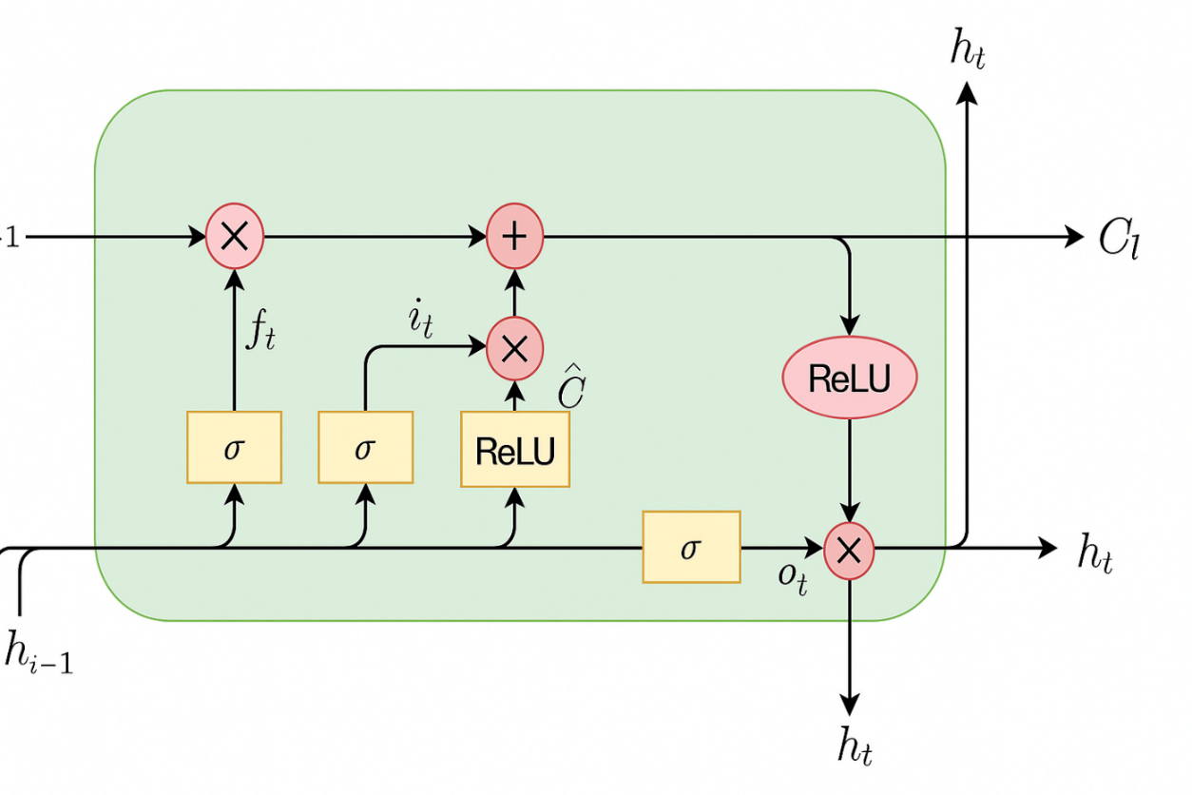
LSTM Model Development
Neural Network (LSTM) Development
Forget gate
Input gate
Output gate
Input Data
Train Neural Network
Dataset Preprocessing
Hyper parameter tuning
No
Compare with Ground Truth
LSTM cell
Dataset
Source: https://www.projectpro.io/article/lstm-model/832
Acceptable Accuracy
Input (3 Features) | Output (6D State vector)
Azimuth, Elevation, Time | Position Vectors (r_x, r_y, r_z,) Velocity Vectors ( v_x, v_y, v_z)
Start
Yes
Acceptable Neural Network Model (MLP)

Slide 11
Results Evaluation

Slide 12
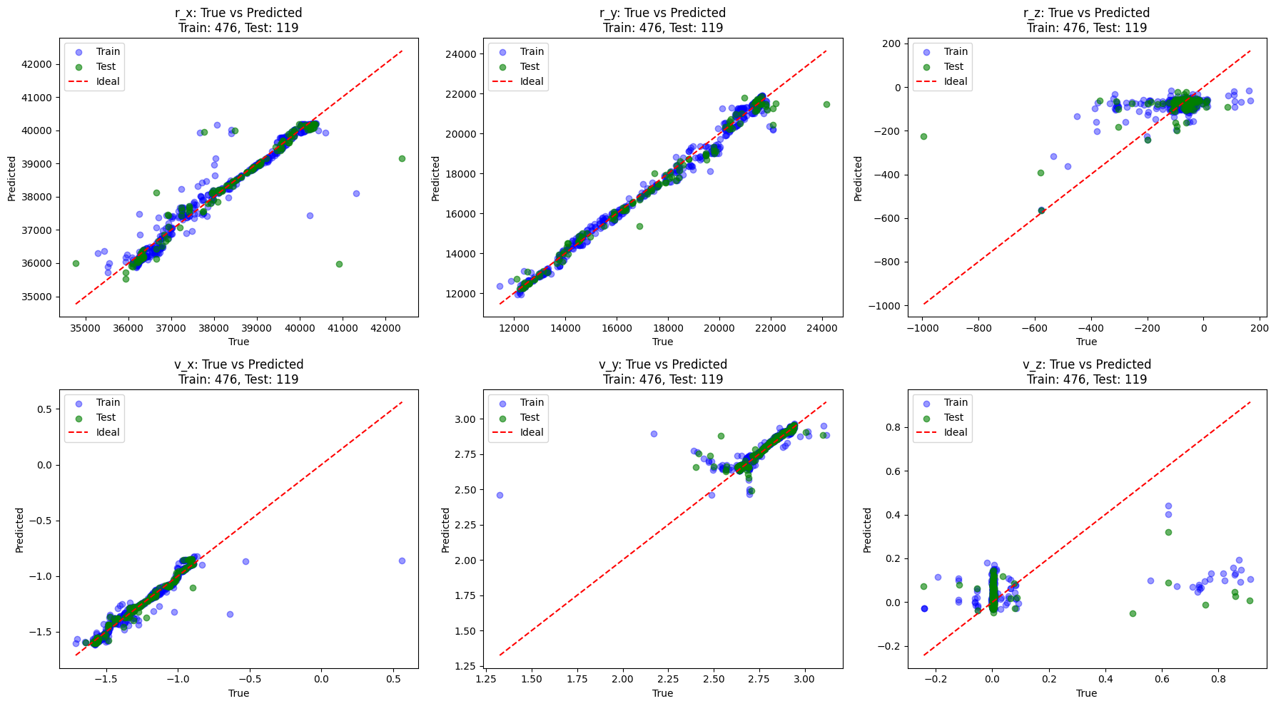
MLP Results (True vs Predicted)

Slide 13
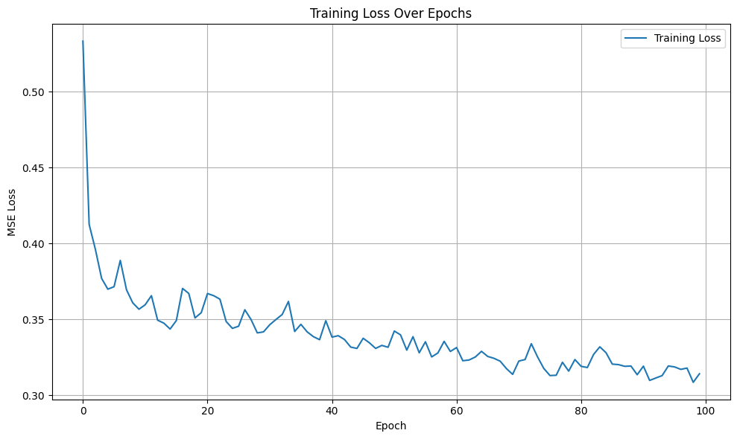
MLP Results - Training Loss over Epochs
Methods/ State Vectors | r_x (km) | r_y (km) | r_z (km) | v_x (km/s) | v_y (km/s) | v_z (km/s)
MAE | 209.7 | 235.27 | 45.13 | 0.03 | 0.03 | 0.08
RMSE | 622.63 | 398.88 | 85.26 | 0.06 | 0.06 | 0.18
Epochs: One full pass through all training data

Slide 14
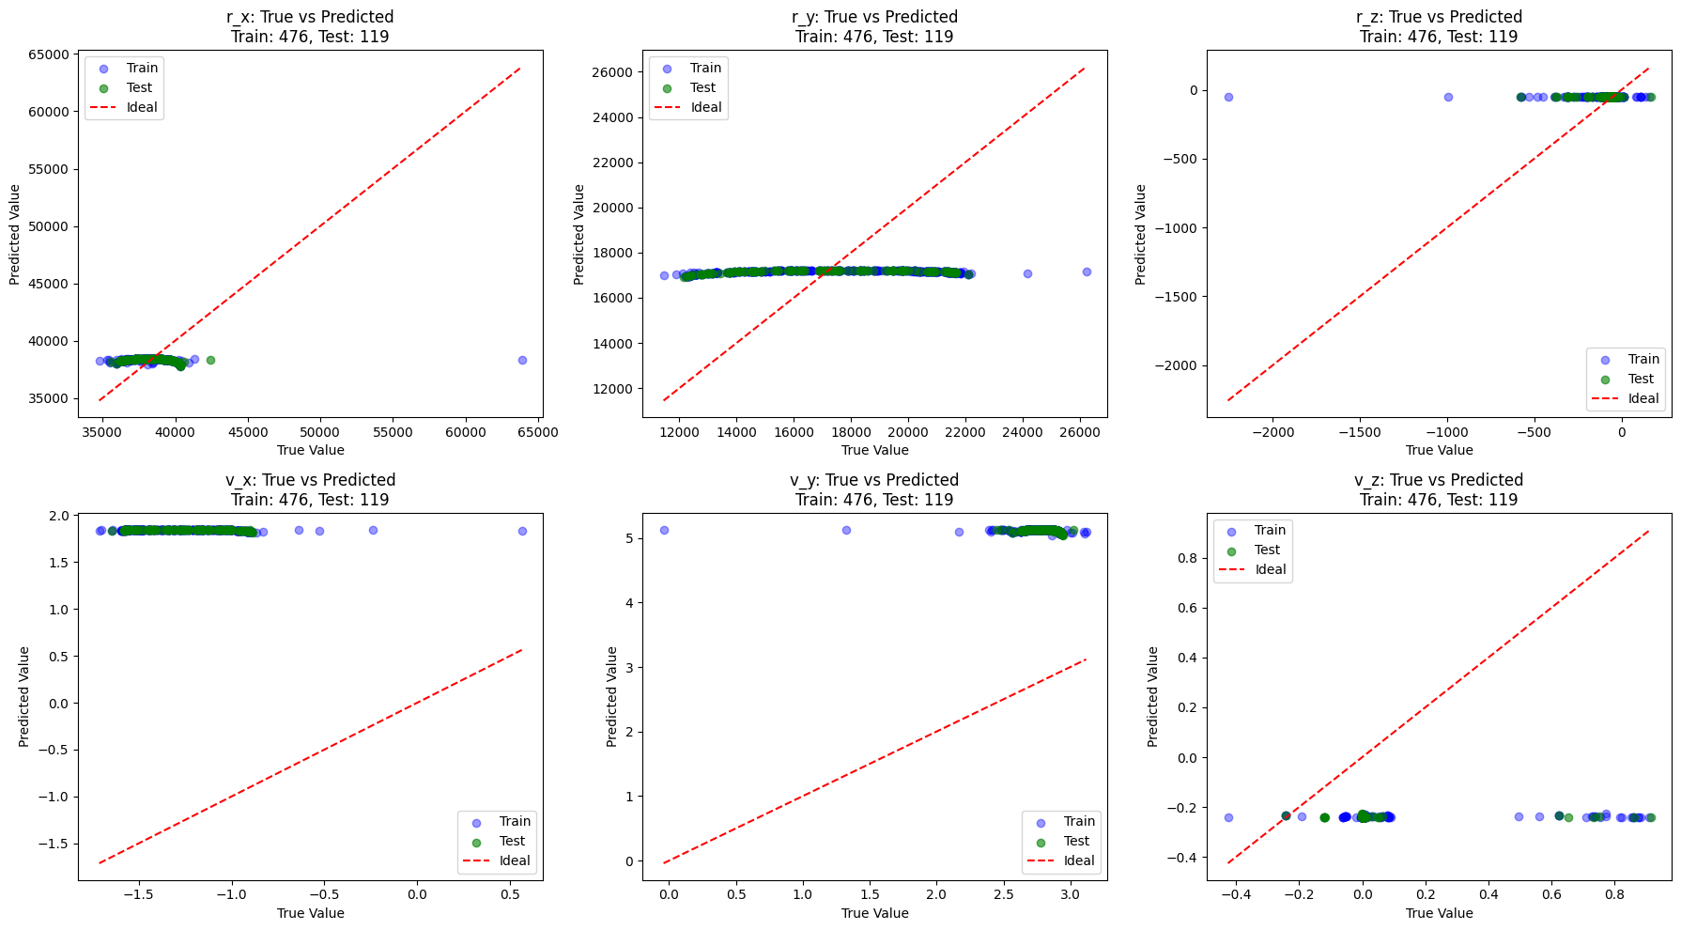
LSTM Results (True vs Predicted)

Slide 15
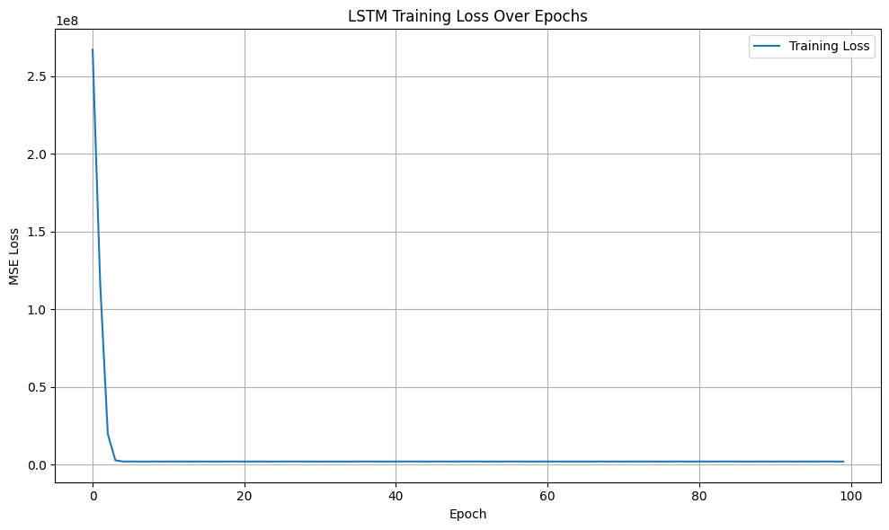
LSTM Results – Training Loss over Epochs
Methods/ State Vectors | r_x (km) | r_y (km) | r_z (km) | v_x (km/s) | v_y (km/s) | v_z (km/s)
MAE | 1665.62 | 3047.47 | 72.694 | 0.311 | 0.88 | 2.508
RMSE | 2869.66 | 3373.77 | 210.684 | 0.378 | 0.894 | 2.514

Slide 16
Traditional Methods Results Evaluation
MAE
Methods/ State Vectors | r_x (km) | r_y (km) | r_z (km) | v_x (km/s) | v_y (km/s) | v_z (km/s)
Gauss | 123.91 | 55.22 | 10.8 | 0.01 | 0.03 | 0.02
Laplace | 124 | 55.26 | 10.8 | 0.01 | 0.03 | 0.02

Slide 17
Traditional Methods Results Evaluation
RMSE
Methods/ State Vectors | r_x (km) | r_y (km) | r_z (km) | v_x (km/s) | v_y (km/s) | v_z (km/s)
Gauss | 673.66 | 300.12 | 57.54 | 0.06 | 0.12 | 0.08
Laplace | 673.68 | 300.12 | 57.54 | 0.06 | 0.12 | 0.08

Slide 18
Neural Network (MLP, LSTM) Methods Evaluation
MAE Error Table Comparison
Methods/ State Vectors | r_x (km) | r_y (km) | r_z (km) | v_x (km/s) | v_y (km/s) | v_z (km/s)
MLP | 209.7 | 235.27 | 45.13 | 0.03 | 0.03 | 0.08
LSTM | 1665.62 | 3047.47 | 72.694 | 0.311 | 0.88 | 2.508
Gauss | 123.91 | 55.22 | 10.8 | 0.01 | 0.03 | 0.02
Laplace | 124 | 55.26 | 10.8 | 0.01 | 0.03 | 0.02

Slide 19
Neural Network (MLP, LSTM) Methods Evaluation
RMSE Error Table Comparison
Methods/ State Vectors | r_x (km) | r_y (km) | r_z (km) | v_x (km/s) | v_y (km/s) | v_z (km/s)
MLP | 622.63 | 398.88 | 85.26 | 0.06 | 0.06 | 0.18
LSTM | 2869.66 | 3373.77 | 210.684 | 0.378 | 0.894 | 2.514
Gauss | 673.66 | 300.12 | 57.54 | 0.06 | 0.12 | 0.08
Laplace | 673.68 | 300.12 | 57.54 | 0.06 | 0.12 | 0.08

Slide 20
Conclusion
Traditional Methods vs Ground Truth : Gauss & Laplace Methods are very close to ground truth with Position Errors ~300–673 km RMSE, ~55–124 km MAE.
Neural Networks (MLP & LSTM ) vs Ground Truth:
MLP model demonstrated moderate accuracy, with position errors ranging between 200–600 km and relatively low velocity errors under 0.1 km/s.
LSTM performs the lowest accuracy among adapted methods, especially in position estimation (errors > 3000 km).
Neural Networks (MLP) vs Traditional Methods:
MLP performs moderately well among adapted methods, with better results than LSTM, and comparable to traditional methods.
MLP produces acceptable velocity estimates, its position errors are notably larger reaching over 200 km in MAE and 600 km in RMSE, compared to less than 125 km in MAE from traditional approaches.
MLP shows promising results, however MLP not yet precise enough for high-accuracy orbital applications and could benefit from further optimization and enhanced training data.

Slide 21
Future Scope
Improve the LSTM model by incorporating Bayesian NNs or Monte Carlo dropout to estimate the uncertainty in orbit predictions, which is crucial for SSA
Integration with Tracking Systems: Work on integrating the model into ground station tracking software.
Physics-Informed Neural Networks (PINNs): Enforce orbital dynamics equations within the NN training process.

Slide 22
References
[1] D. Schwab, P. Singla, and S. O’Rourke,“Angles-only initial orbit determination viamultivariate gaussian process regression,”Electronics, vol. 11, no. 4, 2022, issn: 2079-9292. doi: 10.3390/Schwab.2022. [Online].Available: https://www.mdpi.com/2079-9292/11/4/588
[2] Andrew vernon schaeperkoetter, a comprehensive comparison between angles-only initial orbit determination techniques, Texas A&M University December 2011
[3] Thomas Hasenohr, Initial Detection and Tracking of Objects in Low Earth Orbit, German Aerospace Center Stuttgart, Institute of Technical Physics, Active optical Systems University of Stuttgart
[4] Byoung-Sun Lee , Yoola Hwang, Dae-Won Kim, Machine Learning Approach to Initial Orbit Determination of Unknown LEO Satellites, Electronics and Telecommunications Research Institute (ETRI), Daejeon 34129, Republic of Korea
[5] Ivan Agostinelli, Gilberto Goracci, Fabio Curti, Initial orbit determination via artificial intelligence for too-short arcs, Department of Systems & Industrial Engineering, The University of Arizona, 1127 E. James E. Rogers Way, Tucson, 85721, AZ, United States
[6] Luigi Ansalone , Fabio Curti, A genetic algorithm for Initial Orbit Determination from a too short arc optical observation, Sapienza University of Rome, DIAEE, ARCA Lab, via Salaria 851, 00138 Rome, Italy, August 2013
[7] Zhe Zhang ,Yishuai Shi, andZuoxiu Zheng, first_pagesettingsOrder Article Reprints Open AccessArticle Improving Angle-Only Orbit Determination Accuracy for Earth–Moon Libration Orbits Using a Neural-Network-Based Approach, School of Aerospace Engineering, Beijing Institute of Technology, Beijng 100081, China

Slide 23
Thank you!

Slide 24
LSTM Model Development
Hyperparameters tuning(from optuna):
Hidden layers: 1
Hidden units: 111
Learning rate: 1e-4 0.002
Dropout rate: 0.08
LSTM Architecture:
Activation function: ReLU
Optimizer: Adam
Loss function: MSE
ANN architecture:
Bi directional LSTM (Long Short Term Memory)
Forget gate, Input gate, Output gate
output from the middle time step only

