Slide 1
Basic Python programs, functions

Slide 2
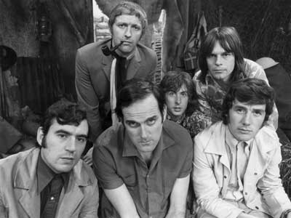
Python!
Created in 1991 by Guido van Rossum (now at Google)
  Named for Monty Python
Useful as a scripting language
  script: A small program meant for one-time use
  Targeted towards small to medium sized projects
Used by:
  Google, Yahoo!, Youtube
  Many Linux distributions
  Games and apps (e.g. Eve Online)

Slide 3
Installing Python
Windows:
Download Python from http://www.python.org
Install Python.
Run Idle from the Start Menu.
Mac OS X:
Python is already installed.
Open a terminal and run python or run Idle from Finder.
Linux:
Chances are you already have Python installed. To check, run python from the terminal.
If not, install from your distribution's package system.

Slide 4
Python Fundamentals
Python comes with great standard library
  Batteries included - Python can be used for complex problems out of the box , many scripts can be run immediately
Python Web - Django, Flask, Pyramid, Tornado
Cloud - Ansible, Boto3 for answer
Data Analytics- Pandas, matplotlib, Bokeh, Tensorflow, Scikit Learning
Python is completely open source
Great community

Slide 5
Python Fundamentals
Python is strongly typed language, i.e. every object in python has a type there is no way to circumvent that type
Python is dynamically types
  type check is done at the runtime
Python is interpreted language, but it is compiled to byte code
Syntax is clear, readable and expressive

Slide 6
Interpreted Languages
interpreted
  Not compiled like Java
  Code is written and then directly executed by an interpreter
    Python Environment is REPL [ Read-Evaluate-Print-Loop]
  Type commands into interpreter and see immediate results
Java:
Code
Compiler
Runtime
Environment
Computer
Python:
Code
Interpreter
Computer

Slide 7
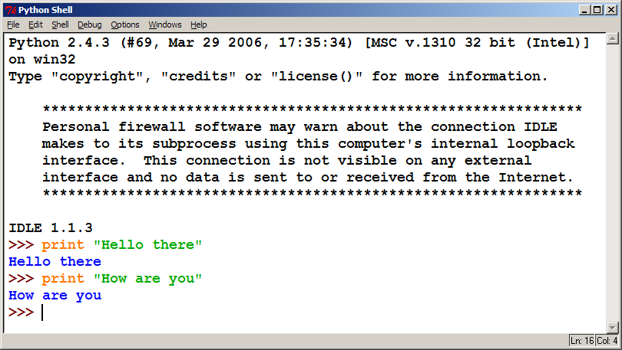
The Python Interpreter
Allows you to type commands one-at-a-time and see results
A great way to explore Python's syntax
  Repeat previous command: Alt+P

Slide 8
Our First Python Program
Python does not have a main method like Java
  The program's main code is just written directly in the file
Python statements do not end with semicolons
hello.py
1 | print("Hello, world!")

Slide 9
The print Statement
  print("text")
  print() (a blank line)
  Escape sequences such as \" are the same as in Java
  Strings can also start/end with '
swallows.py
1 2 3 4 | print("Hello, world!") print() print("Suppose two swallows \"carry\" it together.") print('African or "European" swallows?')

Slide 10
Comments
Syntax:
  # comment text (one line)
swallows2.py
1 2 3 4 5 6 | # Suzy Student, CSE 142, Fall 2097 # This program prints important messages. print("Hello, world!") print() # blank line print("Suppose two swallows \"carry\" it together.") print('African or "European" swallows?')

Slide 11
Whitespace Significance
Python uses indentation to indicate blocks, instead of {}
  Makes the code simpler and more readable
  In Java, indenting is optional. In Python, you must indent.
hello3.py
1 2 3 4 5 6 7 8 | # Prints a helpful message. def hello(): print("Hello, world!") print("How are you?") # main (calls hello twice) hello() hello()

Slide 12
Built-in Data Types
Numbers - 3.1415, 1234, 999L, 3+4j
Strings - 'spam', "guido's"
Lists - [1, [2, 'three'], 4]
Dictionaries - {'food':'spam', 'taste':'yum'}
Tuples - (1, 'spam', 4, 'U')
Files - text = open ('eggs', 'r'). read()

Slide 13
Operators
Booleans: and or not < <= >= > == != <>
Identity: is, is not
Membership: in, not in
Bitwise: | ^ & ~
No ++ -- +=, etc.

Slide 14
Strings
Strings (str)
Immutable sequence of Unicode codepoints
Once created, we cannot modify it's contents
Multiline strings are represented by 3 quotes
  ""“ Hello!
  My Name is Dishant Khanna!
  Welcome to Python Fundamentals course! ""“
Concatination using '+' operator and join() method
Negative indexing is 1 based while positive indexing is 0 based

Slide 15
Strings
List slicing:
  slice = seq[start:stop]
list.copy(): is used to create a copy of the list
list.index(item) method returns the index of the item in the list
del keyword is used to delete an element in the list
list.remove("value") is used to remove a specific value from the list
list.insert("value")
''.join(list) is used to join a list to string

Slide 16
Lists
Similar to arrays
Mutable sequence of objects
Can be heterogeneous
Elements of the List are accessed using the []
Example:
  List_example = [1, “Dishant”, [2, “Khanna”]]

Slide 17
Dictionaries
Maps keys to values
Delimited with {}
Example:
  {k1: v1,
  k2: v2,
  k3:v3 }
  Empty dictionary: example_dict = {}
Values are accessible by keys
Keys are unique
Keys are immutable
Value are Mutuable
The order is arbitrary

Slide 18
Sets
Unordered collection of unique, immutable objects
Delimited by {}
set() constructor is used to create set and used to create empty step_size
There are no duplicate items in a set and is further used to remove duplicate items from the set
sets are iterable but the order is arbitrary
add() is used to add elements to the set
remove() and discard() are used to remove elements
copy() is used to create copies and are shallow
set algebra operations can be done

Slide 19
Loops
For Loop:
  Syntax:
    for item in iterable:
    loop code
While Loop:
  Syntax:
    while condition:
    Loop code

Slide 20
Functions
Function: Equivalent to a static method in Java.
Syntax:
  def name():
  statement
  statement
  ...
  statement
  Must be declared above the 'main' code
  Statements inside the function must be indented
hello2.py
1 2 3 4 5 6 7 | # Prints a helpful message. def hello(): print("Hello, world!") # main (calls hello twice) hello() hello()

