Slide 1

Note: The data and information in this document is reflective of a hypothetical situation and client. This document is to be used for KPMG Virtual Internship purposes only.
Sprocket Central Pty Ltd
Data analytics approach

Slide 2
Note: The data and information in this document is reflective of a hypothetical situation and client. This document is to be used for KPMG Virtual Internship purposes only.
Agenda
Introduction
Data Exploration
Model Development
Interpretation

Slide 3
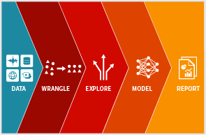
Note: The data and information in this document is reflective of a hypothetical situation and client. This document is to be used for KPMG Virtual Internship purposes only.
Introduction
Data Science Pipeline
A data science pipeline is the overall step by step process towards obtaining, cleaning, visualizing, modeling, and interpreting data within a business or group

Slide 4

Note: The data and information in this document is reflective of a hypothetical situation and client. This document is to be used for KPMG Virtual Internship purposes only.
Data Exploration
It is an initial step in we analyze the data and convert data into a form which can be used for model development
Tasks
Create data visualizations
Use tactical techniques to describe data

Slide 5
Note: The data and information in this document is reflective of a hypothetical situation and client. This document is to be used for KPMG Virtual Internship purposes only.
Data Exploration
Some Examples
Transform columns like DOB as Age
Drop columns like product_first_sold_date
Normalize numeric data such as value and property_valuation
Restructure categorical data such as state and gender
Find correlation between variable like property_valuation, value and wealth_segment

Slide 6

Note: The data and information in this document is reflective of a hypothetical situation and client. This document is to be used for KPMG Virtual Internship purposes only.
Model Development
In this process we will develop a Machine Leering model which will eventually suggests which clients should be targeted
Tasks
Chose optimal model
Create Training and Testing data set
Develop model
Deploy model

Slide 7
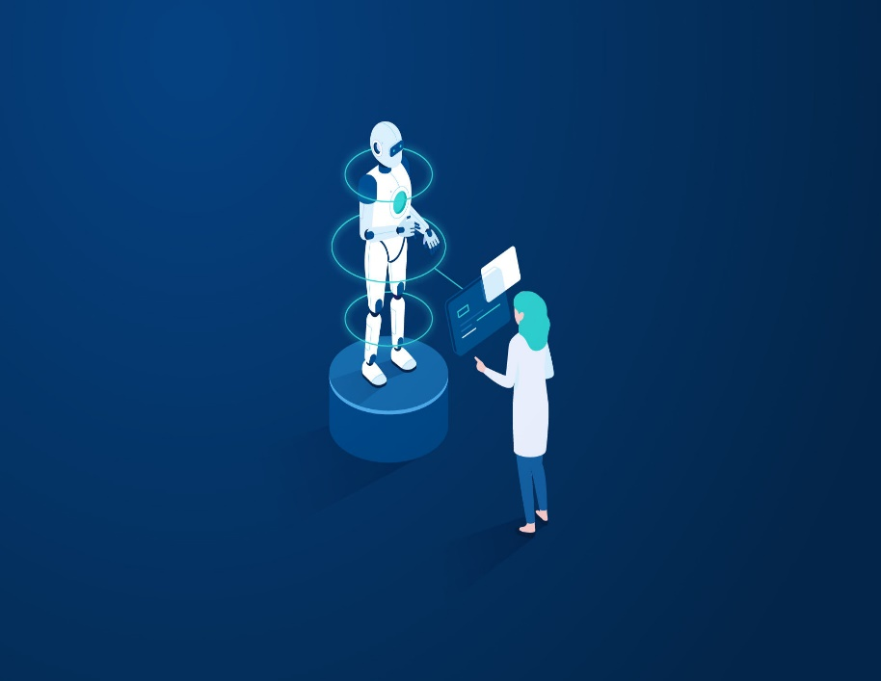
Note: The data and information in this document is reflective of a hypothetical situation and client. This document is to be used for KPMG Virtual Internship purposes only.
Interpretation
After model is developed, we will run it on your data to determine which clients to target to get more business
Tasks
Run model on client’s data
Develop useful suggestions

Slide 8
Note: The data and information in this document is reflective of a hypothetical situation and client. This document is to be used for KPMG Virtual Internship purposes only.
Thank You

