Slide 1

Java Full Stack Internship
A Project Presentation on
Develop a web-based tool for medical professionals to easily store and access patient records.
Under the guidance of
Archana
Software Engineer
@DLithe
Presented by,
Dishanth Shetty - 309CS21012
Akshay Naik - 309CS21006
Rakshith Acharya - 309CS21031
Amrutha - 309CS21007
Koushik Acharya - 309CS21018

Slide 2
Contents
Introduction
Problem statement
Objectives
Methodology
Implementation
Results and analysis
Conclusion
References

Slide 3
Introduction
EHR (Electronic Health Record) :-
An Electronic Health Record (EHR) is a digital version of a patient's medical history. Unlike traditional paper charts, EHR software provides a centralized platform to store and manage a patient's complete medical information in a secure and accessible format.

Slide 4
Problem Statement
Develop a web-based tool for medical professionals to easily store and access patient records.

Slide 5
Objectives
It is a digital version of a patient's medical history.
This software provides a centralized platform to store and manage a patient's complete medical information in a secure and accessible format.

Slide 6
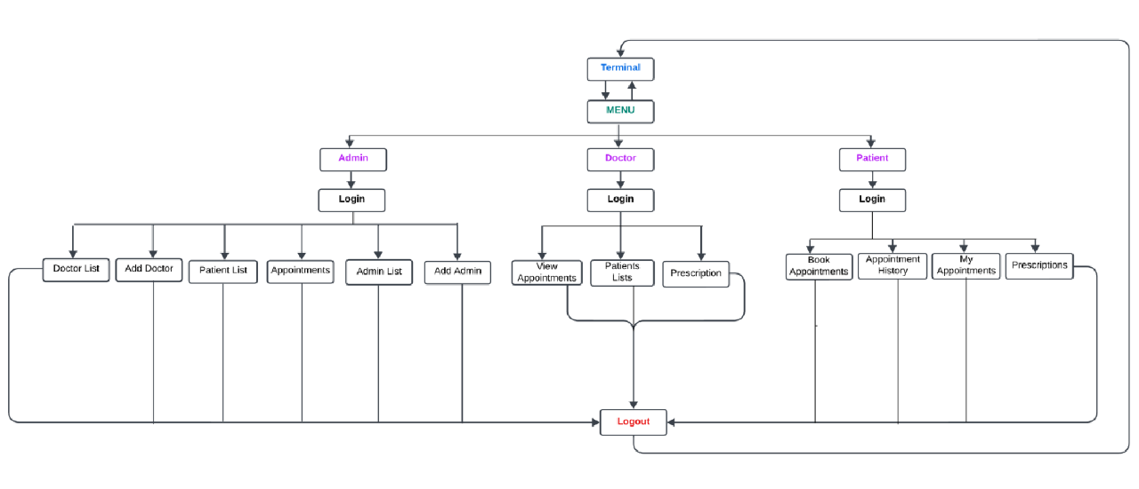
Block diagram(UseCase Diagram)
Block diagram of data transmission using li-fi

Slide 7
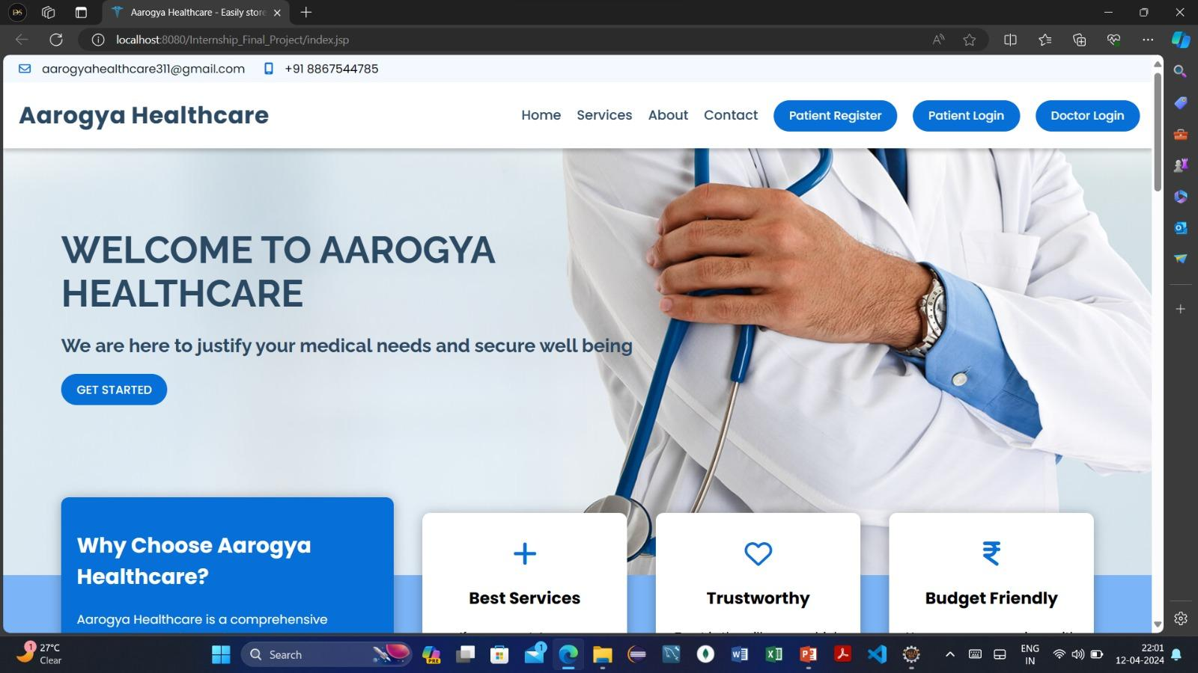
RESULTS AND ANALYSIS
Figure 1

Slide 8
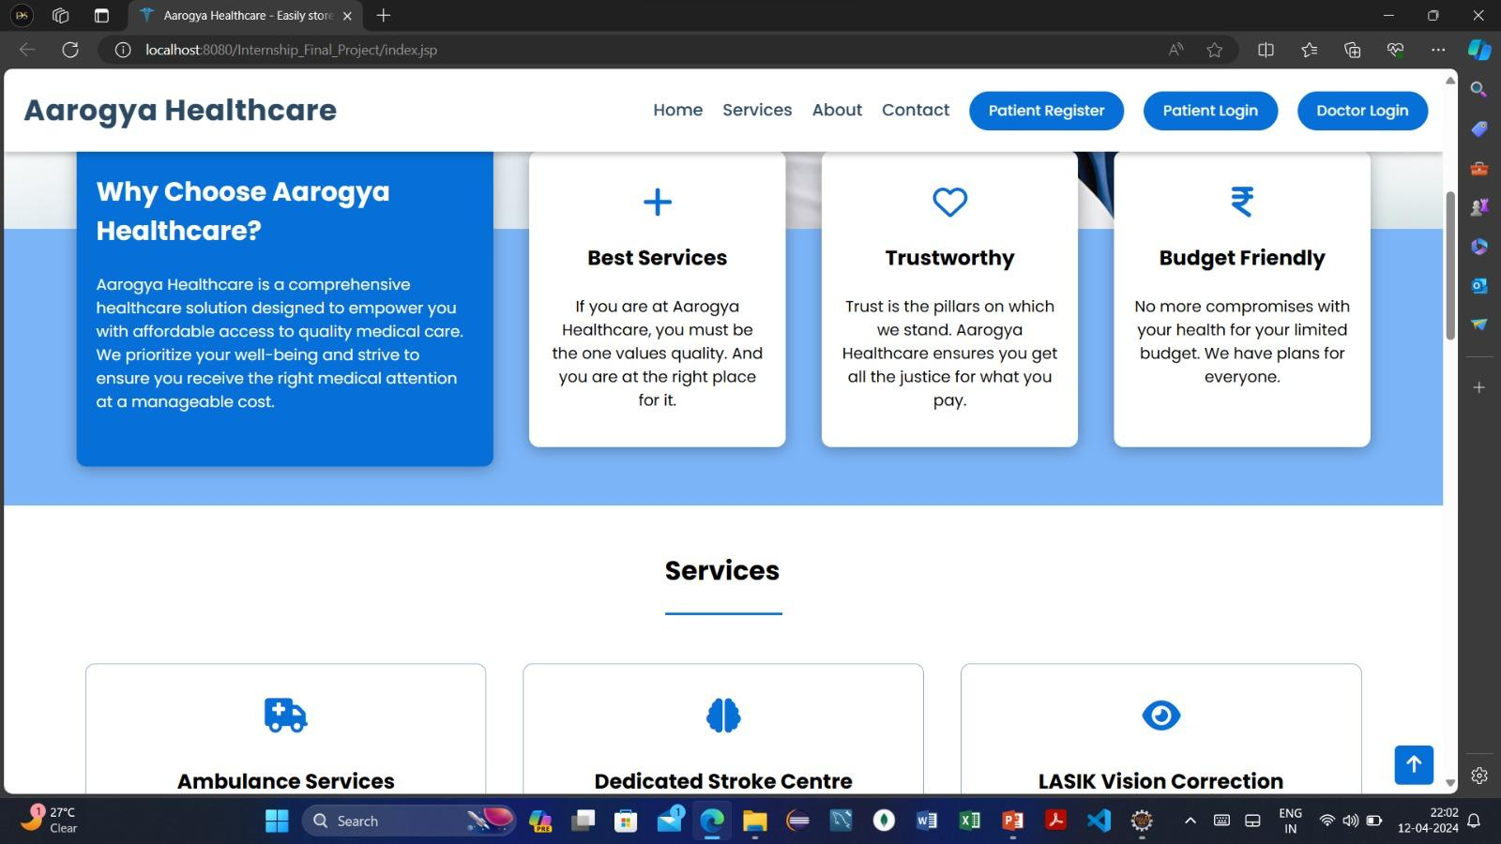
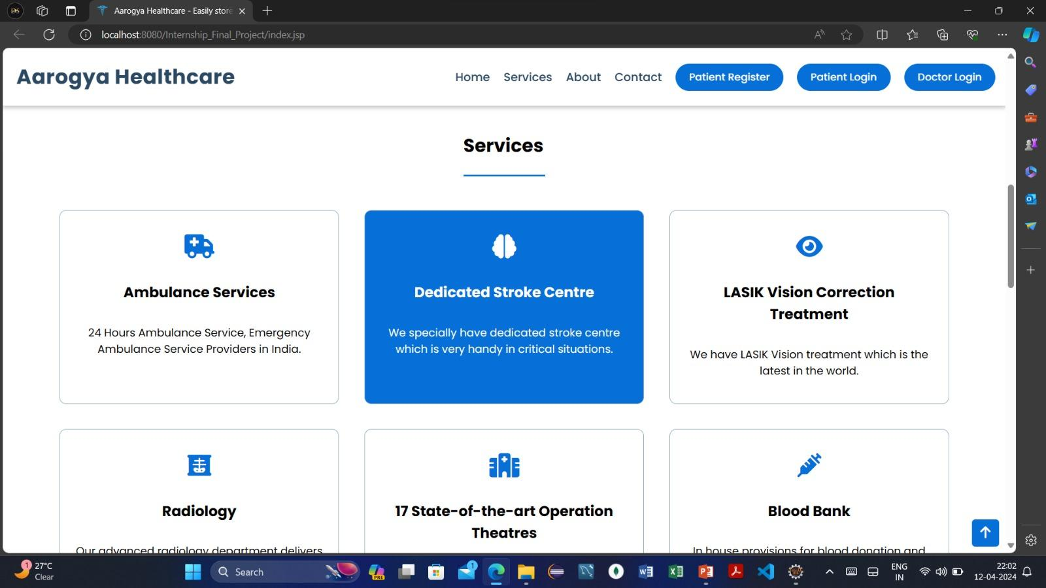
Figure 2
Figure 3

Slide 9
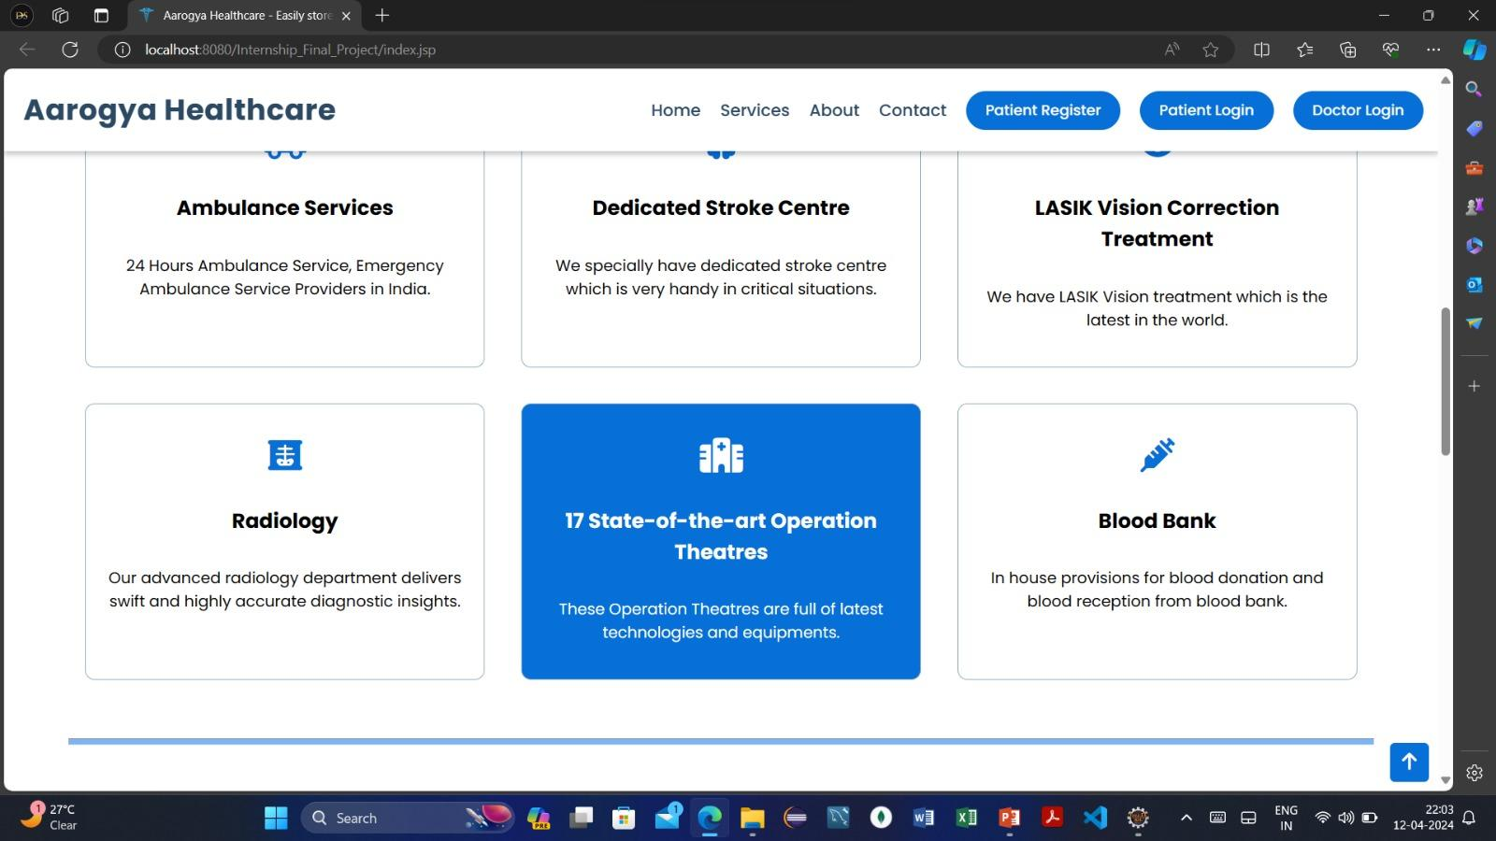
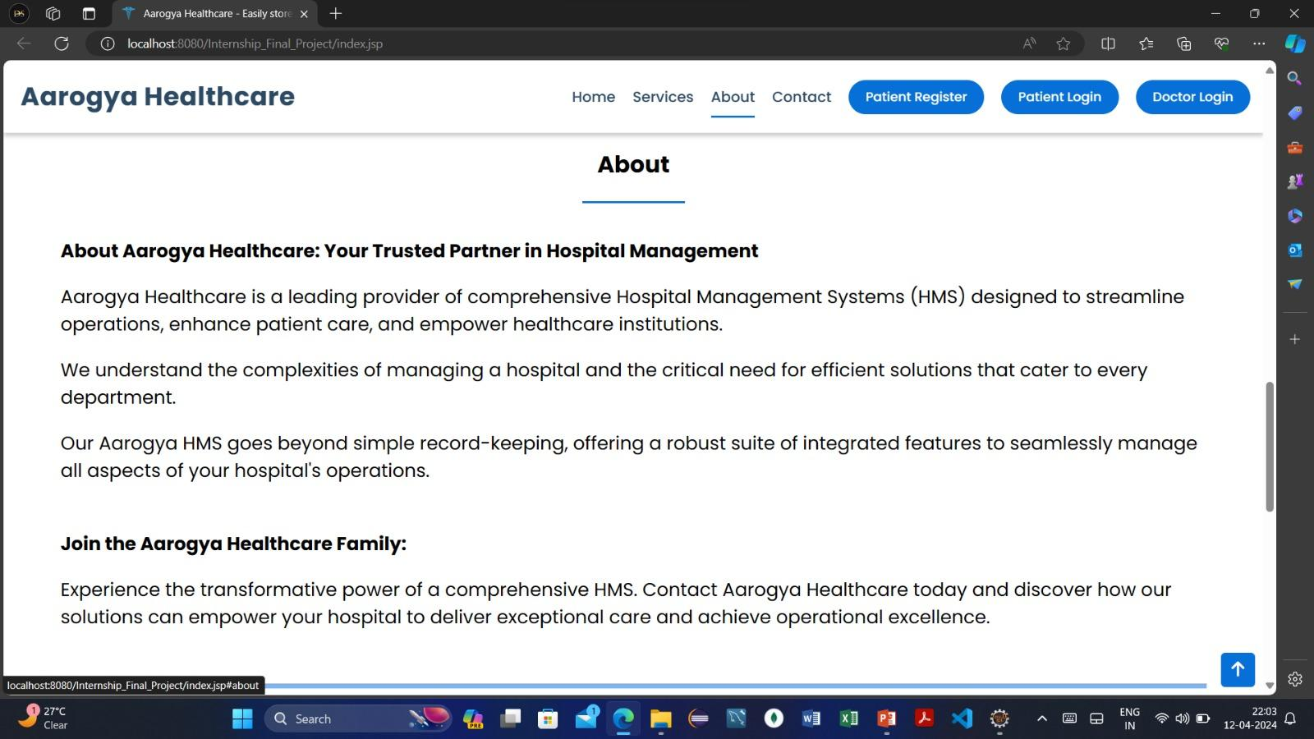
Figure 4
Figure 5

Slide 10
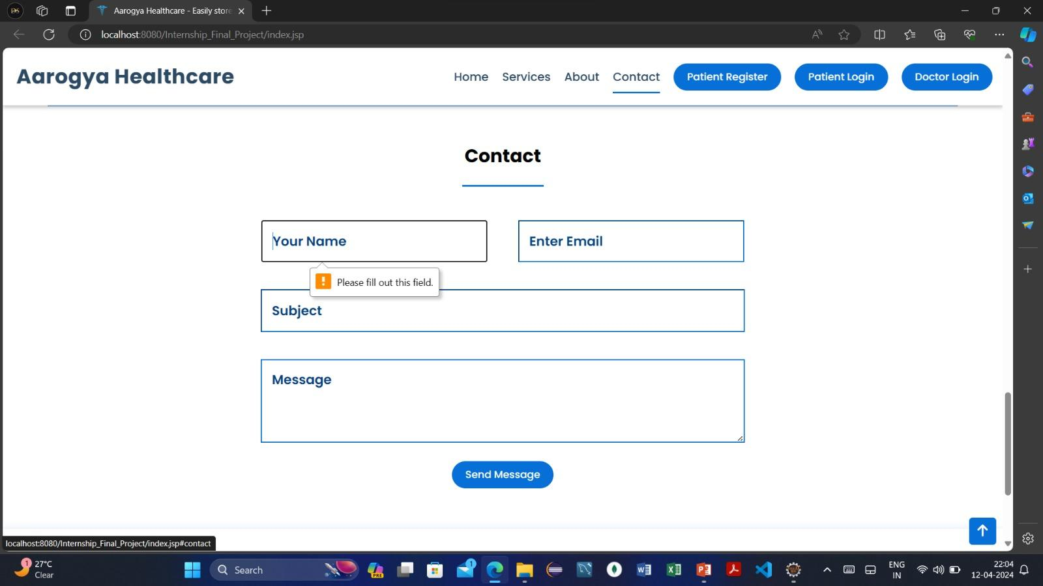
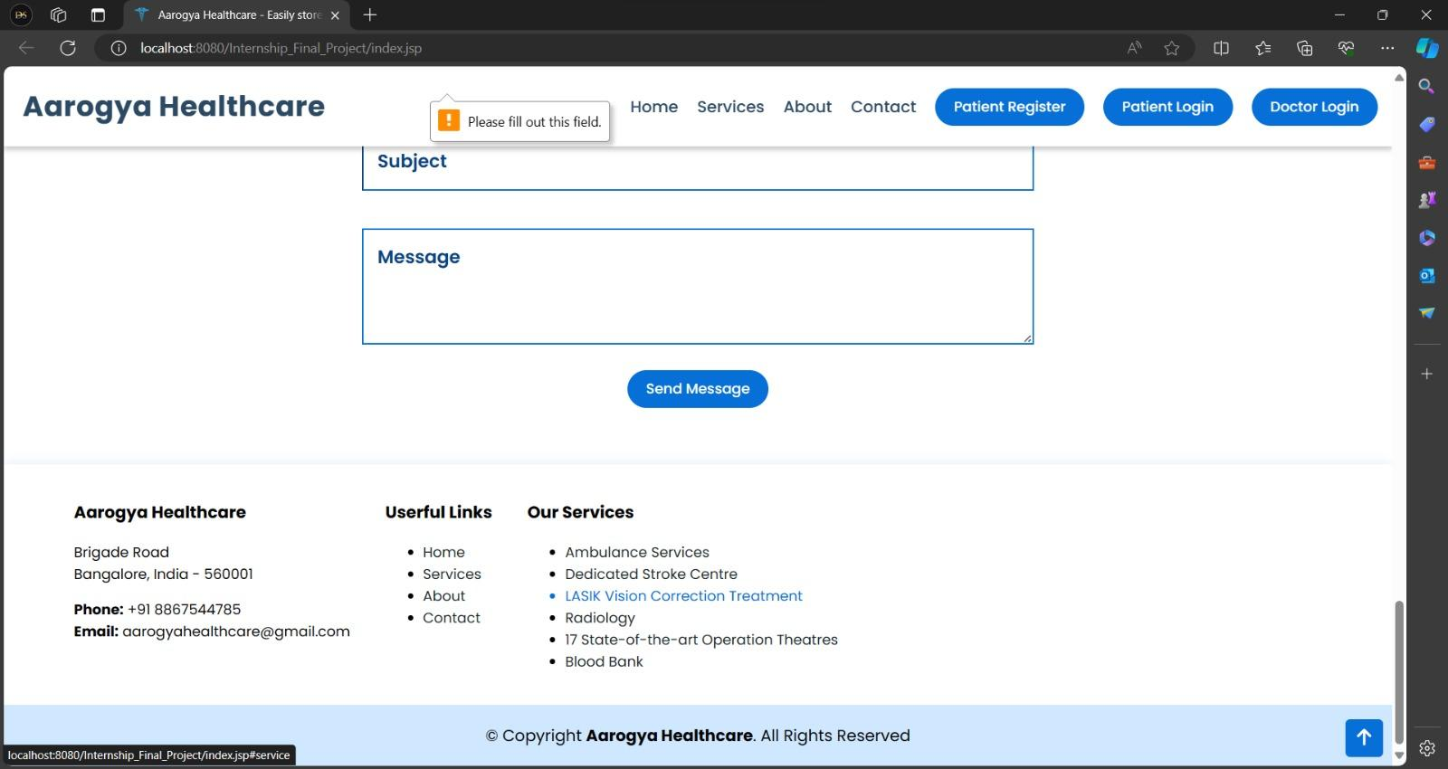
Figure 6
Figure 7

Slide 11
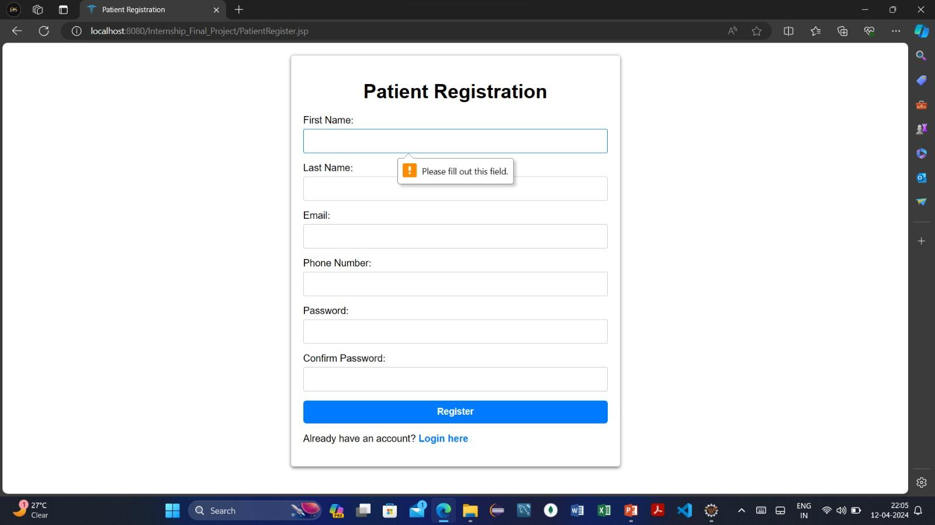
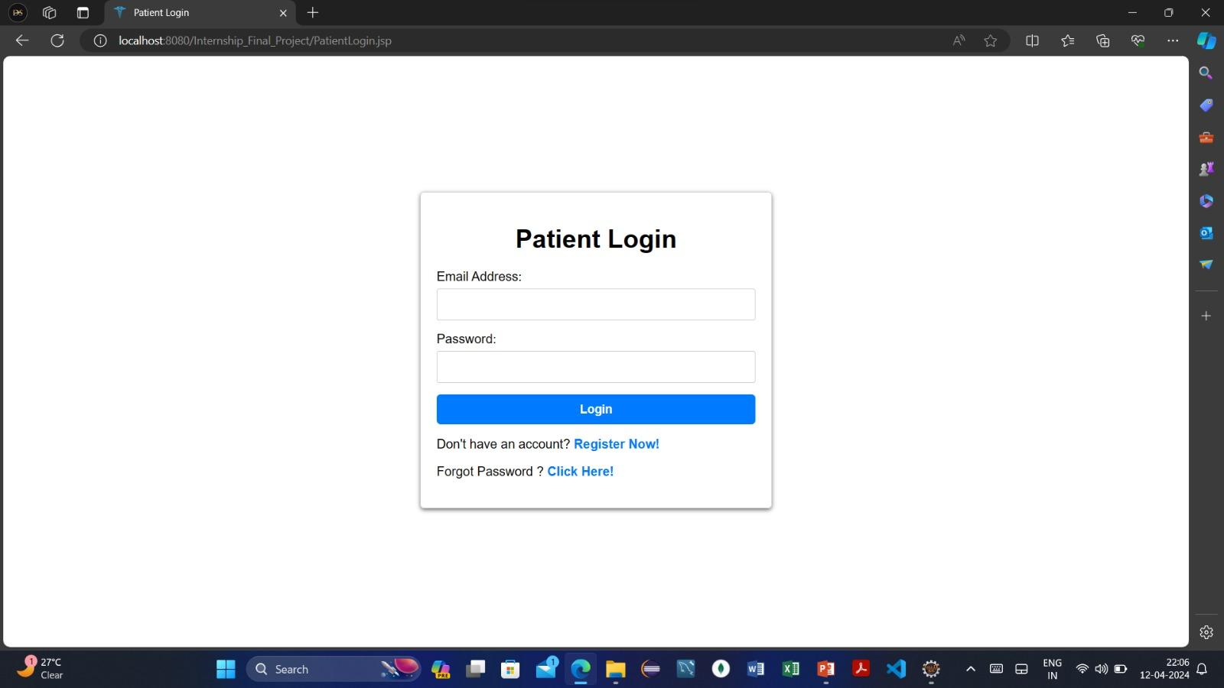
Figure 8
Figure 9

Slide 12
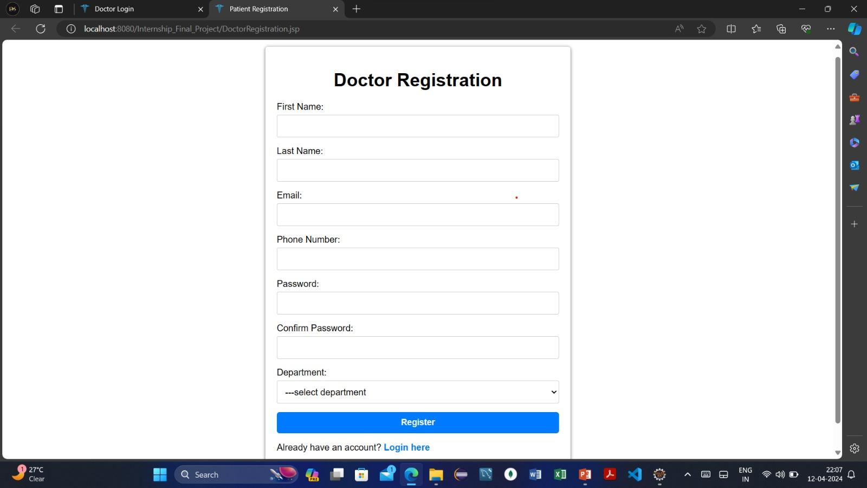
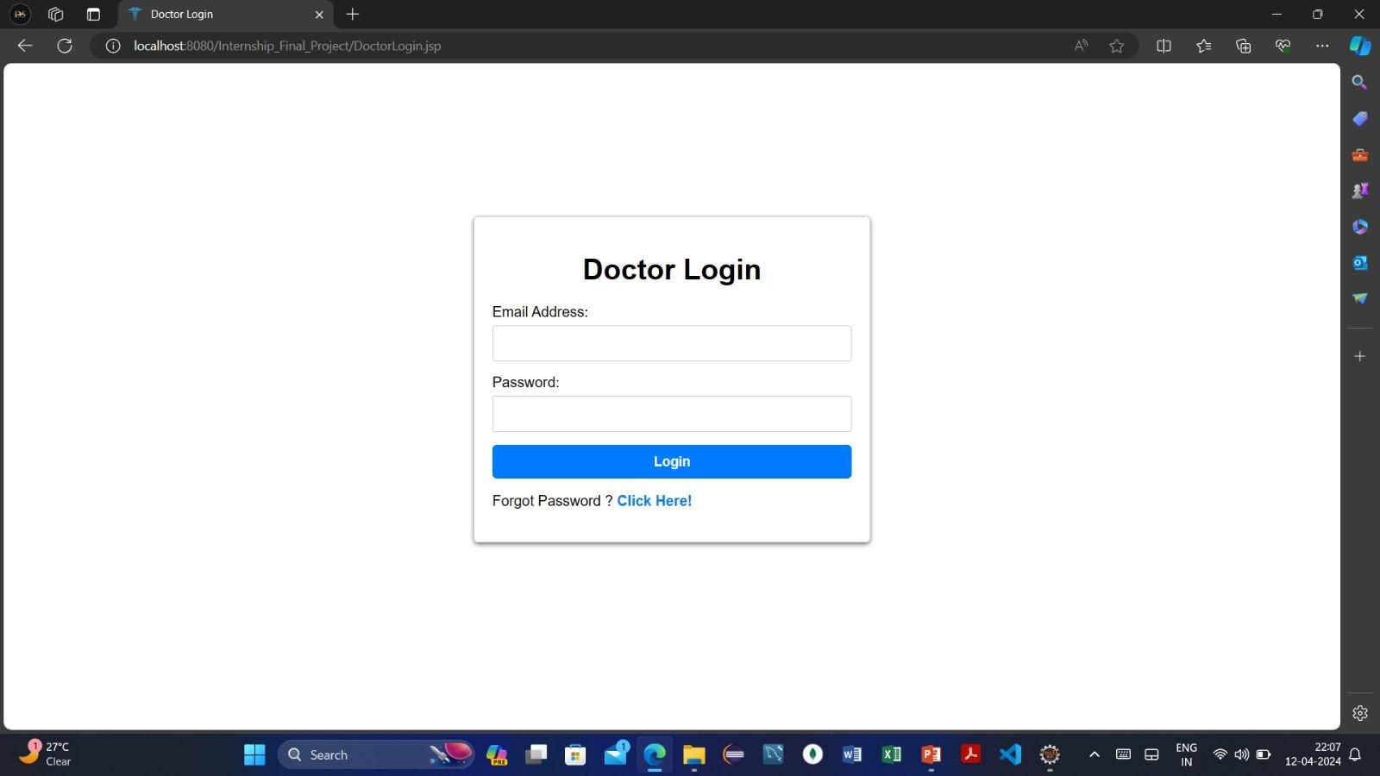
Figure 10
Figure 11

Slide 13
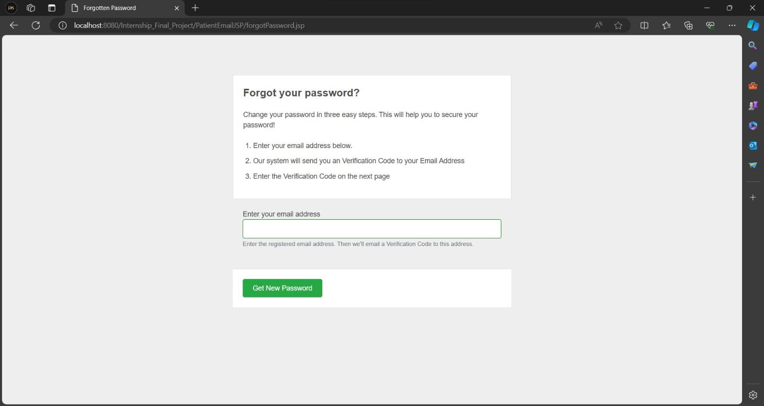
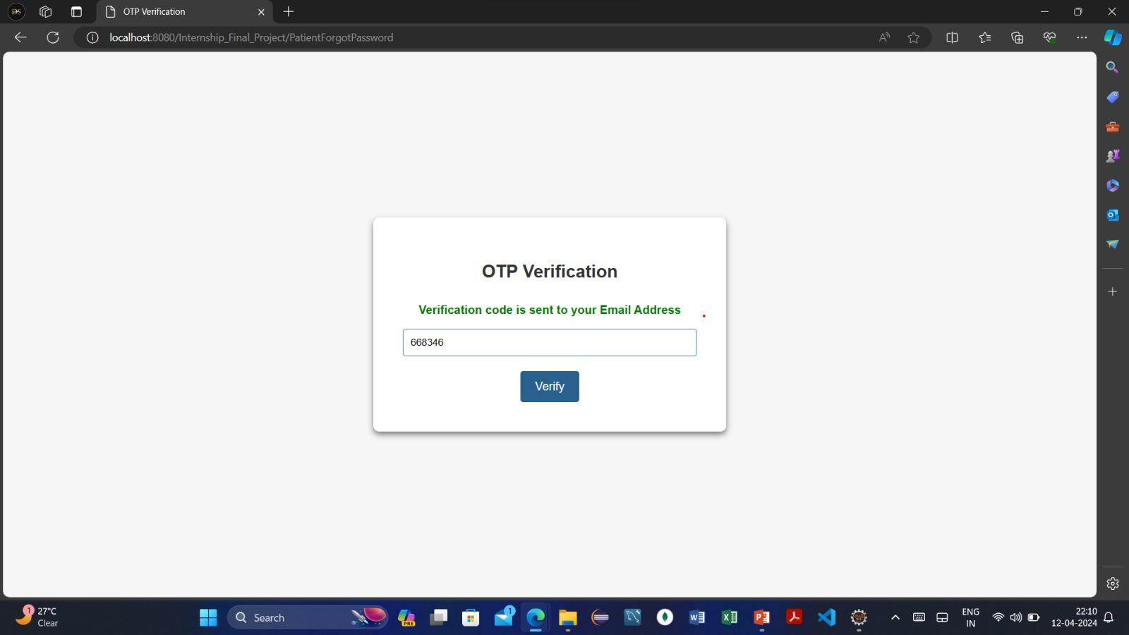
Figure 12
Figure 13

Slide 14
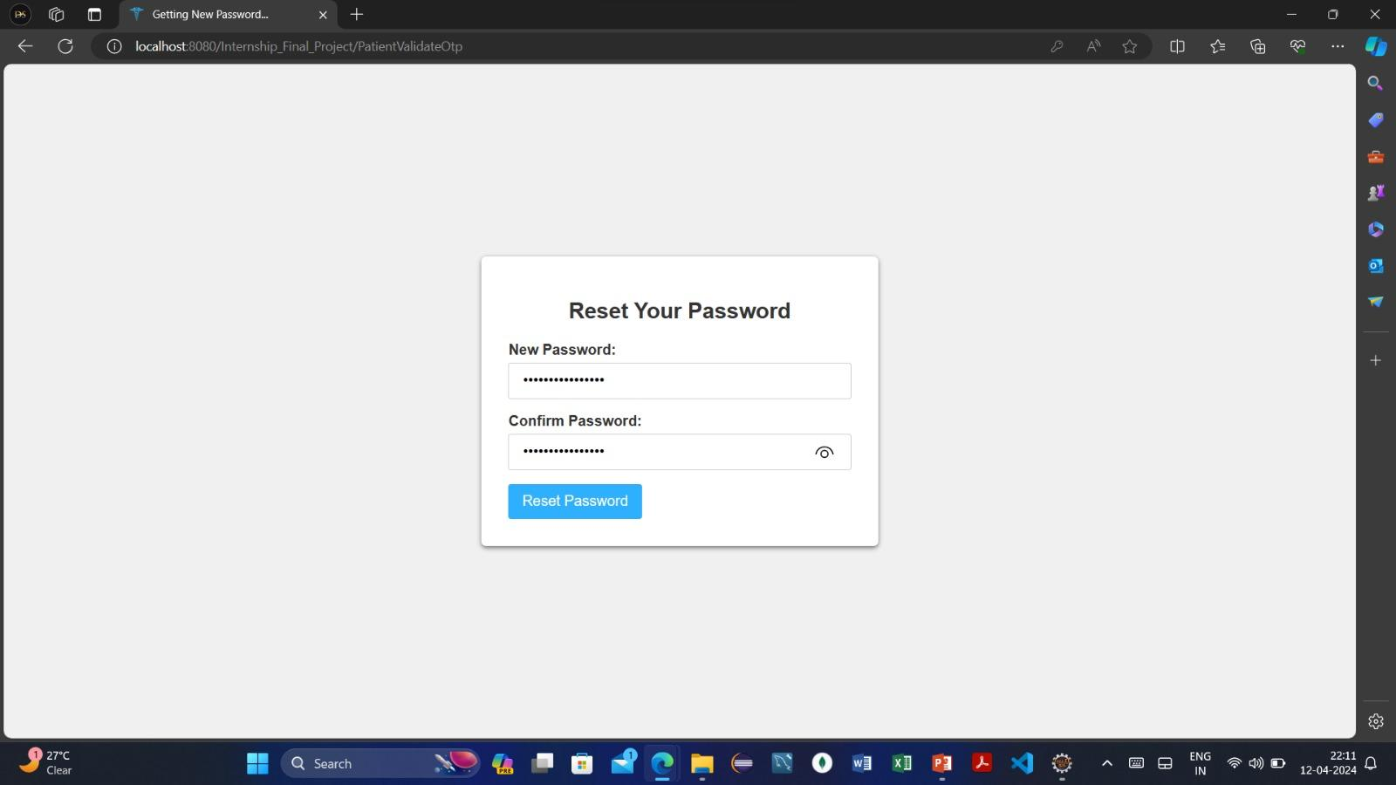
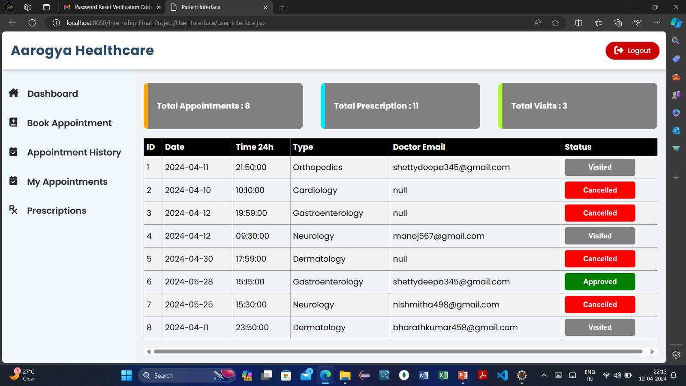
Figure 14
Figure 15

Slide 15
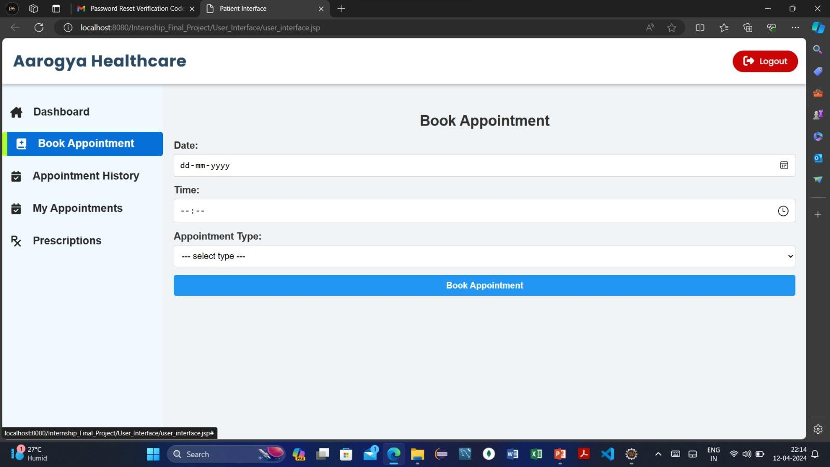
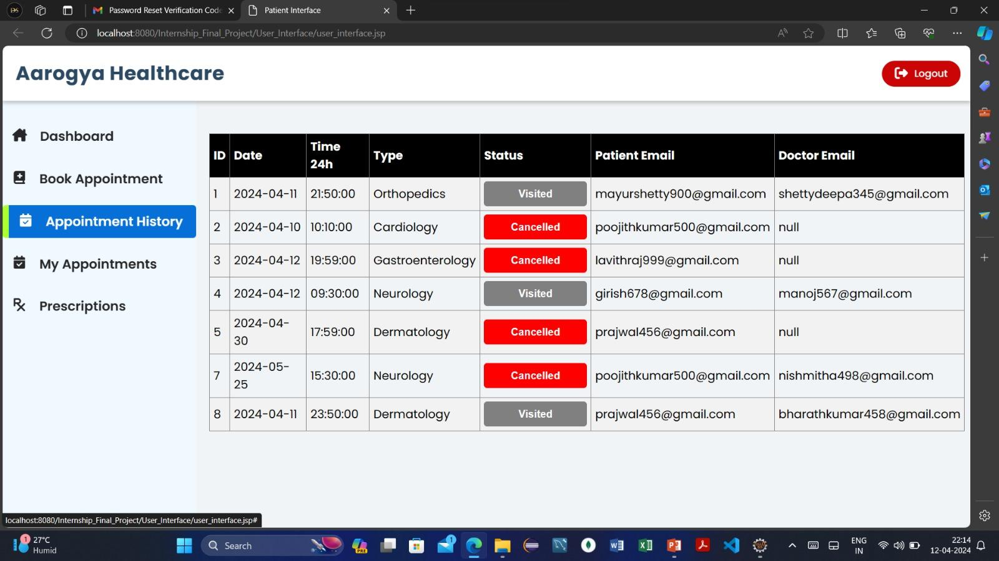
Figure 16
Figure 17

Slide 16
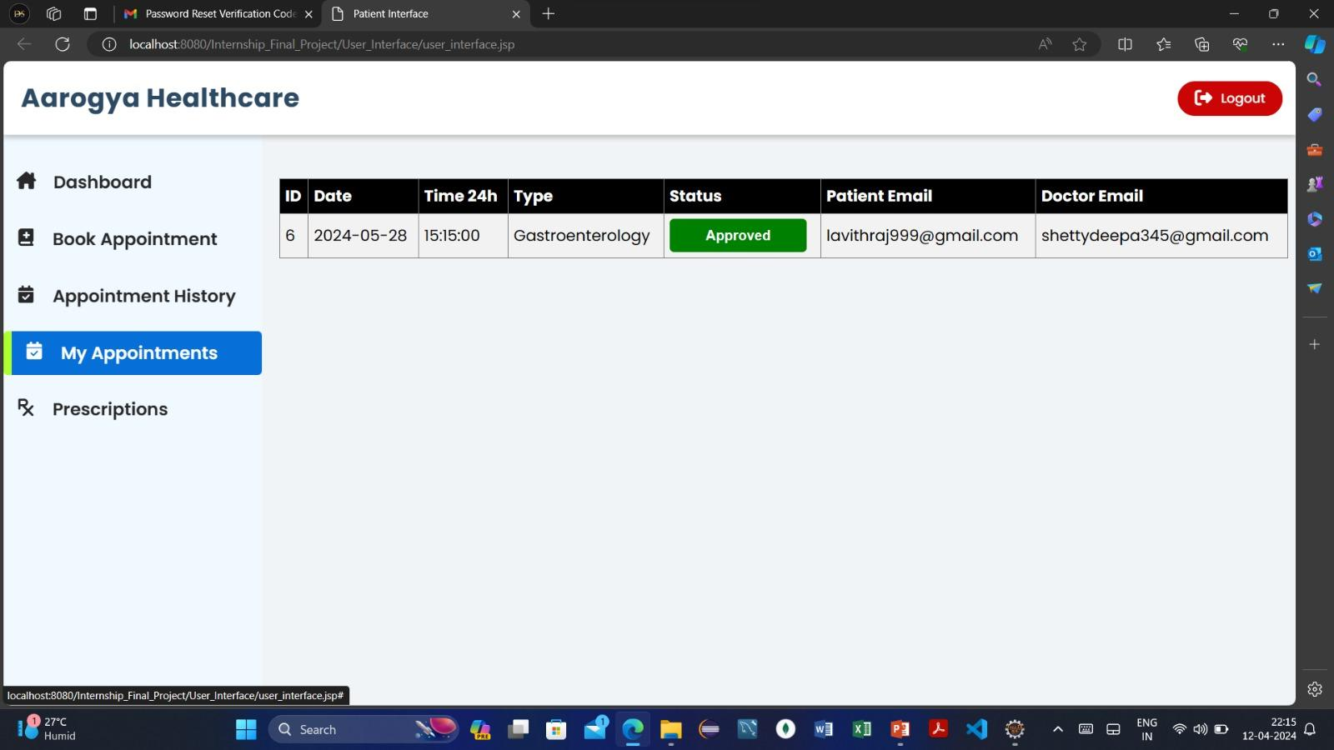
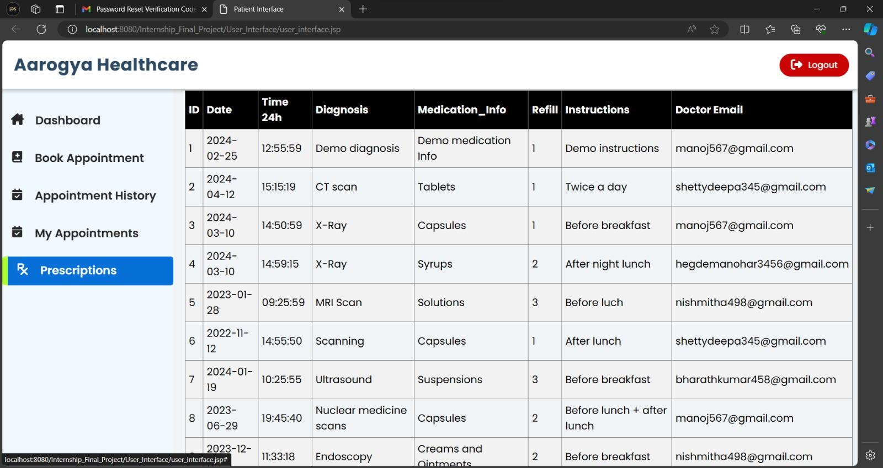
Figure 18
Figure 19

Slide 17
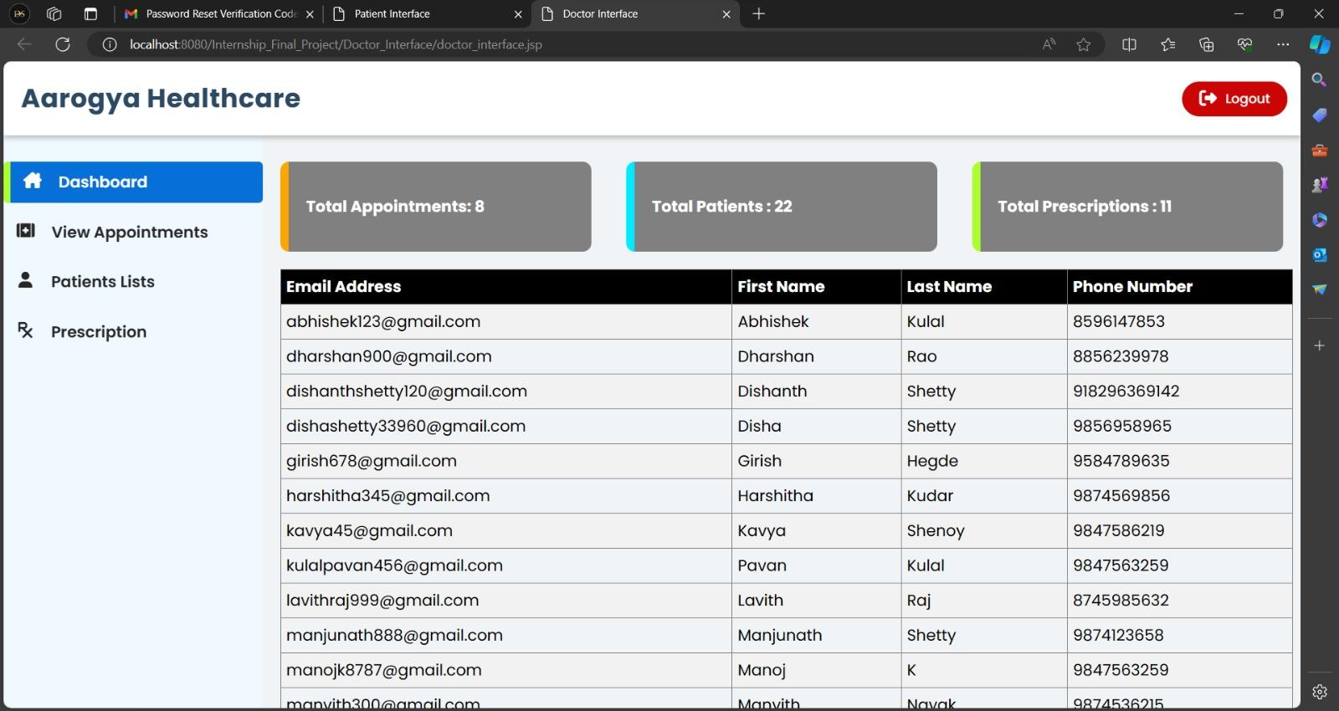
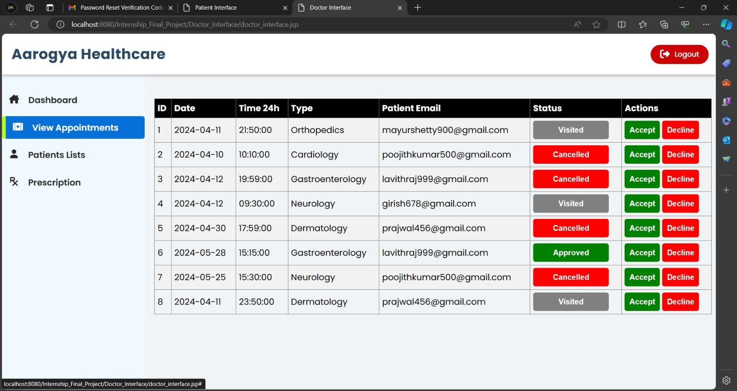
Figure 20
Figure 21

Slide 18
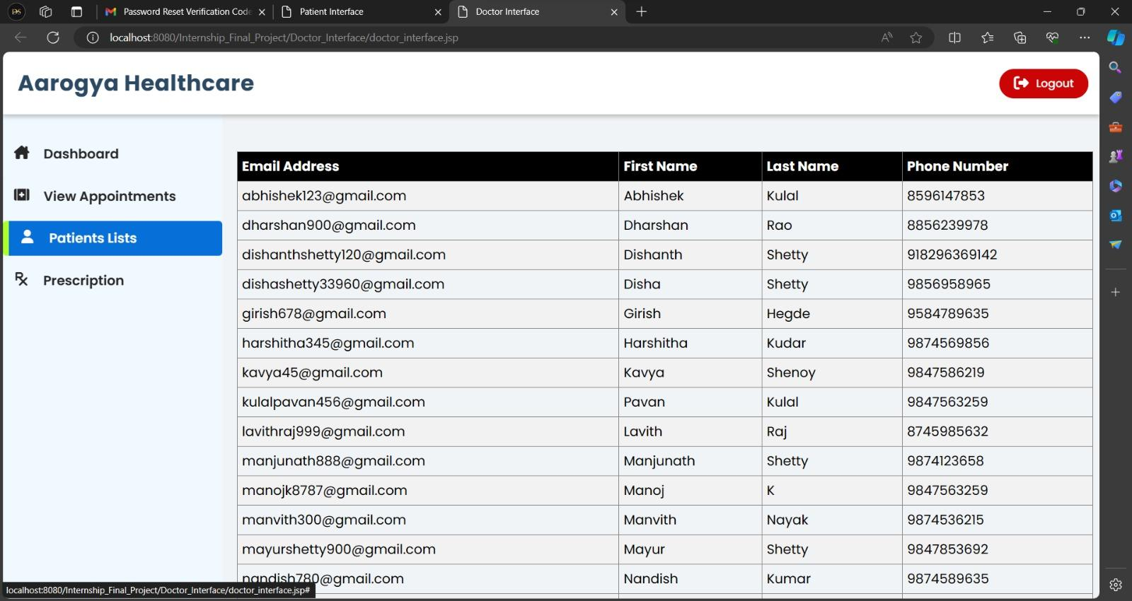
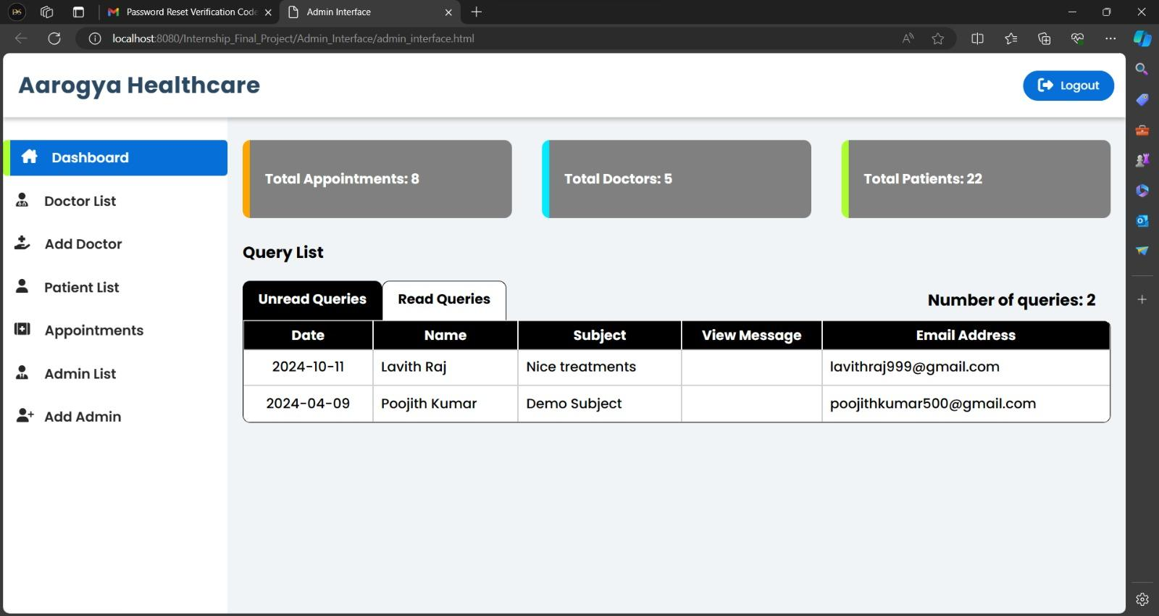
Figure 22
Figure 23

Slide 19
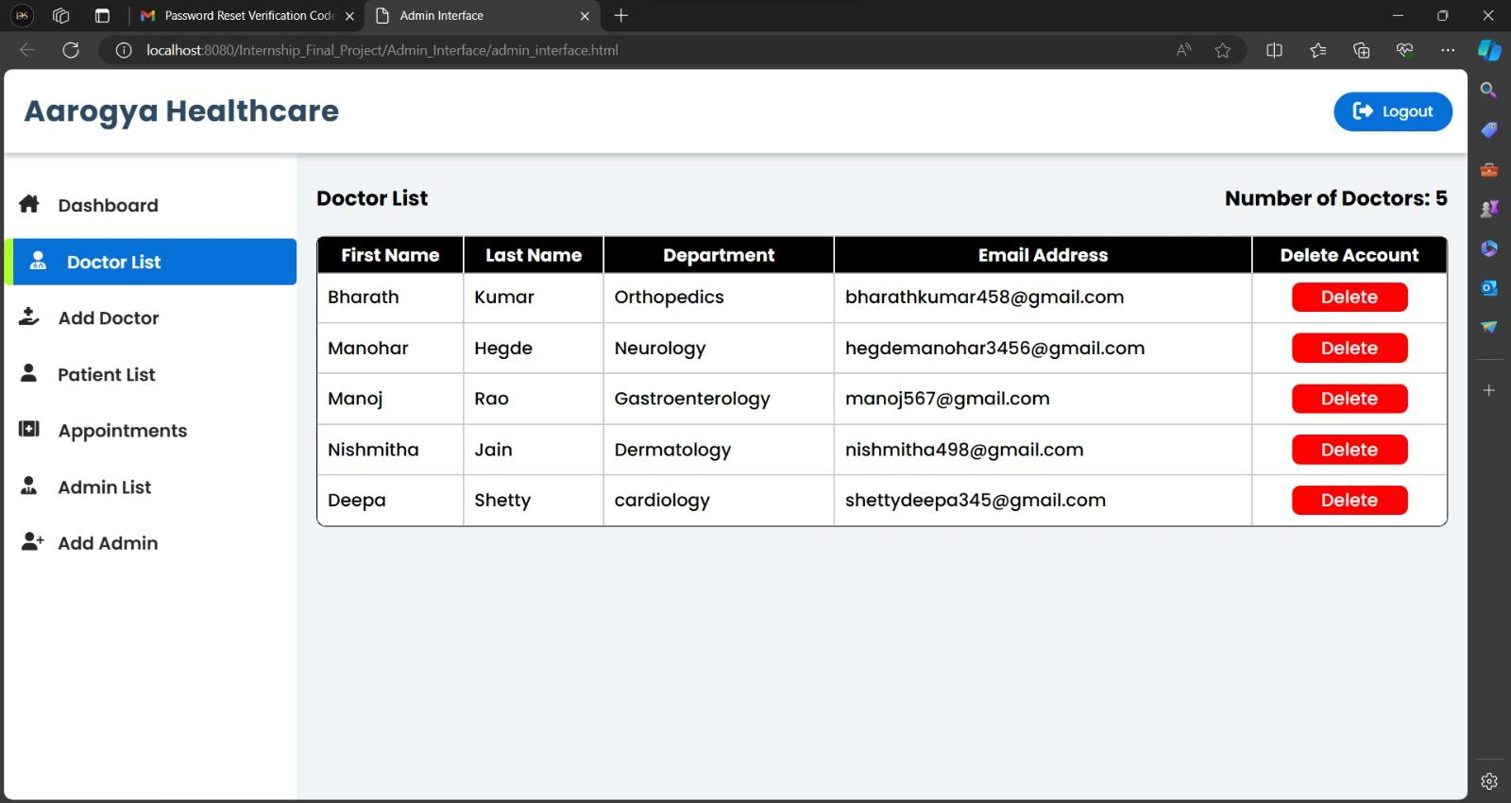
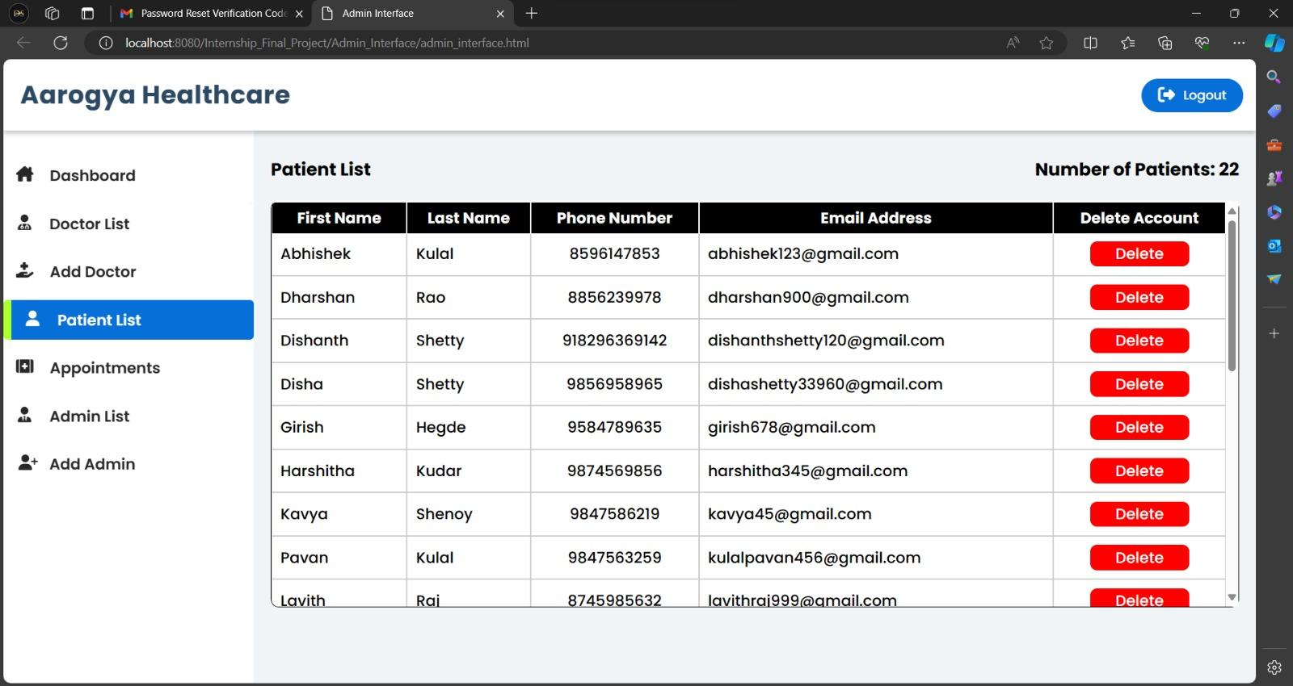
Figure 24
Figure 25

Slide 20
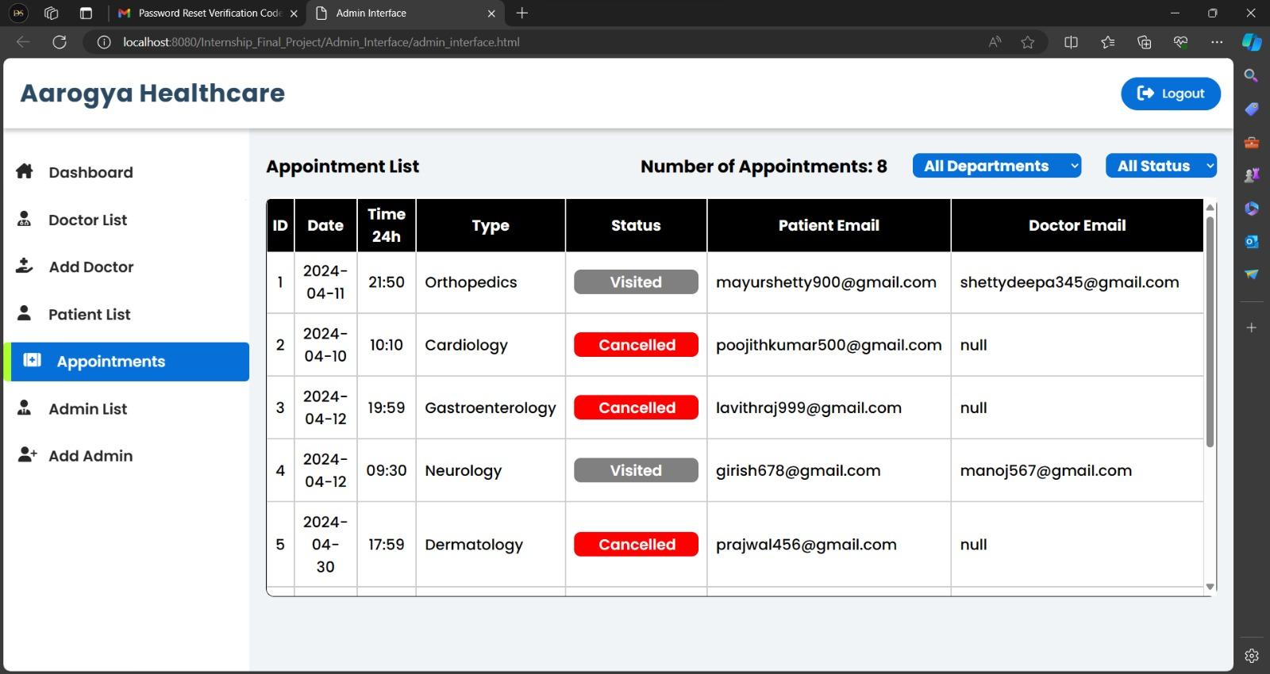
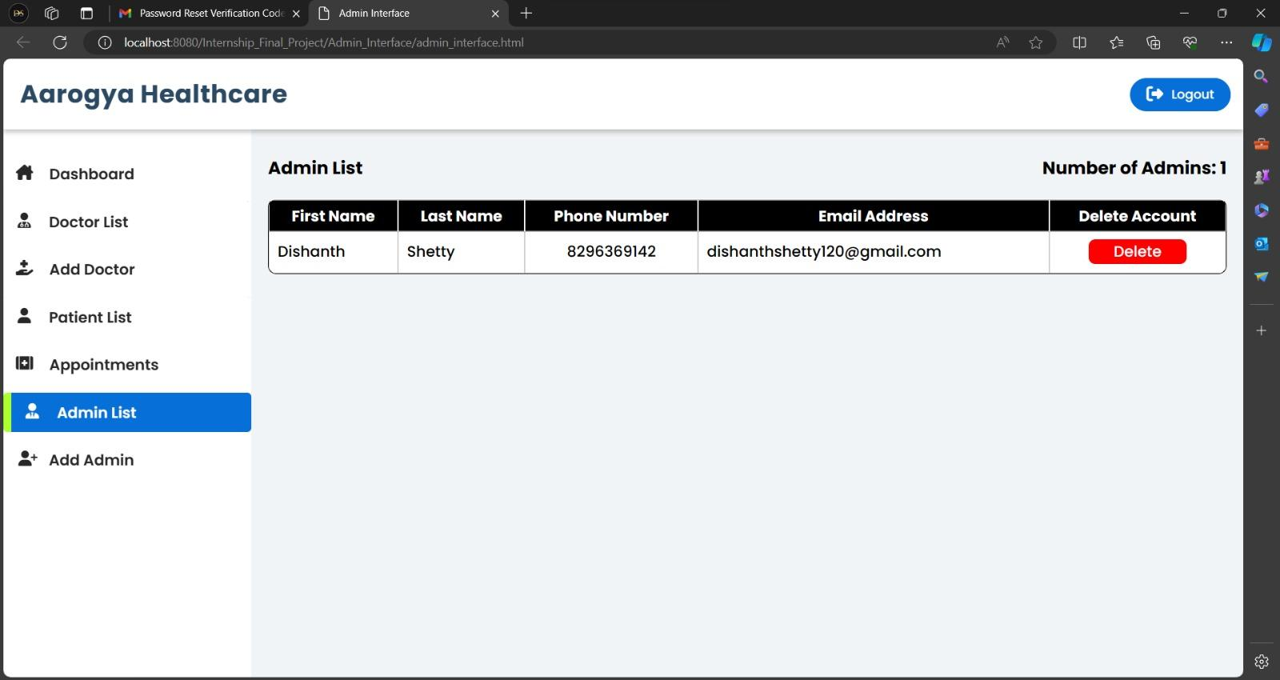
Figure 26
Figure 27

Slide 21
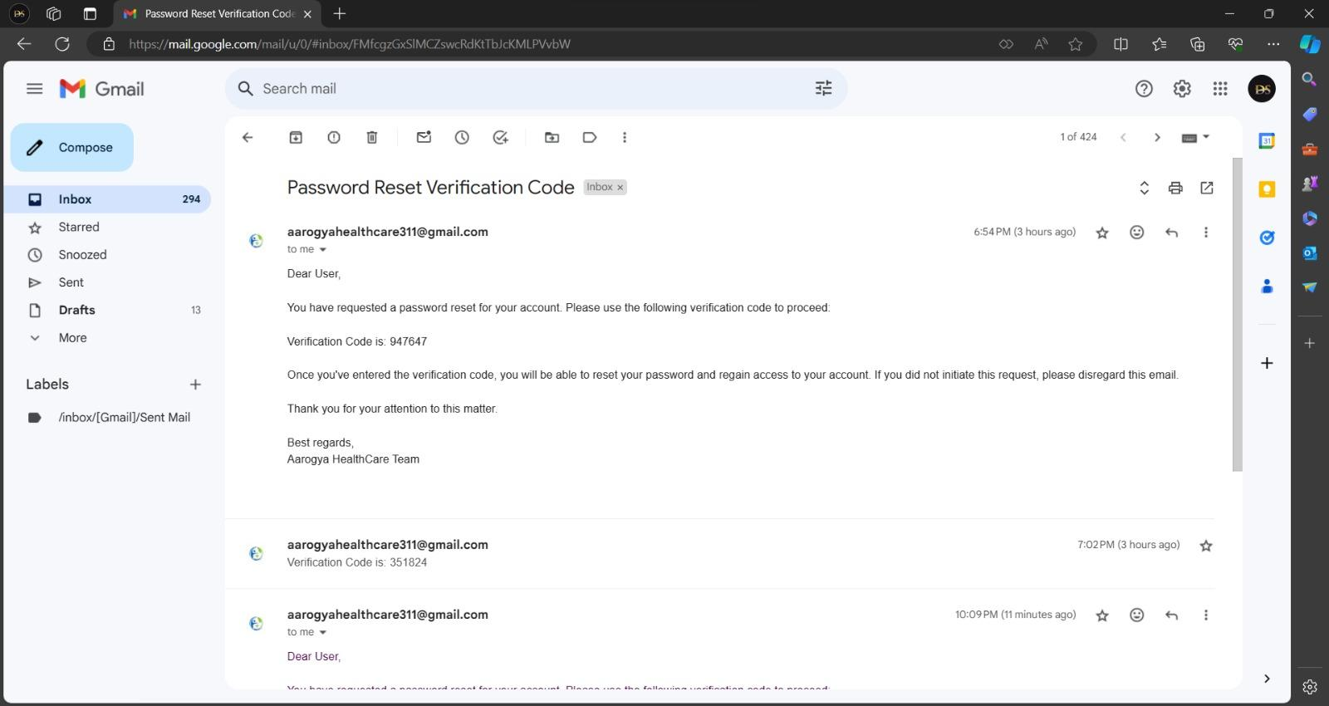
Figure 28

Slide 22
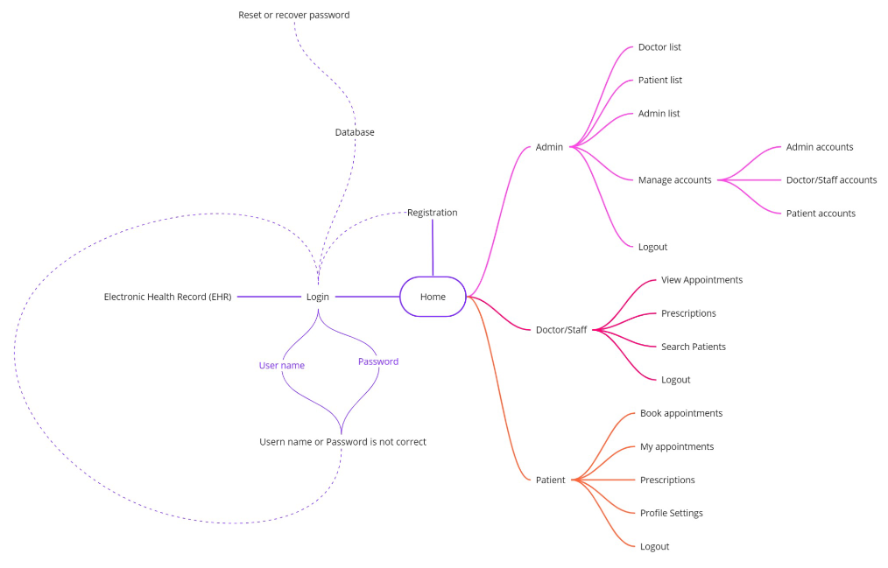
Mind Map

Slide 23
Conclusion
In conclusion, the development of a web-based tool for medical professionals to store and access patient records is paramount in enhancing healthcare efficiency and patient care. Through our project, we have demonstrated the potential of such a tool to streamline record-keeping processes, reduce administrative burden, and facilitate quick access to critical patient information.

Slide 24
By using Front-End Middle-Layer and Back-End we have created a user-friendly interface that allows medical professionals to securely input, update, and retrieve patient records from any location with internet access. This accessibility ensures that healthcare providers can make informed decisions promptly, leading to improved patient outcomes and satisfaction.

Slide 25
References
Google
GitHub
Youtube

Slide 26
THANK YOU

