Slide 1
Chapter 14 Wiener Processes and Itô’s Lemma

Slide 2
Stochastic Processes
Describes the way in which a variable such as a stock price, exchange rate or interest rate changes through time
Incorporates uncertainties

Slide 3
Example 1
Each day a stock price
increases by $1 with probability 30%
stays the same with probability 50%
reduces by $1 with probability 20%

Slide 4
Example 2
Each day a stock price change is drawn from a normal distribution with mean $0.2 and standard deviation $1

Slide 5
Markov Processes
In a Markov process future movements in a variable depend only on where we are, not the history of how we got to where we are
Is the process followed by the temperature at a certain place Markov?
We assume that stock prices follow Markov processes

Slide 6
Weak-Form Market Efficiency
This asserts that it is impossible to produce consistently superior returns with a trading rule based on the past history of stock prices. In other words technical analysis does not work.
A Markov process for stock prices is consistent with weak-form market efficiency

Slide 7
Example
A variable is currently 40
It follows a Markov process
Process is stationary (i.e. the parameters of the process do not change as we move through time)
At the end of 1 year the variable will have a normal probability distribution with mean 40 and standard deviation 10

Slide 8
Questions
What is the probability distribution of the stock price at the end of 2 years?
½ years?
¼ years?
Δt years?
Taking limits we have defined a continuous stochastic process

Slide 9
Variances & Standard Deviations
In Markov processes changes in successive periods of time are independent
This means that variances are additive
Standard deviations are not additive

Slide 10
Variances & Standard Deviations (continued)
In our example it is correct to say that the variance is 100 per year.
It is strictly speaking not correct to say that the standard deviation is 10 per year.

Slide 11
A Wiener Process (equation 14.1)
Define φ(μ,v) as a normal distribution with mean μ and variance v
A variable z follows a Wiener process if
The change in z in a small interval of time Δt is Δz
The values of Δz for any 2 different (non-overlapping) periods of time are independent

Slide 12
Properties of a Wiener Process
Mean of [z (T ) – z (0)] is 0
Variance of [z (T ) – z (0)] is T
Standard deviation of [z (T ) – z (0)] is

Slide 13
Generalized Wiener Processes
A Wiener process has a drift rate (i.e. average change per unit time) of 0 and a variance rate of 1
In a generalized Wiener process the drift rate and the variance rate can be set equal to any chosen constants

Slide 14
Generalized Wiener Processes (continued)
Mean change in x per unit time is a
Variance of change in x per unit time is b²

Slide 15
Taking Limits . . .
What does an expression involving dz and dt mean?
It should be interpreted as meaning that the corresponding expression involving Δz and Δt is true in the limit as Δt tends to zero
In this respect, stochastic calculus is analogous to ordinary calculus

Slide 16
The Example Revisited
A stock price starts at 40 and has a probability distribution of φ(40,100) at the end of the year
If we assume the stochastic process is Markov with no drift then the process is
dS = 10dz
If the stock price were expected to grow by $8 on average during the year, so that the year-end distribution is φ(48,100), the process would be
dS = 8dt + 10dz

Slide 17
Itô Process (equation 14.4)
In an Itô process the drift rate and the variance rate are functions of time
dx=a(x,t) dt+b(x,t) dz
The discrete time equivalent
is true in the limit as Δt tends to
zero

Slide 18
Why a Generalized Wiener Process Is Not Appropriate for Stocks
For a stock price we can conjecture that its expected percentage change in a short period of time remains constant (not its expected actual change)
We can also conjecture that our uncertainty as to the size of future stock price movements is proportional to the level of the stock price

Slide 19
An Ito Process for Stock Prices (equation 14.6 and 14.7)
where μ is the expected return σ is the volatility.
The discrete time equivalent is
The process is known as geometric Brownian motion

Slide 20
Interest Rates
What would be a reasonable stochastic process to assume for the short-term interest rate?

Slide 21
Monte Carlo Simulation
We can sample random paths for the stock price by sampling values for ε
Suppose μ= 0.15, σ= 0.30, and Δt = 1 week (=1/52 or 0.0192 years), then

Slide 22
Monte Carlo Simulation – Sampling one Path (See Table 14.1)

Slide 23
Correlated Processes
Suppose dz₁ and dz₂ are Wiener processes with correlation ρ
Then

Slide 24
Itô’s Lemma (See equation 14.12)
If we know the stochastic process followed by x, Itô’s lemma tells us the stochastic process followed by some function G (x, t ). When dx=a(x,t) dt+b(x,t) dz then
Since a derivative is a function of the price of the underlying asset and time, Itô’s lemma plays an important part in the analysis of derivatives

Slide 25
Indication of Why Itô’s Lemma is True (Appendix to Chapter 14)
A Taylor’s series expansion of G(x, t) gives

Slide 26
Ignoring Terms of Higher Order Than Δt

Slide 27
Substituting for Δx

Slide 28
The ε²Δt Term

Slide 29
Taking Limits

Slide 30
Application of Itô’s Lemma to a Stock Price Process

Slide 31
Examples

Slide 32
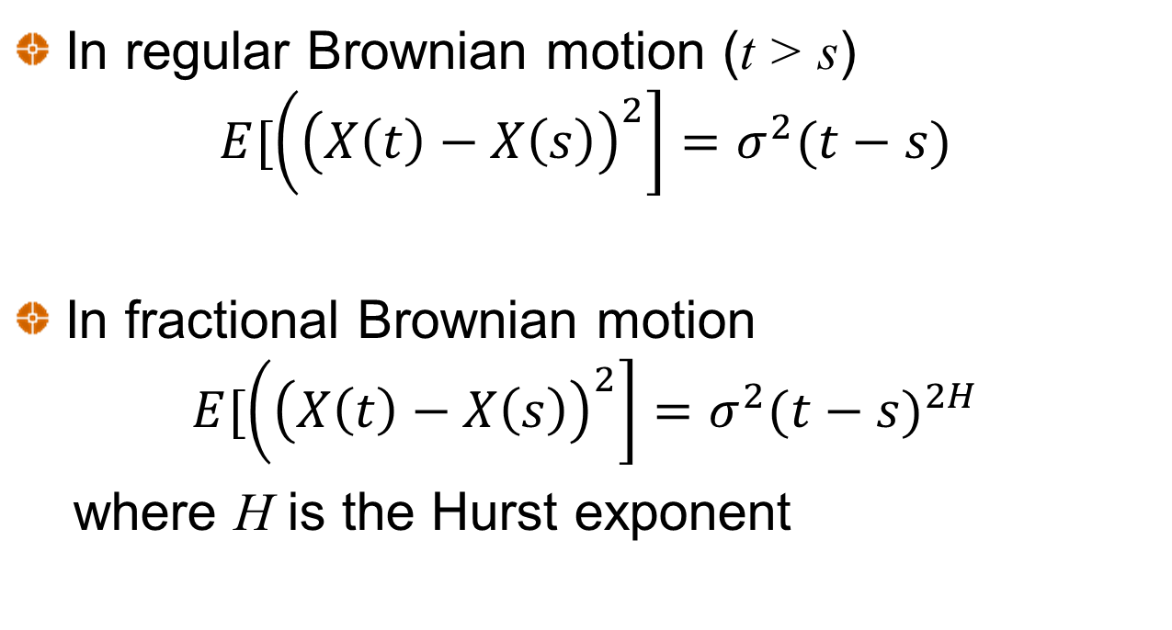
Fractional Brownian Motion
In regular Brownian motion (t > s)
$$E[\left({\left(X\left(t\right)−X\left(s\right)\right)}^{2}\right]=σ^{2}(t−s)$$
In fractional Brownian motion
$$E[\left({\left(X\left(t\right)−X\left(s\right)\right)}^{2}\right]=σ^{2}{(t−s)}^{2H}$$
where H is the Hurst exponent

Slide 33
Fractional Brownian Motion
When H > 0.5, changes in successive periods are positively correlated
When H = 0.5, fractional Brownian motion becomes regular Brownian motion where changes in successive periods are uncorrelated
When H < 0.5, changes in successive periods are negatively correlated

Slide 34
H=0.9 (time step =0.01)

Slide 35
H=0.5 (time step =0.01

Slide 36
H=0.1 (time step =0.01

