Slide 1
Chapter 19 The Greek Letters

Slide 2
Example
A bank has sold for $300,000 a European call option on 100,000 shares of a non-dividend paying stock
S₀ = 49, K = 50, r = 5%, σ = 20%,
T = 20 weeks, μ = 13%
The Black-Scholes-Merton value of the option is $240,000
How does the bank hedge its risk to lock in a $60,000 profit?

Slide 3
Naked & Covered Positions
Naked position
Take no action
Covered position
Buy 100,000 shares today
What are the risks associated with these strategies?

Slide 4
Stop-Loss Strategy
This involves:
Buying 100,000 shares as soon as price reaches $50
Selling 100,000 shares as soon as price falls below $50

Slide 5
Stop-Loss Strategy continued (Figure 19.1)
Ignoring discounting, the cost of writing and hedging the option appears to be max(S₀−K, 0). What are we overlooking?

Slide 6
Greek Letters
Greek letters are the partial derivatives with respect to the model parameters that are liable to change
Usually traders use the Black-Scholes-Merton model when calculating partial derivatives
The volatility parameter in BSM is set equal to the implied volatility when Greek letters are calculated. This is referred to as using the “practitioner Black-Scholes” model

Slide 7
Delta (See Figure 19.2)
Delta (Δ) is the rate of change of the option price with respect to the underlying asset price
Call option price
Slope = Δ = 0.6
B
A
Stock price

Slide 8
Hedge
Trader would be hedged with the position:
short 1000 options
buy 600 shares
Gain/loss on the option position is offset by loss/gain on stock position
Delta changes as stock price changes and time passes
Hedge position must therefore be rebalanced

Slide 9
Delta Hedging
This involves maintaining a delta neutral portfolio
The delta of a European call on a non-dividend paying stock is N (d ₁)
The delta of a European put on the stock is
N (d ₁) – 1

Slide 10
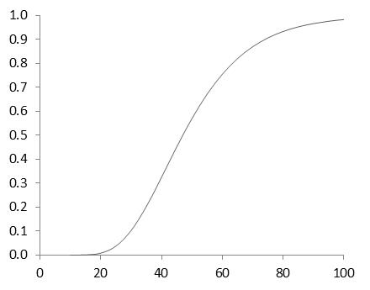
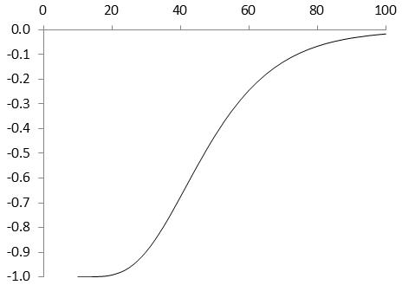
Delta of a Stock Option (K=50, r=0, σ = 25%, T=2, Figure 19.3)
Call
Put

Slide 11
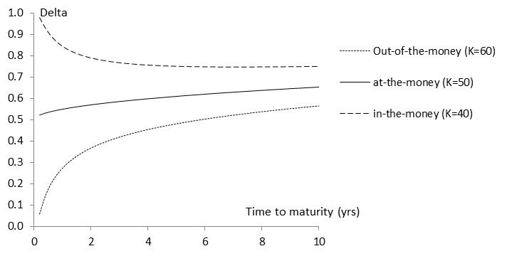
Variation of Delta with Time to Maturity(S₀=50, r=0, σ=25%, Figure 19.4)

Slide 12
The Costs in Delta Hedging continued
Delta hedging a written option involves a “buy high, sell low” trading rule

Slide 13
First Scenario for the Example (Table 19.2)
Week | Stock price | Delta | Shares purchased | Cost (‘$000) | Cumulative Cost ($000) | Interest
0 | 49.00 | 0.522 | 52,200 | 2,557.8 | 2,557.8 | 2.5
1 | 48.12 | 0.458 | (6,400) | (308.0) | 2,252.3 | 2.2
2 | 47.37 | 0.400 | (5,800) | (274.7) | 1,979.8 | 1.9
....... | ....... | ....... | ....... | ....... | ....... | .......
19 | 55.87 | 1.000 | 1,000 | 55.9 | 5,258.2 | 5.1
20 | 57.25 | 1.000 | 0 | 0 | 5263.3

Slide 14
Second Scenario for the Example (Table 19.3)
Week | Stock price | Delta | Shares purchased | Cost (‘$000) | Cumulative Cost ($000) | Interest
0 | 49.00 | 0.522 | 52,200 | 2,557.8 | 2,557.8 | 2.5
1 | 49.75 | 0.568 | 4,600 | 228.9 | 2,789.2 | 2.7
2 | 52.00 | 0.705 | 13,700 | 712.4 | 3,504.3 | 3.4
....... | ....... | ....... | ....... | ....... | ....... | .......
19 | 46.63 | 0.007 | (17,600) | (820.7) | 290.0 | 0.3
20 | 48.12 | 0.000 | (700) | (33.7) | 256.6

Slide 15
Theta
Theta (Θ) of a derivative (or portfolio of derivatives) is the rate of change of the value with respect to the passage of time
The theta of a call or put is usually negative. This means that, if time passes with the price of the underlying asset and its volatility remaining the same, the value of a long call or put option declines

Slide 16
Theta for Call Option (K=50, σ = 25%, r = 0, T = 2, Figure 19.5)

Slide 17
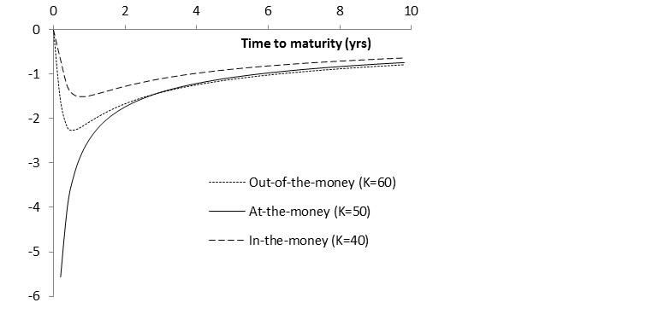
Variation of Theta with Time to Maturity (S₀=50, r=0, σ=25%, Figure 19.6)

Slide 18
Gamma
Gamma (Γ) is the rate of change of delta (Δ) with respect to the price of the underlying asset
Gamma is greatest for options that are close to the money

Slide 19
Gamma Addresses Delta Hedging Errors Caused By Curvature (Figure 19.7)
Call
price
C''
C'
C
Stock price
S
S'

Slide 20
Interpretation of Gamma
For a delta neutral portfolio, ΔΠ ≈ Θ Δt + ½ΓΔS ²
ΔΠ
ΔΠ
ΔS
ΔS
Positive Gamma
Negative Gamma

Slide 21
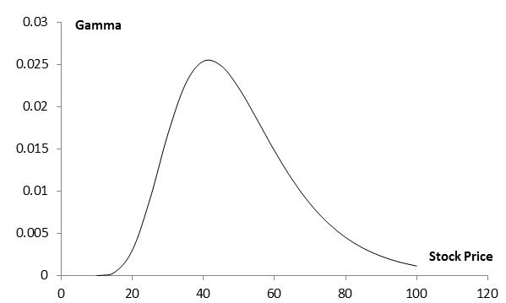
Gamma for Call or Put Option: (K=50, σ = 25%, r = 0%, T = 2, Figure 19.9)

Slide 22
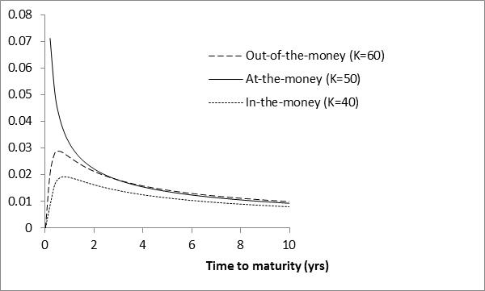
Variation of Gamma with Time to Maturity (S₀=50, r=0, σ=25%, Figure 19.10)

Slide 23
Relationship Between Delta, Gamma, and Theta (equation 19.4)
For a portfolio of derivatives on a stock paying a continuous dividend yield at rate q it follows from the Black-Scholes-Merton differential equation that

Slide 24
Vega
Vega (ν) is the rate of change of the value of a derivatives portfolio with respect to volatility
If vega is calculated for a portfolio as a weighted average of the vegas for the individual transactions comprising the portfolio, the result shows the effect of all implied volatilities changing by the same small amount

Slide 25
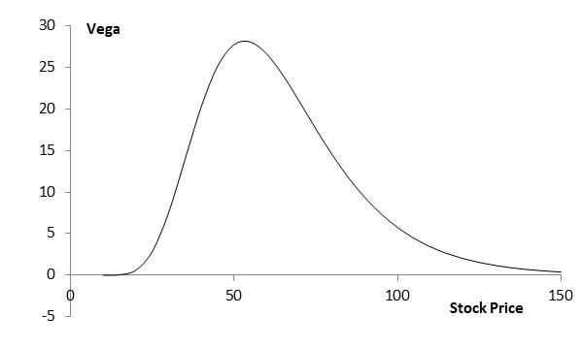
Vega for Call or Put Option (K=50, σ = 25%, r = 0, T = 2, Figure 19.11))

Slide 26
Taylor Series Expansion (Appendix to Chapter 19)
The value of a portfolio of derivatives dependent on an asset is a function of of the asset price S, its volatility σ, and time t

Slide 27
Managing Delta, Gamma, & Vega
Delta can be changed by taking a position in the underlying asset
To adjust gamma and vega it is necessary to take a position in an option or other derivative

Slide 28
Example 19.5
 | Delta | Gamma | Vega
Portfolio | 0 | −5000 | −8000
Option 1 | 0.6 | 0.5 | 2.0
Option 2 | 0.5 | 0.8 | 1.2
What position in option 1 and the underlying asset will make the portfolio delta and gamma neutral? Answer: Long 10,000 options, short 6000 of the asset
What position in option 1 and the underlying asset will make the portfolio delta and vega neutral? Answer: Long 4000 options, short 2400 of the asset

Slide 29
Example 19.5 continued
 | Delta | Gamma | Vega
Portfolio | 0 | −5000 | −8000
Option 1 | 0.6 | 0.5 | 2.0
Option 2 | 0.5 | 0.8 | 1.2
We solve
−5000+0.5w₁ +0.8w₂ =0
−8000+2.0w₁ +1.2w₂ =0
to get w₁ = 400 and w₂ = 6000. We require long positions of 400 and 6000 in option 1 and option 2. A short position of 3240 in the asset is then required to make the portfolio delta neutral

Slide 30
Rho
Rho is the rate of change of the value of a derivative with respect to the interest rate

Slide 31
Hedging in Practice
Traders usually ensure that their portfolios are delta-neutral at least once a day
Whenever the opportunity arises, they improve gamma and vega
There are economies of scale
As portfolio becomes larger hedging becomes less expensive per option in the portfolio

Slide 32
Scenario Analysis
A scenario analysis involves testing the effect on the value of a portfolio of different assumptions concerning asset prices and their volatilities

Slide 33
Greek Letters for European Options on an Asset that Provides a Yield at Rate q (Table 19.6)
Greek Letter | Call Option | Put Option
Delta
Gamma
Theta
Vega
Rho
In practice, the volatility, σ, is usually set equal to the implied volatility

Slide 34
Futures Contract Can Be Used for Hedging
The delta of a futures contract on an asset paying a yield at rate q is e^{(r−q)T} times the delta of a spot contract
The position required in futures for delta hedging is therefore e^{−(r−q)T} times the position required in the corresponding spot contract

Slide 35
Hedging vs Creation of an Option Synthetically
When we are hedging we take positions that offset delta, gamma, vega, etc
When we create an option synthetically we take positions that matchdelta, gamma, vega, etc

Slide 36
Portfolio Insurance
In October of 1987 many portfolio managers attempted to create a put option on a portfolio synthetically
This involves initially selling enough of the portfolio (or of index futures) to match the Δ of the put option

Slide 37
Portfolio Insurance continued
As the value of the portfolio increases, the Δ of the put becomes less negative and some of the original portfolio is repurchased
As the value of the portfolio decreases, the Δ of the put becomes more negative and more of the portfolio must be sold

Slide 38
Portfolio Insurance continued
The strategy did not work well on October 19, 1987...

