Slide 1
Chapter 20 Volatility Smiles and Volatility Surfaces

Slide 2
What is a Volatility Smile?
It is the relationship between implied volatility and strike price for options with a certain maturity
The volatility smile for European call options should be exactly the same as that for European put options
The same is at least approximately true for American options

Slide 3
Why the Volatility Smile is the Same for European Calls and Put
Put-call parity p + S₀e^{−qT} = c +K e^{–rT} holds for market prices (p_{mkt} and c_{mkt}) and for Black-Scholes-Merton prices (p_{bs} and c_{bs})
As a result, p_{mkt}− p_{bs}=c_{mkt}− c_{bs}
When p_{bs} = p_{mkt}, it must be true that c_{bs} = c_{mkt}
It follows that the implied volatility calculated from a European call option should be the same as that calculated from a European put option when both have the same strike price and maturity

Slide 4
The Volatility Smile for Foreign Currency Options (Figure 20.1)
Implied
Volatility
K/S₀

Slide 5
Implied Distribution for Foreign Currency Options (Figure 20.2)

Slide 6
Properties of Implied Distribution for Foreign Currency Options
Both tails are heavier than the lognormal distribution
It is also “more peaked” than the lognormal distribution

Slide 7
Possible Causes of Volatility Smile for Foreign Currencies
Exchange rate exhibits jumps rather than continuous changes
Volatility of exchange rate is stochastic

Slide 8
Historical Analysis of Exchange Rate Changes (Table 20.1)
 | Real World (%) | Normal Model (%)
>1 SD | 23.32 | 31.73
>2SD | 4.67 | 4.55
>3SD | 1.30 | 0.27
>4SD | 0.49 | 0.01
>5SD | 0.24 | 0.00
>6SD | 0.13 | 0.00

Slide 9
The Volatility Smile for Equity Options (Figure 20.3)
Implied
Volatility
K/S₀

Slide 10
Implied Distribution for Equity Options (Figure 20.4)

Slide 11
Properties of Implied Distribution for Equity Options
The left tail is heavier than the lognormal distribution
The right tail is less heavy than the lognormal distribution

Slide 12
Reasons for Smile in Equity Options
There is a negative correlation between equity prices and volatility. Possible reasons:
Leverage
Volatility feedback
Crashophobia
When the price decreases (increases), volatility tends to increase (decrease) making further decreases (increases) more (less) likely

Slide 13
Other Volatility Smiles?
What is the volatility smile if
True distribution has a less heavy left tail and heavier right tail
True distribution has both a less heavy left tail and a less heavy right tail

Slide 14
Ways of Characterizing the Volatility Smiles
Plot implied volatility against
Plot implied volatility against
Note: traders frequently define an option as at-the-money when K equals the forward price, F₀, not when it equals the spot price S₀
Plot implied volatility against delta of the option
Note: traders sometimes define at-the money as a call with a delta of 0.5 or a put with a delta of −0.5. These are referred to as “50-delta options”

Slide 15
Volatility Term Structure
In addition to calculating a volatility smile, traders also calculate a volatility term structure
This shows the variation of implied volatility with the time to maturity of the option
The volatility term structure tends to be downward sloping when volatility is high and upward sloping when it is low

Slide 16
Volatility Surface
The implied volatility as a function of the strike price and time to maturity is known as a volatility surface

Slide 17
Example of a Volatility Surface (Table 20.2)

Slide 18
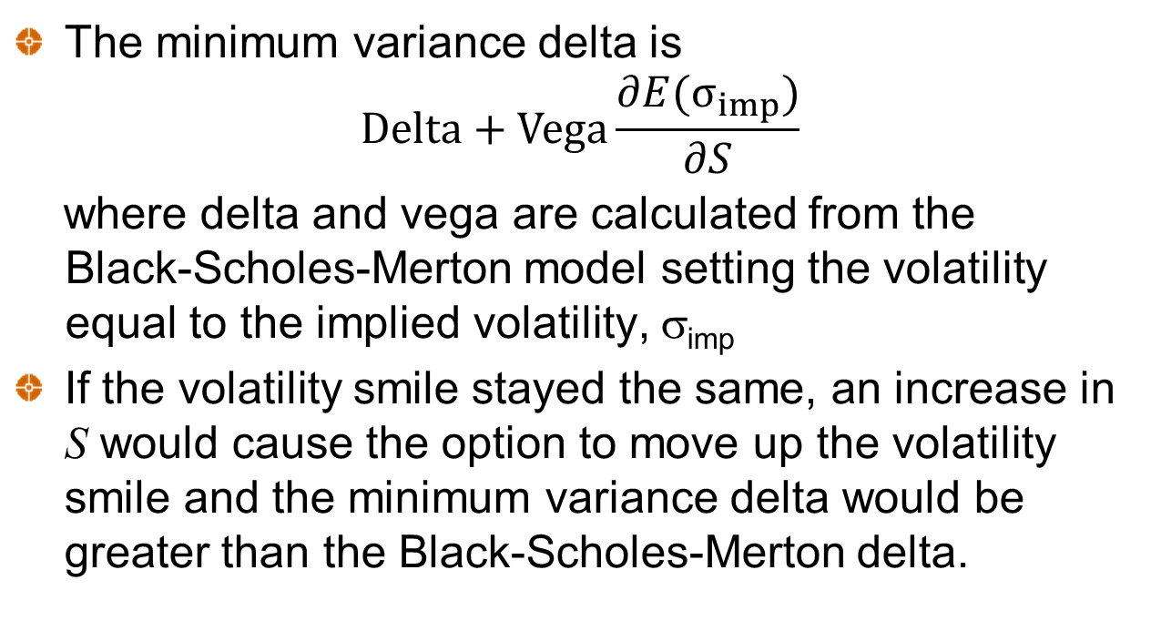
Minimum Variance Delta
The minimum variance delta is
$$Delta+Vega\frac{∂E(σ_{imp})}{∂S}$$
where delta and vega are calculated from the Black-Scholes-Merton model setting the volatility equal to the implied volatility, σ_{imp}
If the volatility smile stayed the same, an increase in S would cause the option to move up the volatility smile and the minimum variance delta would be greater than the Black-Scholes-Merton delta.

Slide 19
Minimum Variance Delta continued
In practice the volatility smile tends to move down when the stock price increases (negative correlation)
The net result of the two effects is that the minimum variance delta is less than the Black-Scholes-Merton delta

Slide 20
Volatility Smiles When a Large Jump is Expected
At the money implied volatilities are higher that in-the-money or out-of-the-money options (so that the smile is a frown!)

Slide 21
Determining the Implied Distribution for S (Appendix to Chapter 20)

Slide 22
A Geometric Interpretation (Figure 20A.1)
Assuming that density is g(K) from K−δ to K+δ, c₁ +c₃ −c₂ = e^{−rT} δ² g(K)

