Slide 1
Chapter 27 More on Models and Numerical Procedures

Slide 2
Time Varying Volatility
The variance rate substituted into BSM should be the average variance rate
Suppose the volatility is σ₁ for the first year and σ₂ for the second and third
Total accumulated variance at the end of three years is σ₁² + 2σ₂²
The 3-year average volatility is given by

Slide 3
Three Alternatives to Geometric Brownian Motion
Constant elasticity of variance (CEV)
Mixed Jump diffusion
Variance Gamma

Slide 4
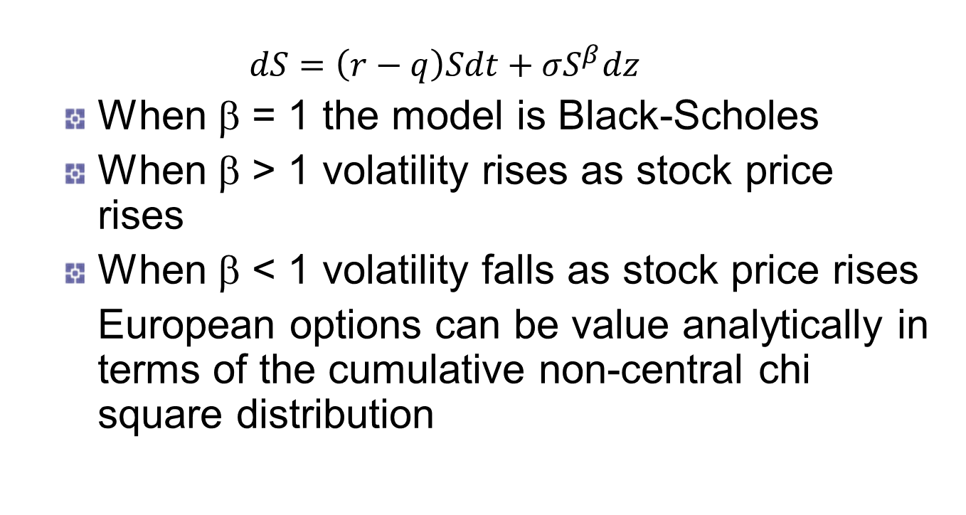
CEV Model
$$dS=\left(r−q\right)Sdt+σS^{β}dz$$
When β = 1 the model is Black-Scholes
When β > 1 volatility rises as stock price rises
When β < 1 volatility falls as stock price rises
European options can be value analytically in terms of the cumulative non-central chi square distribution

Slide 5
CEV Models Implied Volatilities
σ_{imp}
β < 1
β > 1
K

Slide 6
Mixed Jump Diffusion Model
Merton produced a pricing formula when the asset price follows a diffusion process overlaid with random jumps
dp is the random jump
k is the expected size of the jump
λ dt is the probability that a jump occurs in the next interval of length dt
λk is the expected return from jumps

Slide 7
Simulating a Jump Process
In each time step
Sample from a binomial distribution to determine the number of jumps
Sample to determine the size of each jump

Slide 8
Jumps and the Smile
Jumps have a big effect on the implied volatility of short term options
They have a much smaller effect on the implied volatility of long term options

Slide 9
The Variance-Gamma Model
Define g as change over time T in a variable that follows a gamma process. This is a process where small jumps occur frequently and there are occasional large jumps
Conditional on g, ln S_{T} is normal. Its variance proportional to g
There are 3 parameters
v, the variance rate of the gamma process
σ², the average variance rate of ln S per unit time
θ, a parameter defining skewness

Slide 10
Understanding the Variance-Gamma Model
g defines the rate at which information arrives during time T (g is sometimes referred to as measuring economic time)
If g is large the change in ln S has a relatively large mean and variance
If g is small relatively little information arrives and the change in ln S has a relatively small mean and variance

Slide 11
Stochastic Volatility Models (equations 27.2 and 27.3)
When V and S are uncorrelated a European option price is the Black-Scholes-Merton price integrated over the distribution of the average variance rate

Slide 12
Stochastic Volatility Models continued
When V and S are negatively correlated we obtain a downward sloping volatility skew similar to that observed in the market for equities
When V and S are positively correlated the skew is upward sloping. (This pattern is sometimes observed for commodities)

Slide 13
SABR Model
Typically practitioners estimate parameters for each maturity.
There are good analytic approximations for the implied volatility
Can match many different volatility smiles

Slide 14
Rough Volatility Model
The variance rate is assumed to follow fractional Brownian motion with a Hurst exponent less than 0.5
This fits the observed behavior of stock indices fairly well
It also can be fitted better than some other stochastic volatility models to the volatility surfaces that are observed in practice

Slide 15
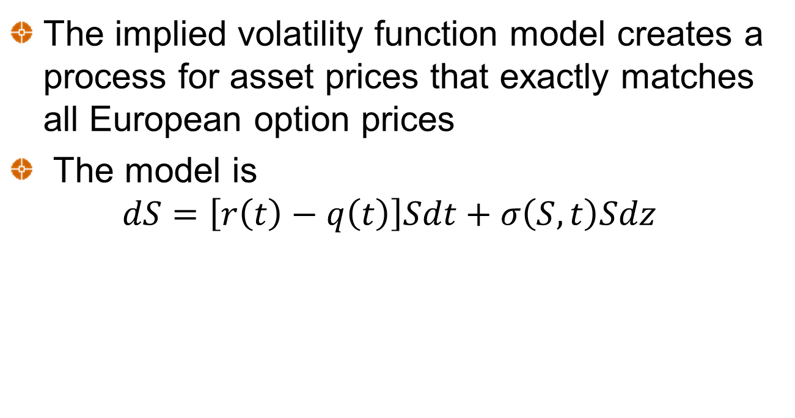
The IVF Model
The implied volatility function model creates a process for asset prices that exactly matches all European option prices
The model is
$$dS=\left[r\left(t\right)−q\left(t\right)\right]Sdt+σ\left(S,t\right)Sdz$$

Slide 16
The Volatility Function (equation 27.4)
The volatility function that leads to the model matching all European option prices is

Slide 17
Strengths and Weaknesses of the IVF Model
The model matches the probability distribution of asset prices assumed by the market at each future time
The models does not necessarily give reasonable values for the joint probability distribution of asset prices at two or more times

Slide 18
Convertible Bonds (Section 27.4)
Often valued with a tree where during a time interval Δt there is
a probability p_{u} of an up movement
A probability p_{d} of a down movement
A probability 1-exp(-λt) that there will be a default (λ is the hazard rate)
In the event of a default the stock price falls to zero and there is a recovery on the bond

Slide 19
The Probabilities

Slide 20
Node Calculations
Define:
Q_{1:} value of bond if neither converted nor called
Q₂: value of bond if called
Q₃: value of bond if converted
Bond is called if Q₂<Q₁
Bond is converted if Q₃>min(Q₁,Q₂)

Slide 21
Example 27.1
9-month zero-coupon bond with face value of $100
Convertible into 2 shares
Callable for $113 at any time
Initial stock price = $50,
volatility = 30%,
no dividends
Risk-free rates all 5%
Default intensity, λ, is 1%
Recovery rate=40%

Slide 22
The Tree (Figure 27.2)
G
78.42
D
156.83
67.49
B
134.99
H
58.09
58.09
A
116.18
E
116.15
50.00
50.00
107.44
C
106.78
I
43.04
43.04
101.37
F
100.00
37.04
98.61
J
31.88
100.00
Default
Default
Default
0.00
0.00
0.00
40.00
40.00
40.00

Slide 23
Numerical Procedures
Topics:
Path dependent options using tree
Barrier options
Options where there are two stochastic variables
American options using Monte Carlo

Slide 24
Path Dependence: The Traditional View
Trees work well for American options. They cannot be used for path-dependent options
Monte Carlo simulation works well for path-dependent options; it cannot be used for American options

Slide 25
Extending the Use of Trees
Backwards induction can be used for some path-dependent options
We will first illustrate the methodology using lookback options and then show how it can be used for Asian options

Slide 26
Lookback Example
Consider an American lookback put on a stock where
S = 50, σ = 40%, r = 10%, Δt = 1 month & the life of the option is 3 months
Payoff is S_{max}-S_{T}
We can value the deal by considering all possible values of the maximum stock price at each node
(This example is presented to illustrate the methodology. It is not the most efficient way of handling American lookbacks (See Technical Note 13)

Slide 27
Example: An American Lookback Put Option
S₀ = 50, σ = 40%, r = 10%, Δt = 1 month,
70.70
70.70
62.99
0.00
56.12
62.99
56.12
3.36
62.99 56.12
50.00
5.47
56.12
50.00
6.87
0.00
4.68
A
44.55
56.12 50.00
44.55
6.12
2.66
56.12 50.00
50.00
39.69
11.57
5.45
Top number is stock price
Middle numbers are alternative maximum stock prices
Lower numbers are option prices
6.38
50.00
35.36
10.31
50.00
14.64

Slide 28
Why the Approach Works
This approach works for lookback options because
The payoff depends on just 1 function of the path followed by the stock price. (We will refer to this as a “path function”)
The value of the path function at a node can be calculated from the stock price at the node and from the value of the function at the immediately preceding node
The number of different values of the path function at a node does not grow too fast as we increase the number of time steps on the tree

Slide 29
Extensions of the Approach
The approach can be extended so that there are no limits on the number of alternative values of the path function at a node
The basic idea is that it is not necessary to consider every possible value of the path function
It is sufficient to consider a relatively small number of representative values of the function at each node

Slide 30
Working Forward
First work forward through the tree calculating the max and min values of the “path function” at each node
Next choose representative values of the path function that span the range between the min and the max
Simplest approach: choose the min, the max, and N equally spaced values between the min and max

Slide 31
Backwards Induction
We work backwards through the tree in the usual way carrying out calculations for each of the alternative values of the path function that are considered at a node
When we require the value of the derivative at a node for a value of the path function that is not explicitly considered at that node, we use linear or quadratic interpolation

Slide 32
Part of Tree to Calculate Value of an Option on the Arithmetic Average (Figure 27.3)
S = 54.68
Y
Average S
47.99
51.12
54.26
57.39
Option Price
7.575
8.101
8.635
9.178
0.5056
S = 50.00
Average S
46.65
49.04
51.44
53.83
Option Price
5.642
5.923
6.206
6.492
X
S = 45.72
0.4944
Average S
43.88
46.75
49.61
52.48
Option Price
3.430
3.750
4.079
4.416
S=50, X=50, σ=40%, r =10%, T=1yr, Δt=0.05yr. We are at time 4Δt
Z

Slide 33
Part of Tree to Calculate Value of an Option on the Arithmetic Average (continued)
Consider Node X when the average of 5 observations is 51.44
Node Y: If this is reached, the average becomes 51.98. The option price is interpolated as 8.247
Node Z: If this is reached, the average becomes 50.49. The option price is interpolated as 4.182
Node X: value is
(0.5056×8.247 + 0.4944×4.182)e^{–0.1×0.05} = 6.206

Slide 34
Using Trees with Barriers (Section 27.6)
When trees are used to value options with barriers, convergence tends to be slow
The slow convergence arises from the fact that the barrier is inaccurately specified by the tree

Slide 35
True Barrier vs Tree Barrier for a Knockout Option: The Binomial Tree Case
Tree Barrier
True Barrier

Slide 36
Inner and Outer Barriers for Trinomial Trees (Figure 27.4)
Outer barrier
True barrier
Inner Barrier

Slide 37
Alternative Solutions to Valuing Barrier Options
Interpolate between value when inner barrier is assumed and value when outer barrier is assumed
Ensure that nodes always lie on the barriers
Use adaptive mesh methodology
In all cases a trinomial tree is preferable to a binomial tree

Slide 38
Modeling Two Correlated Variables Using a 3-Dimensional Tree (Section 27.7)
Approaches
Transform variables so that they are not correlated and build the tree in the transformed variables
Take the correlation into account by adjusting the position of the nodes
Take the correlation into account by adjusting the probabilities

Slide 39
Monte Carlo Simulation and American Options
Two approaches:
The least squares approach
The exercise boundary parameterization approach
Consider a 3-year put option where the initial asset price is 1.00, the strike price is 1.10, the risk-free rate is 6%, and there is no income

Slide 40
Sampled Paths (Table 27.4)
Path | t = 0 | t =1 | t =2 | t =3
1 | 1.00 | 1.09 | 1.08 | 1.34
2 | 1.00 | 1.16 | 1.26 | 1.54
3 | 1.00 | 1.22 | 1.07 | 1.03
4 | 1.00 | 0.93 | 0.97 | 0.92
5 | 1.00 | 1.11 | 1.56 | 1.52
6 | 1.00 | 0.76 | 0.77 | 0.90
7 | 1.00 | 0.92 | 0.84 | 1.01
8 | 1.00 | 0.88 | 1.22 | 1.34

Slide 41
The Least Squares Approach
We work back from the end using a least squares approach to calculate the continuation value at each time
Consider year 2. The option is in the money for five paths. These give observations on S of 1.08, 1.07, 0.97, 0.77, and 0.84. The continuation values are 0.00, 0.07e^{-0.06}, 0.18e^{-0.06}, 0.20e^{-0.06}, and 0.09e^{-0.06}

Slide 42
The Least Squares Approach continued
Fitting a model of the form V=a+bS+cS² we get a best fit relation
V=-1.070+2.983S-1.813S²
for the continuation value V
This defines the early exercise decision at
t =2. We carry out a similar analysis at t=1

Slide 43
The Least Squares Approach continued
In practice more complex functional forms can be used for the continuation value and many more paths are sampled

Slide 44
The Early Exercise Boundary Parametrization Approach
We assume that the early exercise boundary can be parameterized in some way
We carry out a first Monte Carlo simulation and work back from the end calculating the optimal parameter values
We then discard the paths from the first Monte Carlo simulation and carry out a new Monte Carlo simulation using the early exercise boundary defined by the parameter values.

Slide 45
Application to Example
We parameterize the early exercise boundary by specifying a critical asset price, S*, below which the option is exercised.
At t =1 the optimal S* for the eight paths is 0.88. At t =2 the optimal S* is 0.84
In practice we would use many more paths to calculate the S*

