Slide 1
Chapter 28 Martingales and Measures

Slide 2
Derivatives Dependent on a Single Underlying Variable (equations 28.1 to 28.3)

Slide 3
Forming a Riskless Portfolio (equations 28.4 and 28.5)

Slide 4
Market Price of Risk (equation 28.6)
This shows that (μ – r )/σ is the same for all derivatives dependent on the same underlying variable, θ
We refer to (μ – r )/σ as the market price of risk for θ and denote it by λ

Slide 5
Extension of the Analysis to Several Underlying Variables (Equations 28.12 and 28.13)

Slide 6
Martingales
A martingale is a stochastic process with zero drift
A variable following a martingale has the property that its expected future value equals its value today

Slide 7
Alternative Worlds

Slide 8
The Equivalent Martingale Measure Result

Slide 9
Numeraire
We will refer to a world where the market price of risk is the volatility of g as “a world defined by numeraire g”
If E_{g} denotes expectations in a world defined by numeraire g

Slide 10
Alternative Choices for the Numeraire Security g
Money Market Account
Zero-coupon bond price
Annuity factor

Slide 11
Money Market Account as the Numeraire
The money market account is an account that starts at $1 and is always invested at the short-term risk-free interest rate
The process for the value of the account is
dg = rg dt
This has zero volatility. Using the money market account as the numeraire leads to the traditional risk-neutral world where λ=0

Slide 12
Money Market Account continued

Slide 13
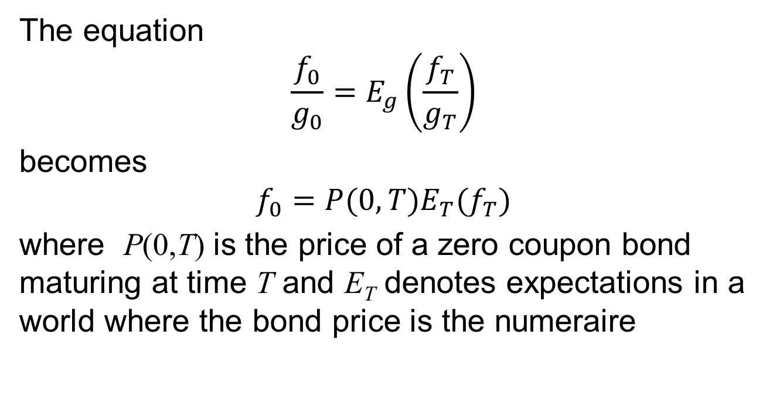
Zero-Coupon Bond Maturing at time T as Numeraire
The equation
$$\frac{f_{0}}{g_{0}}=E_{g}\left(\frac{f_{T}}{g_{T}}\right)$$
becomes
$$f_{0}=P(0,T)E_{T}(f_{T})$$
where P(0,T) is the price of a zero coupon bond maturing at time T and E_{T} denotes expectations in a world where the bond price is the numeraire

Slide 14
Forward Prices
In a world defined by numeraire P(0,T), the expected value of a security at time T is its forward price

Slide 15
Interest Rates
In a world defined by numeraire P(0,T₂), the expected value of an interest rate lasting between times T₁ and T₂ is the forward interest rate

Slide 16
Annuity Factor as the Numeraire

Slide 17
Annuity Factors and Swap Rates
Suppose that s(t) is the swap rate corresponding to the annuity factor A.
Then:
s(t)=E_{A}[s(T)]

Slide 18
Extension to Several Independent Factors

Slide 19
Extension to Several Independent Factors continued

Slide 20
Applications
Extension of Black’s model to case where interest rates are stochastic
Valuation of an option to exchange one asset for another

Slide 21
Black’s Model (equations 28.28 and 28.29)
By working in a world defined by numeraire P(0,T), it can be seen that Black’s model is true when interest rates are stochastic providing the forward price of the underlying asset is has a constant volatility
c = P(0,T)[F₀N(d₁)−KN(d₂)]
p = P(0,T)[KN(−d₂) − F₀N(−d₁)]

Slide 22
Option to exchange an asset worth U for one worth V (Section 28.7)
This can be valued by working in a world defined by numeraire U
Value is

Slide 23
Change of Numeraire (Section 28.8)

