Slide 1
Chapter 31 Equilibrium Models of the Short Rate

Slide 2
The Zero Curve
The process for the instantaneous short rate, r, in the traditional risk-neutral world defines the process for the whole zero curve in this world
The price at time t of a zero-coupon bond maturing at time T is
where is the average r between times t and T and the yield on the bond is

Slide 3
Term Structure Models
Term structure models attempt to describe the evolution of the whole term structure
An equilibrium model usually starts with assumptions about economic variables and derives a process for the short rate
A no-arbitrage model is designed to exactly match today’s term structure

Slide 4
Equilibrium Models (Risk Neutral World)

Slide 5
Mean Reversion (Figure 31.1)
Interest
rate
HIGH interest rate has negative trend
Reversion
Level
LOW interest rate has positive trend

Slide 6
Alternative Term Structures in Vasicek & CIR (Figure 31.2)
Zero Rate
Zero Rate
Maturity
Maturity
Zero Rate
Maturity

Slide 7
Properties of Vasicek and CIR
P(t,T) = A(t,T)e^{−B(t,T)r}
The A and B functions are different for the two models:

Slide 8
Alternative Convexity and Duration Measures
These can be used with a Taylor series expansion to determine the effect of a small change in r on a bond portfolio

Slide 9
Bond Price Processes in a Risk Neutral World (equations 31.11 and 31.12)
From Itô’s lemma, risk neutral processes are
What is the Vasicek real-world process for P(t,T) if the market price of risk is a constant, λ?

Slide 10
Real vs. Risk-Neutral Processes: Vasicek
The risk-neutral world process is
If the market price of interest rate risk is λ (negative) the real world process is
where

Slide 11
Real vs. Risk-Neutral Processes: CIR
The risk-neutral world process is
If the market price of interest rate risk is (negative), the real world process is
where

Slide 12
Estimating Parameters (Section 31.4)
The real world parameters can be estimated from historical movements in the three month rate
The market price of risk can then be estimated so that yields match the current term structure as closely as possible

Slide 13
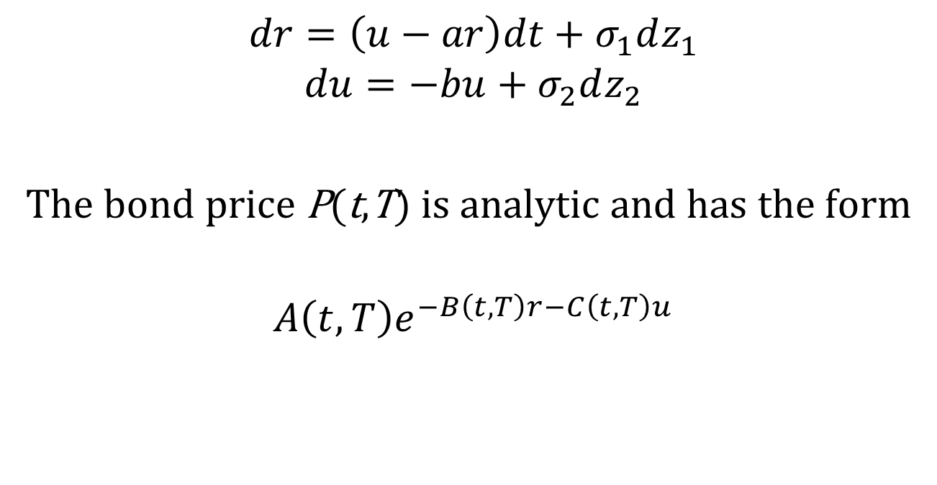
The Two-Factor Hull-White model (Section 31.5)
$$dr=\left(u−ar\right)dt+σ_{1}dz_{1}$$
$$du=−bu+σ_{2}dz_{2}$$
The bond price P(t,T) is analytic and has the form
$$A\left(t,T\right)e^{−B\left(t,T\right)r−C\left(t,T\right)u}$$

