Slide 1
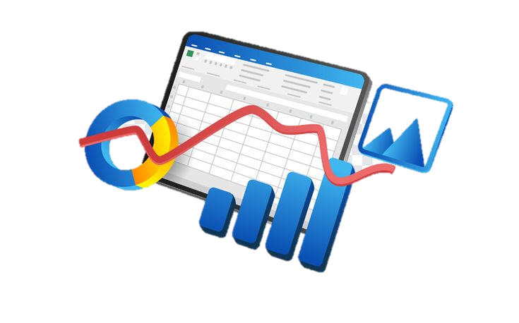
TABLEFORGE
TEAM NAME: CodeX

Slide 2
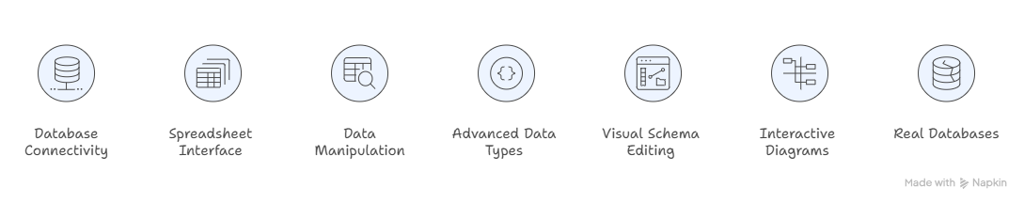
Problem Statement
Problem
Modern applications rely heavily on databases like SQLite, MySQL, and PostgreSQL to store and manage structured data. However, interacting with these databases usually requires SQL knowledge and developer-focused tools. Meanwhile, spreadsheet-style platforms such as Airtable make data easy to edit but lock users into isolated ecosystems.
Why it matters
Non-technical users want Airtable's simplicity, but their data gets locked in isolation. Data professionals use DBeaver, but it requires SQL expertise. No tool bridges both worlds while keeping data in control.
As students, we often face a frustrating choice: simple tools or powerful ones — rarely both. We use Google Sheets because it’s easy for group projects. But when our project ideas needed real databases with proper relationships and constraints, things became complicated. SQL suddenly felt like a barrier.
What needs to be done : Tableforge-A Spreadsheet-Like Interface for Real Databases

Slide 3
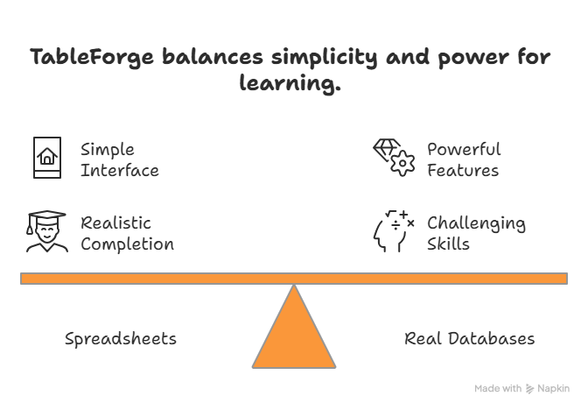
Solution Overview
With TableForge, we wanted to make working with databases much easier and more intuitive. Our platform allows users to interact with real databases like SQLite, PostgreSQL, and MySQL through a spreadsheet-style interface, without needing to write SQL and without locking their data into proprietary systems.
How our solution works :
Spreadsheet-Style Database like Experience: We will design a interface so that tables look and give feel like a spreadsheet. So that users can easily view records, edit cells, sort data, and apply filters, while all the changes are directly applied to the actual database.
Visual Database Management:
We will Manage databases visually—so that user can connect, explore tables, and see relationships easily.
Smart Data Editing: Our solution Automatically provides the right input for each data type, making editing quick and error-free.

Slide 4




Tech Stack
Frontend
Streamlit
Used to quickly build the main interface and dashboard.
Vanilla JavaScript
Added to enhance interactivity and dynamic behavior in the
application.
Custom CSS
Helps us design a more creative, colorful, and user-friendly interface.
Backend
Python
Handles the core functionality of the platform.

Slide 5

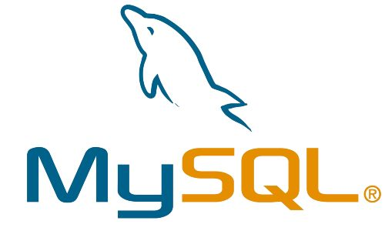

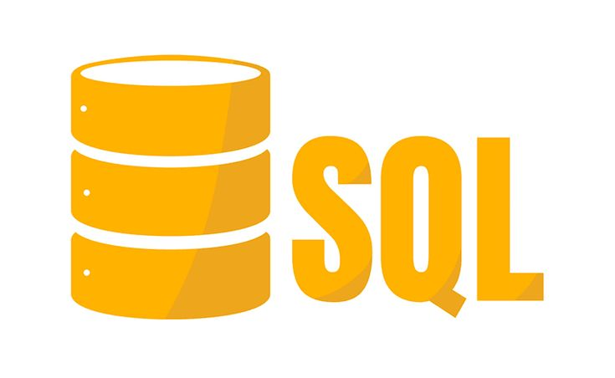
Streamlit
It will Act as both the UI framework and backend controller for our prototype.
Database Support
SQLite
Used as the primary database for demonstration and testing.
Scalable support for:
Database Integration :For connecting and interacting with databases:
SQLAlchemy
We used it to manage database connections and queries efficiently.
Visualization & Data Interaction :To improve the understanding of database structures
Interactive table views and dynamic UI components built within Streamlit.

Slide 6

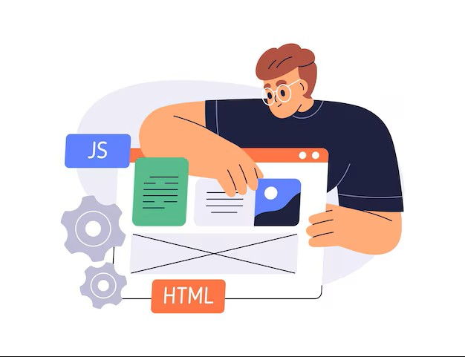

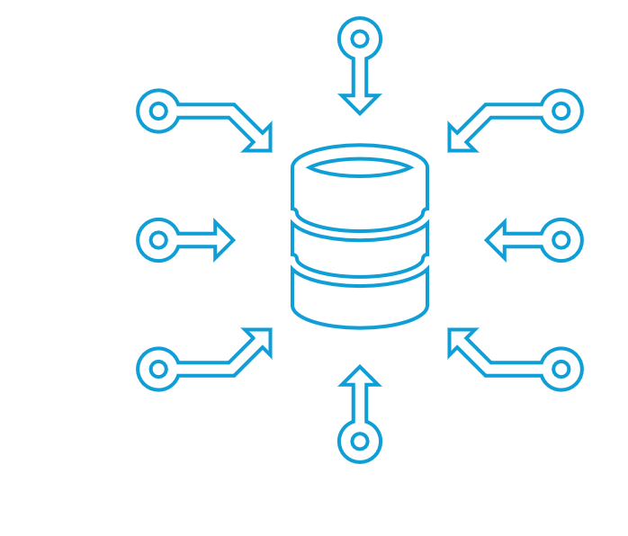
Implementation
Backend Setup
We start by building the application using Python and Streamlit to handle the main functionality. Then, we connect the system to databases using SQLAlchemy, so therefore TableForge can work with real relational databases.
Database Integration
TableForge support working with real databases like SQLite for the prototype, with planned support for PostgreSQL and MySQL. This allows users to connect their own databases and manage data easily.
Frontend Interface
The UI will be built using Streamlit, along with Vanilla JavaScript and Custom CSS, to create an interactive and visually engaging spreadsheet-style dashboard where users can easily view, explore, and manage their data.
Data Sync & Processing
Whenever a user edits, filters, or sorts data, the system processes the request and updates the database in real time while ensuring proper data validation.

Slide 7
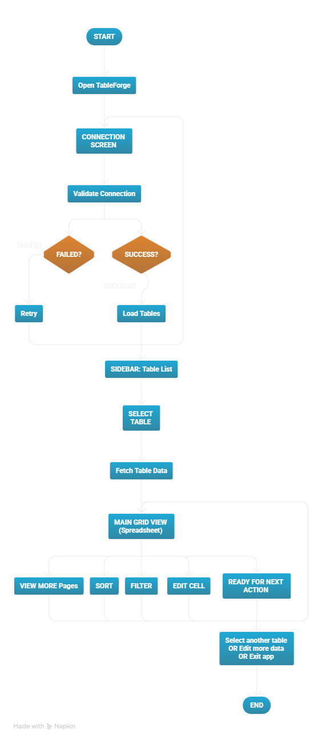
Diagrams

Slide 8
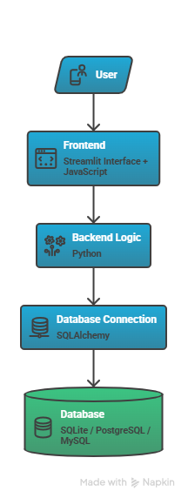
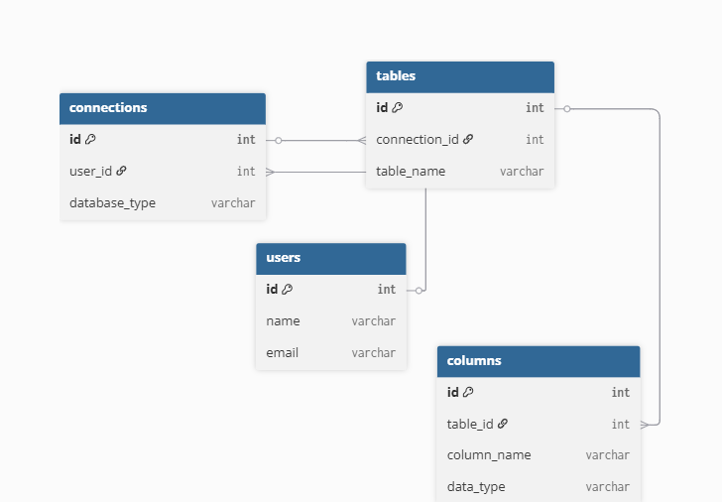
Our technical
architecture diagram :
Our Database schema design:

